Slide 1
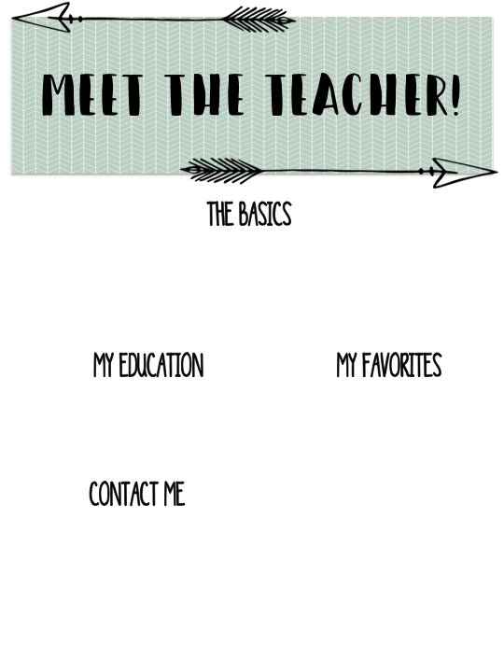
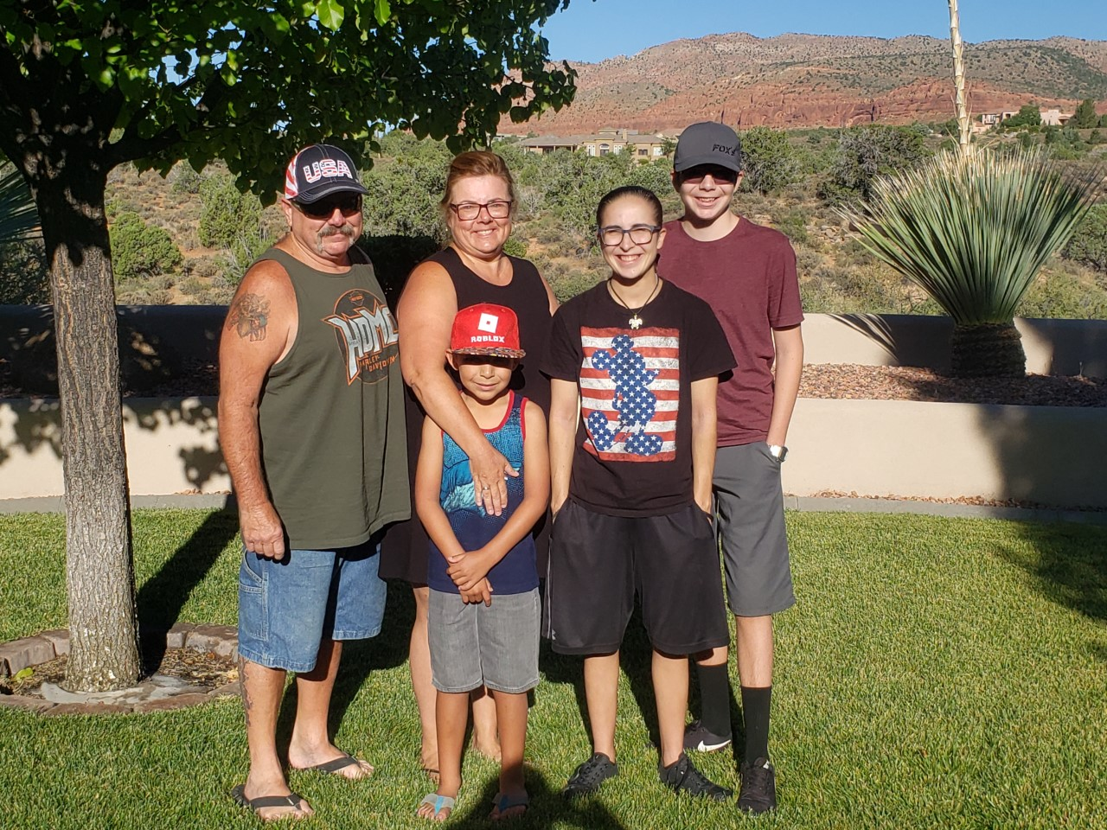
Ms. Myers
My name is Manya Myers. I grew up in Chino and attended CVUSD schools including Newman, Ramona and Don Lugo. I have been a teacher for 28 years at Hidden Trails and taught kindergarten, second, fourth, fifth and sixth grade. I have 3 children that have all attended Hidden Trails. My goal this year is to guide you as you prepare for junior high school. Junior high school can be a challenging transition in your academic path, but with our teamwork, hard work and perseverance you will be ready to soar into junior high. I am here for you, and we are in this together.
I attended Chaffey College and received my A.A. from Mt. SAC. I completed my B.A. and teaching credential at the University of Laverne. I also have a GATE and EL certificate as well as an Education M.A.
Food: steak & shrimp
Flower: daisies & sunflowers
Book: Fish in a Tree
Subject: Science & Math
Color: green
Drink: coffee
Sports: car racing
Fast food: In-N-Out Burger
Store: Kohl’s & Amazon
Candy: m&m's & Twix
Season: autumn
Hobby: sleeping & camping

