Slide 1
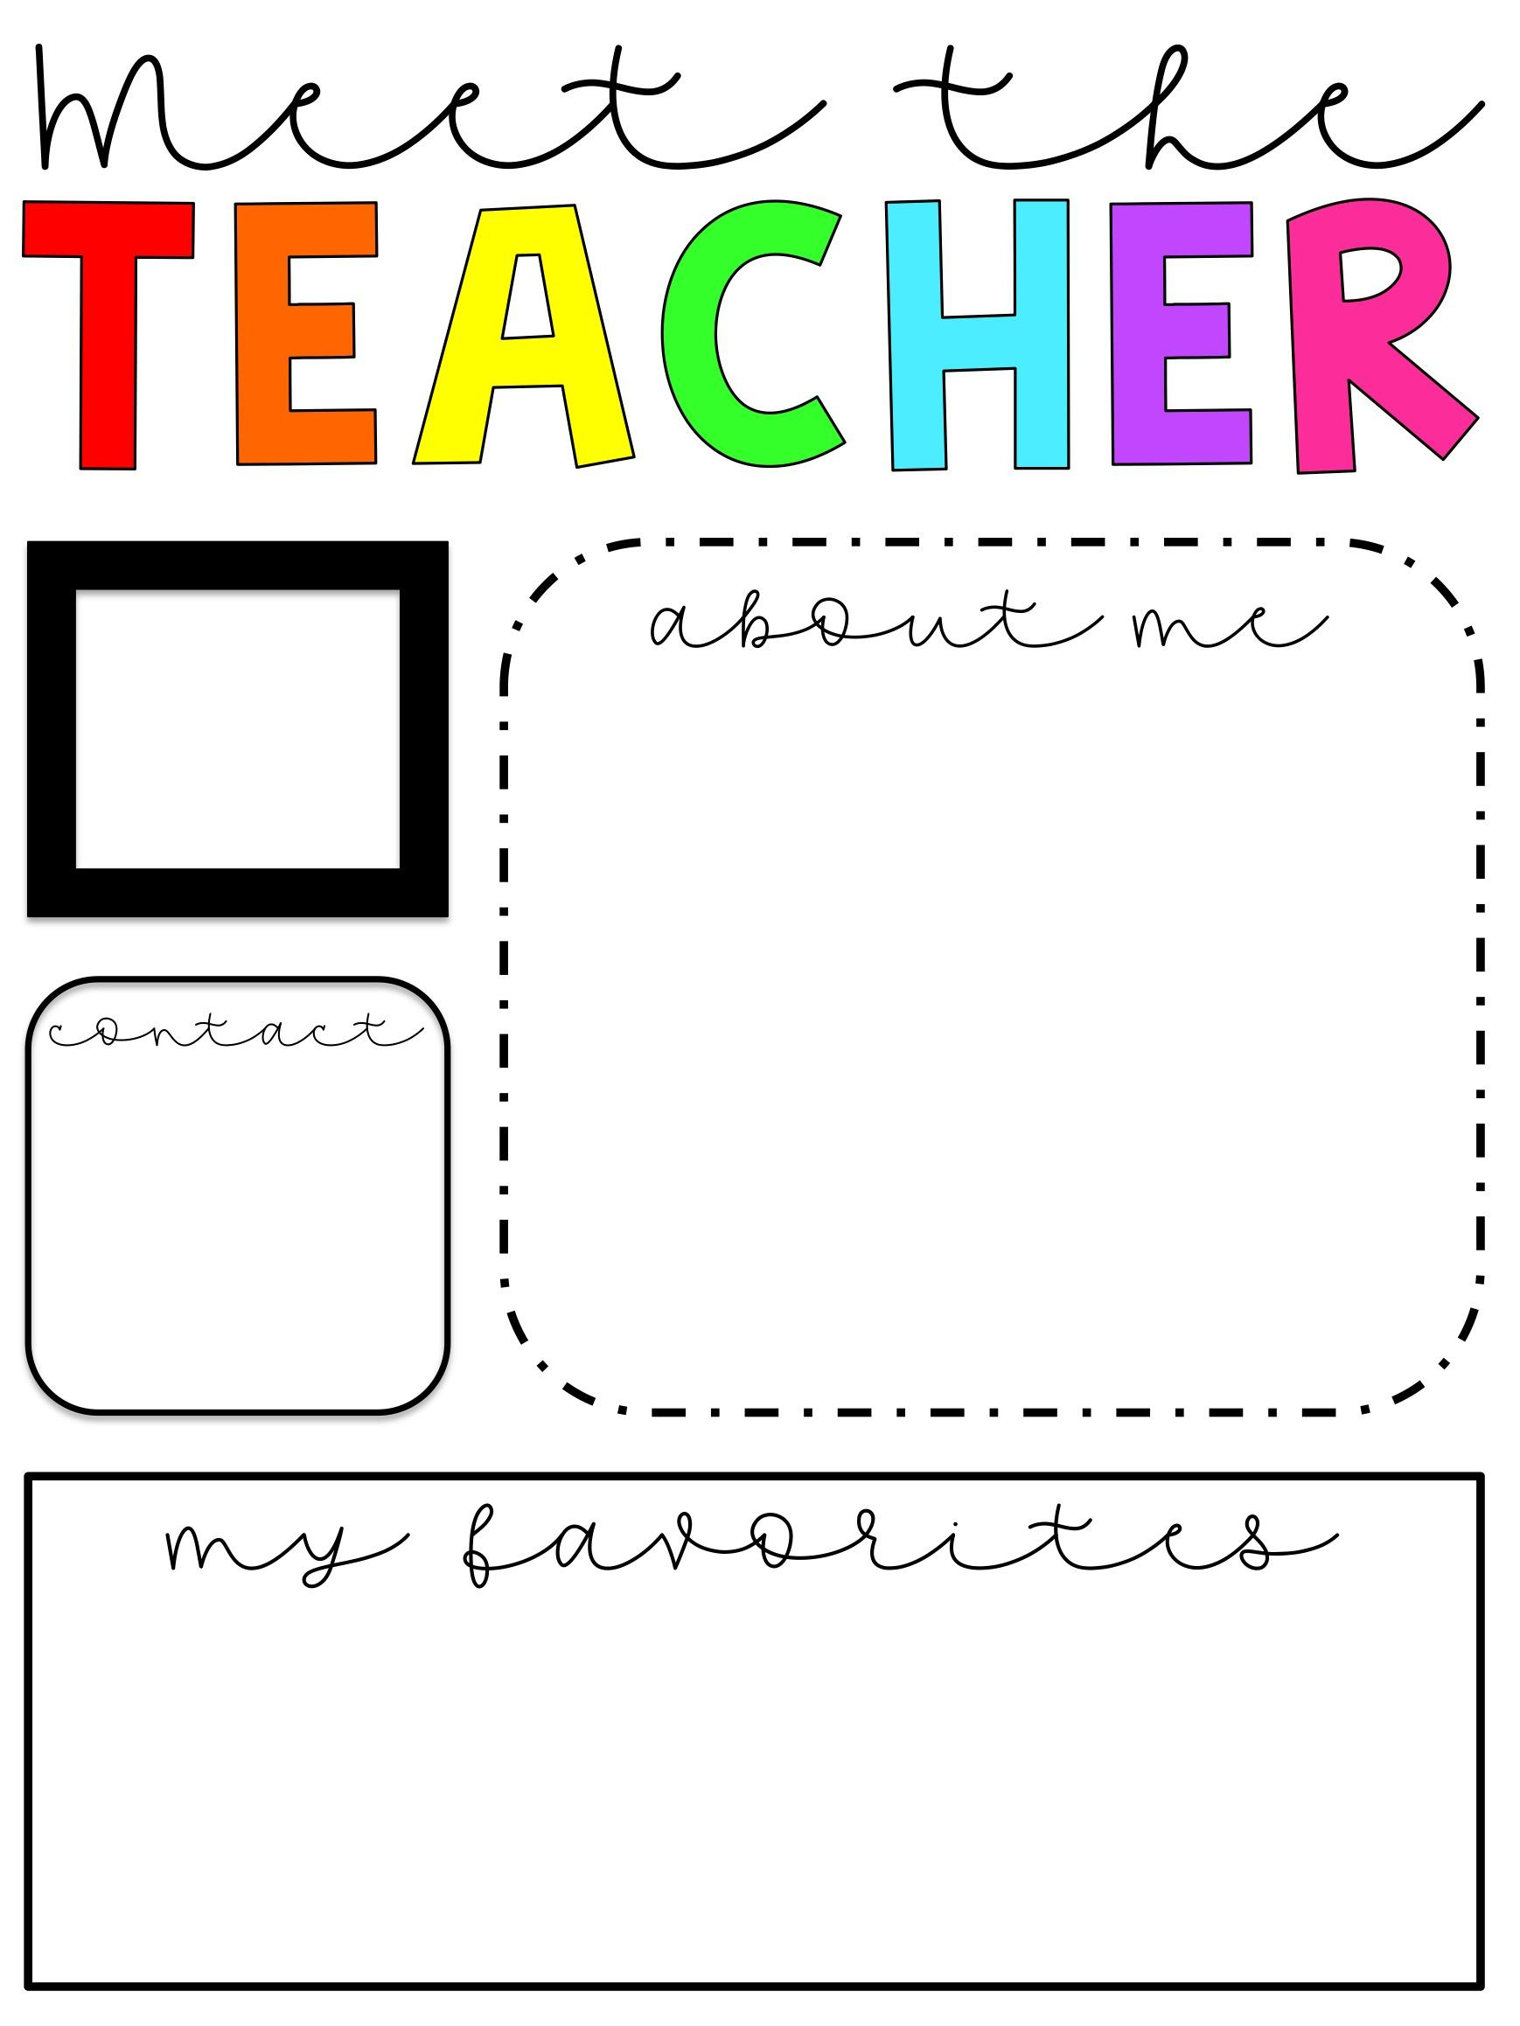
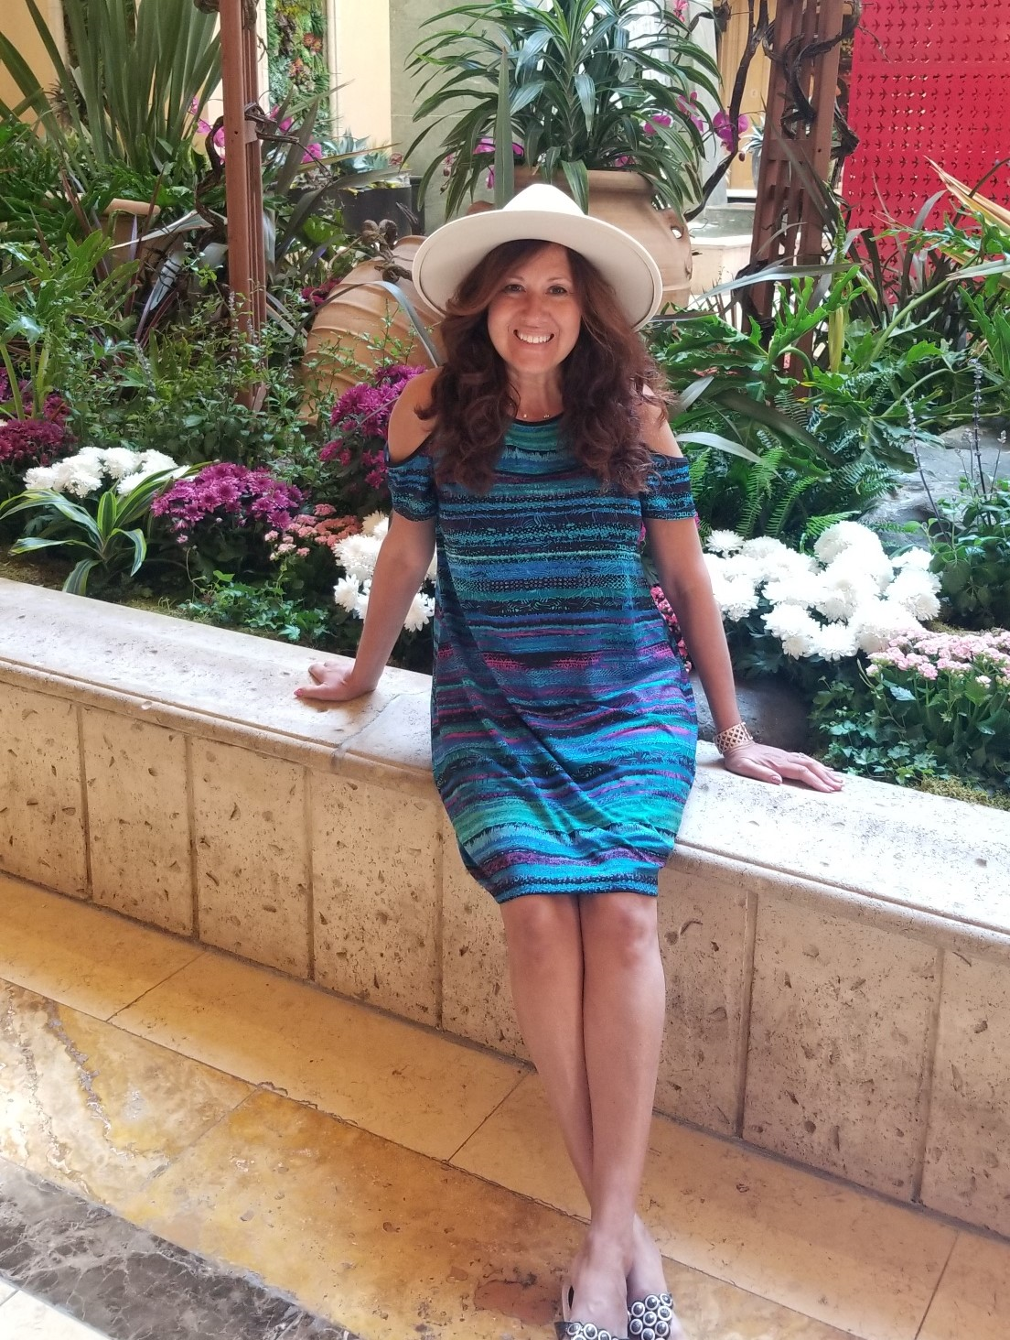
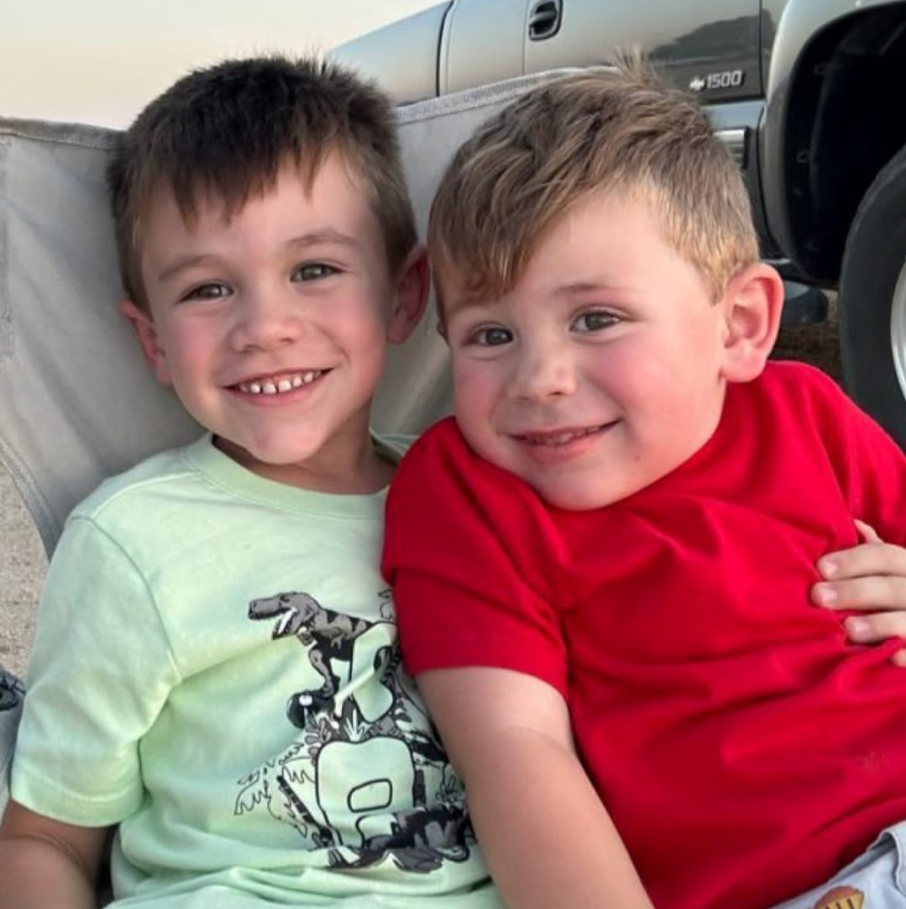
Insert picture here
Hi! My name is Mrs. Jacqueline Brazynetz and
I am so excited to work with you and your child this year! It is going to be a year filled with fun, adventure, and lots of learning! Here is a little bit of information about me. I have three adult children.
I am a proud grandmother of Titus and Micah. This is my 27th year teaching first grade, which is my favorite grade to teach! I enjoy teaching because I love to see the tremendous academic growth the littles experience at this stage! I look forward to an awesome year partnering together with parents to challenge students to be their very best!
Email
Jackie_brazynetz@chino.k12.ca.us
Remind App:
Text @brazy2023 to 81010
Grandsons: Titus and Micah!
Color: Pink!
Pets: Bulldogs Ty & Jemma.
Candy: Anything chocolate!
Food: Italian & Mexican!
Drink: Coffee, all day everyday!
Hobbies: Reading!

