Slide 1
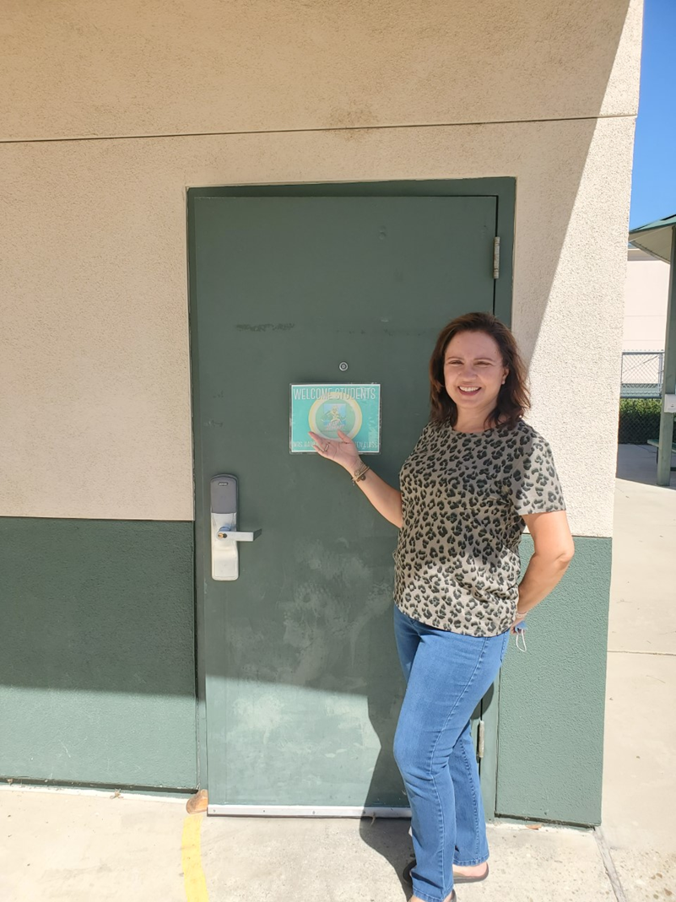
Insert picture here
Hi! My name is Mrs.Harirchi. I have been a Kindergarten teacher for 36 fabulous years. I love teaching young children because it is so much fun to observe how they learn, grow emotionally and educationally. I am a mom of two beautiful young women. I have one grandbaby and his name is name is Teddy. I am so excited to have your child in my class. My goal is to fill your child with so much knowledge in the areas of reading, writing, math, science and social studies. I cannot wait for this year to begin. We will have an amazing year together. I look forward to meeting you very soon!!
Email:
maria_harirchi@chino.k12.ca.us
Color: Black and teal
Pets: Herky
Candy: Anything chocolate!
Food: Anything and everything!
Drink: Coffee, all day everyday!
Hobbies: Reading and shopping.

