Slide 1
Back to School Night
2024-2025
MRS. NOVICK
SECOND GRADE
TRACK C
Notes:
1

Slide 2
About Me
Mrs. Novick
*Professional Experience Bachelor of Arts, UCR
Bachelor of Arts
UCR
Special Ed Credential
Master’s Degree
*Life
Married with 6 pets
24th year teaching
Notes:
2

Slide 3
Expectations
Get a good night's rest and eat a healthy breakfast.
Students come to school by 7:50 and are with the teacher at 8:00 PREPARED TO LEARN.
Make illness the only excuse for absences.

Slide 4
Homework
District guidelines are 20-30 focused minutes daily as well as an
additional 20 minutes a day of outside reading.
Homework will be assigned Monday through Thursday.
1. Read: 20 minutes and complete reading log.
2. Reading Fluency Page
3. Weekly story vocabulary and reading skills will be posted in Google
Classroom. Please review daily. No spelling tests will be given.
4. Math: Current day’s lesson
5. Math Facts Practice-Flashcards 10 min. daily/XtraMath on Classlink
6. Unfinished classwork
7. Test prep when necessary
Notes:
4

Slide 5
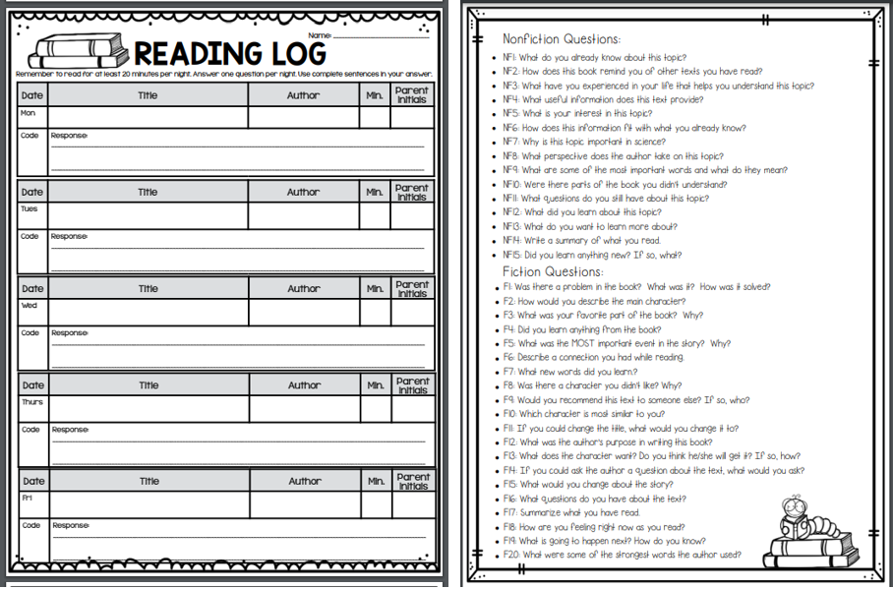
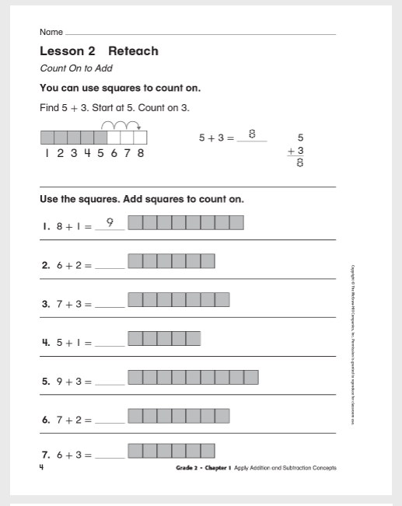
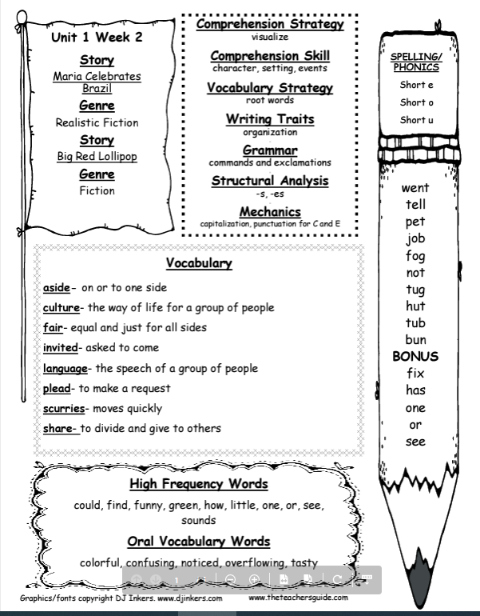
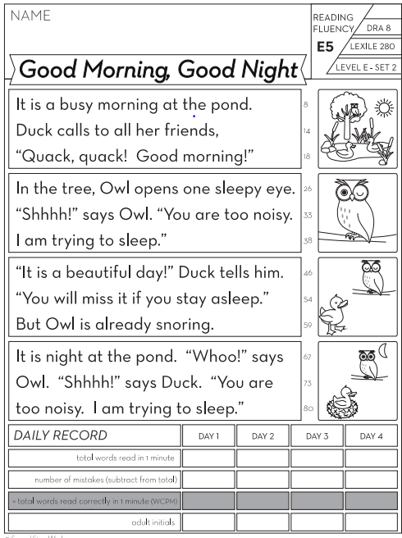
Daily Homework
Daily Reading Log
Math Homework
*Select a question from the back of log to respond to.
*Math Homework will be sent home Monday-Thursday. Math topics and lessons will not be taught in order.
Weekly Story Vocabulary and Reading Skills
*Weekly story vocabulary and reading skills will be posted in Google Classroom. Please review daily. NO Spelling tests will be given.
Read each night 1 minute and record how many words read.
Notes:
5

Slide 6
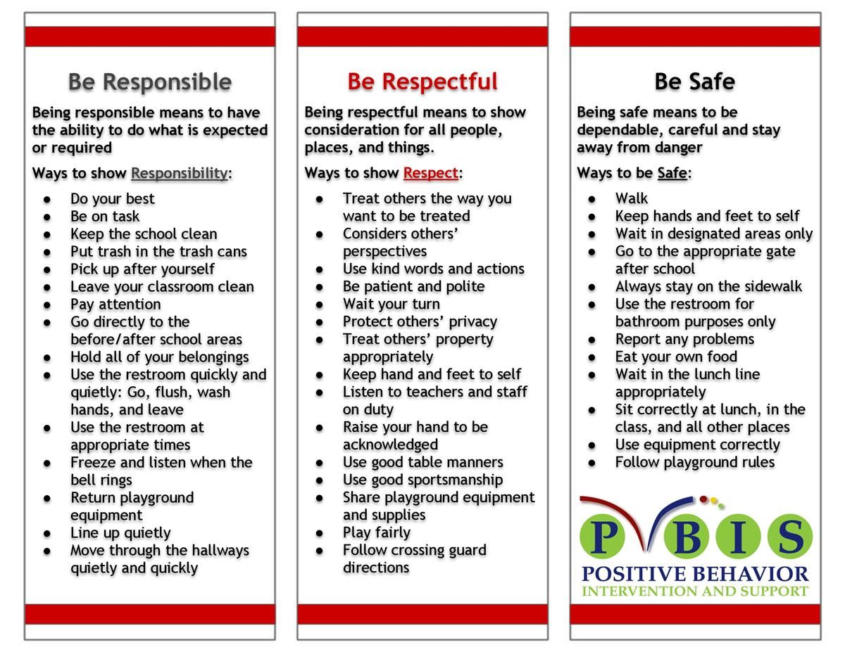
School Wide Behavior Expectations
Rick Morris Behavior Clionstrates exemplary behavior hone call home, email, or notification on daily behavior calendar.

Slide 7
Incident Logs
Incident Logs are used for minor playground and classroom offenses.
Examples: running before, during, or after school, pushing, playing after bell, using bathroom after the bell, hitting, using inappropriate language…
Parent signature REQUIRED
Grades 1-6
Incident Logs will warrant the following consequences (per trimester):
1st: Warning
2nd: Loss of a recess and citizenship grade on the report card lowered one level
3rd: Office referral for 1 lunch detention
4th: Parent/Student/Teacher Conference with an Administrator

Slide 8
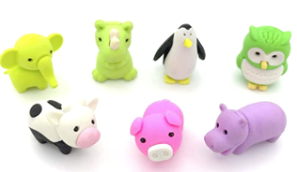
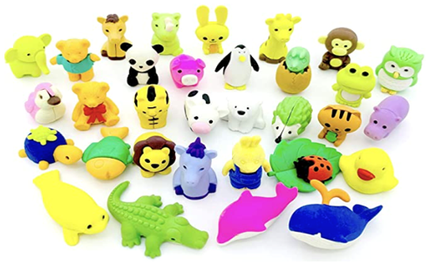
Behavior Expectation Rewards
Student’s will earn AIM High points for positive behavior both in the classroom and on the playground.
Students will be able to redeem points to purchase DESK PETS!

Slide 9
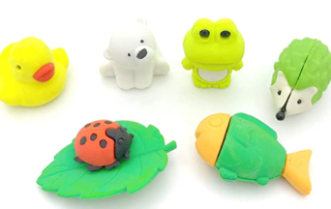
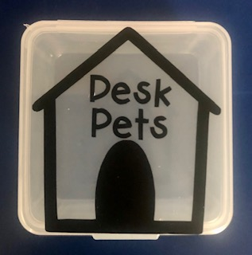
How does my student earn a Desk Pet?
Follow directions quickly.
Be kind with words and actions.
Be ready to learn and have all necessary materials.
Stay focused in line. Stay distance and walk with a purpose.
Stay on task and complete class work.
When students do these things, they can earn up to 25 points a week! “Marley’s Pet Shop”
will be each month.
Students can buy; pets, accessories, food for their pets, and supplies to build their pet’s habitat.

Slide 10
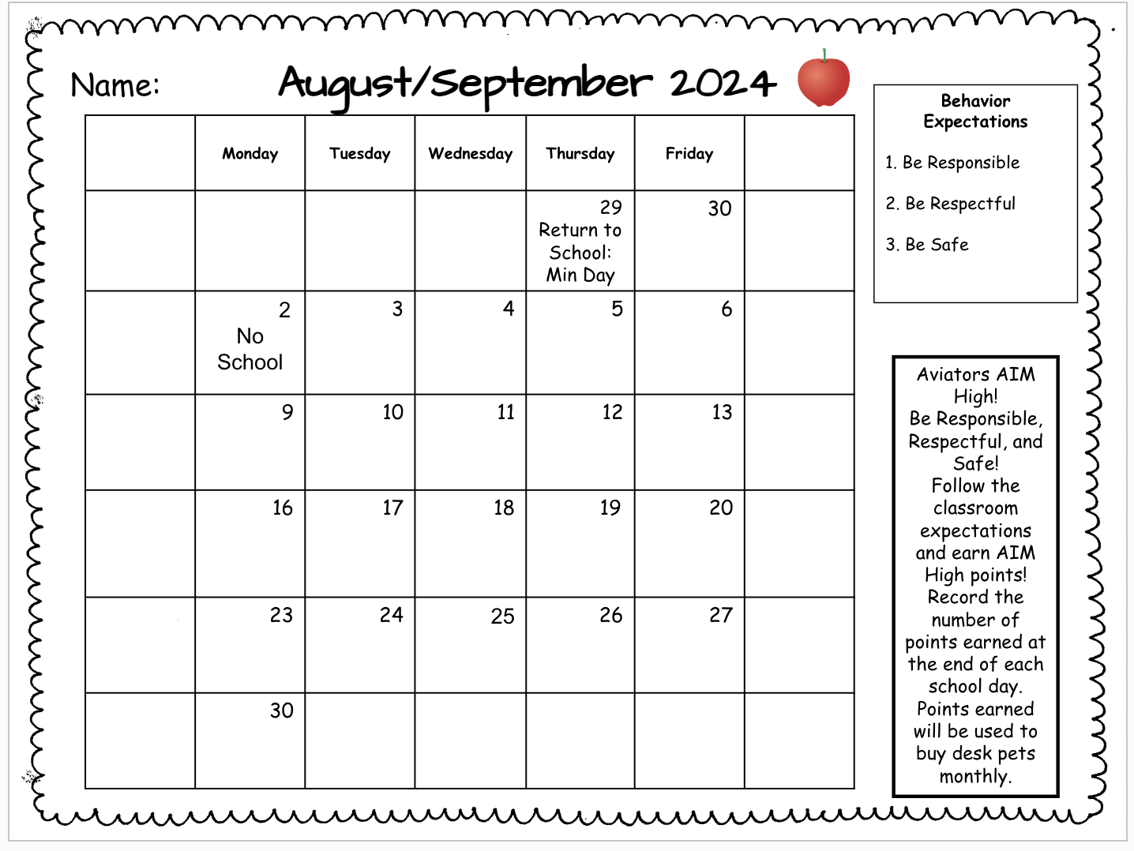
Monthly Behavior Calendar to Record AIM High Points

Slide 11
Classwork
It is important that each student completes his/her classwork. If classwork is not finished in the time allotted, the student will have to complete it during recess or at home.
Please check your
child’s take home
folder daily.
Notes:
11

Slide 12
Grading Policy
All grades are a combination of class work, tests, quizzes, class participation, homework, and/or teacher observation.
Notes:
12

Slide 13
Grading Scale
Grade/Number | Meaning
4- Excelling | Students at the Excelling level of performance are consistently performing at grade level, can demonstrate independence, and can extend the grade level standards, when applicable, expected at this point of the school year.
3- Achieving | Students at the Achieving level of performance demonstrate an adequate understanding of and ability to apply skills needed to meet grade level standards expected at this point of the school year.
2- Progressing | Students at the Progressing level of performance are partially meeting the grade level standards expected at this point in the school year.
1- Beginning | Students at the Beginning/Standard Not Met are not yet meeting the grade level standards expected at this point of the school year.
Standards Based Grading Report Card, resulting in students receiving the grades of 1, 2, 3, and 4.

Slide 14
Parent/Teacher Communication
We can only communicate through AERIES PARENT PORTAL/Parent Square.
Make sure to have notifications on as this is where I will send important information.
The school also sends information through this site.

Slide 15
Pick Up
*If you plan on taking your child out early, please let me know so I can have your child ready.
*Please try not to pick your child up during our breaks as we have too many students at school to go around looking for your child.
*Below are the times we are outside:
9:30-9:43 ( Monday, Tuesday, Wednesday, and Friday)
11:00-11:40 ( Monday, Tuesday, Wednesday, and Friday)
1:35-1:48 ( Monday, Tuesday, Wednesday, and Friday)
9:20-9:50 (Thursday)

Slide 16
Minimum Days
9/16 - 9/18
Please sign up for a date/time on Sign-Up Genius on our classroom page.
Notes:
16

Slide 17
Absences
Please make sure your child is in school unless ill.
ATTENDANCE COUNTS!
Please try to schedule appointments after school. If you are taking your child out of school, please let me know ASAP. Work missed will need to be completed.
Missed tests will be given the next day the student returns or when time permits.
TARDIES do count against perfect attendance!
Notes:
17

Slide 18
Student Recognition
There will be 3 awards assemblies this year.
Top Flight
Captain
Lieutenant
Perfect attendance (no absences, and no more than 2 tardies or leaving school early)
Aviator Spirit Days
University spirit wear is on Mondays
Aviator spirit wear is on Fridays

Slide 19
School Wide Parties
Christmas in November
Valentine’s Day/Friendship
End of the Year
* All parties will occur during the last hour of the day.

Slide 20
Birthdays
Birthdays’ will be celebrated in class with a birthday song and dance as well as a class birthday letter book.
Treats may be brought ONLY in the morning. They CAN NOT be dropped off in the office.
Birthday invitations can only be given out before/after school off campus. No invitations will be passed out in the classroom.
NO balloons please

Slide 21
School Supplies
Please replenish necessary school supplies throughout the year as needed.
Pencils, Paper, Crayons, Glue Sticks, etc.
Notes:
21

Slide 22
Classroom Donations
White copy paper (8 ½ x 11)
Unscented baby wipes,
Expo Markers
Pencils
Glue sticks
Amazon Wish List- Available on my classroom page or click the link below.
https://www.amazon.com/hz/wishlist/ls/3OMRSEA04URB2?ref_=wl_share

Slide 23
McGraw-Hill Reading Wonders
ELA Curriculum
Focus will be on:
Vocabulary Instruction
Reading Comprehension Skill Development
Phonics
Spelling
Grammar
Writing
Writing Domains:
Informational
Narrative
Opinion
Online Access:
Online access for students and parents can be found on your child’s ClassLink account.
https://www.youtube.com/watch?v=HbS0F2bvPuA

Slide 24
Math Curriculum Savvas Envision Math
*Supplemental programs utilized daily on Chrome books in class.
Prodigy
XtraMath
Focus will be on:
Operation and Algebraic Thinking
Numbers and Operations in Base Ten
Measurement and Data
Geometry
Online Access:
Online access for students and parents can be found on your child’s ClassLink account.

Slide 25
Other Core Subjects -English Language Development (ELD)​ Remediation, Intervention & Enrichment​ Social Studies- Houghton Mifflin-NGSS​ - NGSS Science- TWIG Secon Step- Thursdays(Teach coping skills and how to solve problems) - P.E. – Appropriate shoes​ - Music- Once a week​ -Library- Once every other week

Slide 26
Second Step
Please consent to the Second Step curriculum as part of the data confirmation
To preview the Second Step curriculum, use the QR code
July 25 from 8:00-3:15 p.m., Counselor Nguyen will be available to preview the curriculum and answer questions. Counselor email: anhxuan_nguyen@chino.k12.ca.us

Slide 27
Field Trips 24-25 Track C Fall-November Ralph B. Clark Interpretive Center Spring-May Heritage Museum of Orange County

Slide 28
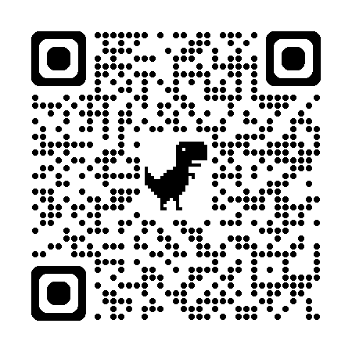
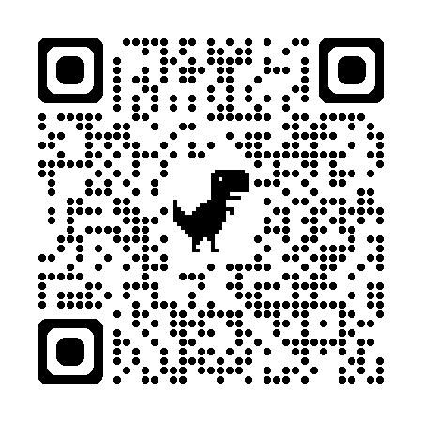
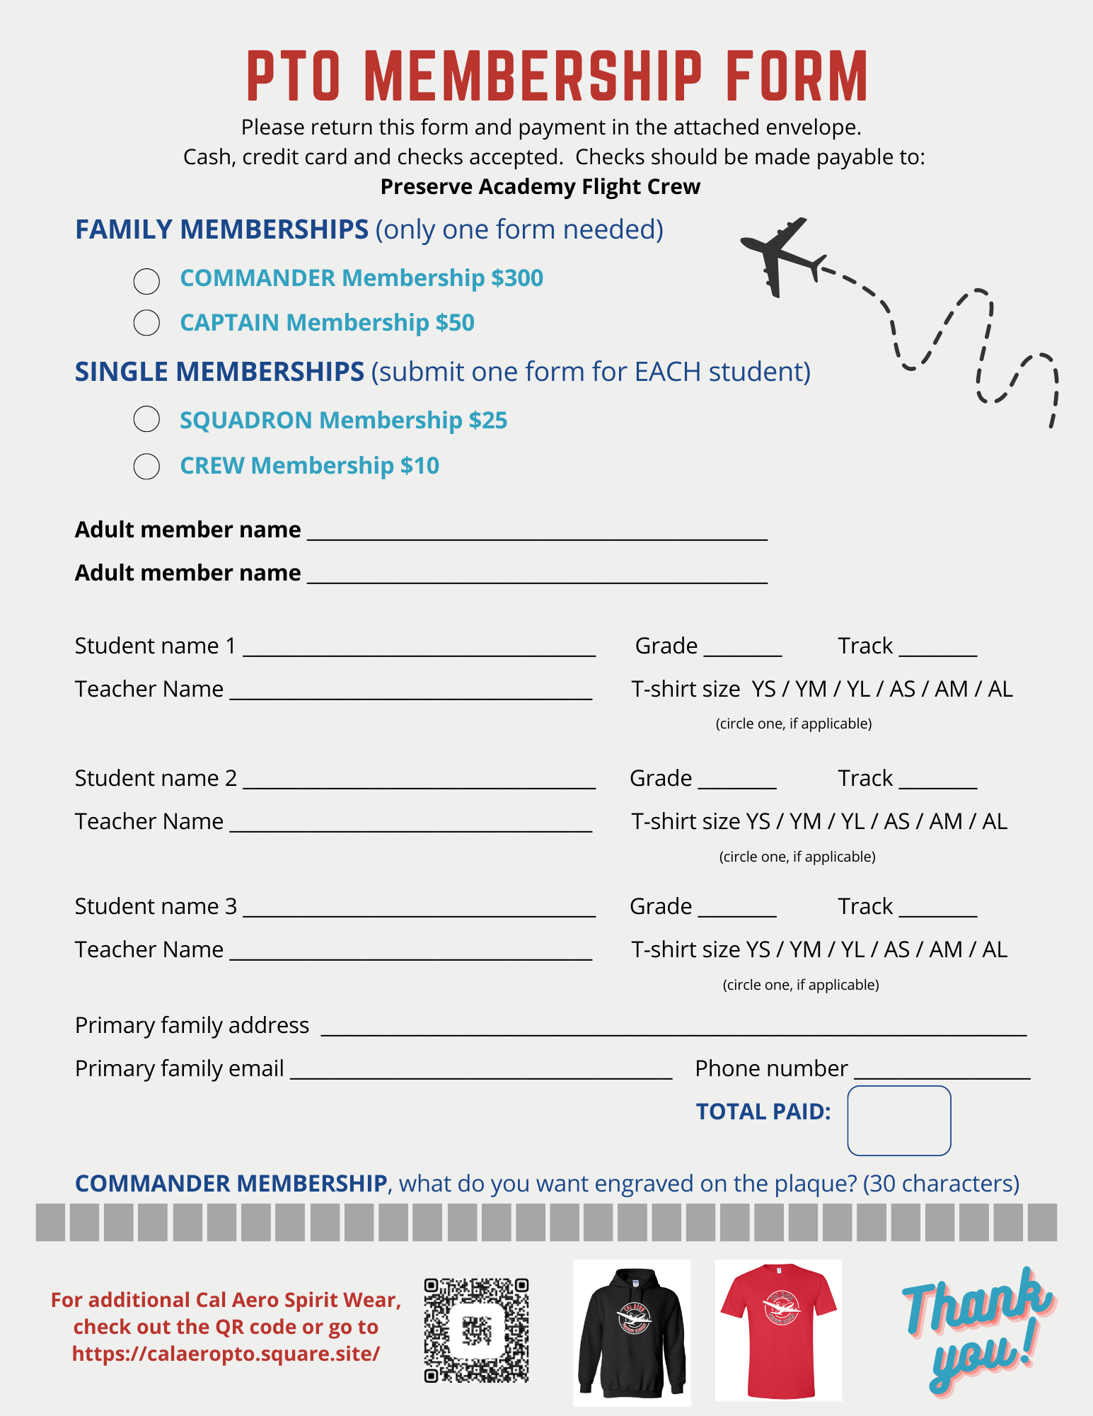
PTO Please join the PTO ☺ Funds help with field trips and other activities. Forms to join will be sent home!!! Please join their Facebook and Instagram pages for information

Slide 29
Goals for the Year
Have every student reach or exceed Common Core State and District standards.
Provide a safe, fun-filled, nurturing learning environment where children thrive.
Increase each child’s academic success in all subject areas.
Develop students’ organizational skills and sense of responsibility.

Slide 30
Contact Information
Please feel free to send me a note or an email regarding any questions or concerns.
Cal Aero Preserve (909) 606-8531
Jennifer_Novick@chino.k12.ca.us
Parent Square/Aeries Parent Portal
I’m looking forward to a terrific year!
Thank you ☺
Notes:
30

