Slide 1
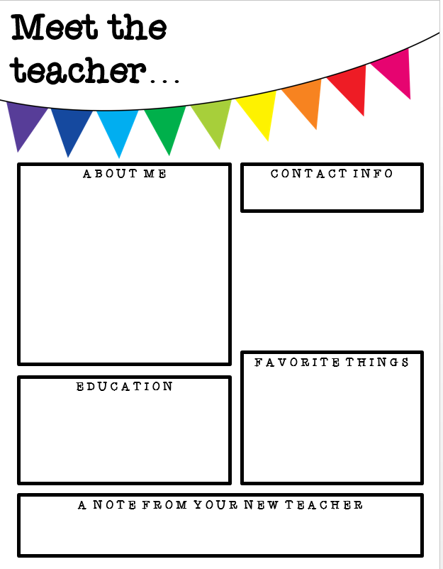
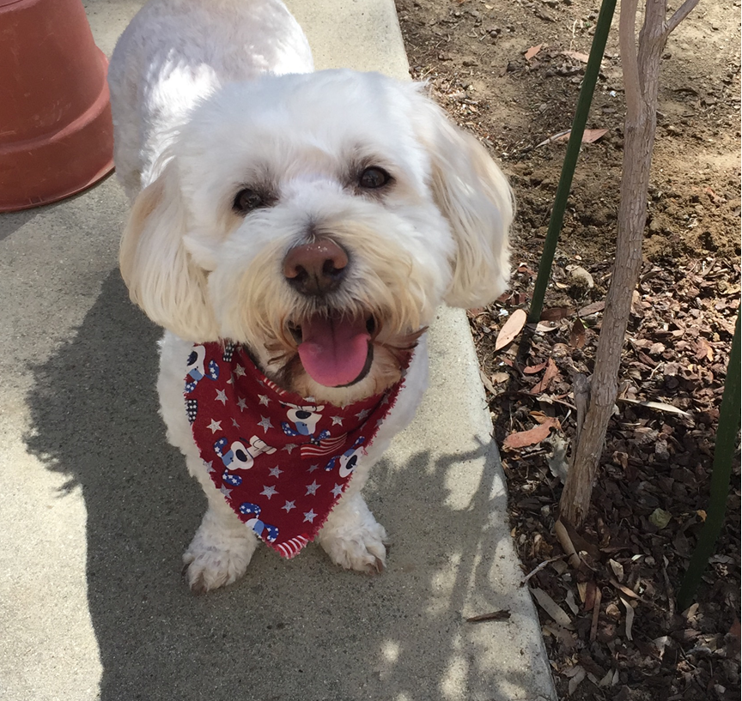
Mrs. Shiba
I’ve been married for 36 years, have two grown children and an adorable grandson. I have a dog named Cooper, who is very spoiled. He loves his walks, goodies and to fetch toys. Our classroom is the University of Oregon. Our Cheer:
We are(2claps) Oregon
We are(2claps)the Ducks
We are college bound, Orrrregon
Janelle_Shiba@chino.k12.ca.us
Teaching ☺
Family time
Going to the beach
Flair pens
Reading-mysteries
Chocolate with caramel
Target, Michaels, Hobby Lobby
I have a BA in Business from CSUF and I completed my teaching credential through The University of LaVerne.
To join REMIND please text 81010; then text message @ducks20202. Please check out my webpage on the Cattle Home page for up to date information.

