Slide 1
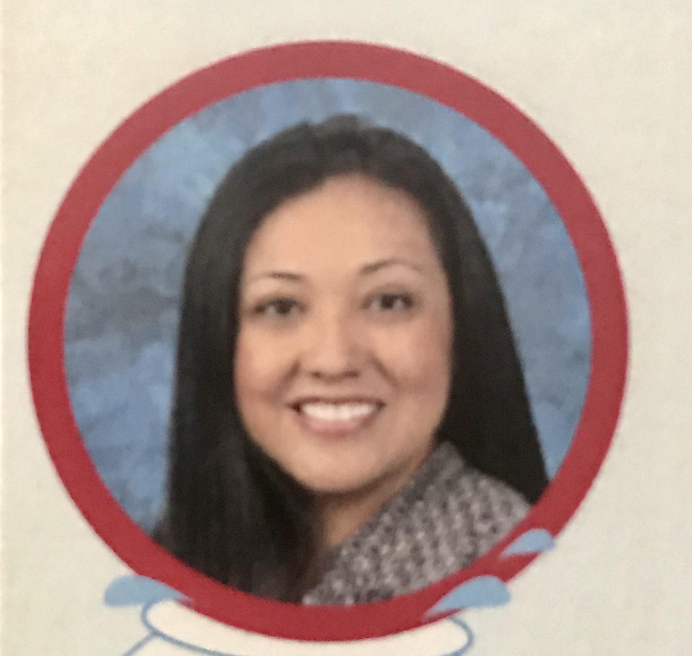
Mrs. Juarez
About Me
Welcome to 3rd Grade!
I am pleased to welcome you to the 2024-2025 school year! I am looking forward to having your child as a student. Third grade is such a fun year with so many wonderful learning activities to celebrate. In order to have a fun year, my most important goal is to create a family of learners in my classroom. I am committed to creating a classroom environment where your child is a valued, trusted, and integral part of our family of learners. In order to accomplish this, I have planned a variety of activities to emphasize and reinforce this goal. It is my hope that you will support and encourage this vision at home.
Hello! I am Ileana Juarez, and this will be my eighth year teaching at Rhodes Elementary. I also have an additional 10 years teaching for SBCUSD and 2 years teaching middle school.
I’ve been married for 15 years and have a 13 year old daughter. We also have a 8 year old pit bull at home.
I attended Azusa Pacific University. I received my Bachelors of Arts in Elementary Education with a minor in English. I also have a Masters Degree in Education and my GATE Certificate.
Contact Me
My Favorites
I would love to hear from you, and you are welcome to contact me with any questions, comments, or concerns you may have.
Snacks: Trail Mix, sunflower seeds, beef jerky, popcorn
Drink: Coffee, Coke
Candy: Dark Chocolate
Hobby: Cooking/ Baking
Parent Square
https://www.chino.k12.ca.us/Domain/4843
ileana_juarez@chino.k12.ca.us

