Slide 1
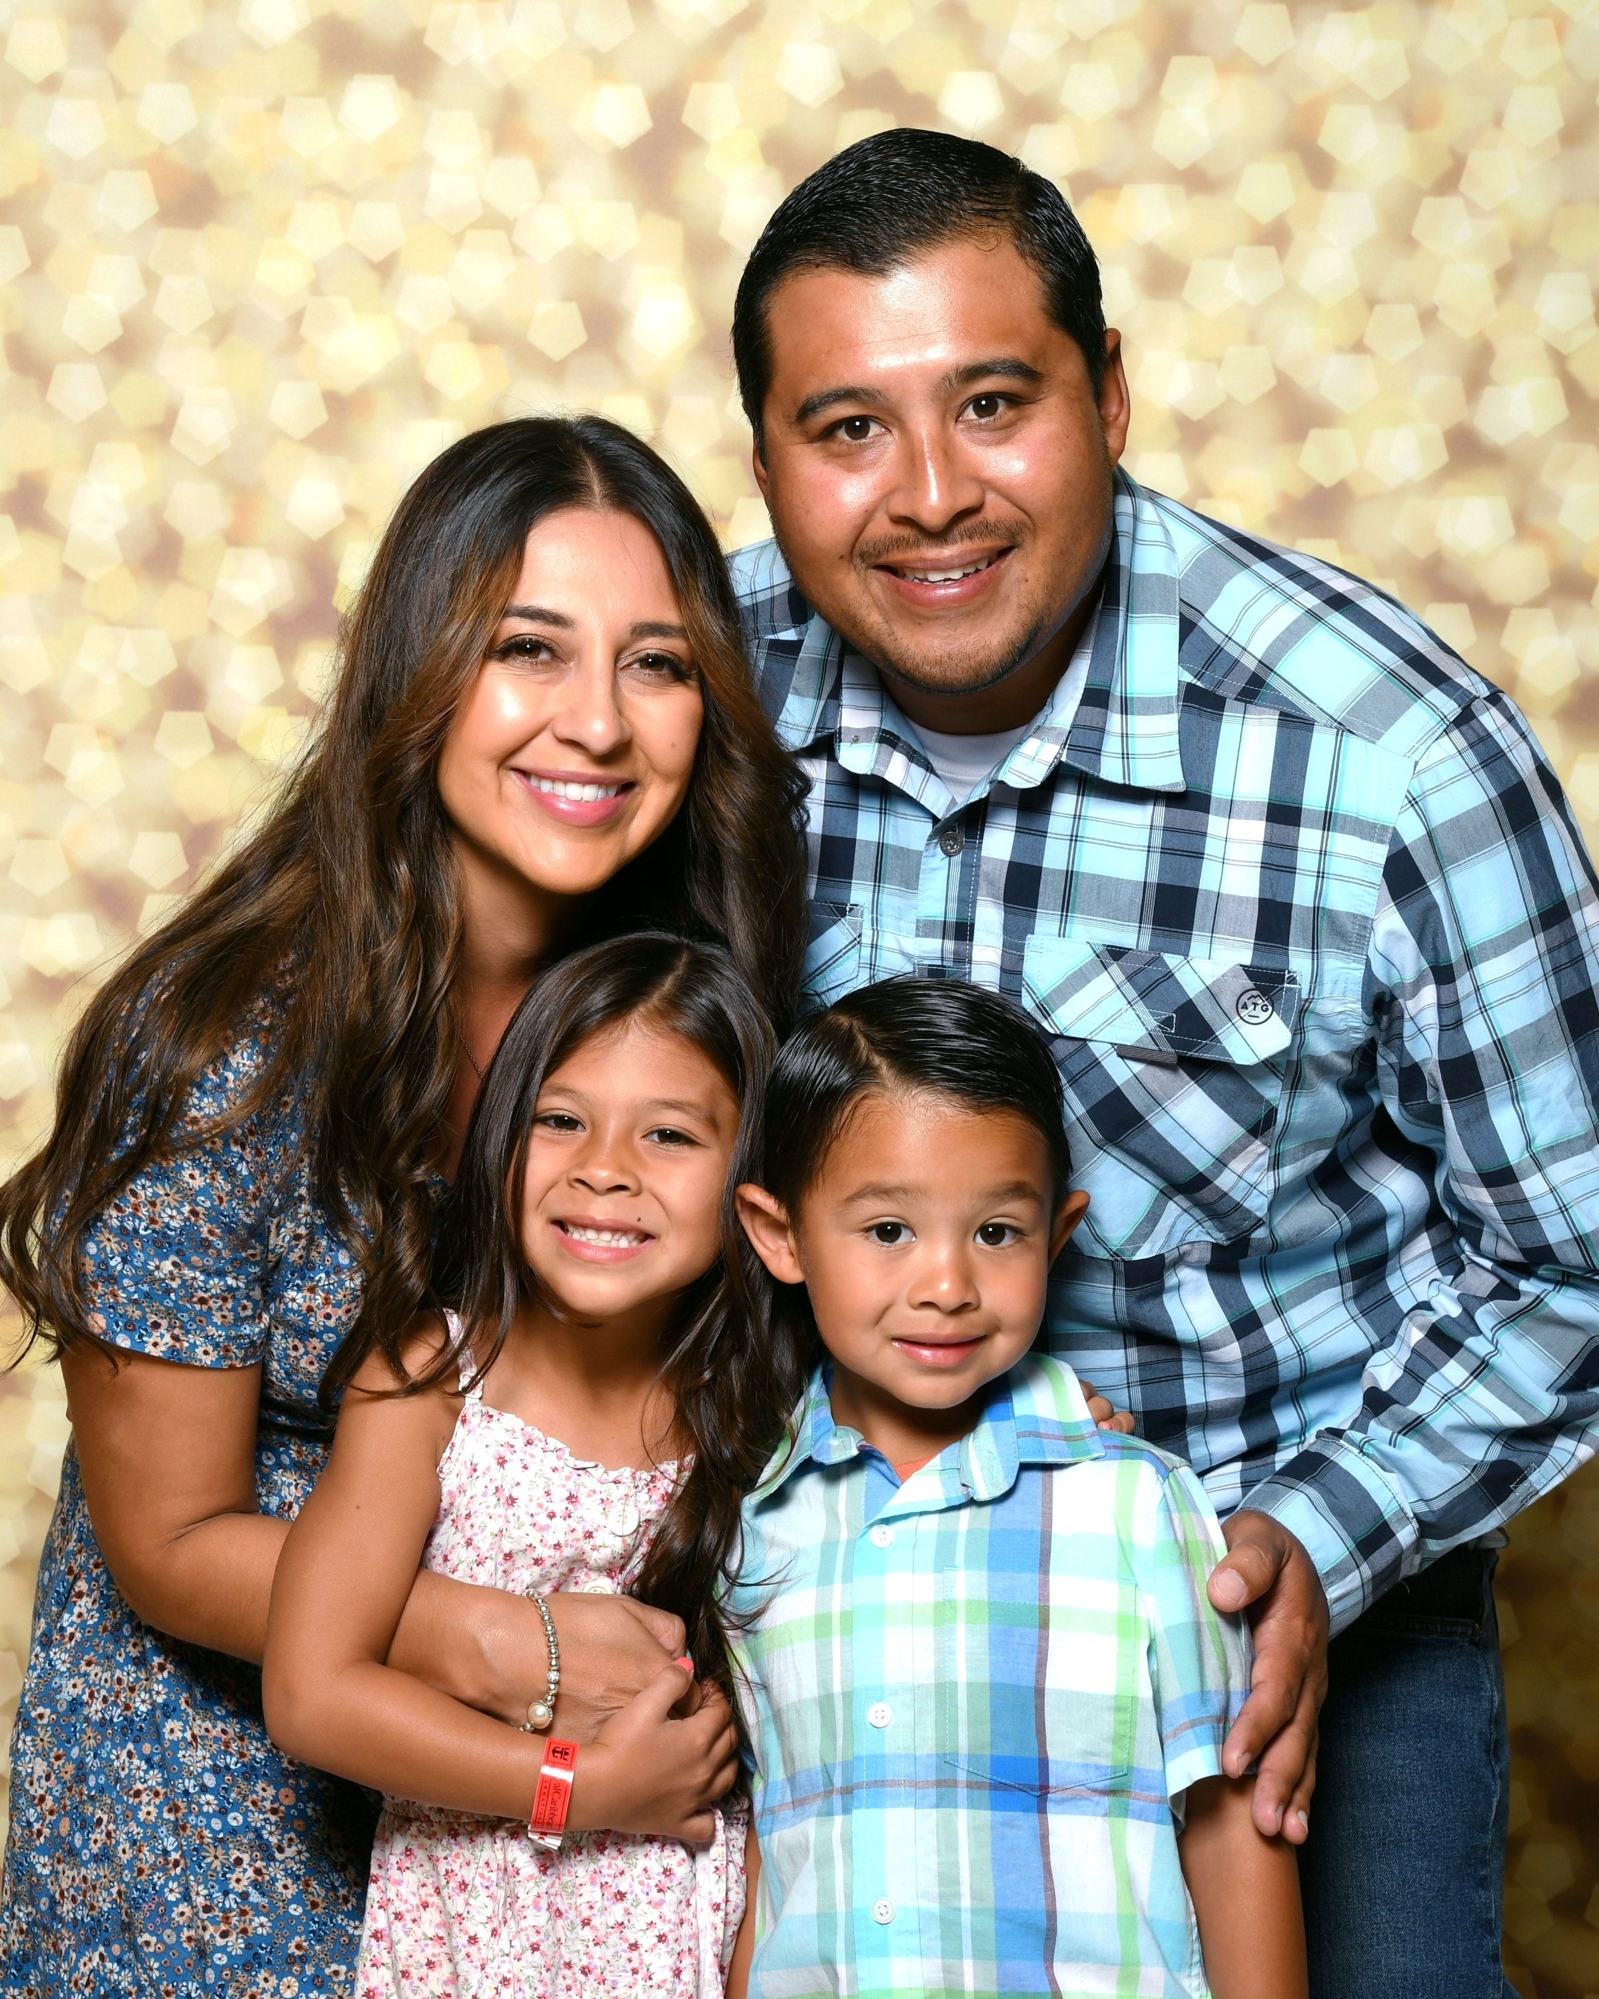
MEET THE
SPEECH-LANGUAGE PATHOLOGIST
WELCOME TO SPEECH AND LANGUAGE!
Mrs. Magallon
I am so happy to be your Speech-Language Pathologist!
This year is going to be full of fun, learning, and growing. You’ll meet new friends, learn lots of new skills, and make wonderful new memories. I can’t wait!
I absolutely love Speech and Language! I have been in the profession since 2010 and I have experience with all ages and abilities. When I’m not providing speech services, I love to spend time with my husband, our two children, bicycling and gardening! You’ll be seeing lots of photos of them this year.
I like 7 Leaves, going to Target, trying new restaurants, and being outside. Colorful pens and markers make me happy. You can always catch me snacking on something (usually chocolate!).
The best way to reach me outside of school is by email. My email address is sirena_magallon@chino.k12.ca.us

