Slide 2
Hello, my name is Mrs. Kristi Day (Szuh) and I am excited to be your child's Second Grade Teacher.
This will be my 30th year at Eagle Canyon. I have taught 6th grade, Kindergarten, 1st grade, and a 1st/2nd grade combo.
I have 2 grown sons that both attended Eagle Canyon and I have a grandson in 3rd grade.

Slide 3
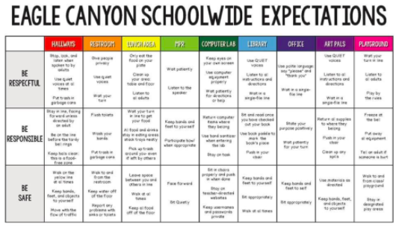
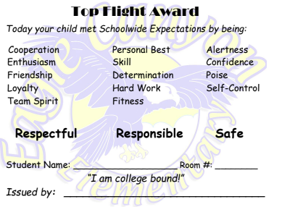
PBIS / Top Flight Awards

Slide 4
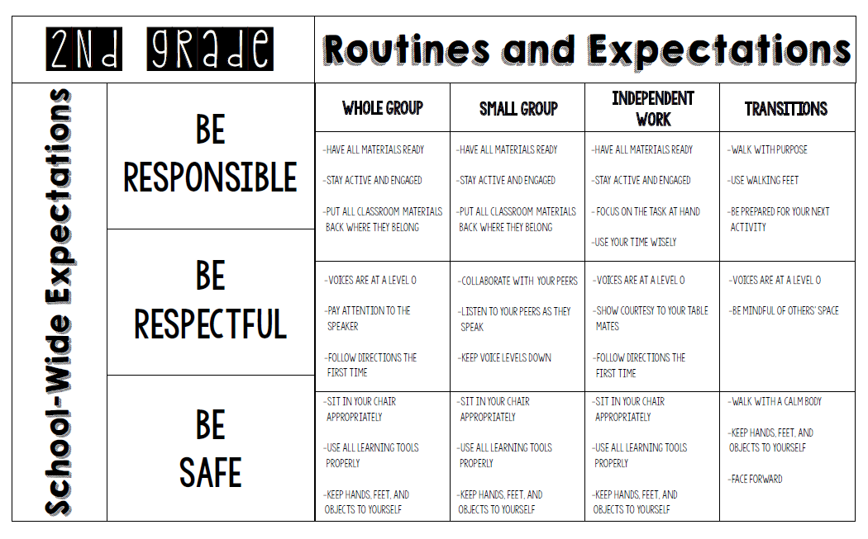

Slide 5
REWARDS
Individual: Class Dojo Points and Top Flights- You can shop at the Eagle Canyon Emporium when logged into PBIS through ClassLink.
Group: All students that have followed the classroom expectations the entire week will receive a small piece of candy on Friday. Your child knows they have to show it to you before they eat it. You will know they had to pull a card if they do not have the candy. If there is a serious issue I will reach out to parents immediately.

Slide 6
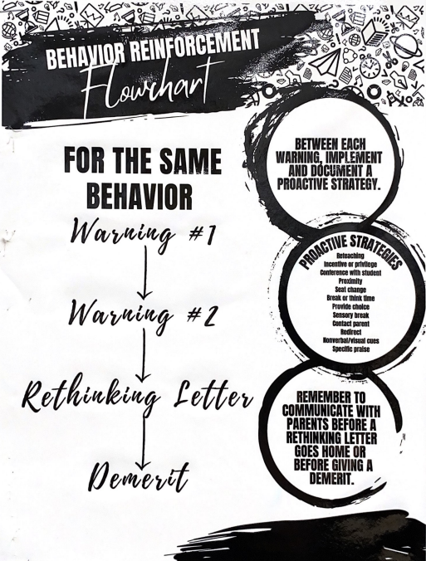
Consequences

Slide 7
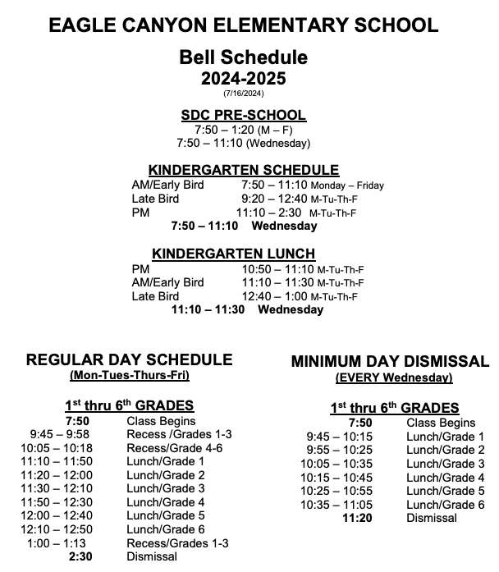
Bell
Schedule

Slide 8
Attendance
Attendance will be taken each morning. Please make sure your child is on time each morning. Class begins promptly at 7:50.
If your child arrives after 7:50, they will be marked absent or tardy. When a child is late, it interrupts instruction.
Please contact the office directly if your child will be missing any duration of school.
If you have a doctor’s note, please send it with your child so we can send it to the office.

Slide 9
On Sunday afternoons, a digital weekly newsletter will be sent out. Homework expectations will be displayed for the week.. Homework packets will be sent home on Monday and need to be returned that Friday.
*Incomplete work will be sent home to finish and they will need to complete and return the work..

Slide 10
4 ... EXCELLING
Students at the Excelling performance level are consistently performing at grade level, can demonstrate independence, and can extend the grade level standards, when applicable, expected at this point of the school year.
3 ... ACHIEVING
Students at the Achieving level of performance demonstrate an adequate understanding of and ability to apply skills needed to meet grade level standards expected at this point of the school year.
2 ... PROGRESSING
Students at the Progressing level of performance are partially meeting the grade level standards expected at this point in the school year.
1 ... BEGINNING / STANDARD NOT MET
Students at the Beginning/Standard Not Met are not yet meeting the grade level standards expected at this point of the school year.

Slide 11
Math- enVision Math… SAVVAS app, IXL
ELA- Wonders… connectED app,
Physical Education- Based off of the California State Standards
Second Step - Social/Emotional Learning
**We will alternate between each one throughout the Trimester.**
Social Studies- Reflections
Science- Imagine Twig

Slide 12
Essential Standards
Our Second Grade Curriculum will be driven by the Essential Standards for Math and ELA.
To Access the Essential standards click on the link below:
https://www.chino.k12.ca.us/Page/23987

Slide 13
Please make sure your child knows where and who is picking them up.
Second Grade is dismissed by the kindergarten gate.

Slide 14
ESA (Essential Standard Assessment):
ELA and MATH every trimester
Writing Performance Task: 3 per year
Informational Piece
Narrative Piece
Opinion Piece
Math topic tests
Weekly spelling (phonics), vocabulary and reading comprehension test

Slide 15
Assessment Goals
ESA (Essential Standards Assessments):
-ELA and Math every trimester
-Increase score by at least 3%.
CSA’s (Summative Assessments):
-Increase scores by at least 3%.

Slide 16
Parent Volunteers
If you are interested in helping to run copies and prep class work, please send me a message on Class Dojo.
If you are interested in being a room parent, please sign the sheet on the counter. The more the merrier!

Slide 17
Parent Conferences
September 23-27. Every day that week will be a minimum day.
Please add Your child’s name to a time slot.
Each time slot is 20 minutes long. Please be on time in order to respect the conferences before and after your allotted time.

Slide 18
Spirit Days
Wednesday - Wear College Shirt: Cal State Long Beach, The Beach. T-shirts are $15 and order forms need to be returned by Sept. 4th. No late orders will be accepted.
Friday - Eagle Canyon shirt/ blue or yellow.
*Spirit Count is taken and the class with the highest percentage wins an incentive.

Slide 19
2nd Grade Days
Field Trip, Jurupa Valley Mountain Center: March 7th.
Culminating Days: Earth Day: April 25th

Slide 20
Please feel free to contact me when you need help!
-Email: kristi_day@chino.k12.ca.us
-ClassDojo: Direct Messaging (This will be my main source of contact.)
-Home/EC Folder: This folder is to come to school every day. You can send me back a note in the folder. *Please make sure you go through your child’s work and remove it from the folder every day.

Slide 21
Thank you
Questions?
**Please join the PTA!

