Slide 1
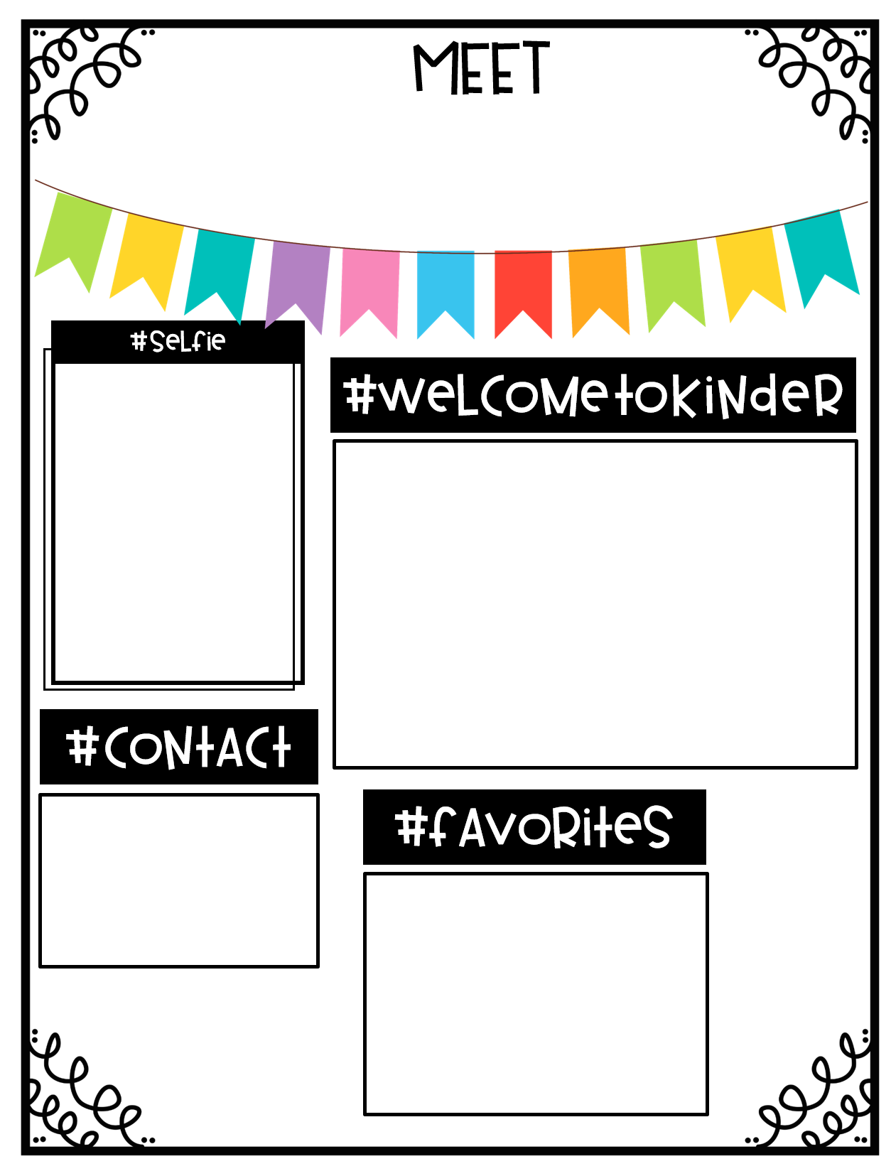
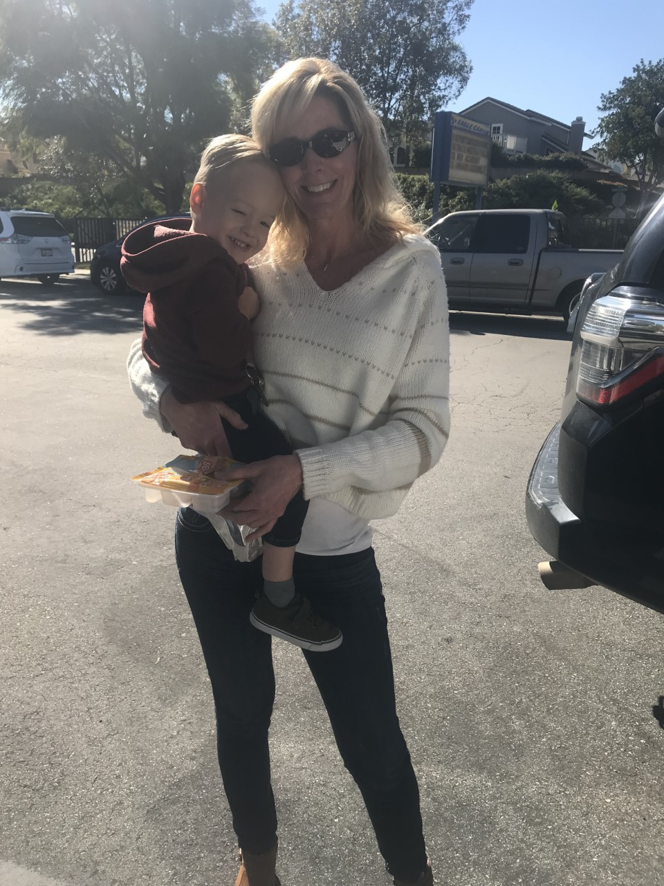
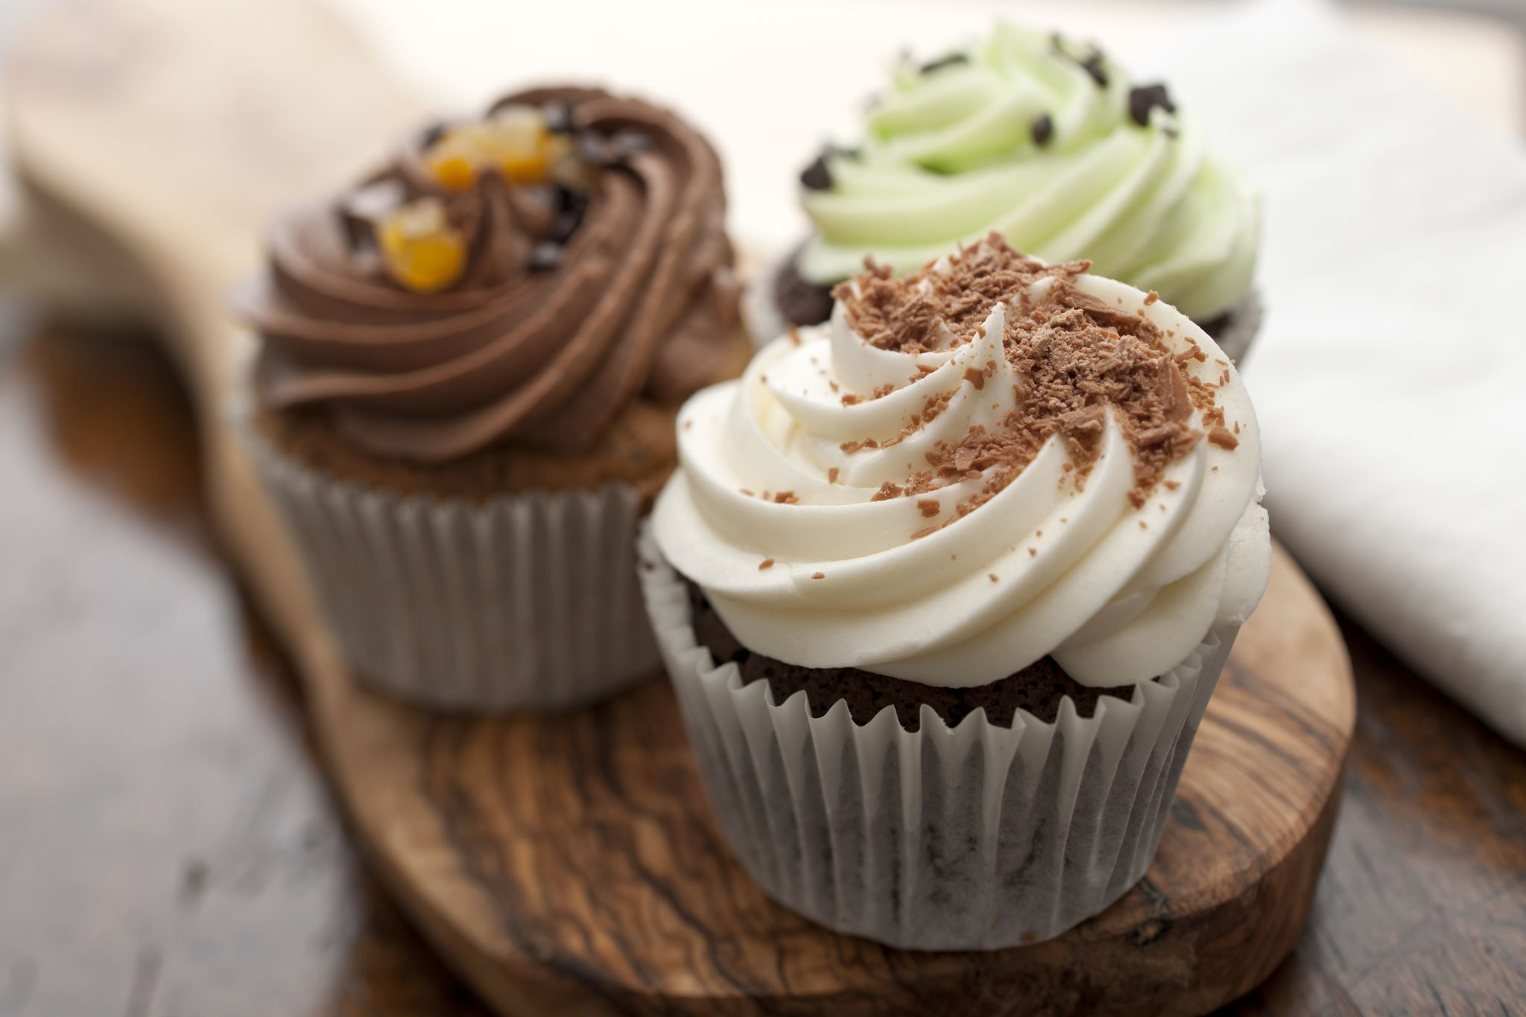
Mrs. Day
Hi! My name’s Kristi Day and I’m so excited to be your child’s kindergarten teacher. This will be my 27th year at Eagle Canyon and I’ve taught from sixth grade to kindergarten, but kindergarten is my favorite! I have 2 boys, Nick and Todd that were former Eagles and I’m a proud Nana of a grandson, Lucas, and a granddaughter Shyanne. I’m looking forward to meeting you and getting this year off to a great start!
Email:
Kristi_day@chino.k12.ca.us
School phone:
909-590-2707
Food: Mexican Food!!
Color: Pink
Season: Fall
Subject: Math
Store: Amazon & Target
Restaurant: Yard House
Candy: Chocolate!

