Slide 1
Eagle Canyon's Eagle Canyon's Kindergarten Readiness

Slide 2
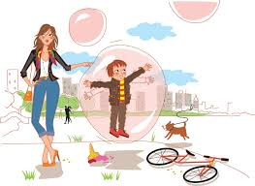
How can Parents Help?
One of the most important things you can do over the summer to prepare your five-year-old for kindergarten is to help your child to become more independent.
C

Slide 3
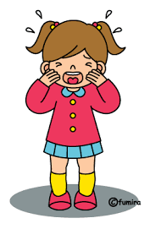
Ultimately, it’s all about balance
“Even if my preschooler is already reading, he’s not ready for kindergarten if he cries at every turn, doesn’t know how to play independently, and lacks self control.”
http://www.themeasuredmom.com/10-ways-to-get-ready-for-kindergarten/

Slide 4
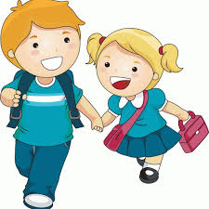
Foster Independence
Your kindergartner should be able, without assistance, to take care of their personal needs such as:
Care for their toilet needs and remember to wash their hands.
Use tissue to blow their nose.
Zip and button pants and jacket independently.
Tie shoelaces.

Slide 5
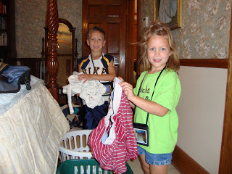
Independence and Responsibility
Your 5-year-old will gain a sense of independence and responsibility if you teach and expect your child to:
Put their own clothes away.
Help set the table.
Help with laundry and shopping.
Help care for pets.
Clean up after themselves, putting toys away.
Listen when others are speaking to them.
Follow simple directions.

Slide 6
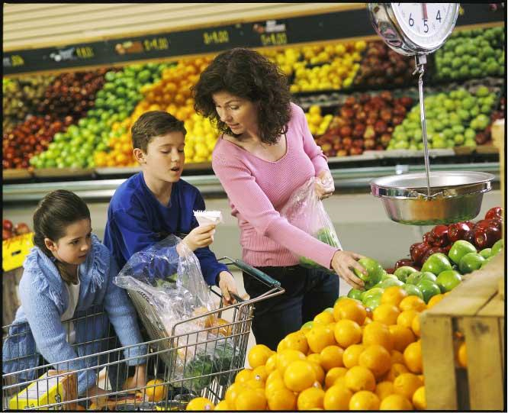
Incidental Learning
Field Trips
Take a walk, go to the store, post office, park, etc.
In the car: “I spy,” rhyming, 2 minute stories…
Role Play at Home

Slide 7
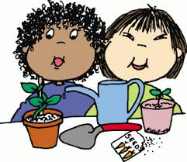
Local Resources/Activities
Public Library http://www.sbclib.org/CoursesandEvents.aspx
http://colapublib.org/libs/diamondbar/index.php
Barnes & Noble http://stores.barnesandnoble.com/store/2300
Home Depot http://www.homedepot.com/workshops/#store/6645
Chino Creek Wetlands & Educational Park
Earth Day Event: https://www.ieua.org/event/10936/
Amy’s Farm http://www.amysfarm.com/
Chino Youth Museum http://www.chinoyouthmuseum.com/
Parks and Recreation https://recreation.chinohills.org/wbwsc/webtrac.wsc/splash.html

Slide 8
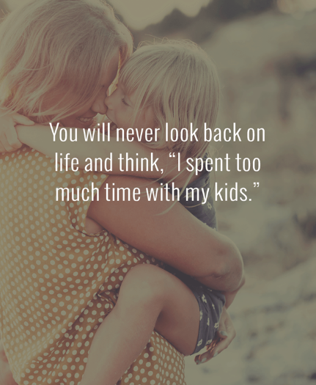

Slide 9
Important Skills
in Preparation for
Kindergarten

Slide 10
Write & Recognize First Name
It is very important for children to learn early on to write a capital letter for only the first letter of their name.
Letters should be written top to bottom, left to right.
Students should be able to recognize their name.

Slide 11
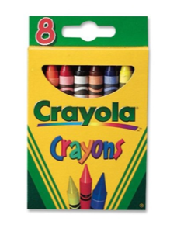
Identify the Colors

Slide 12
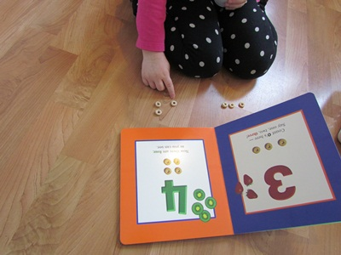
Count & Recognize Numbers to Ten

Slide 13
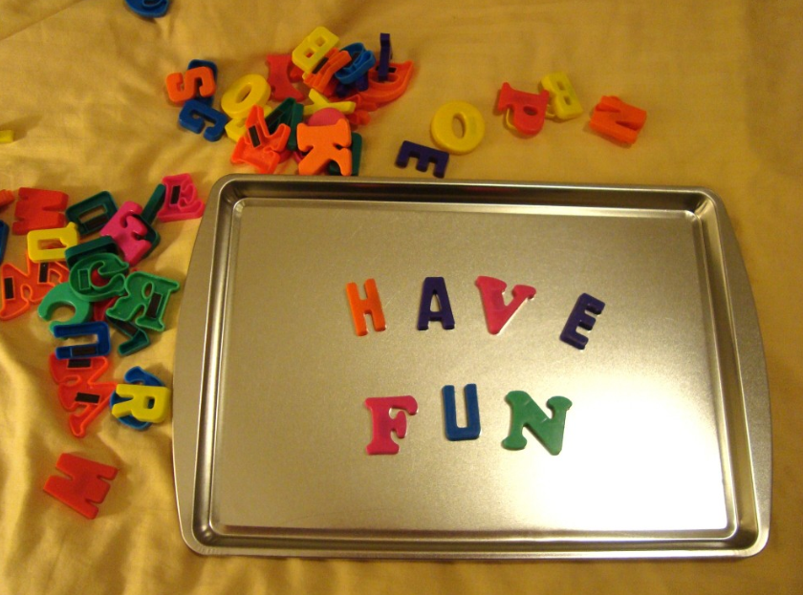
Letter Names
Environmental Print

Slide 14
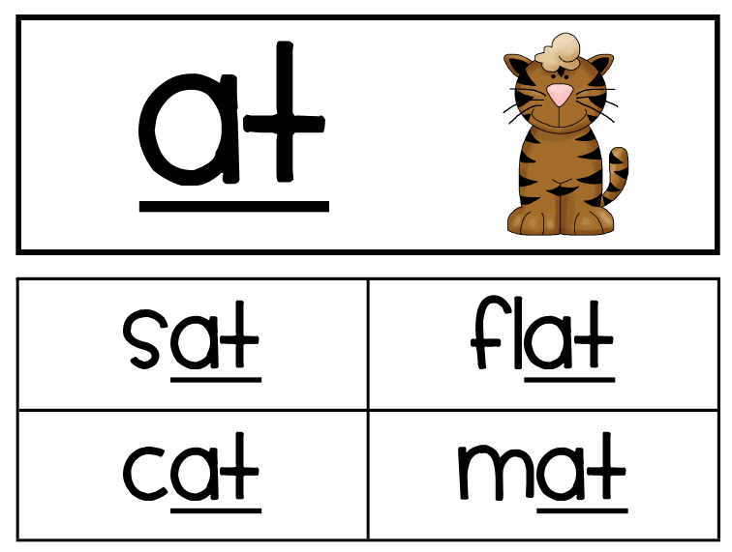
Rhyming

Slide 15
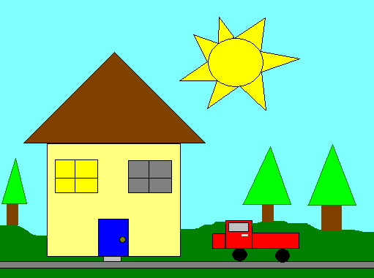
Recognize Shapes

Slide 16
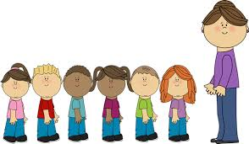
Follow 3 Directions
“Go upstairs”
“Put your pajamas on”
“Put your clothes in the hamper”

Slide 17
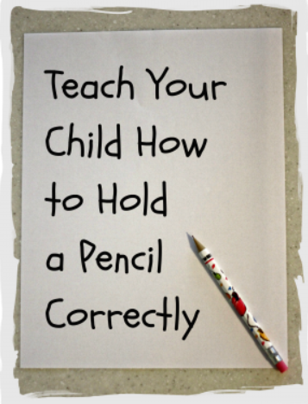
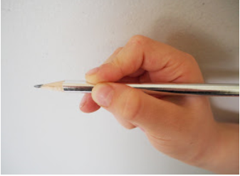

Slide 18
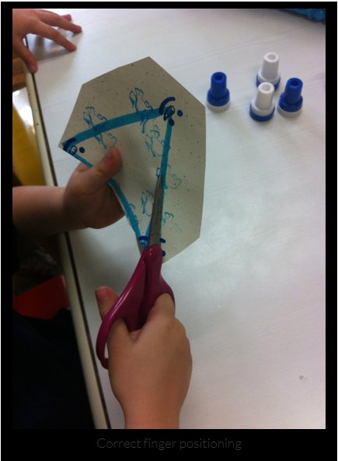
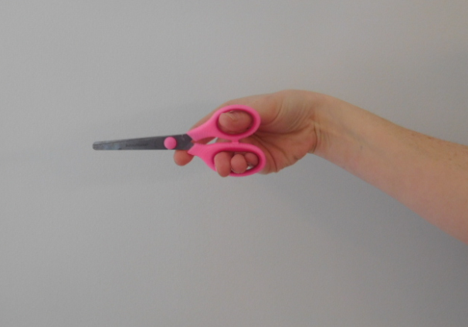
Hold Scissors Correctly
Thumb on top

Slide 19
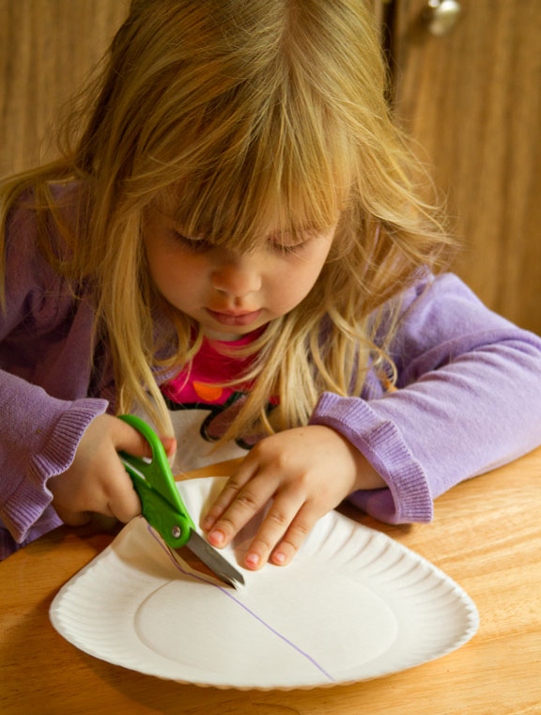
Cut on Lines

Slide 20
Color Within the Lines

Slide 21
Sit Quietly for 15 Minutes

Slide 22
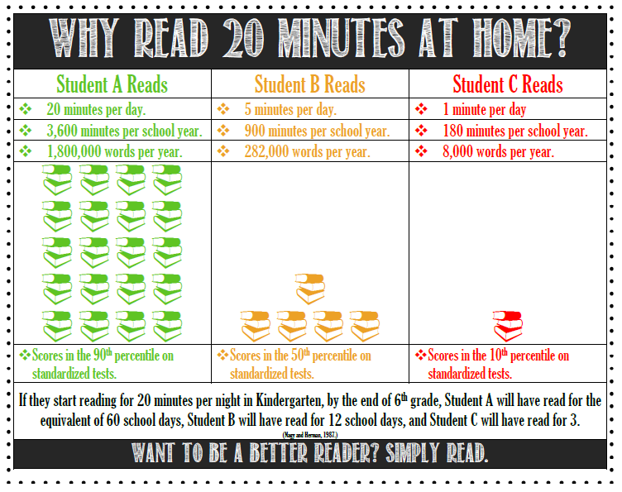

Slide 24
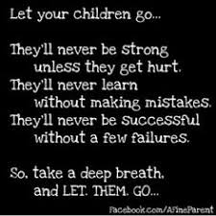

Slide 25
Online Resources
http://www.themeasuredmom.com/10-ways-to-get-ready-for-kindergarten/
http://www.themeasuredmom.com/teach-child-write-name-kindergarten/
http://thisreadingmama.com/free-cutting-practice-with-scissors/
http://www.learnwithplayathome.com/?m=1
http://growingbookbybook.com/101-books-read-kids-kindergarten/
http://www.merakilane.com/10-scissor-activities-for-preschoolers/#_a5y_p=3661011
http://www.pre-kpages.com/teach-scissor-cutting-skills/

Slide 26
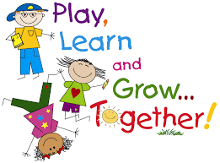
Thank You for Working with your Child!
We can't wait to see you at
Back To School Night
August 5, 2020
6:30 pm.

