Slide 1
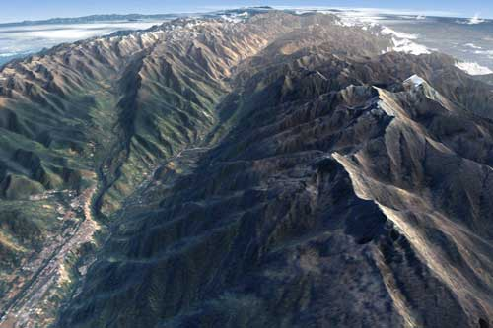
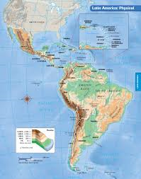
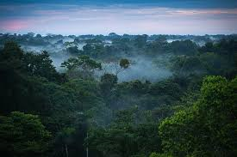
Geography of Latin America: Human-Environment Interaction

Slide 2
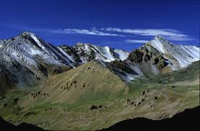
“A human perspective”
High in the Andes Mountains, in what is present-day Peru, the ancient Inca needed fields in which to grow crops.
By the 1200s, in the high lands around their capital of Cuzco and elsewhere, the Inca carved terraces out of the steep sides of the Andes Mountains as well as irrigation channels.

Slide 3
Machu Picchu – Short Video Questions https://www.youtube.com/watch?v=cnMa-Sm9H4k
Where is Machu Picchu located?
Which ancient empire flourished with Machu Picchu at the center?
When was it built?
How is the architectural design of Machu Picchu related to the theme of Human environment interaction?

Slide 4
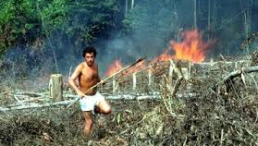
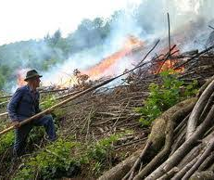
Agriculture reshapes the Environment
Slash-and-Burn: to clear fields, native peoples used the slash-and-burn technique – they cut trees, brush, and grasses and burned the debris to clear the field.
Today, farmers practice the same method as they move into the Amazon River basin in Brazil and clear land for farming in the rain forest.

Slide 5
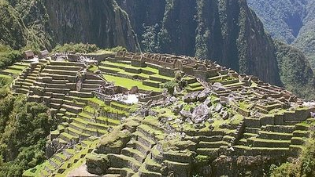
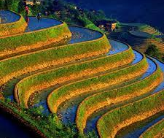
Terraced farming-
Terraced farming is an ancient technique for growing crops on hillsides or mountain slopes. It is especially important technique in the mountainous areas of the region.
Used by the Inca in Peru and the Aztecs in Mexico.

Slide 6
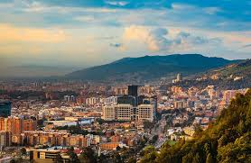
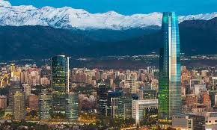
Urbanization: The Move to the Cities
Throughout Latin America, people are moving from rural areas into the cities. They leave farms and villages in search of jobs and a better life.

Slide 7
Reasons for Urbanization
Push factors are factors that “push” people to leave rural areas. Make a list of possible push factors.
Pull factors are factors that “pull” people toward the cities. Make a list of possible pull factors.

Slide 8
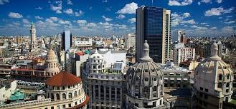
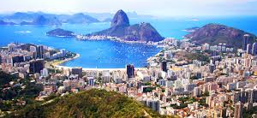
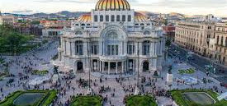
Rapidly Growing Cities (Skillbuilder on pg. 212)
Largest populations in South America include:
Sao Paulo, Brazil
Rio de Janerio, Brazil
Buenos Aires, Argentina
Lima, Peru
Bogota, Columbia
Santiago, Chile
Mexico City, Mexico

Slide 9
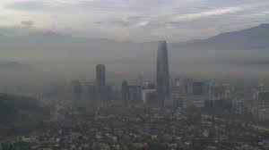
Problems of Growing Cities
Unemployment and crime often increase as urbanization increases.
Pollution from cars and factories.
Poor infrastructure (sewers, transportation, electricity and housing)

Slide 10
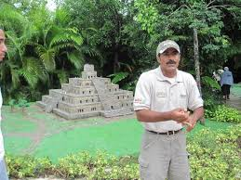
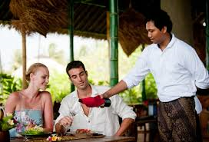
Tourism: Positive and Negative Impacts
Advantages:
1. Creates jobs in the local economy
2. Brings money into local business and industry

Slide 11
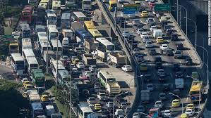
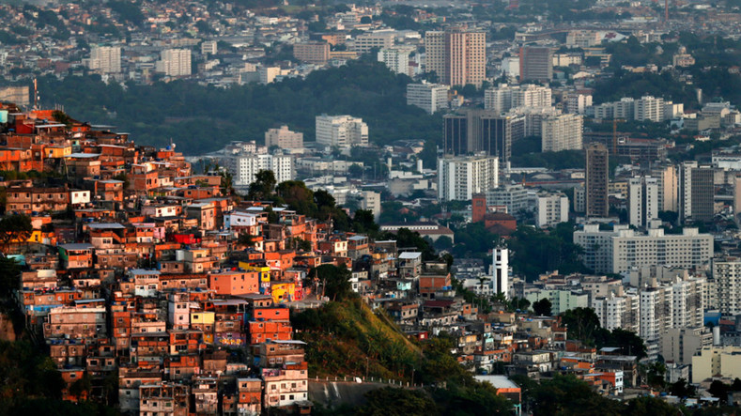
Disadvantages
1. Congestion and pollution
2. Gap between rich tourists and less well-off local residents.
3. Local governments can run up large public debts by borrowing money to build tourist facilities.

