Slide 1
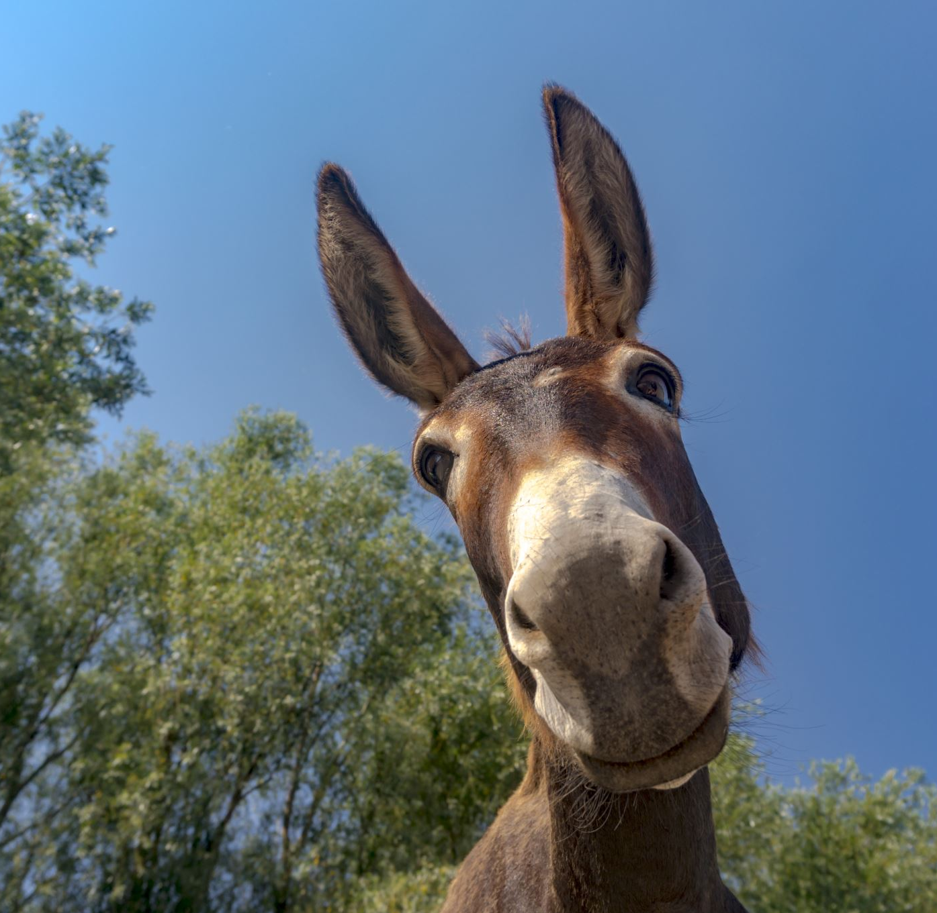
Old MacDonald
Using GABED

Slide 3
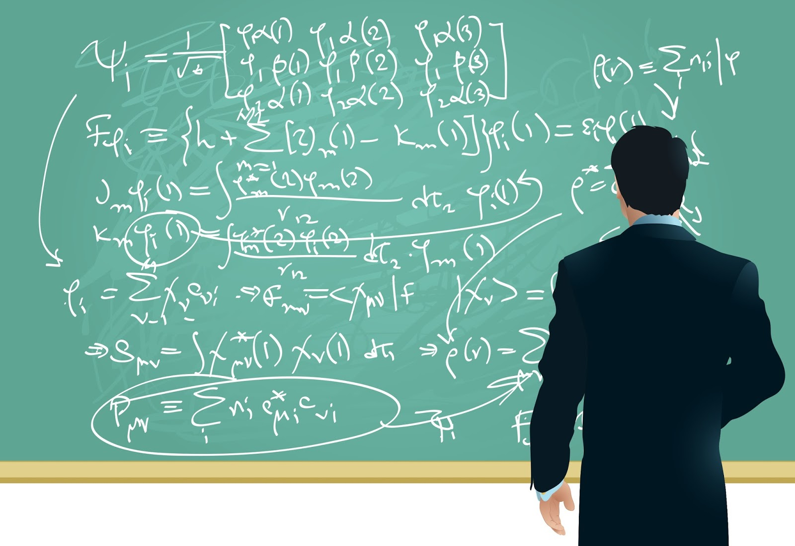
X+1/2X = X .
Math in Music!
X
=
2
How many counts is a halfnote?
What is half of 2?
1
Or 2+1=3
X+1/2X=X. or
+
1/2
=

Slide 4
Notes in this song:
B A G E D

