Slide 1
Nominating Candidates
Ch 16 sec 3

Slide 2
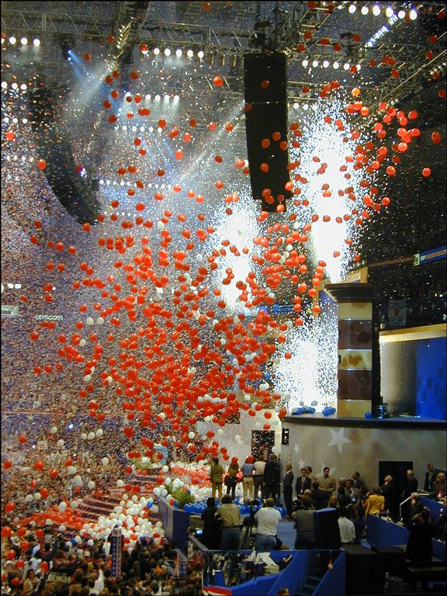
I. How Candidates Are Selected
In twelve states party leaders hold caucuses to select candidates for public office.
As party caucuses came under attack, the nominating convention to choose candidates became popular.
Notes:
http://www.mccullagh.org/db9/950-12/gop-convention-5.jpg

Slide 3
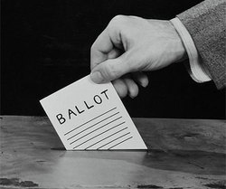
I. How Candidates Are Selected
The direct primary is the method most used by parties today to nominate candidates; most states hold closed primaries, in which only party members vote, but some states have open primaries in which any voter can participate.
Notes:
http://media.pegasusnews.com/img/photos/2009/01/19/vote-ballot-b-w_t250.jpg

Slide 4
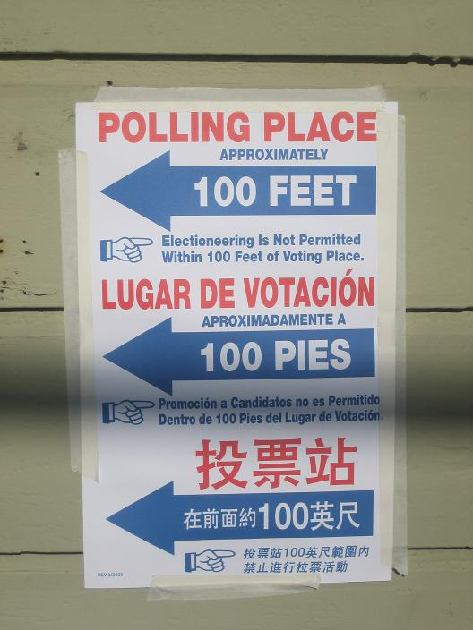
I. How Candidates Are Selected
Primary elections, run according to state law and held at regular polling places, are used to select party candidates for the House, Senate, governor, and other state and local offices.
Notes:
http://blogs.sfweekly.com/thesnitch/polling_place.JPG

Slide 5
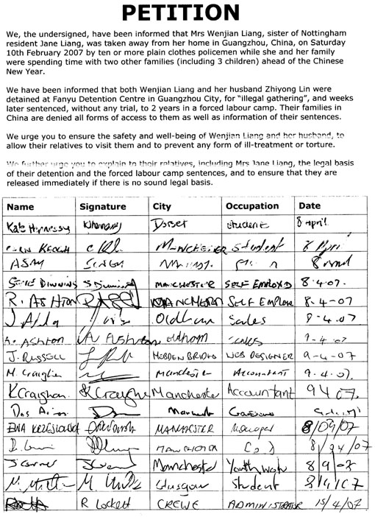
I. How Candidates Are Selected
A person can file petitions, signed by a specified number of voters, to run for office and be placed on the ballot; however, the caucus or convention candidate of the major parties has an advantage because of party backing and resources.
Notes:
http://www.freewebs.com/rescuewenjian/petition08April2007.jpg

Slide 6
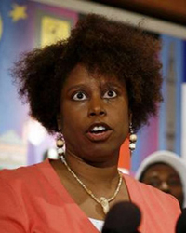
II. Presidential Nominations
Every four years, each major party holds a nominating convention to choose candidates for president and vice president in the November general election.
Before nominating conventions, congressional caucuses selected presidential candidates.

Slide 7
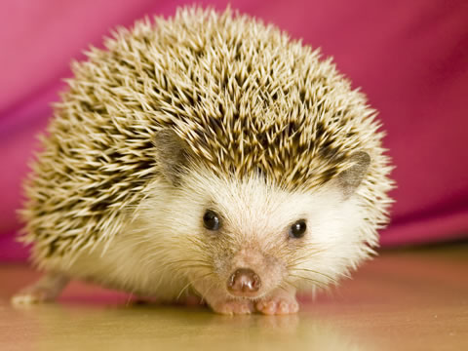
II. Presidential Nominations
Presidential primary elections operate under a wide variety of state laws and party rules in selecting candidates to run for office.
Notes:
http://www.treehugger.com/sonic-hedgehog-ll-year-old-pet-laws-kansas.jpg

Slide 8
II. Presidential Nominations
Criticisms of presidential primaries are:
The process extends over too long a period.
The primaries seem to focus on the image of the candidate more than the issues.
Relatively few people vote in primaries, thus the winner may not be as popular as the victory would indicate.
Primaries often result in one-sided conventions and become simply rubber stamp operations.

Slide 9
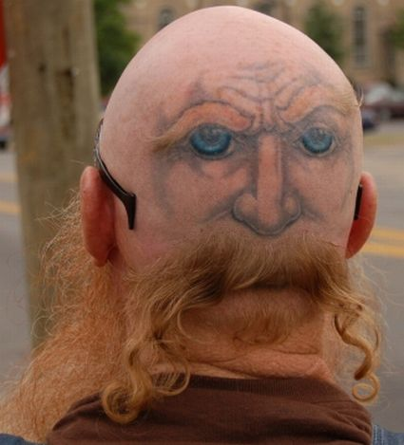
III. The National Convention
Each party’s national committee chooses the site and date of the convention, and decides how many votes each state will have.
Many of the delegates who assemble at the convention are already pledged to a candidate, though some are not.
Notes:
http://www.instablogsimages.com/images/2007/11/28/crazy-tattoo_1822.jpg

Slide 10
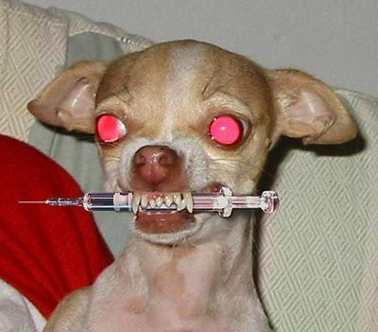
III. The National Convention
On the evening of the opening day, an important party member gives the keynote address, a speech intended to unite the party for the campaign; in the next day or two, the delegates listen to committee reports and speeches about them.
Notes:
http://jonwye.files.wordpress.com/2008/11/crazy_dog.jpg

Slide 11
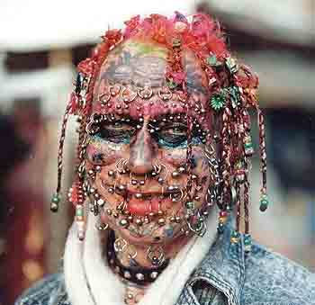
III. The National Convention
Each party’s rules committee governs the way the convention is run; in most cases the delegates accept the rules committee’s report, but sometimes hard-fought battles may take place by delegates who oppose decisions made by the committee.
Notes:
http://www.egitara.ru/damir/images/strange.jpg

Slide 12
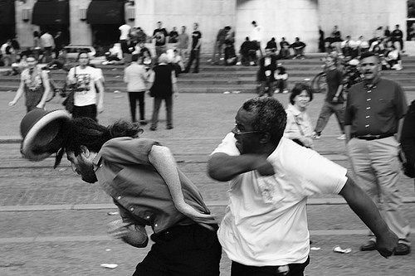
III. The National Convention
The credentials committee must approve the delegates from each state, and sometimes lively fights have occurred between rival delegations for a state’s seats.
Notes:
http://artofmanliness.com/wp-content/uploads/2008/01/fight.jpg

Slide 13
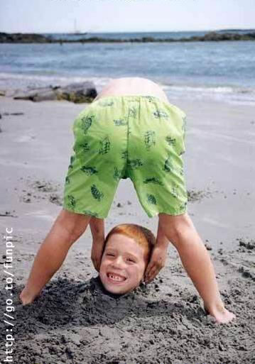
III. The National Convention
A committee on permanent organization selects the permanent chairperson and other permanent officials for the convention.
The platform committee is assigned the important task of writing the party’s platform – a statement of its principles, beliefs, and positions on vital issues.
Notes:
http://www.thejokester.net/Photos/People%20Photos/images/Ooops,%20I%20Dropped%20%20It%20Again_jpg.jpg

Slide 14
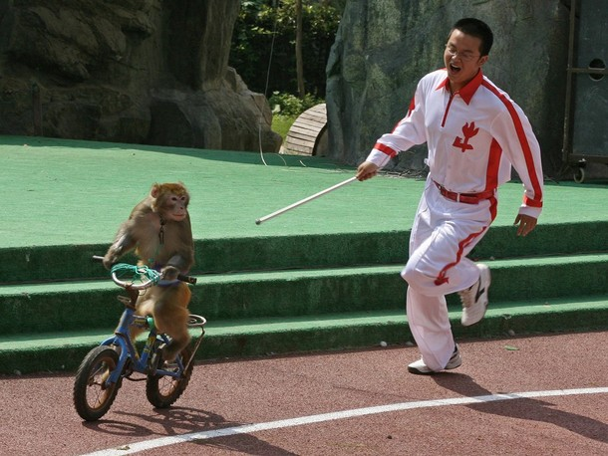
III. The National Convention
The highlight of the convention is the selection of the party’s candidate for president. In recent years, front-runners have had enough committed delegates that it was known they would be the party’s nominee, and they were selected on the first ballot.
Notes:
http://cache.daylife.com/imageserve/071Hb0KdG2h0v/610x.jpg

Slide 15
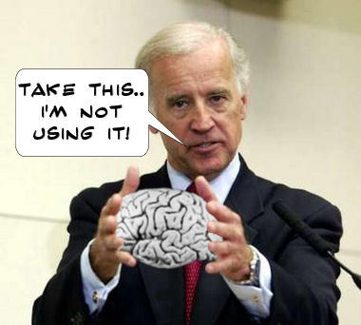
III. The National Convention
The vice presidential nomination sometimes creates some suspense because the presidential candidate’s choice, who is always selected by the delegates, is not known in advance.
Notes:
http://4.bp.blogspot.com/_k_bgXPrPWx0/SUxGKl6XwvI/AAAAAAAABts/kFclyXYwUaA/s400/Biden_brain.jpg

Slide 16
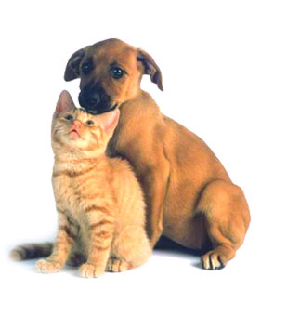
III. The National Convention
The vice presidential nominee usually is chosen to balance the ticket, with a person who has a personal, political, or geographic background different from the presidential candidate’s.
Notes:
http://cacarc.files.wordpress.com/2009/01/dog-cat.jpg

Slide 17
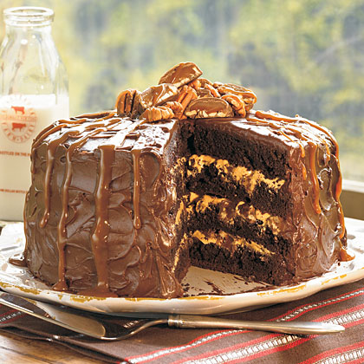
III. The National Convention
The convention adjourns after the presidential and vice presidential candidates have delivered their acceptance speeches, intended to unify the party and appeal to the national television audience.
Notes:
http://img.timeinc.net/recipes/i/recipes/oh/08/chocolate-cake-oh-1727433-x.jpg

