Slide 1
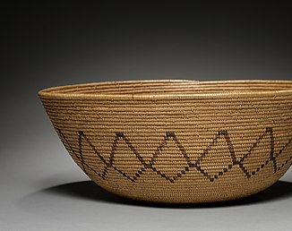
Gabrielino Tribe
By Isaiah and Gabriel
This Photo by Unknown author is licensed under CC BY-SA.

Slide 2
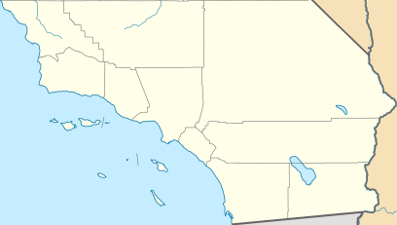
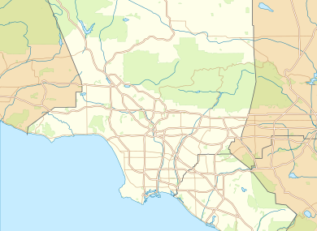
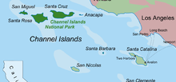
​Location
The Gabrielino tribe lived along the rivers. There were trees, hills, grass and mountains in their area. They lived on the islands off southern California.
This Photo by Unknown author is licensed under CC BY-SA.

Slide 3
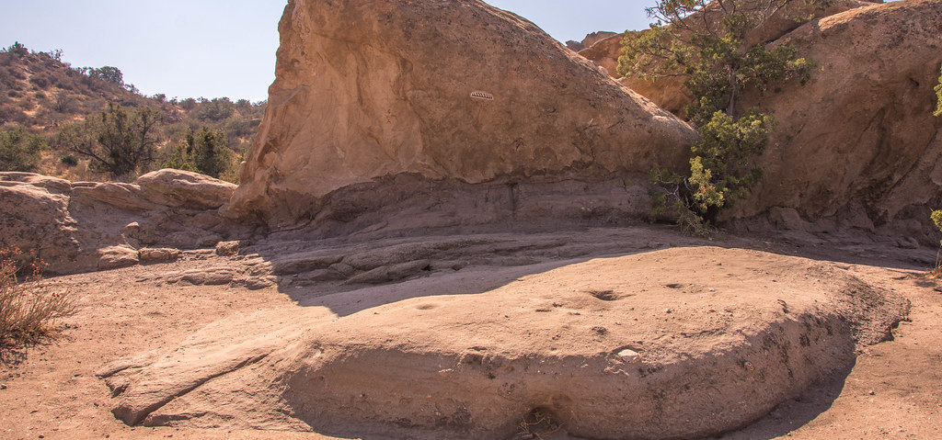
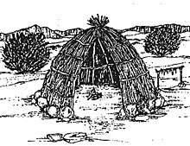
Shelter
The Gabrielino tribe called their houses emeseales. Homes were made by making a frame of poles and filled it in with sticks. Some houses can hold 50 or 60 people!
This Photo by Unknown author is licensed under CC BY-SA.
This Photo by Unknown author is licensed under CC BY-NC.

Slide 4
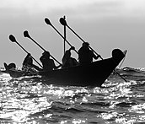
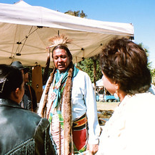
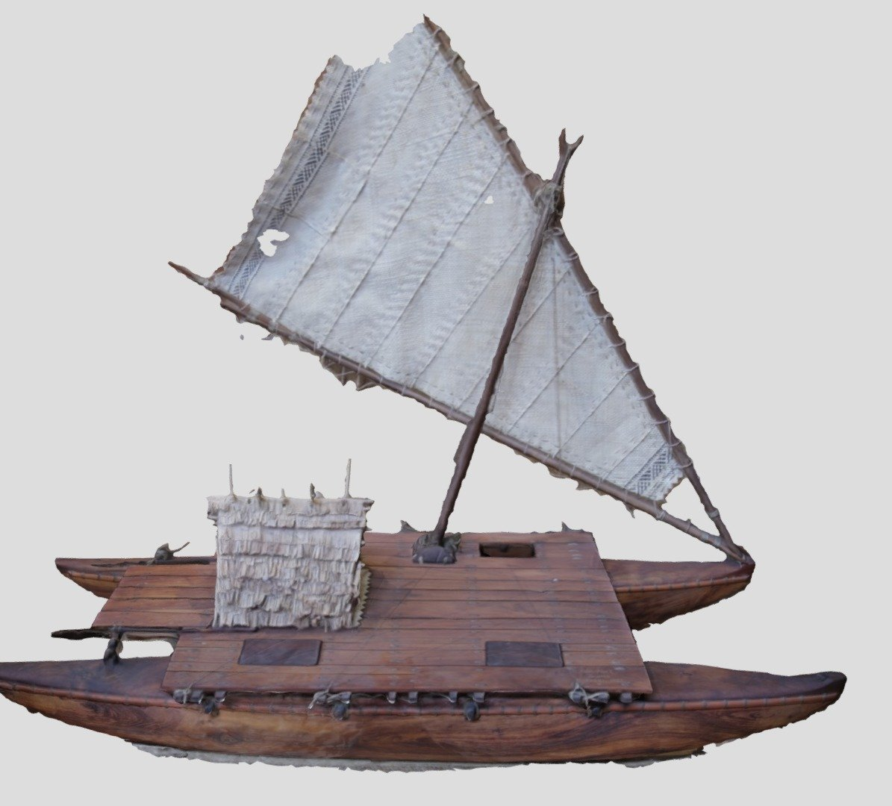
Culture
The Gabrielino had dances and sang for several days. They built boat to catch the fish. Their biggest ceremony was the week of the dead.
This Photo by Unknown author is licensed under CC BY-SA.
This Photo by Unknown author is licensed under CC BY-NC-ND.
This Photo by Unknown author is licensed under CC BY-NC.

Slide 5
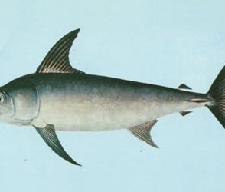
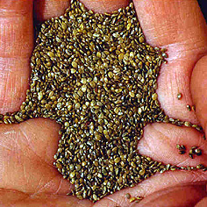
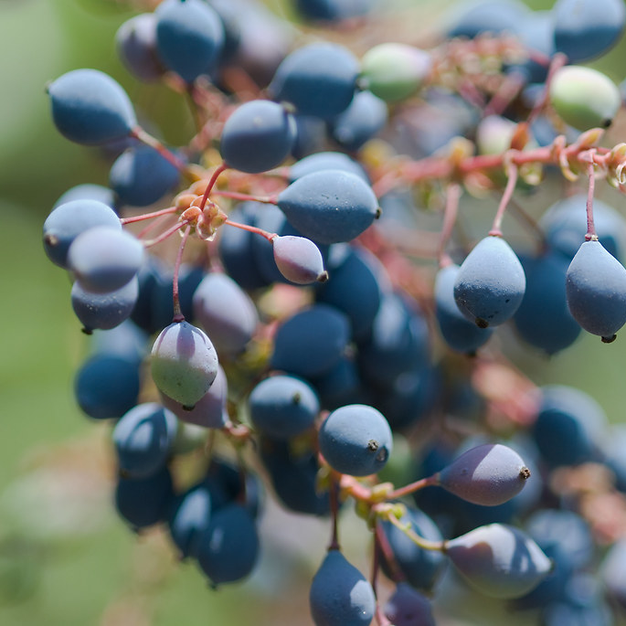
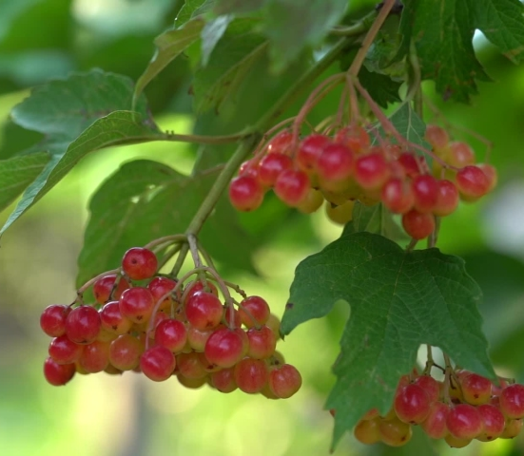
Food
The Gabrielino ate tuna, sword fish and sharks. They gathered acorns, pinon nuts, berries, and other plants. The tribe used the land to find food. They hunted deer, bears, snakes and rabbits.
This Photo by Unknown author is licensed under CC BY.
This Photo by Unknown author is licensed under CC BY-SA.
This Photo by Unknown author is licensed under CC BY-NC.

Slide 6
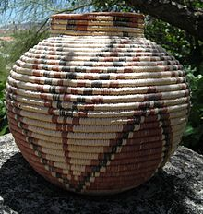
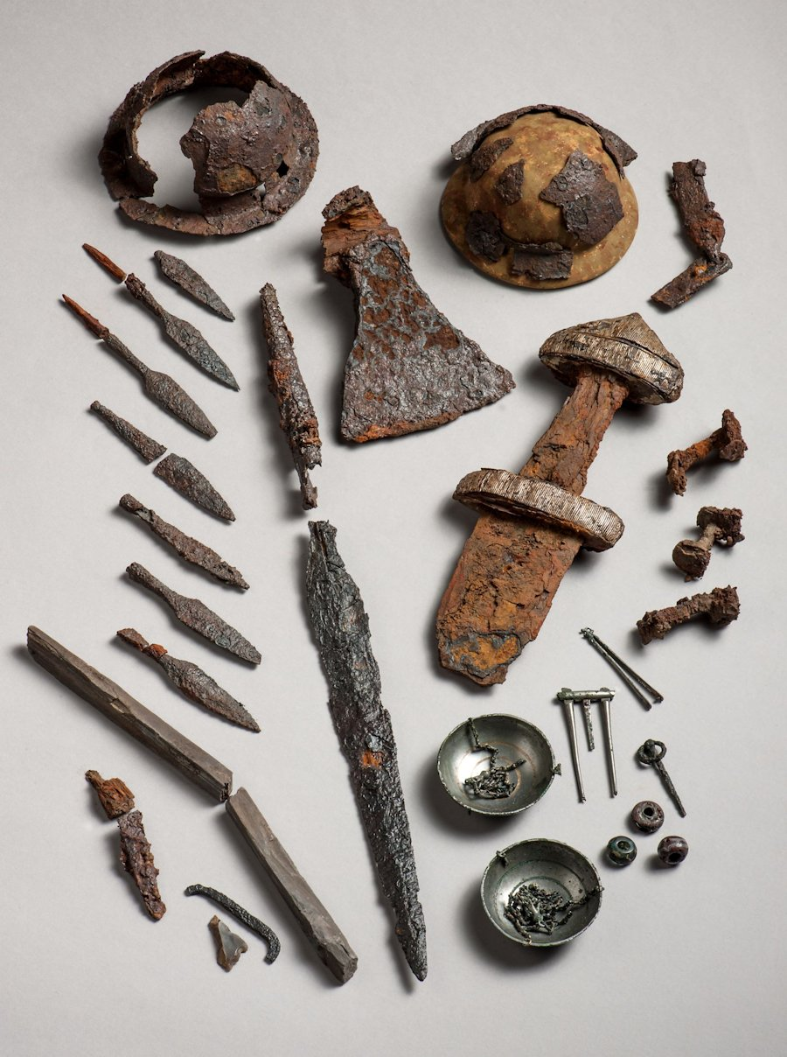
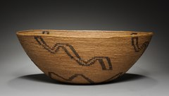
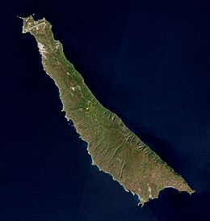
Gabrielino's life
This Photo by Unknown author is licensed under CCY-SA.
This Photo by Unknown author is licensed under CC BY-SA.
This Photo by Unknown author is licensed under CC BY-SA.
This Photo by Unknown author is licensed under CC BY.
This Photo by Unknown author is licensed under CC BY-SA.

Slide 7
This Photo by Unknown author is licensed under CC BY-SA.

