Slide 1
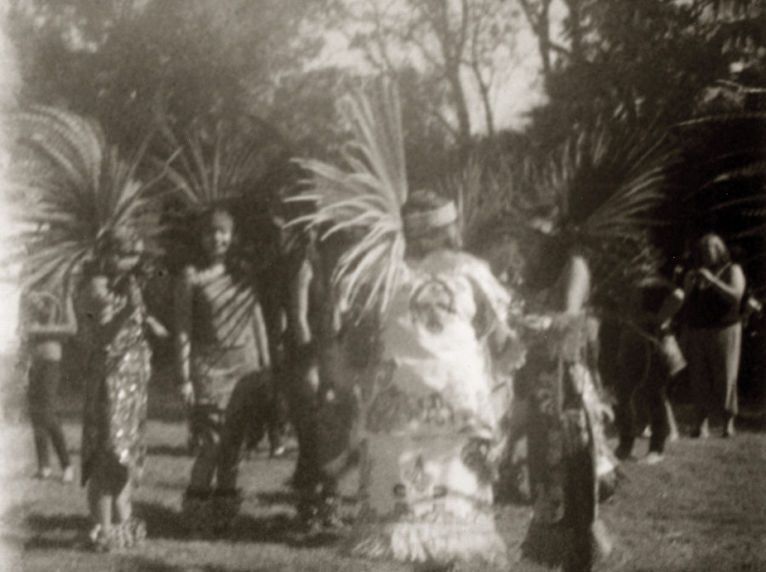
Gabrielino
By Frank and Caleb
This Photo by Unknown author is licensed under CC BY-NC.

Slide 2
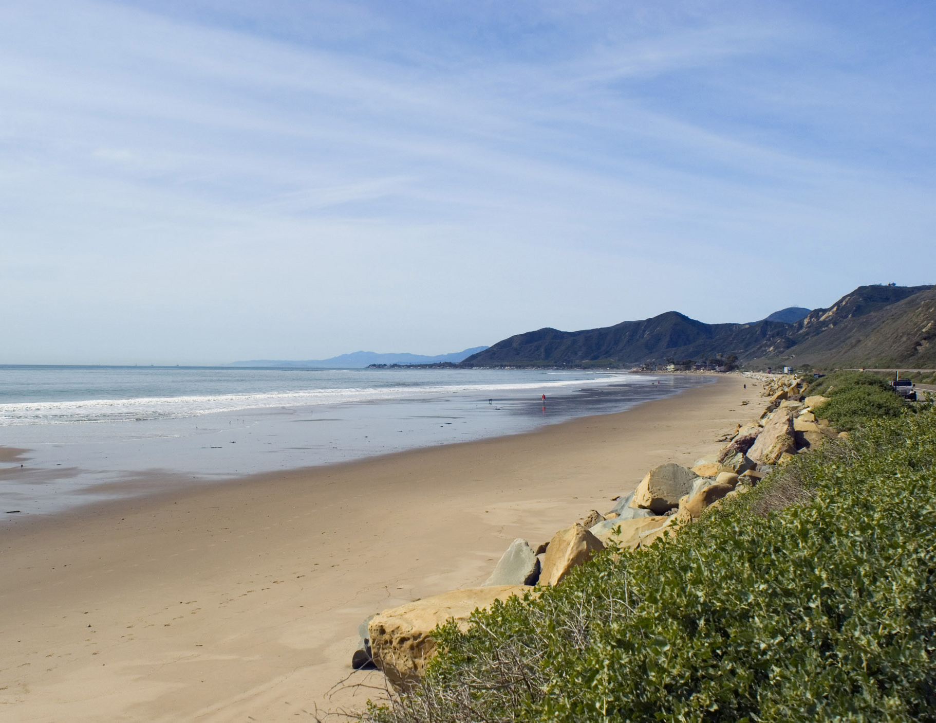
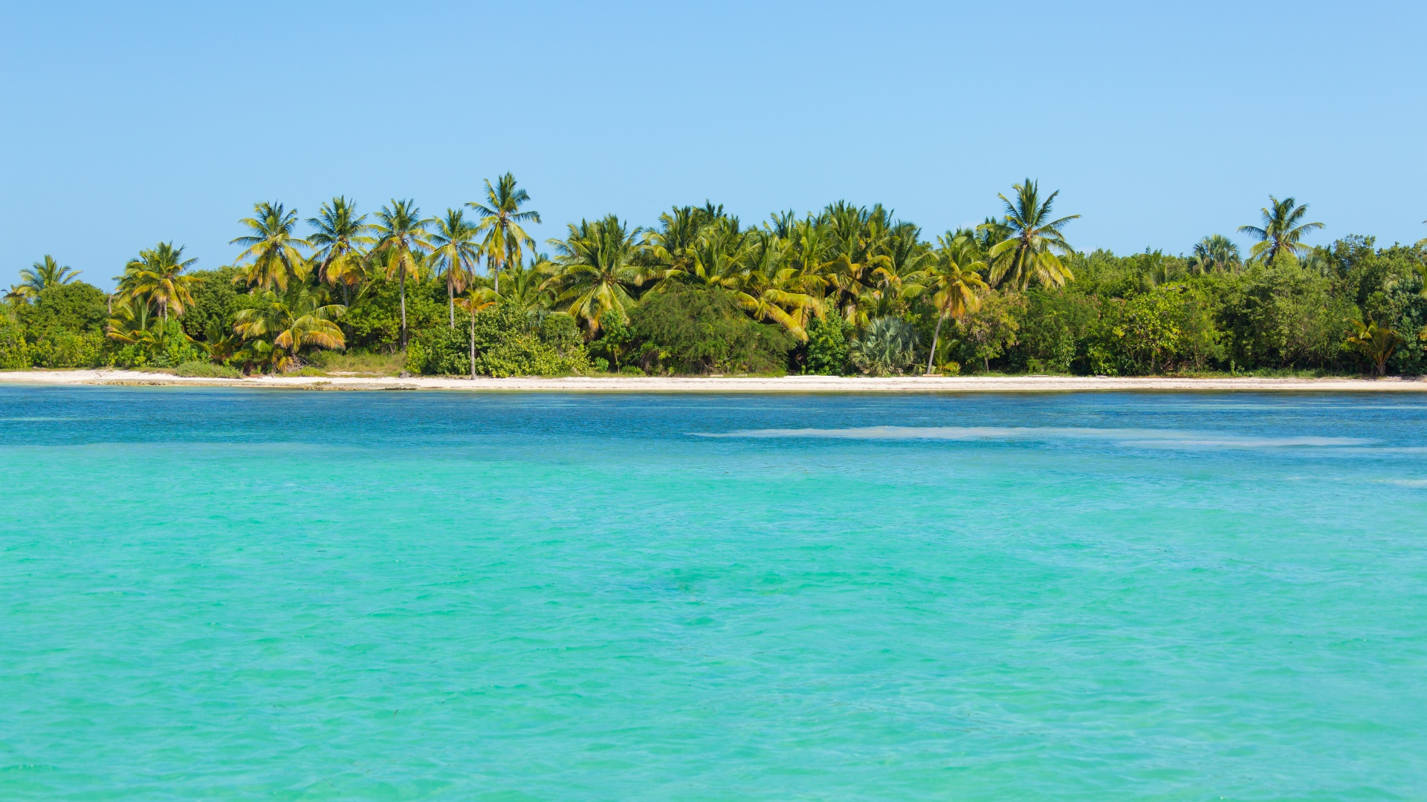
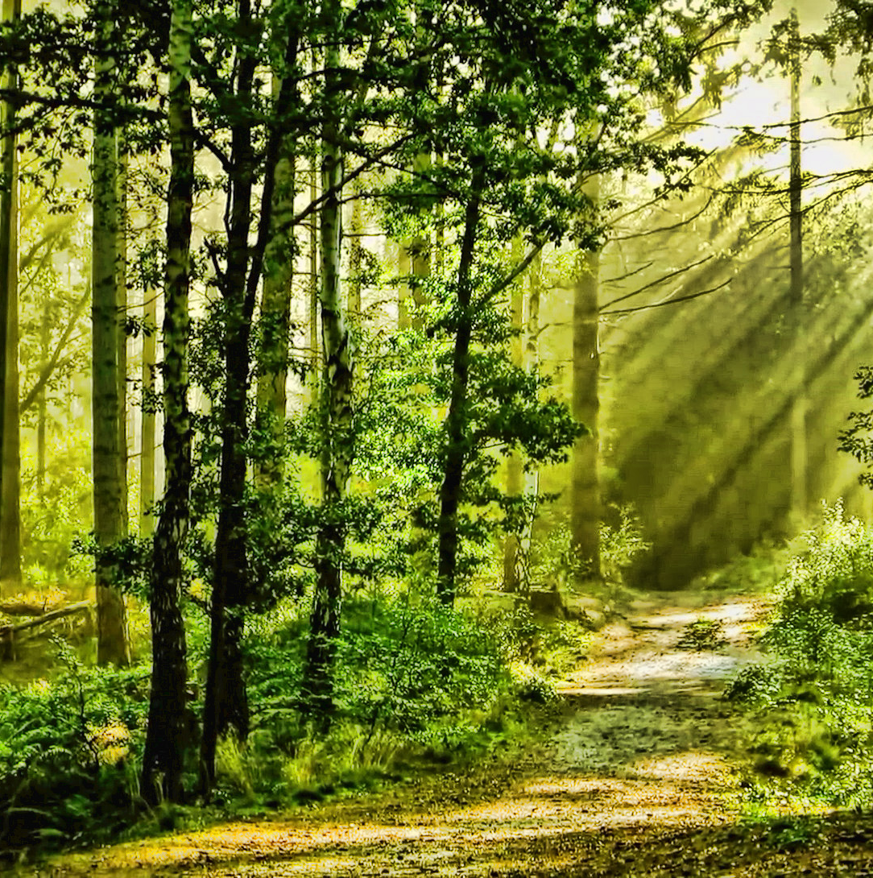
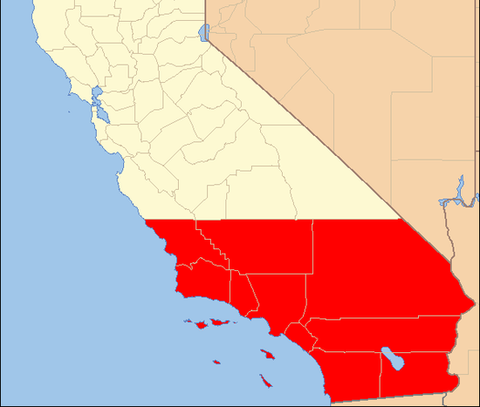
Location
The Gabrielinos lived in the southern part of California. The Gabrielino tribe lived along the coast. They also lived inland near the forest. The coast and the forest both had climate that was mild, not too hot or not too cold.
This Photo by Unknown author is licensed under CC BY.
This Photo by Unknown author is licensed under CC BY-SA.

Slide 3
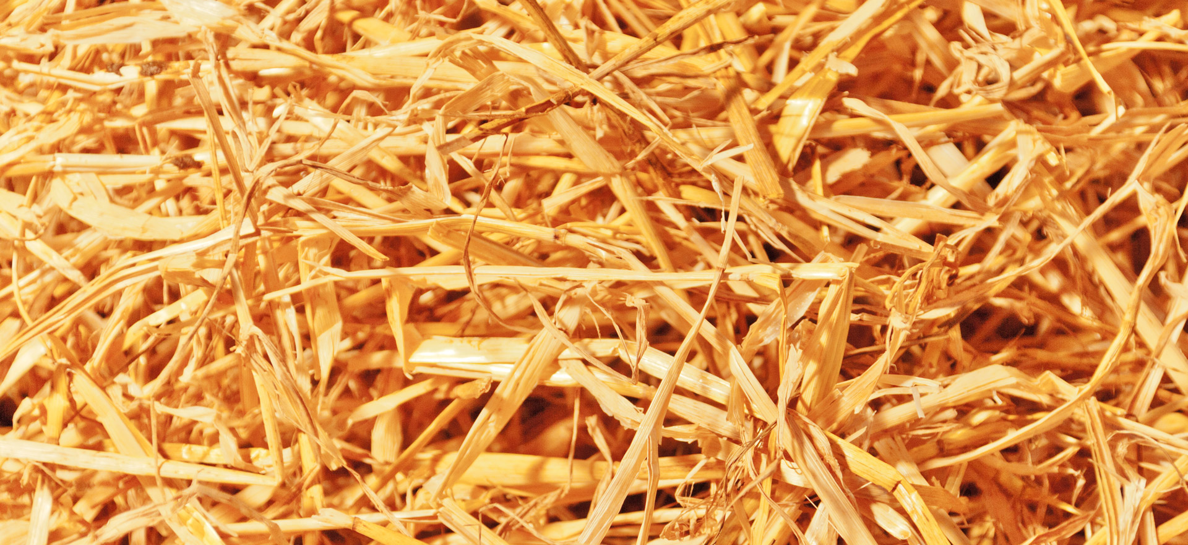
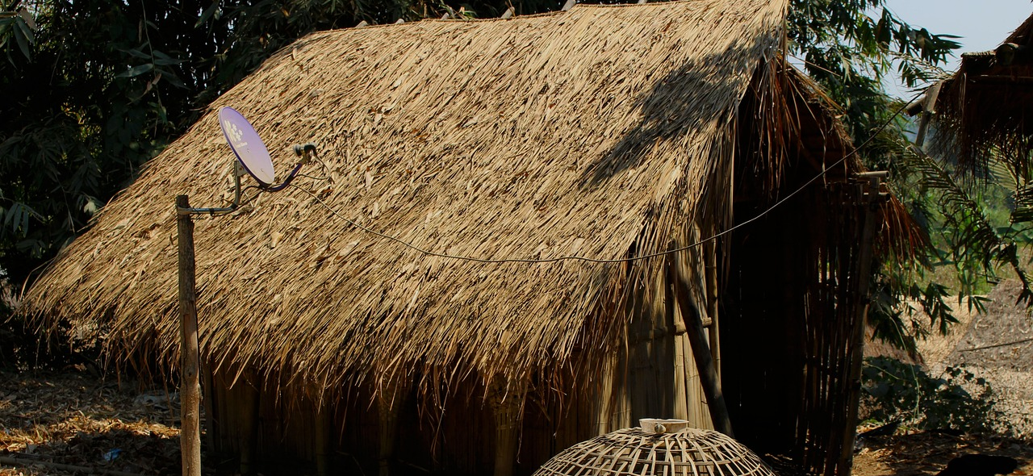
Shelter
Gabrielino's homes were made by placing poles upright and covering them with straw.
The shape was a round like a dome.
They were big enough to fit 50 or 60 people.

Slide 4
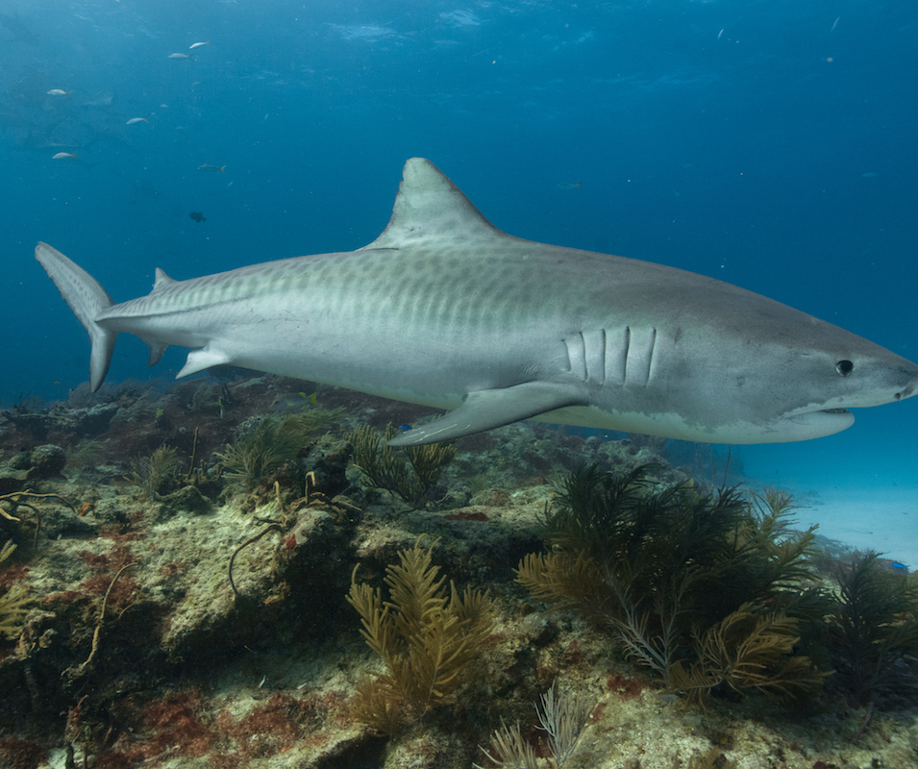
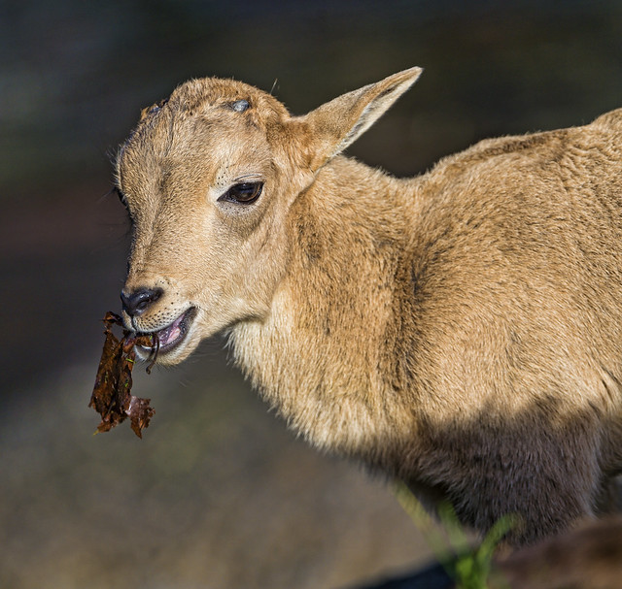
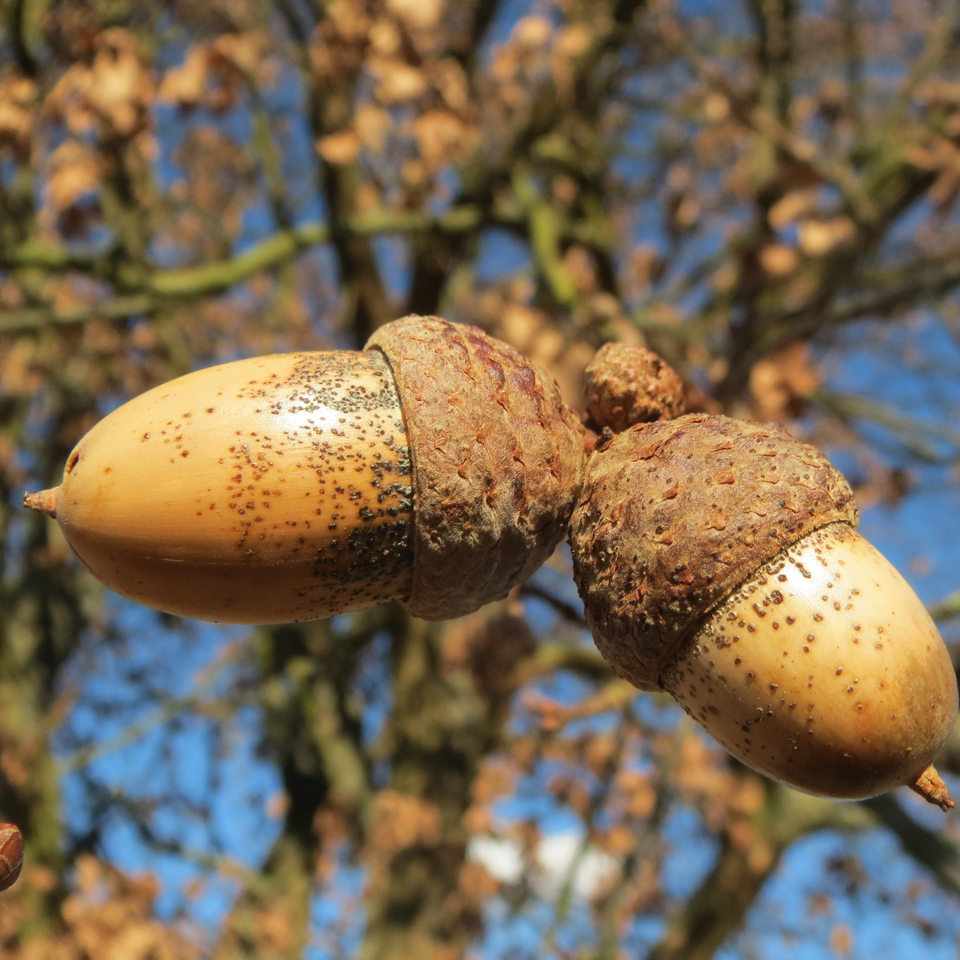
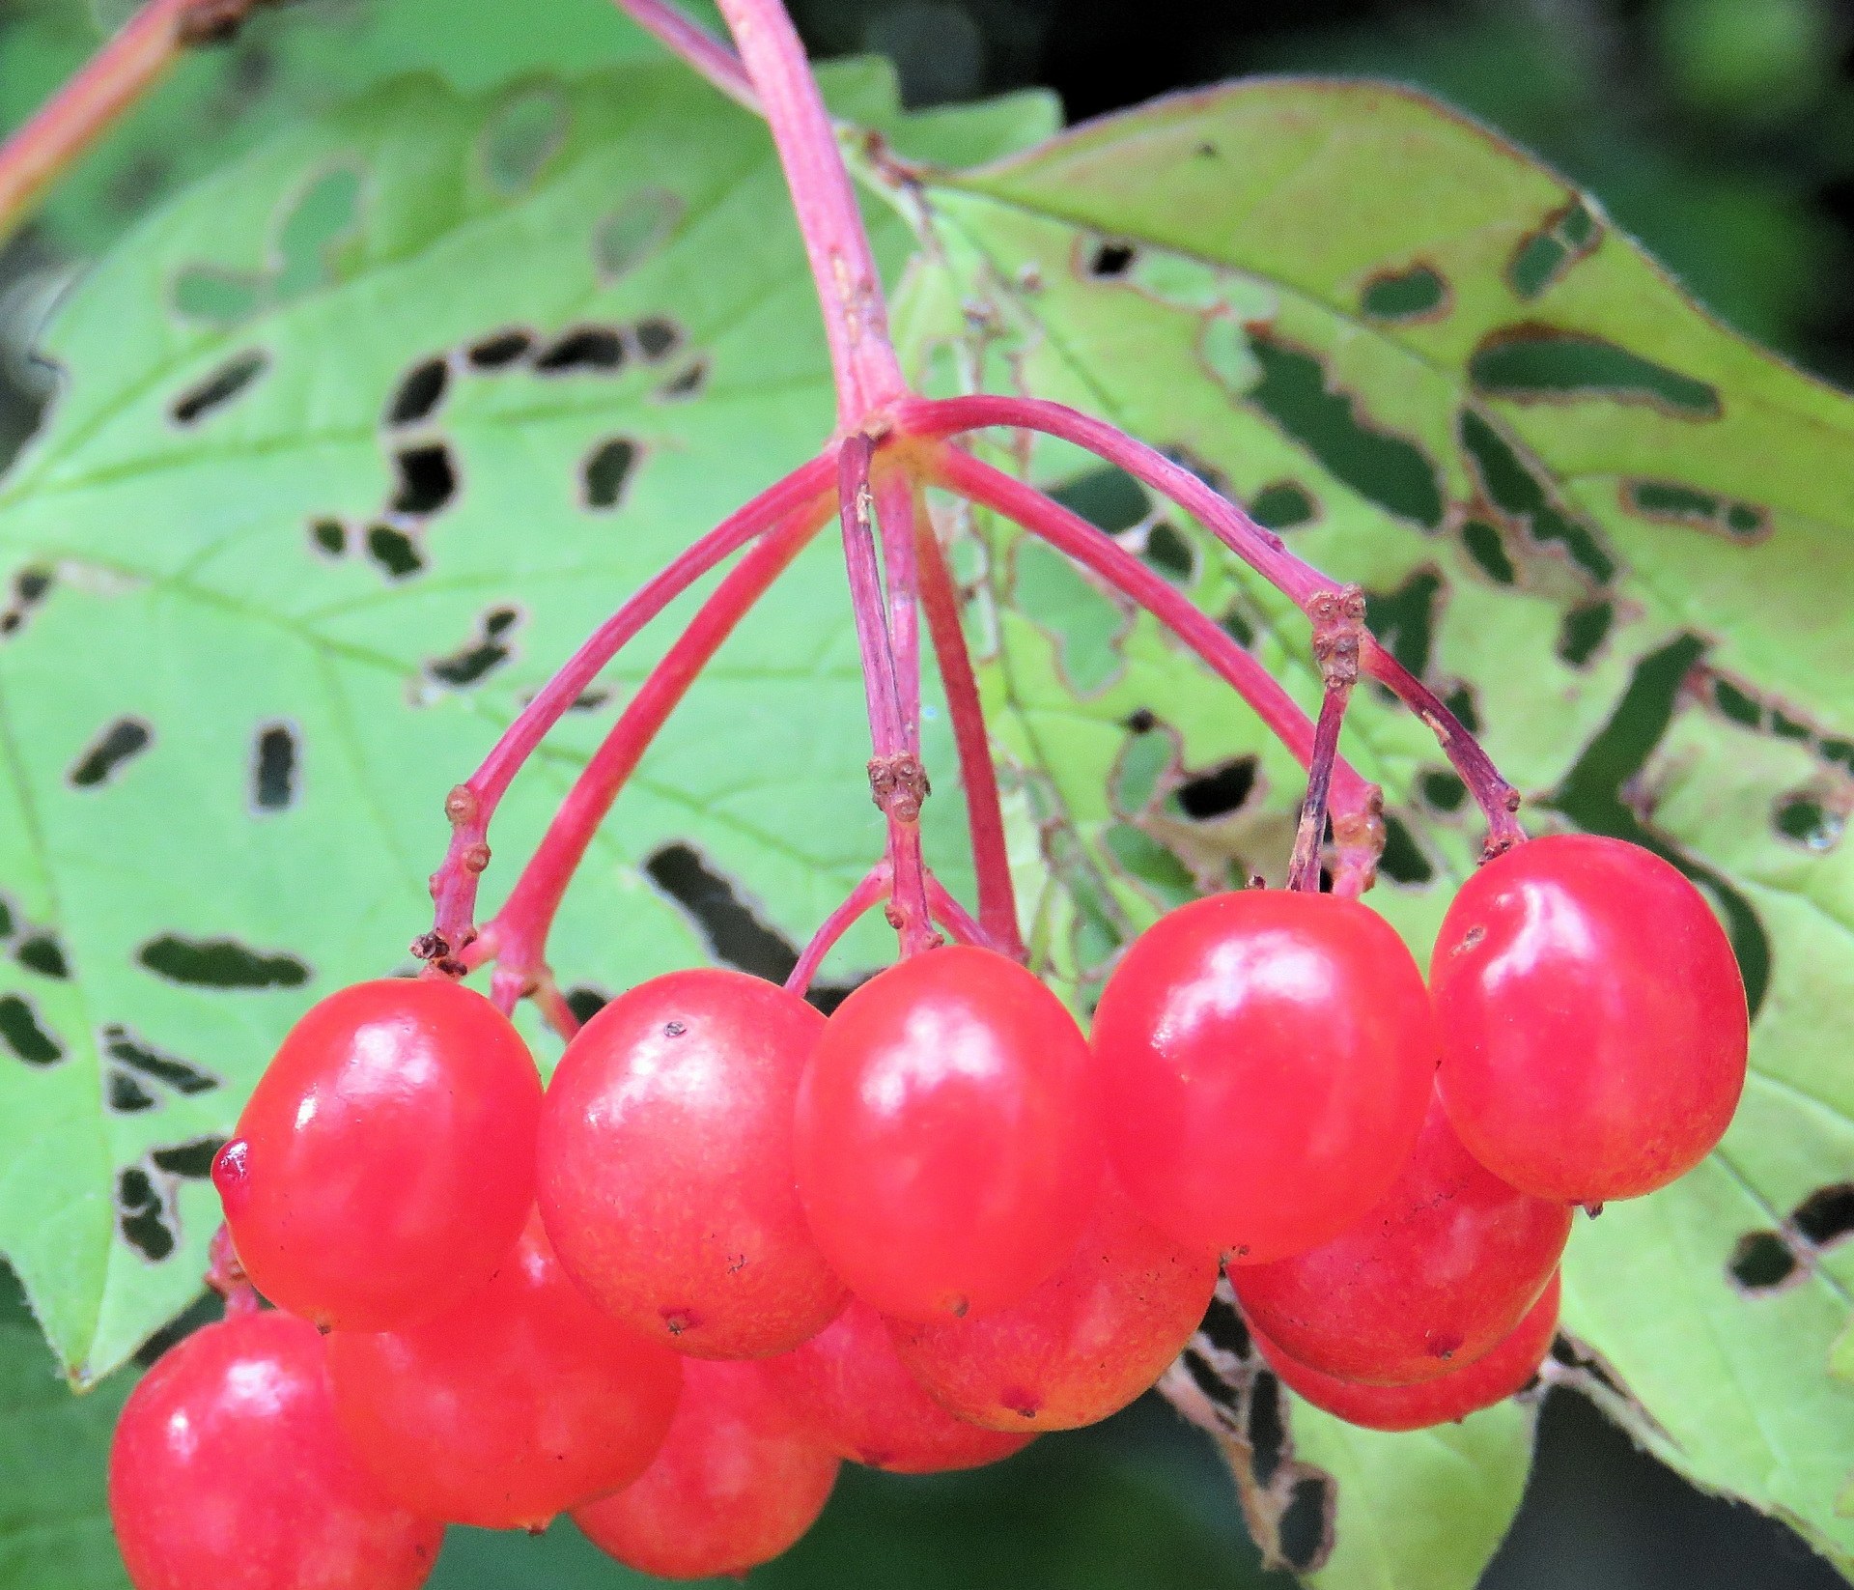
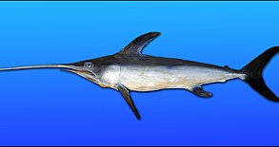
Food
The Gabrielino ate things from the water and land. From the water they ate tuna, sharks, and swordfish. From the land they ate pinon nuts, acorns, young shoots, and berries.
This Photo by Unknown author is licensed under CC BY-SA.
This Photo by Unknown author is licensed under CC BY-ND.
This Photo by Unknown author is licensed under CC BY-ND.

Slide 5
Culture
The Gabrielino had many ceremonies but the main one was in the fall. This ceremony was held to remember everyone that died during the year. They celebrated for seven days by dancing, singing, and eating. The ceremonies were held in an oval area called a yuvar.
This Photo by Unknown author is licensed under CC BY-NC.

Slide 6
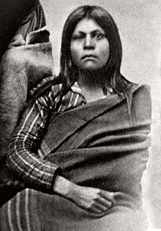
.

Slide 7
Tools
The Gabrielino tribe used tools to help them survive , eat ,and hunt.
er CC BY.

Slide 8
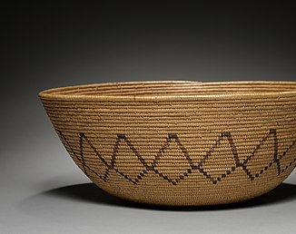
Baskets
The Gabrielino tribe used baskets to carry food seeds and rocks the baskets come in handy.

Slide 9
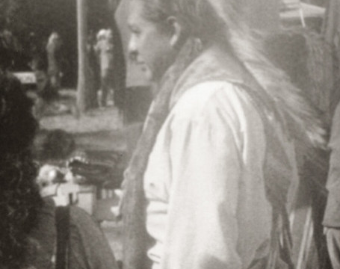
Gabrielino people
If you don’t know what Gabrielino people look this is how they look.

