Slide 1
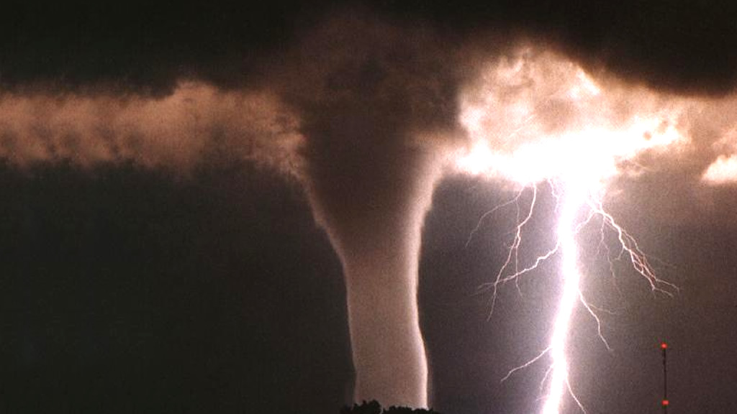
Weather and Climate
By: Vincent and Greidys
This Photo by Unknown author is licensed under CC BY-SA.

Slide 2
Tropical Climate Zone
Has swamps
Hot all year
Temperature is between 80 – 90 degrees
Has two seasons – the wet and dry season
Rains about 300 inches a year
Lots of plants
Located around the equator
This Photo by Unknown author is licensed under CC BY-SA.

Slide 3
Temperate Climate Zone
Not too hot or cold
Has four seasons
Far from the equator
Mild climates
Widest seasonal changes
Divided in smaller climate zones
This Photo by Unknown author is licensed under CC BY-SA.

Slide 4
Desert Climate Zone
Hot
Dry
Cold in winter
Highest temperate on Earth
Rivers in the desert
Covers 14.2 % of land
Desert covers Arizona, Nevada, Utah, and Colorado in the USA
This Photo by Unknown author is licensed under CC BY-SA.

Slide 5
Polar Climate Zone
In summers the sun shines all day
Plants don't grow there
Winters are dark there
There is snow and ice
Very cold
Covers the North Pole and the South Pole
Gets lots of snow

Slide 6
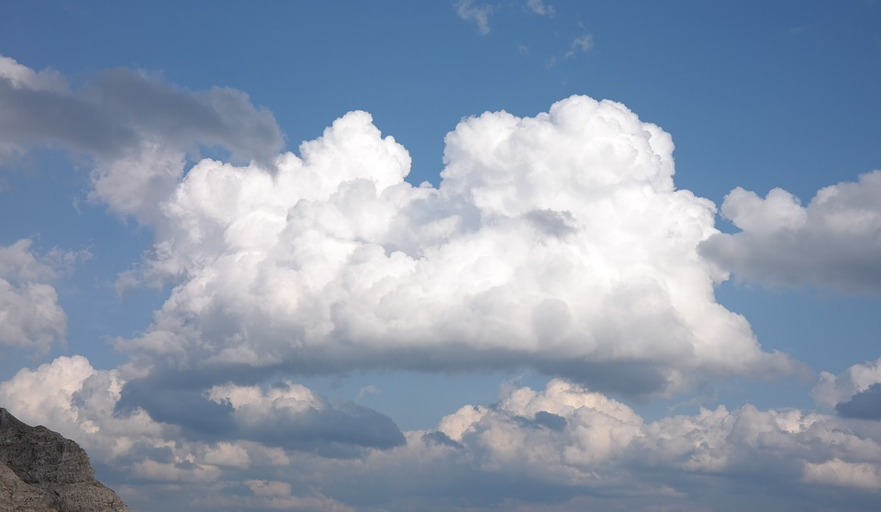
Cumulus Clouds
Large piles of clouds
It is fluffy
Has nice weather
Contains no storm
Looks like cotton candy
Only appears in fair weather
It could change

Slide 7
Cumulonimbus Clouds
Dark towering clouds
Known as thunder clouds
Brings lightning
Storm last under an hour
Not that rare
Really tall
This Photo by Unknown author is licensed under CC BY-SA.

Slide 8
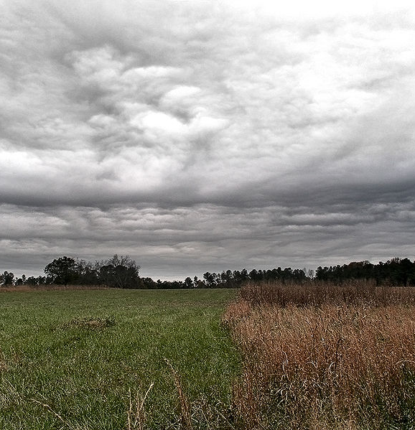
Stratus Clouds
Covers the sky
Spread out
Brings no storm
Makes gloomy skies
Cloud can change
They're a sign of rain
This Photo by Unknown author is licensed under CC BY-SA.

Slide 9
Stratonimbus Clouds
Sheets of gray dark clouds
Bring rain or snow
They're under 5,000 feet in the sky
It is not a thunder cloud
Rain could last all day
It covers the whole sky
This Photo by Unknown author is licensed under CC BY-SA.

Slide 10
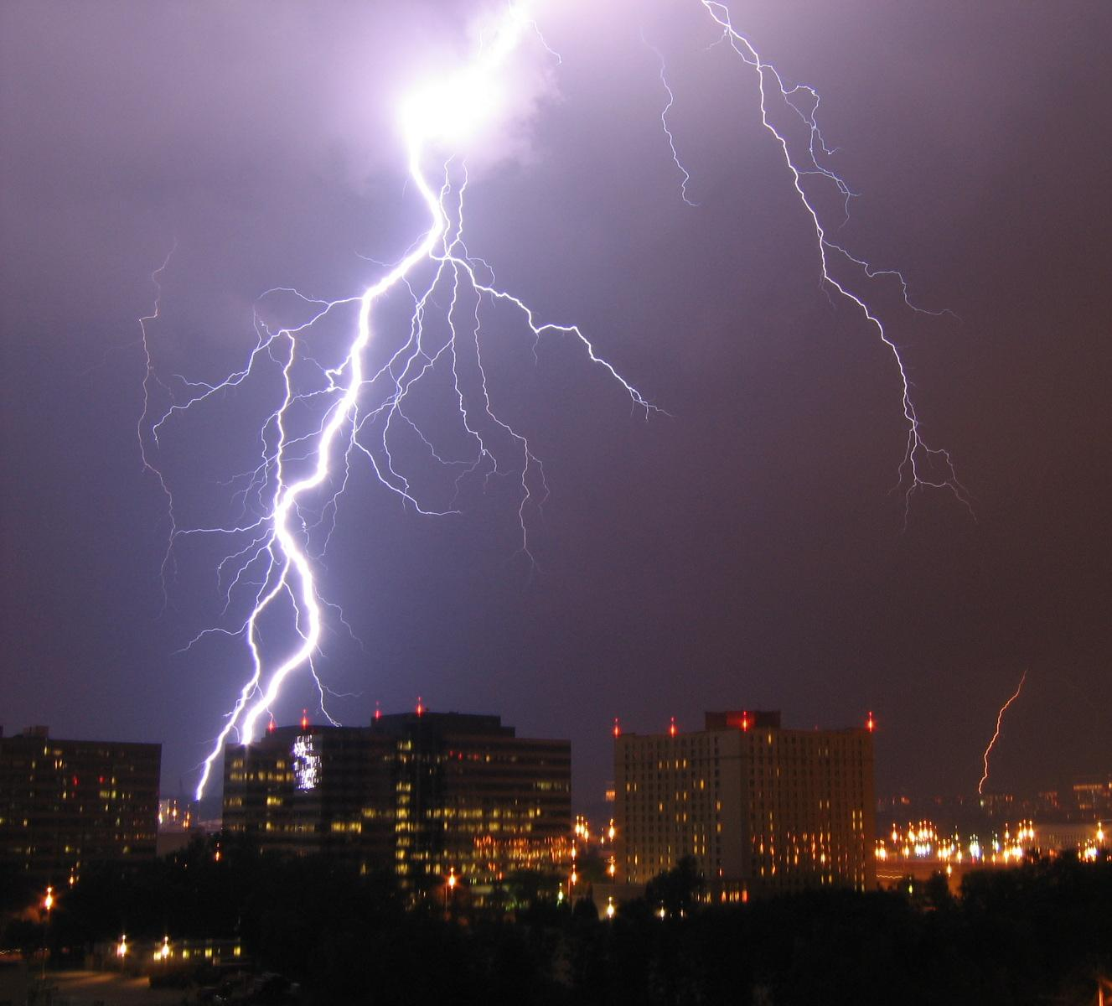
Extreme Weather –Lightning storms
It is an electrical storm.
Also known as a thunder shower
Affects Earth's atmosphere
This Photo by Unknown author is licensed under CC BY-SA.

Slide 11
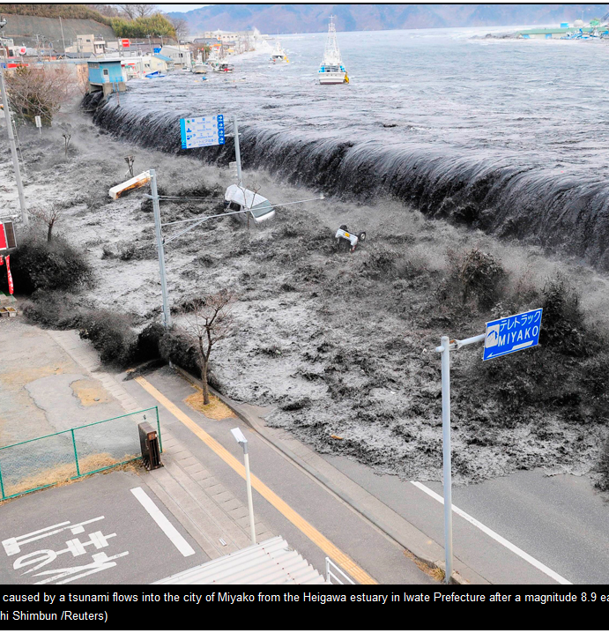
Extreme Weather -Tsunami
A big sea wave.
It is generated by the displacement of water.
Causes earthquakes and eruptions.
Generated by the moon and the sun.
It is not a normal wave.
It is a series of waves of a water body.
They are caused by the shifts in the ocean bottom.
This Photo by Unknown author is licensed under CC BY.

Slide 12
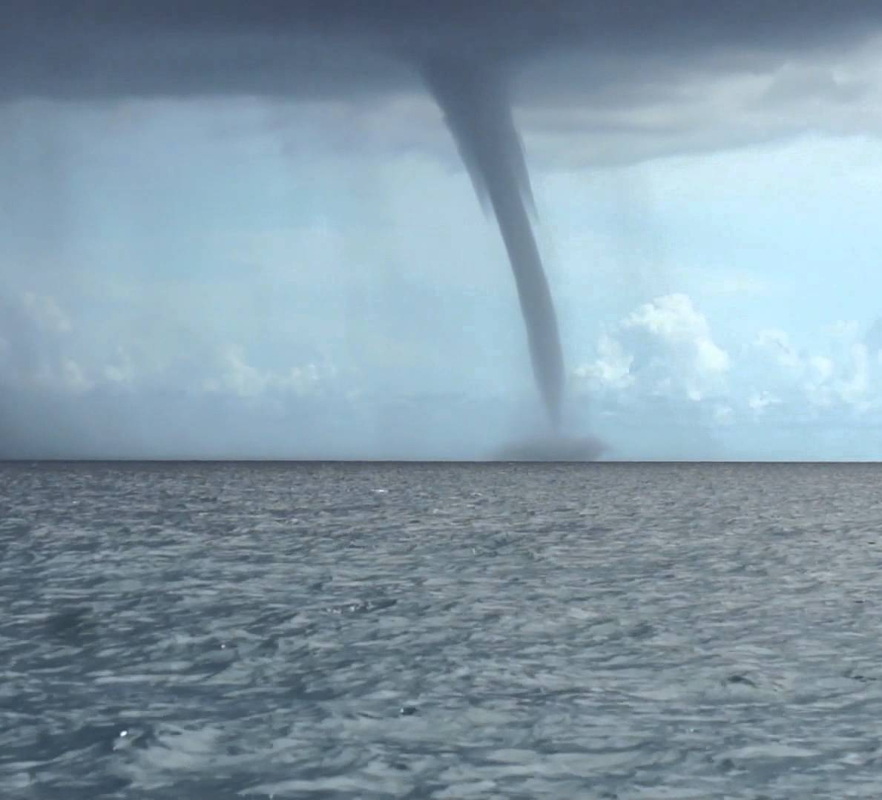
Tornadoes
Wind could go over 200 miles per hour
Involves thunder inside
Occurs over land
Some tornadoes could be weak
This Photo by Unknown author is licensed under CC BY-SA-NC.

Slide 13
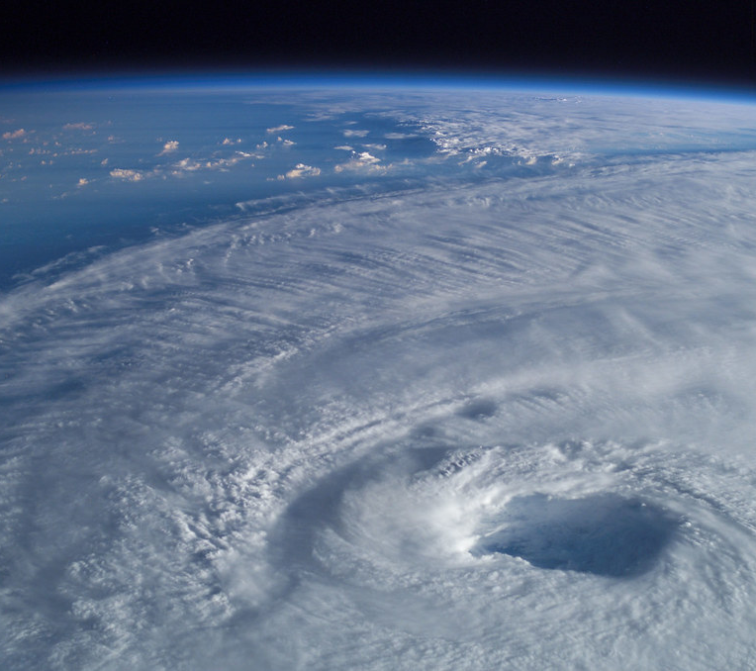
Hurricanes
Starts over large bodies of water.
Could cause floods
It can take over more than 75 miles.
It’s a big storm.
This Photo by Unknown author is licensed under CC BY.

Slide 14
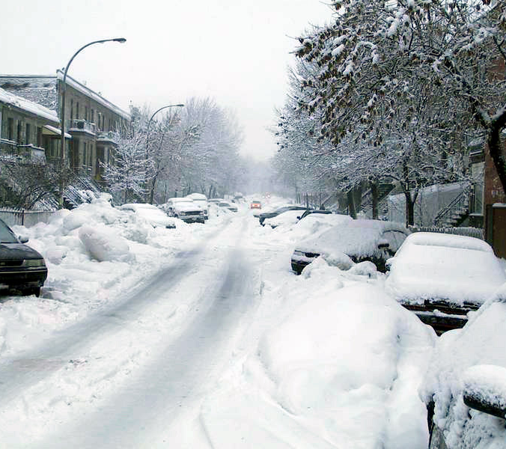
Extreme Weather Blizzards
Brings lots of snow
It brings lots of snow on cars
Snow is very powerful
Snow blocks sidewalks and streets
It could make cars crash
It gives you frost bite
This Photo by Unknown author is licensed under CC BY-SA.
This Photo by Unknown author is licensed under CC BY-ND.

Slide 15
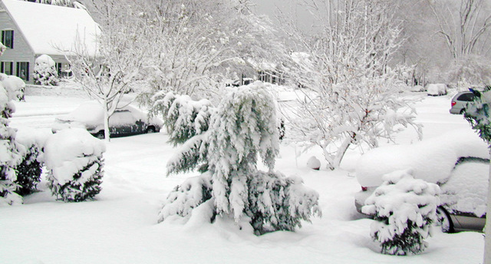
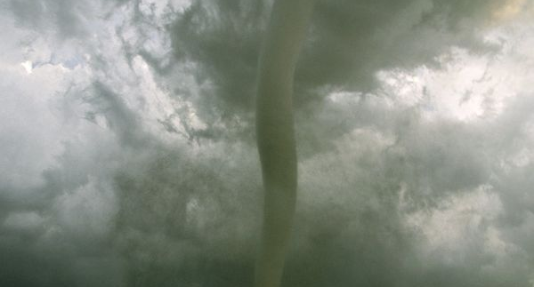
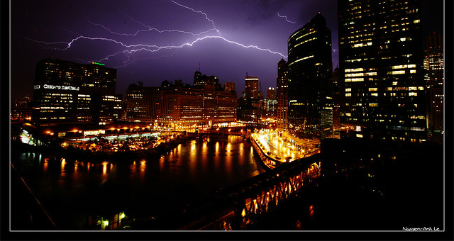
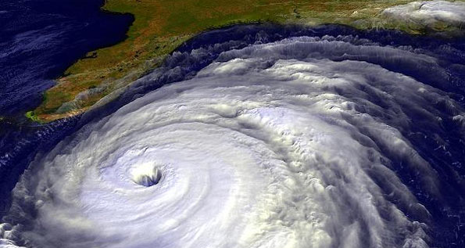
This Photo by Unknown author is licensed under CC BY-NC-ND.
This Photo by Unknown author is licensed under CC BY-SA-NC.
This Photo by Unknown author is licensed under CC BY-SA-NC.
This Photo by Unknown author is licensed under CC BY-SA.
This Photo by Unknown author is licensed under CC BY-SA.
This Photo by Unknown author is licensed under CC BY-NC-ND.

