Slide 1
The Pomo tribe
By : Ethan,Tenner,and Zuleyma

Slide 2
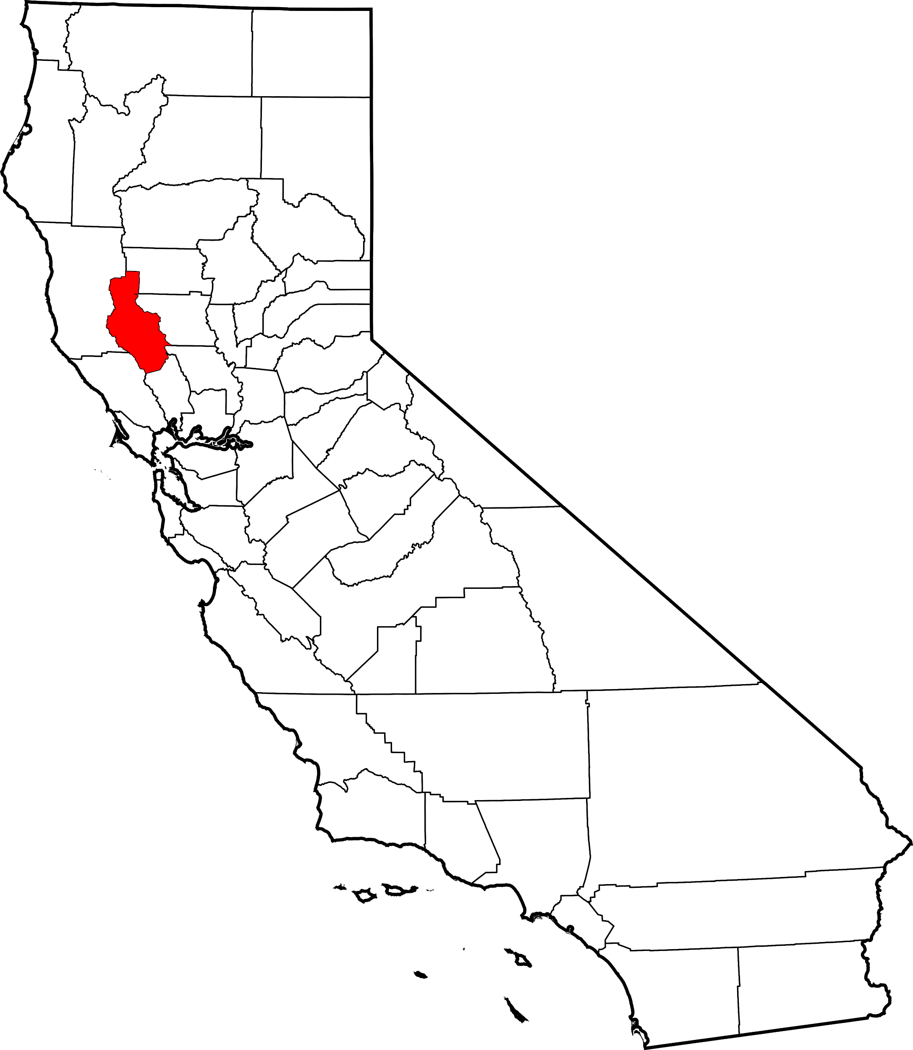
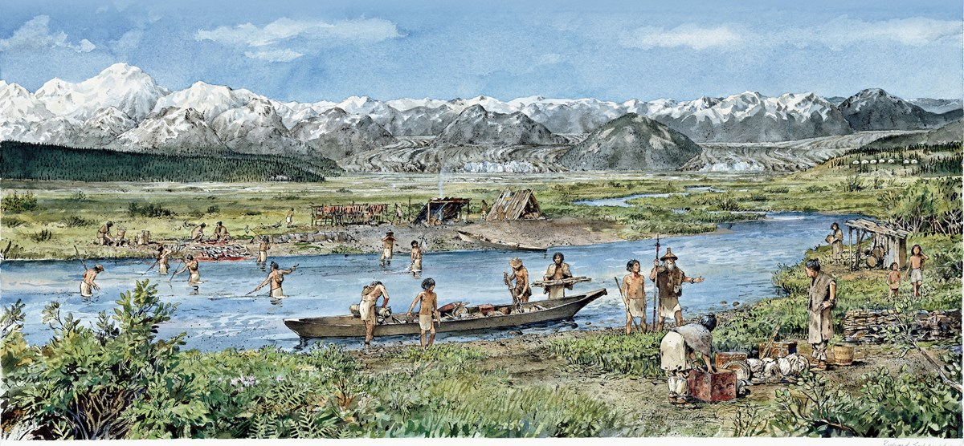
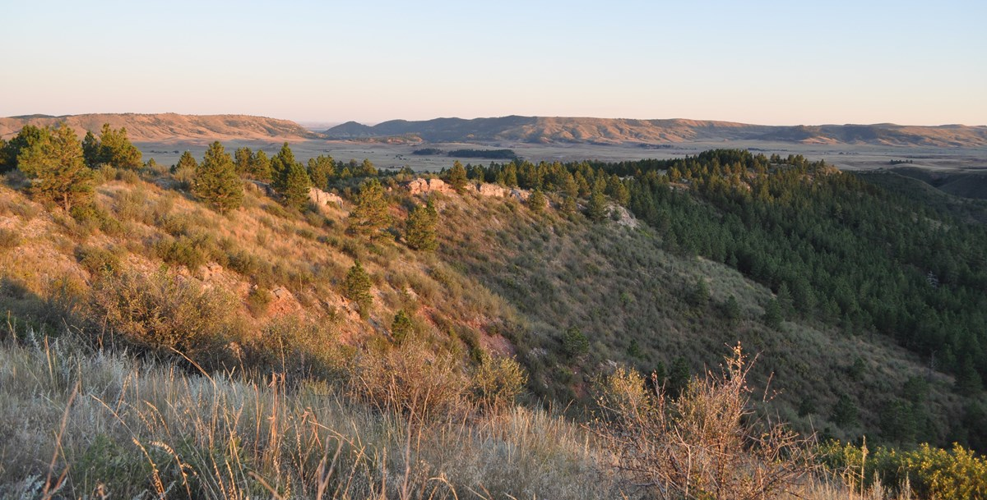
location
California’s Pomo Indians lived along the north-central coast what are today Mendocino, Sonoma, and Lake Counties. The climate is rainy season. They also live near the Pacific ocean.
Notes:
Write about the landforms, geographical location, and climate unique to the area.

Slide 3
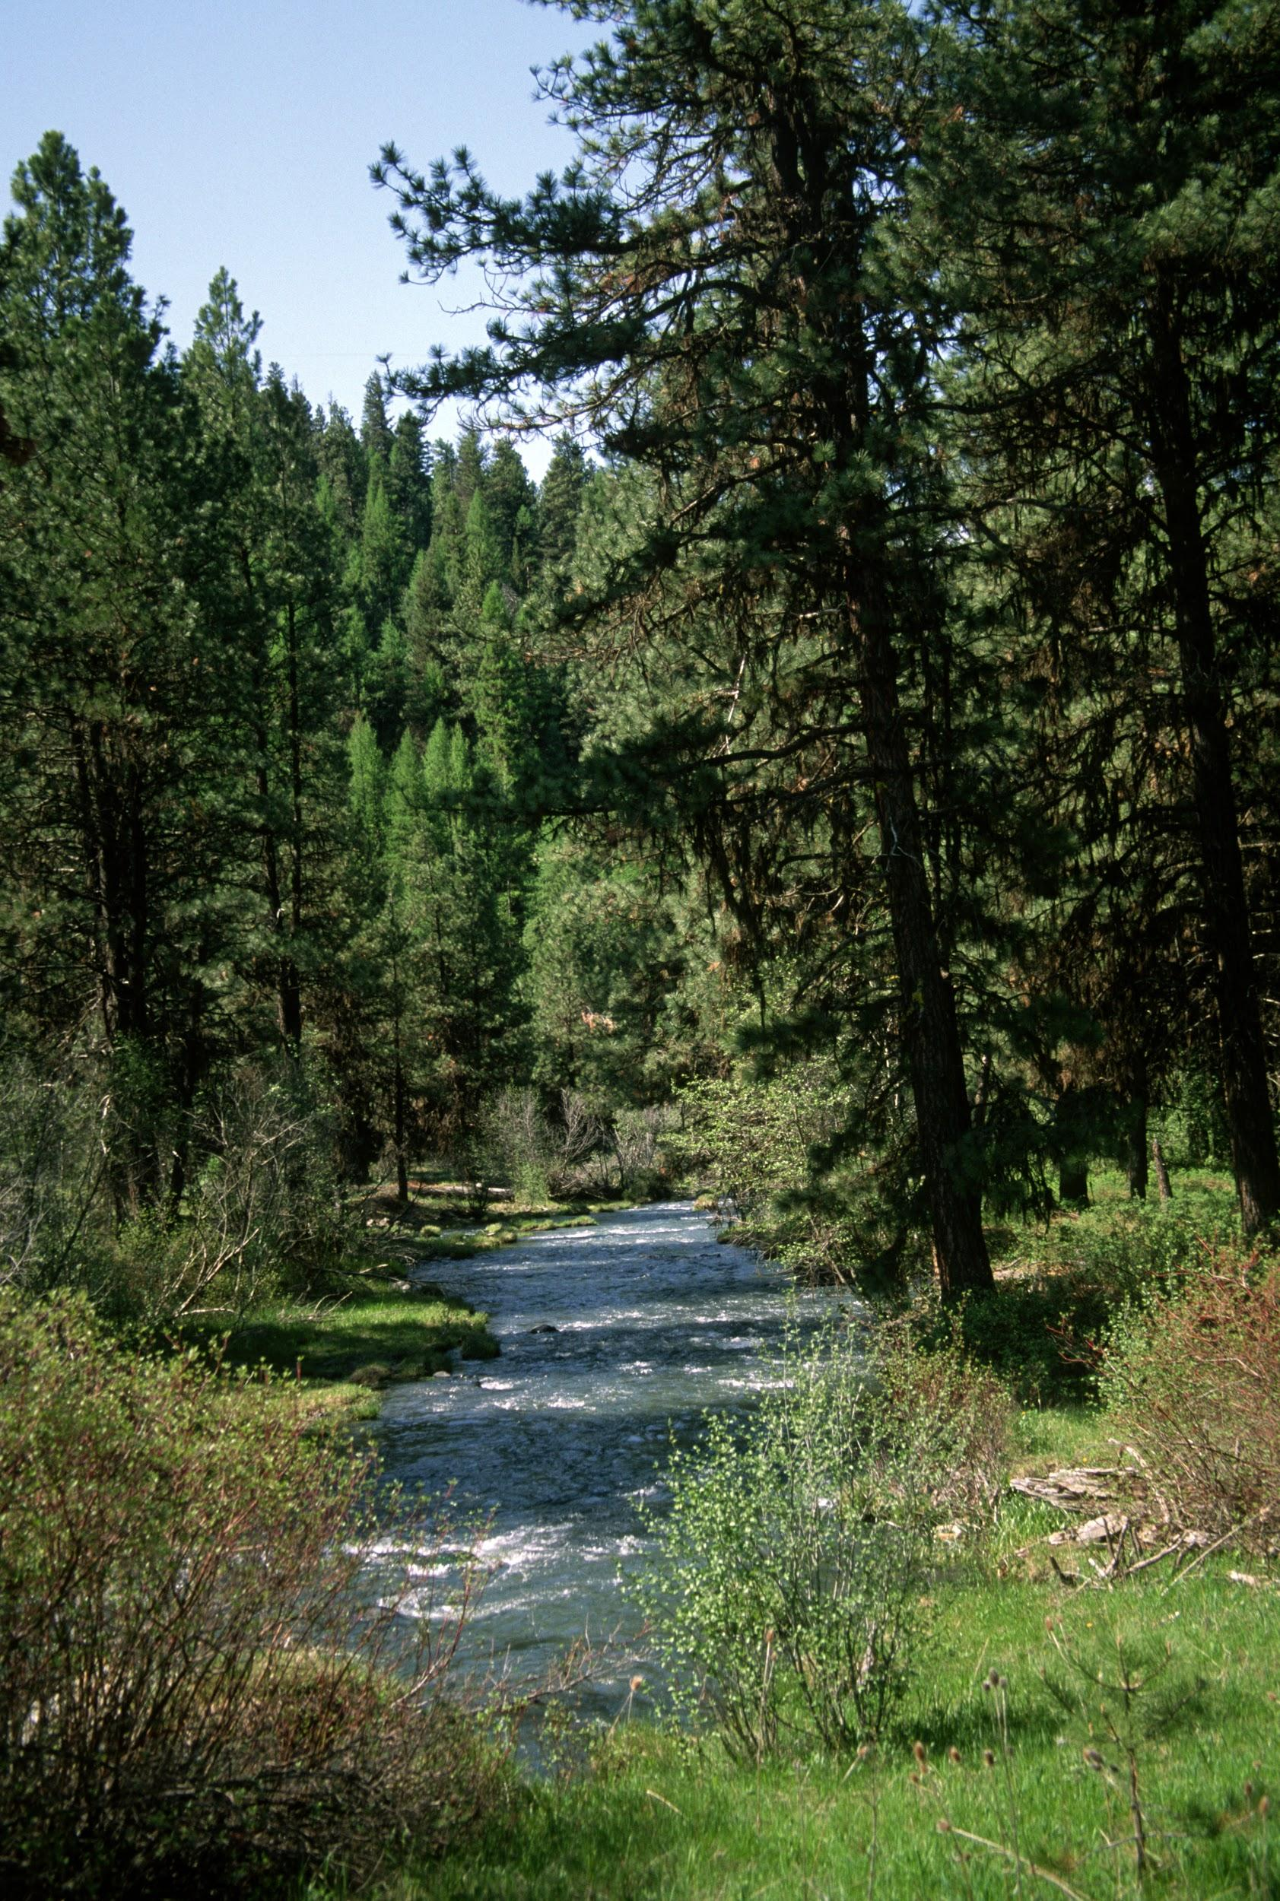
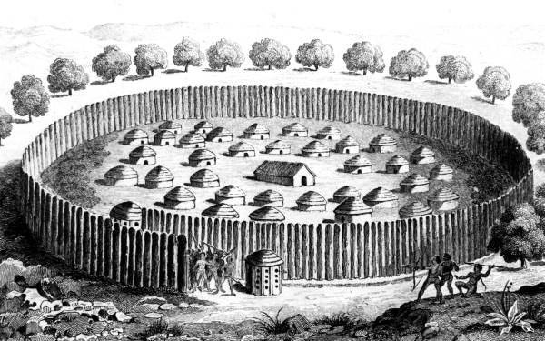
MORE INFORMATION ABOUT THE LOCATION OF THE POMO TRIBE.
.California Pomo indians lived Northern coastal
.The Pomo Indians had more than 70 villages
. The geography of their area is forests, rivers, rainy, mild climate.

Slide 4
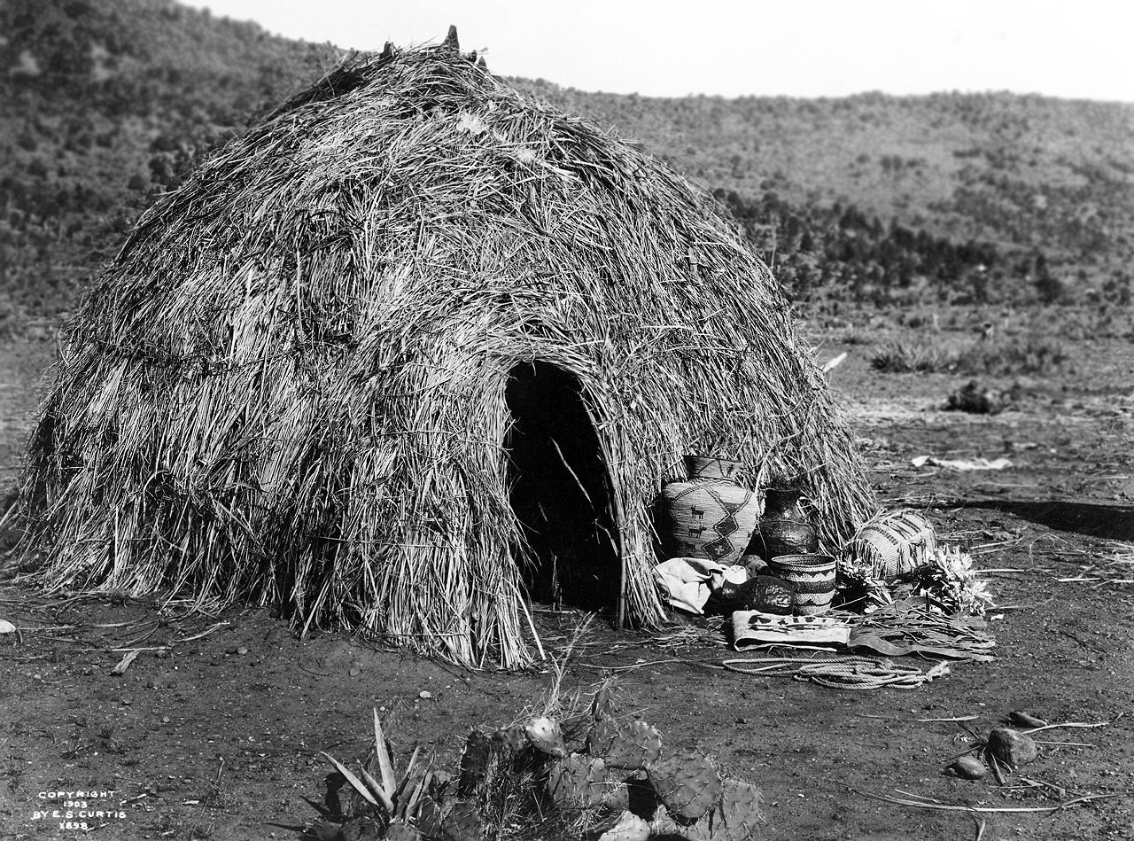
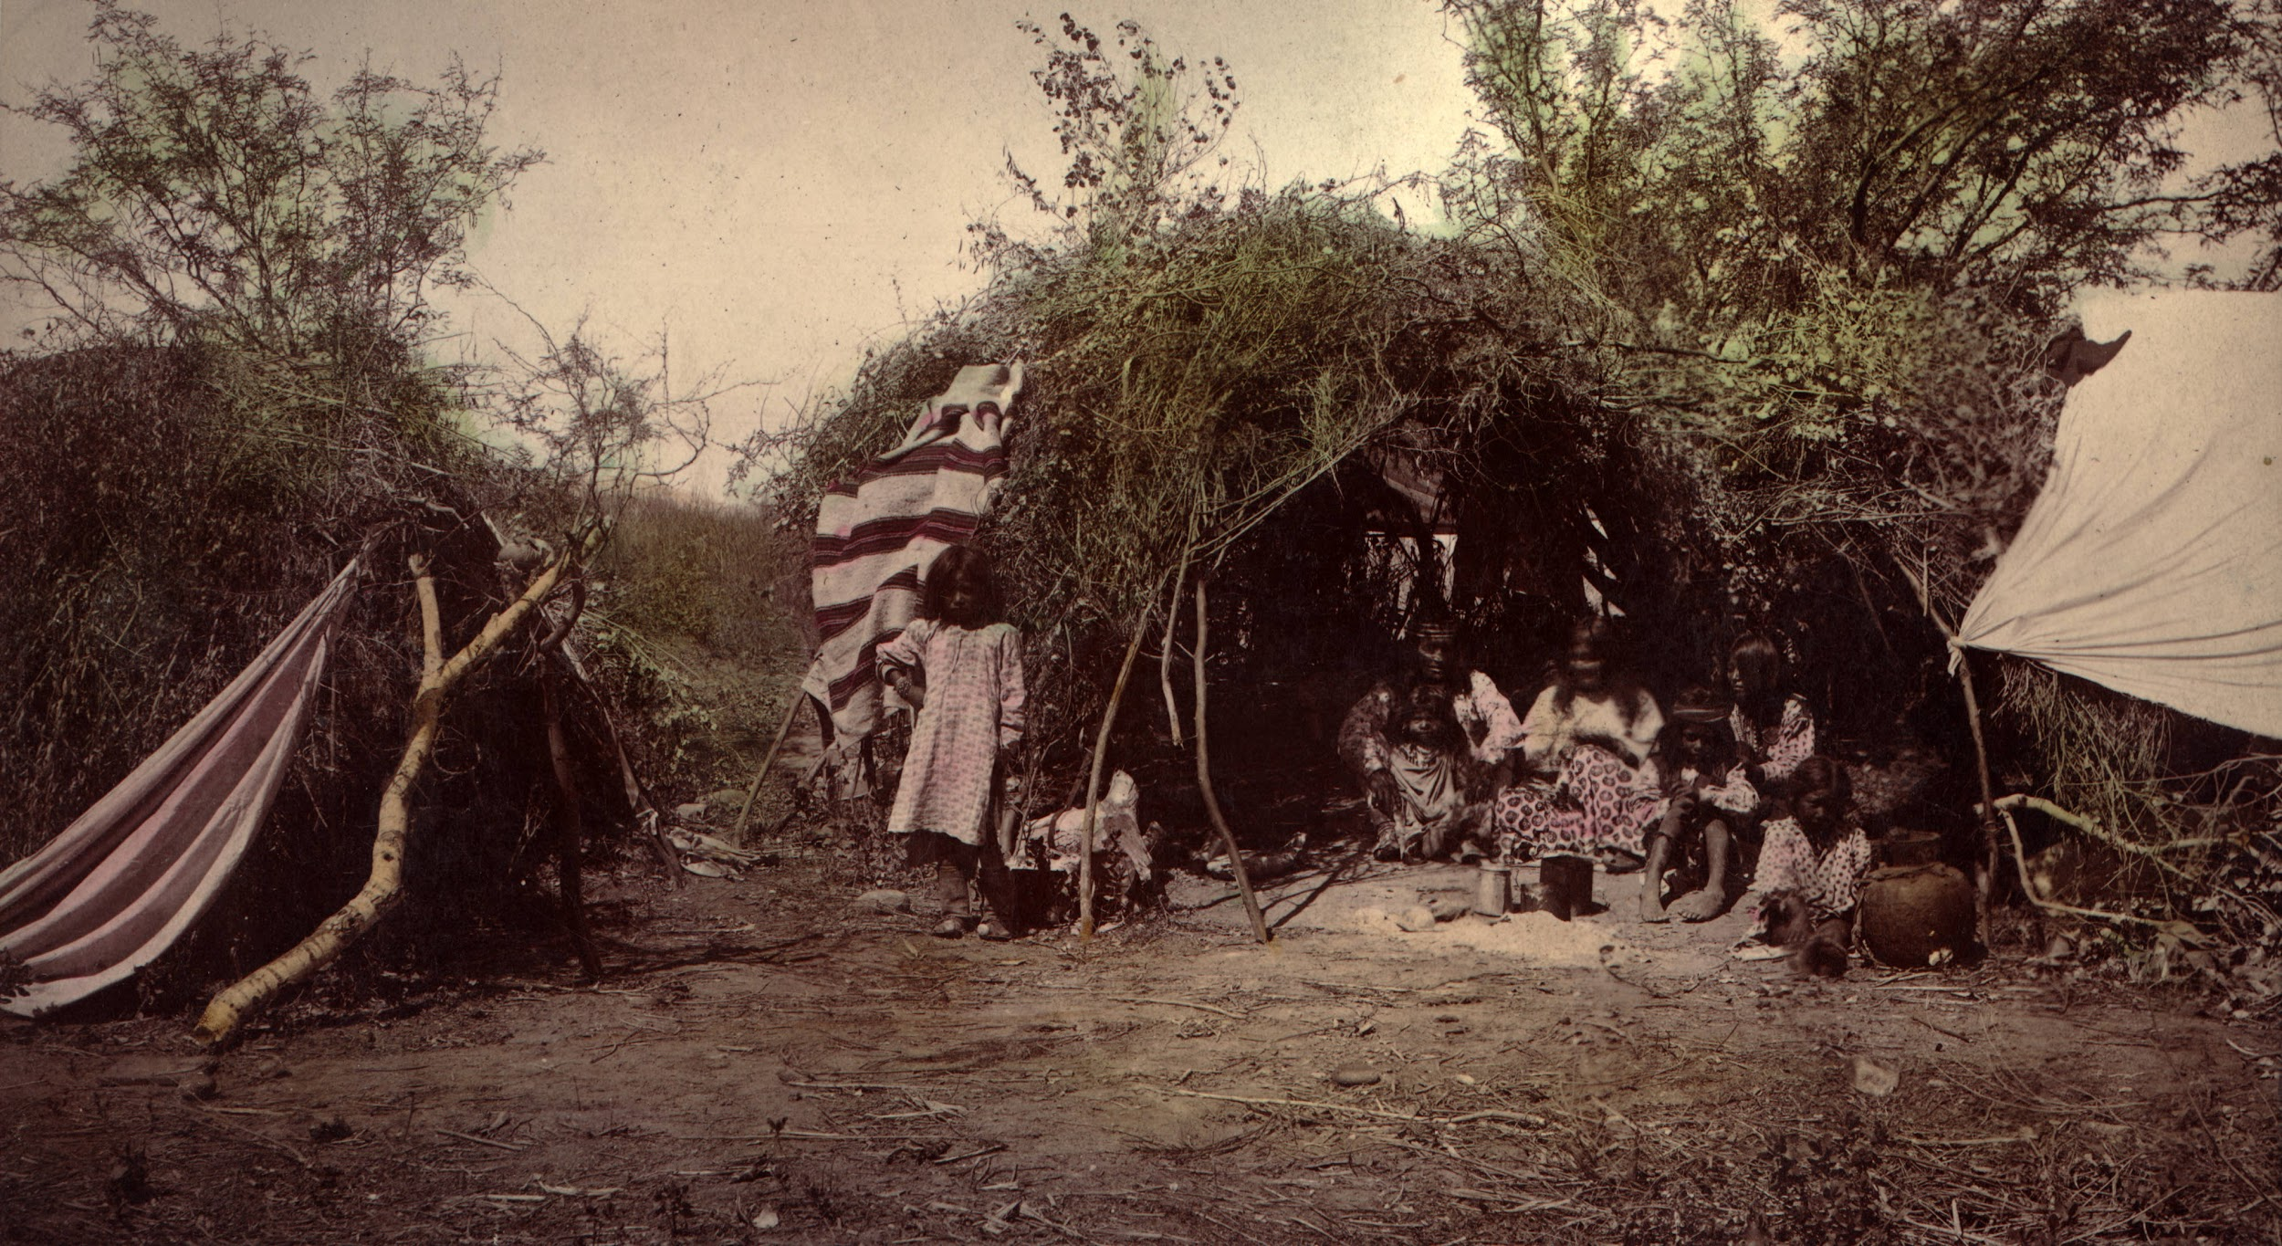
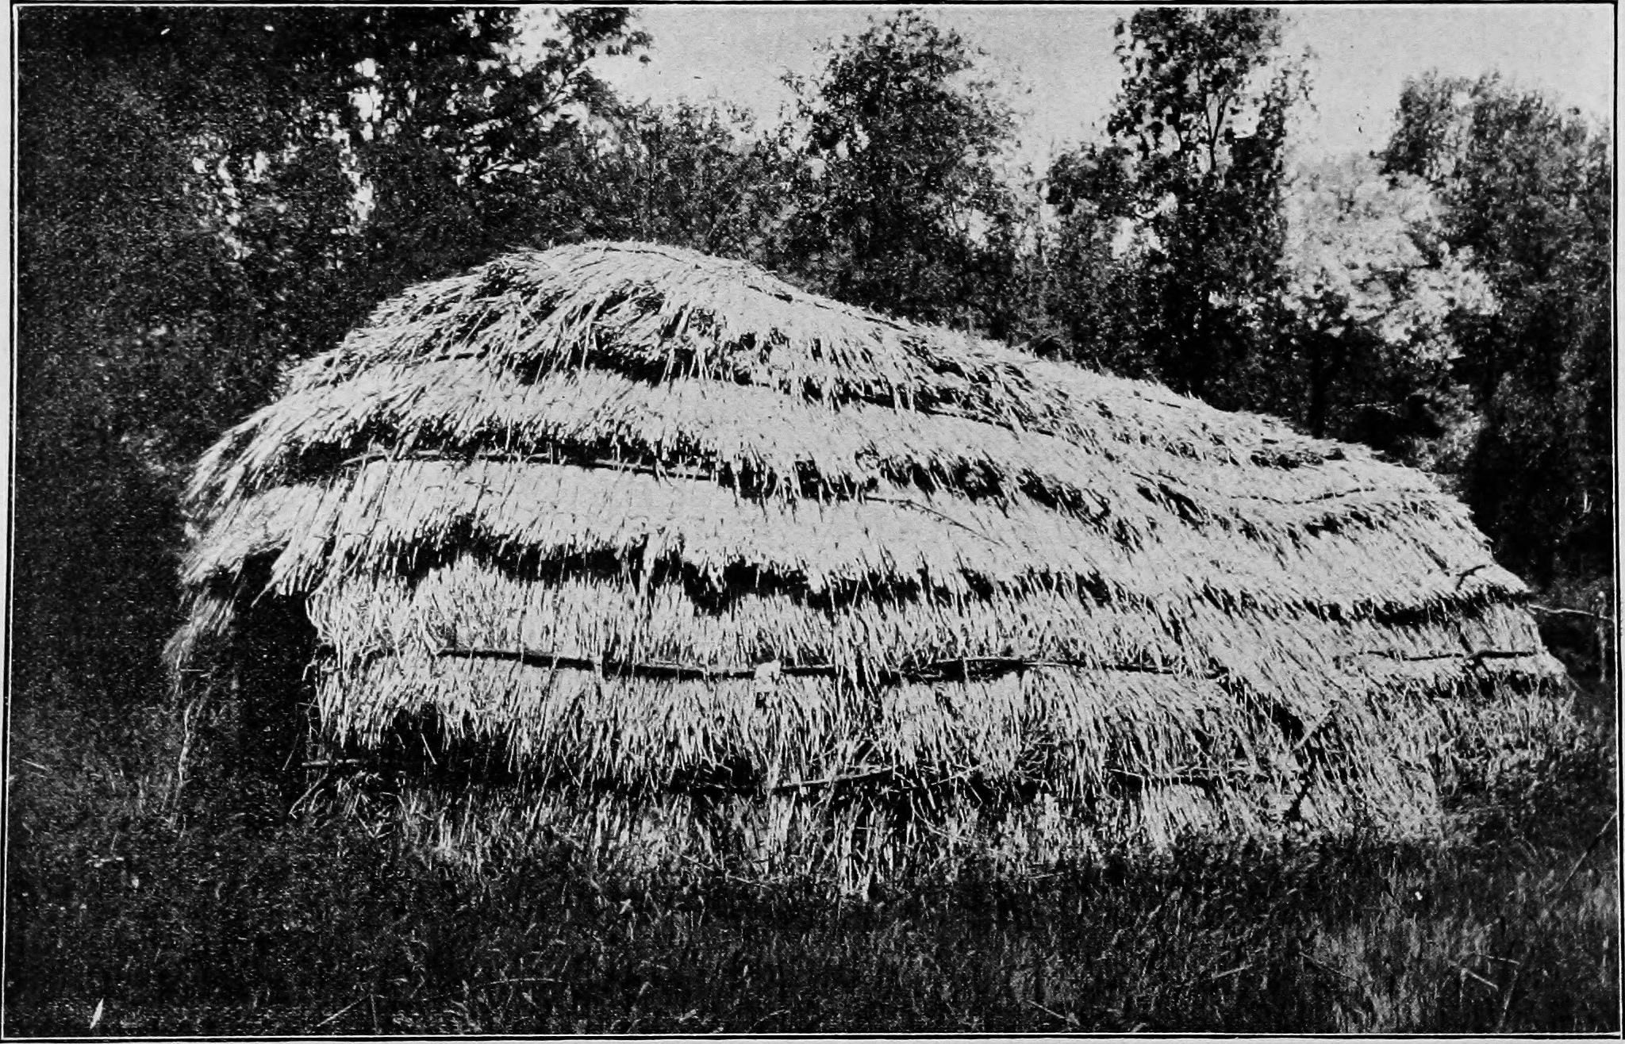
Shelter
There were lots of houses that the Pomo tribe built, depending on where the group lived. These houses were 8-15 feet tall. They could also use poles covered with slabs of redwood bark. Each community had a small, round house built over a hole dug in the ground.
Notes:
Write about the materials, shape, name, and unique features of the structure.

Slide 5
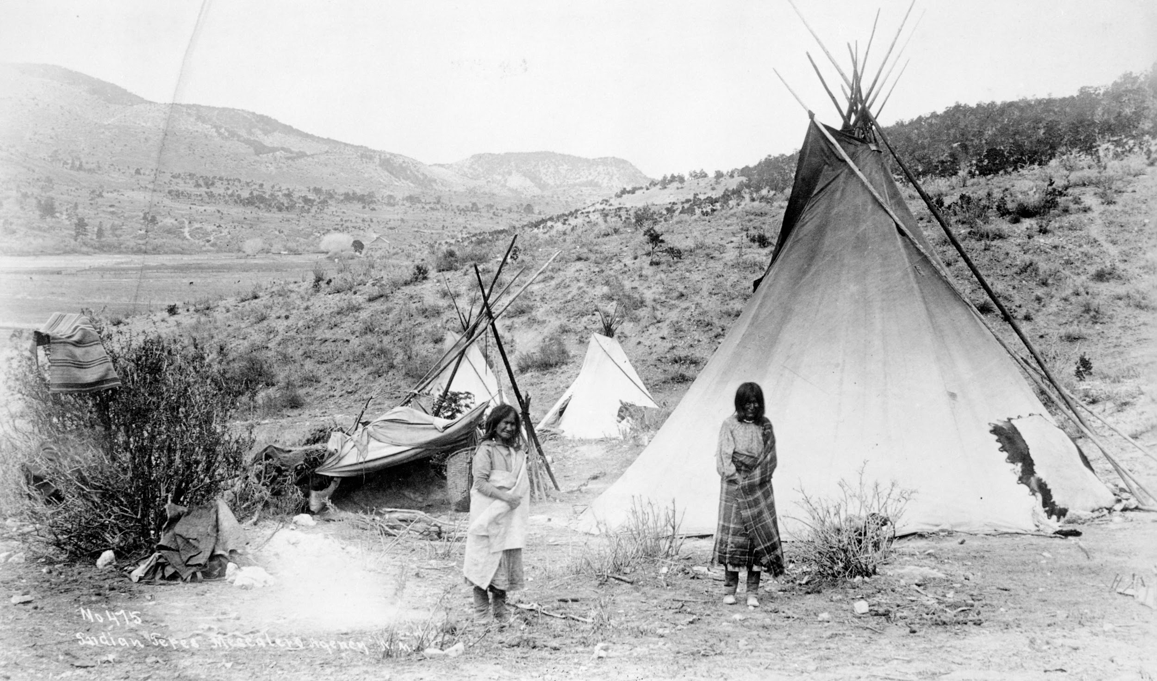
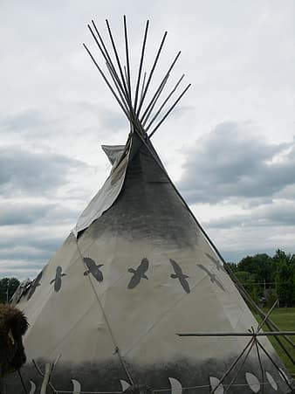
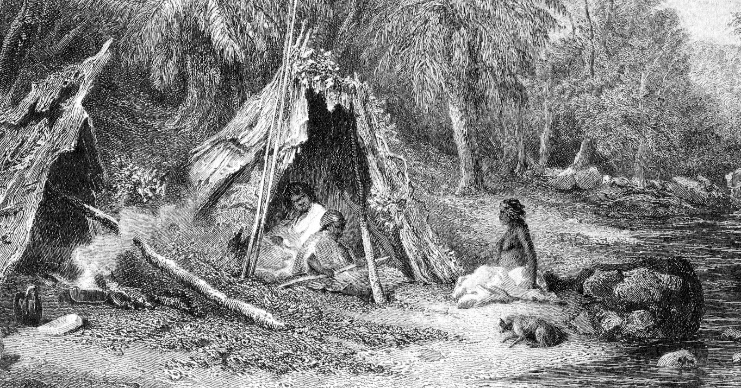
INFORMATION ABOUT TIPIS
Modern tipis usually have a canvas. Most often,American indians used buffalo hides for the tipis covers.
Tipis were the homes of nomadic tribes of the great plains..

Slide 6
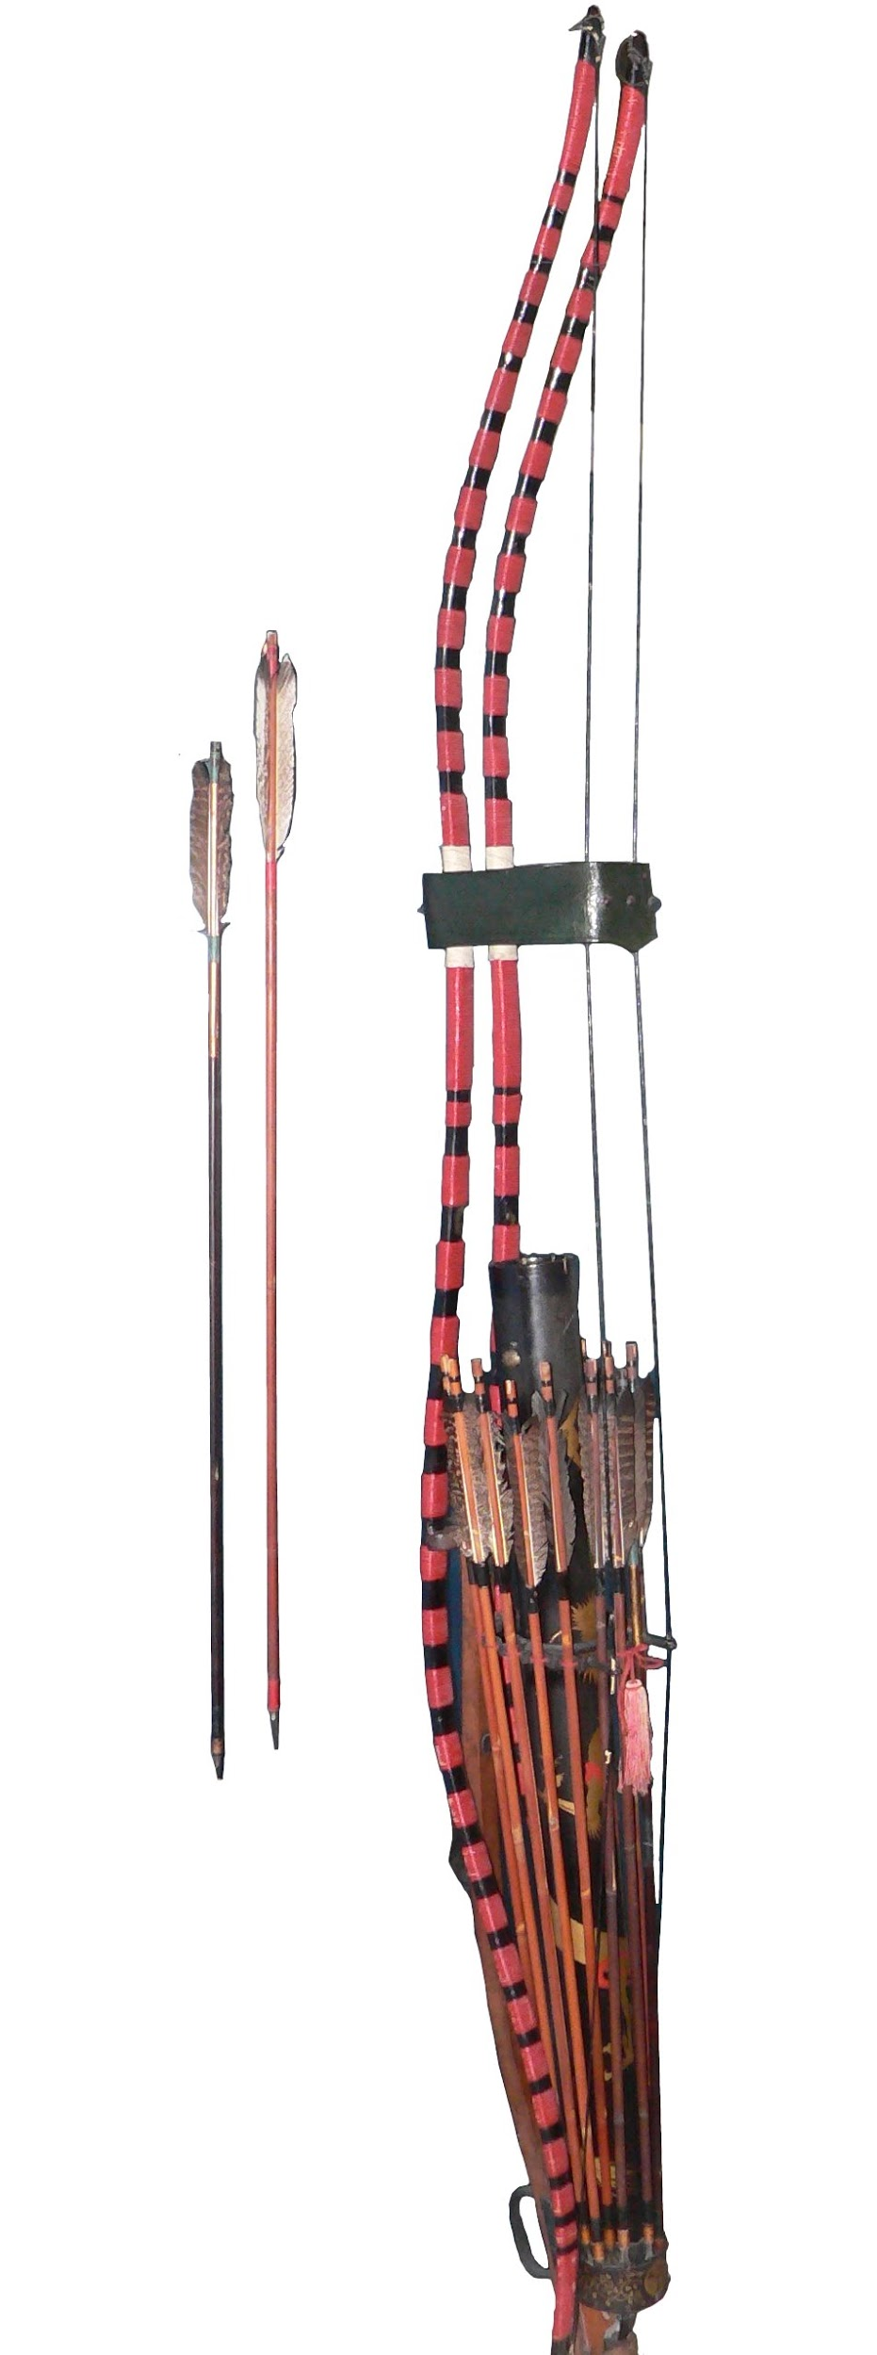
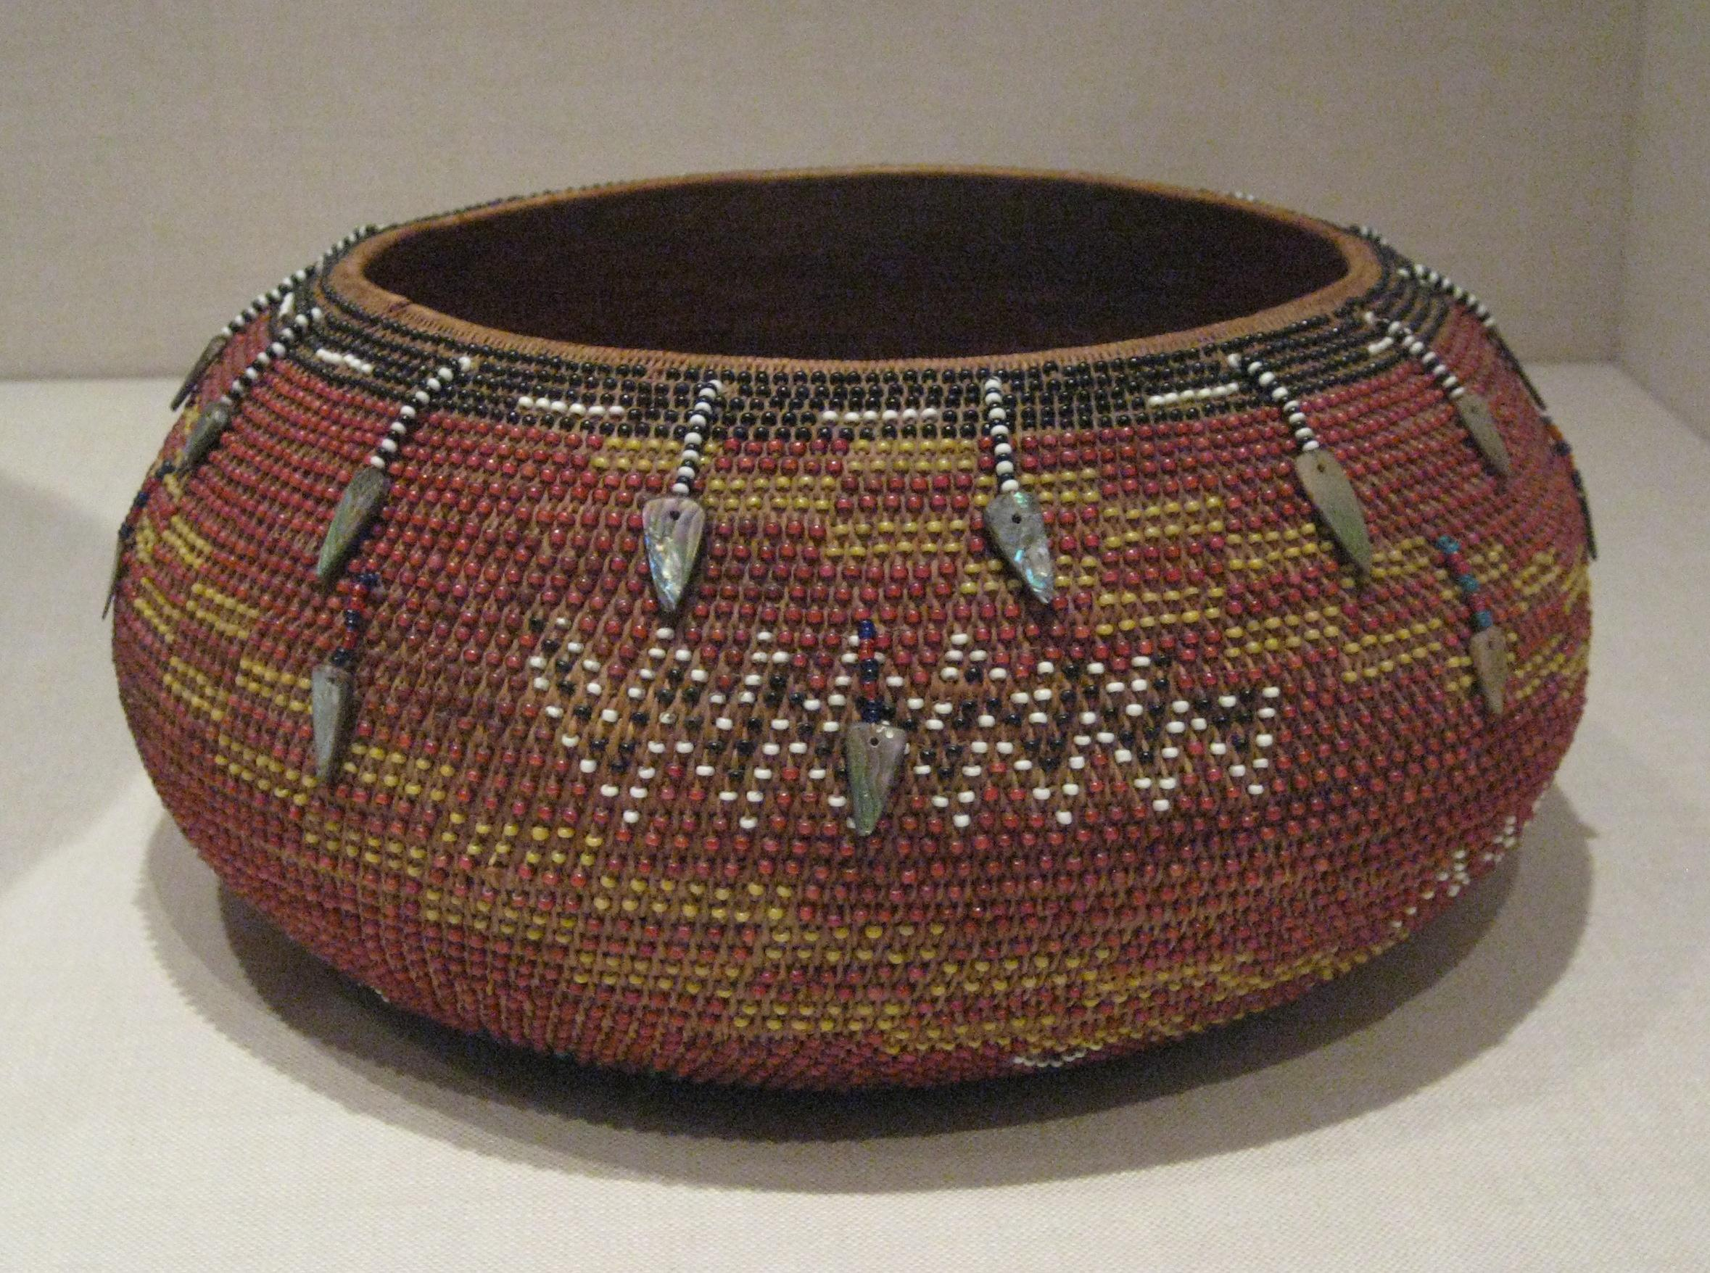
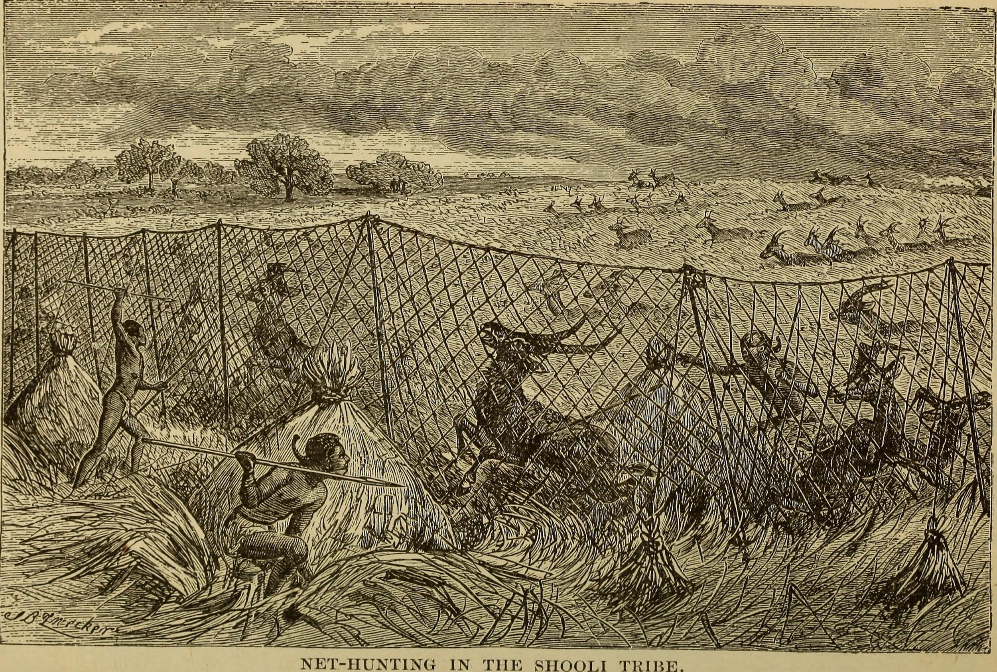
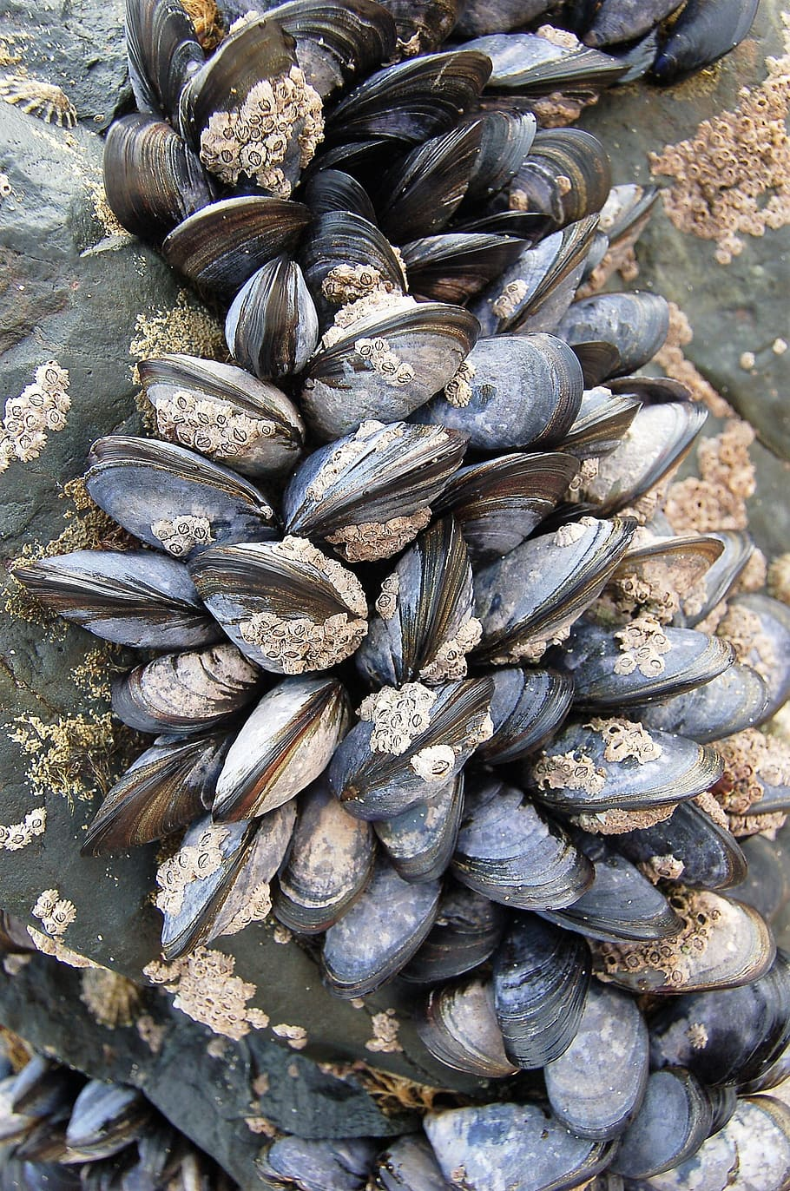
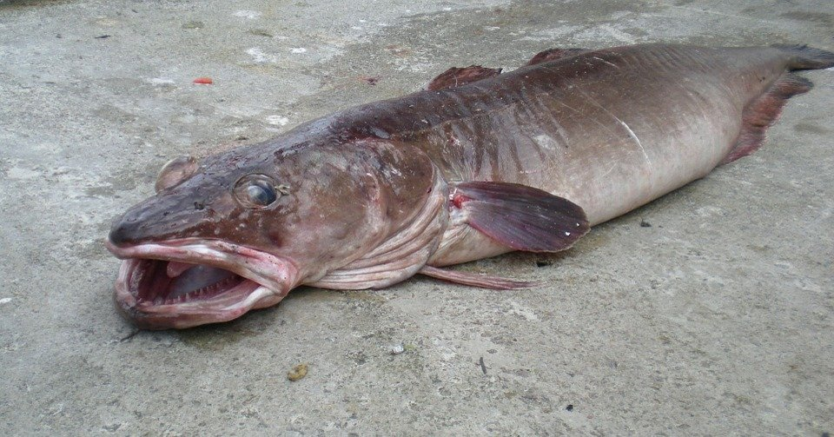
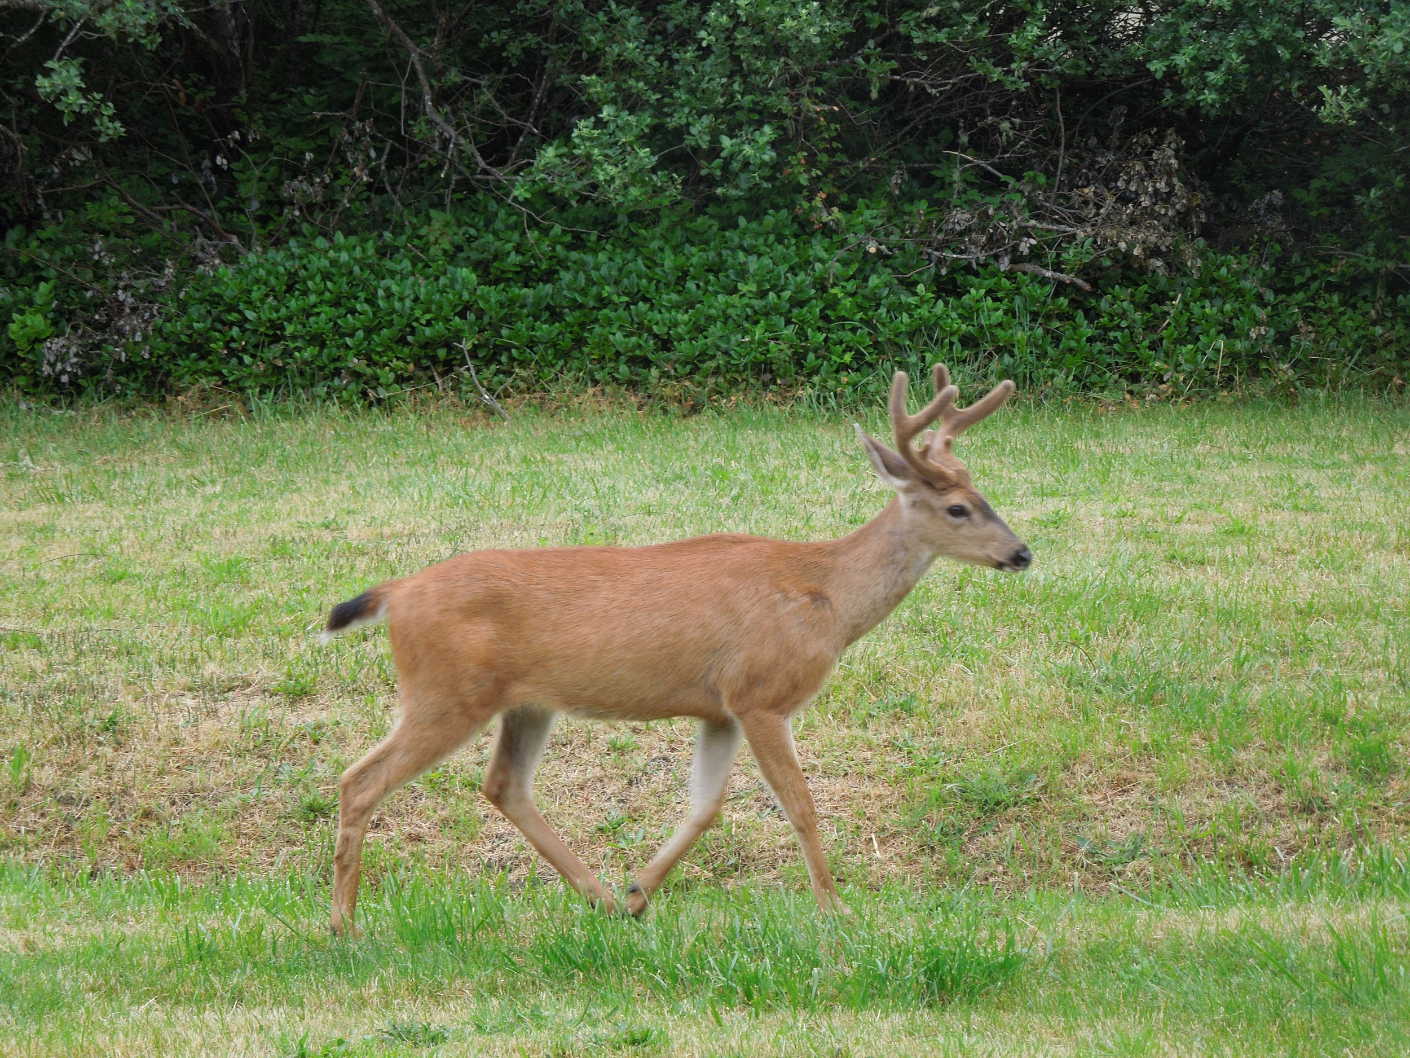
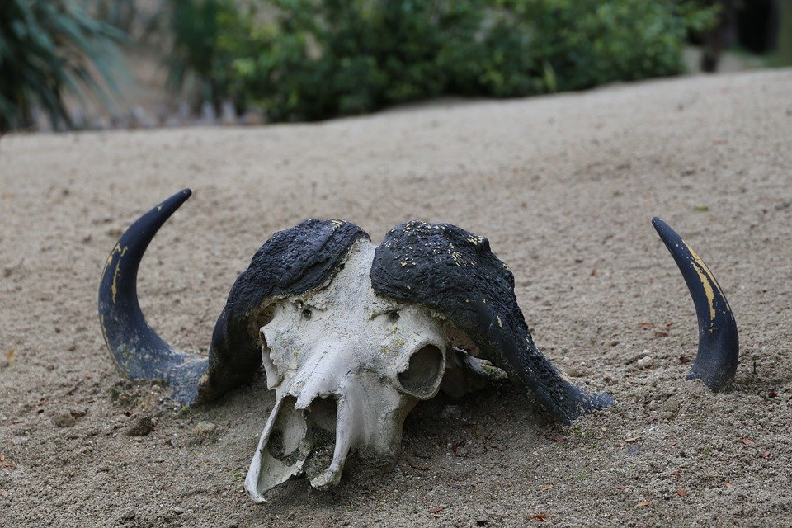
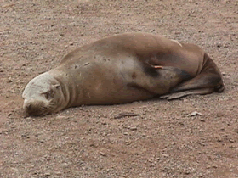
Food
What the Pomo tribe ate depended on where they lived. They ate fish,shellfish, sea lions from the ocean,deer,elk and smaller animals from the redwood dark forest. Food was so plentiful that the Pomo languages had no word for starvation. They use many tools, included nets, spears, and traps for fishing, and the bow and arrow for hunting birds, deer, and other animals. The Pomo used basket to store, and cook their food. The Pomo hunted and fished.
Notes:
Write about the food the tribe ate, crops they grew, hunting & gathering skills, and ways to prepare meals.

Slide 7
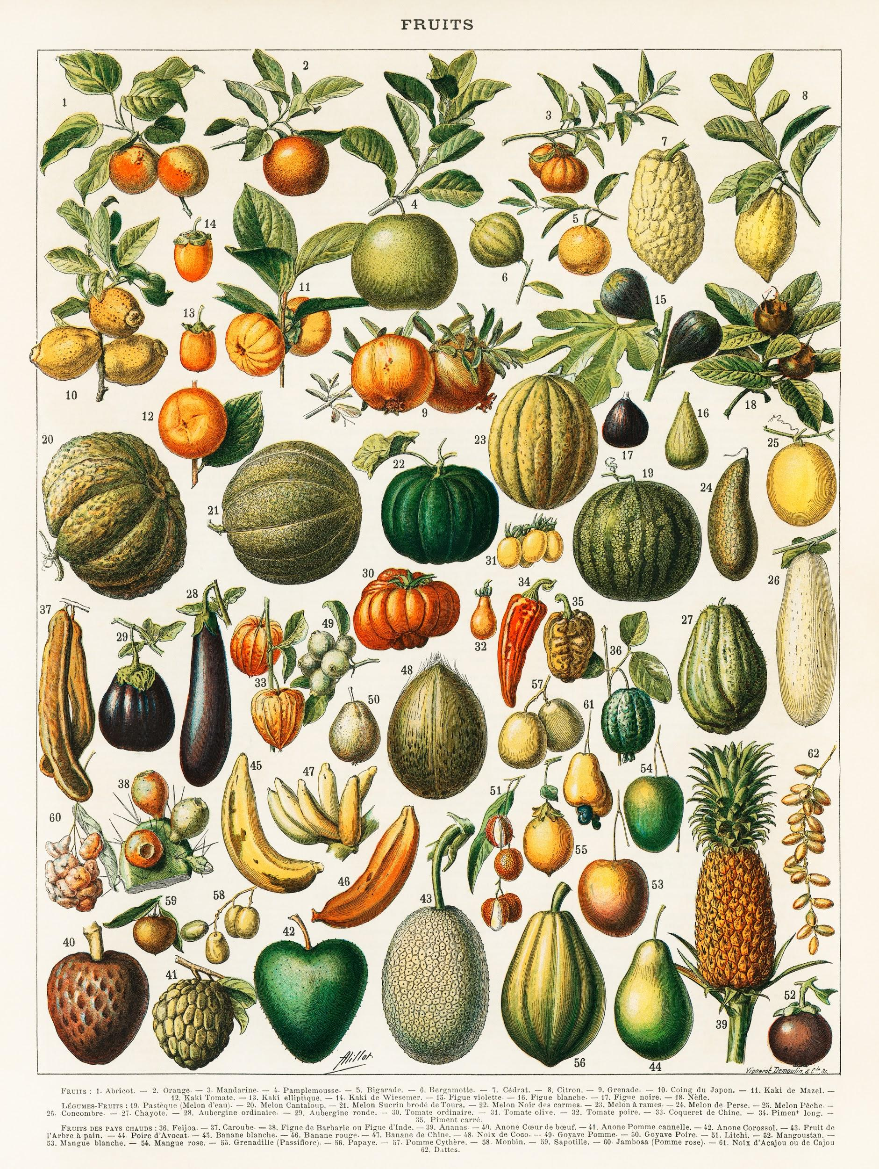
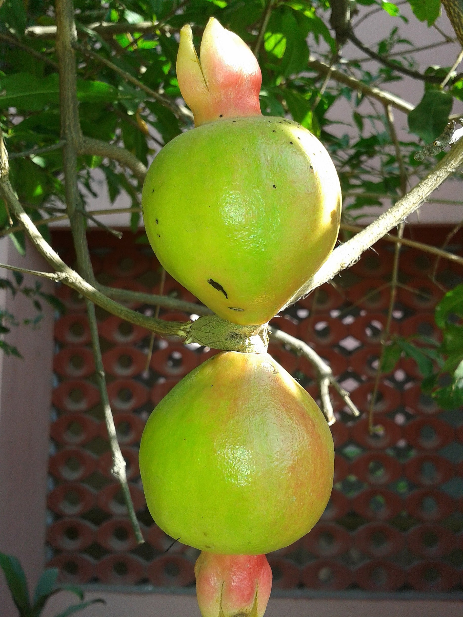
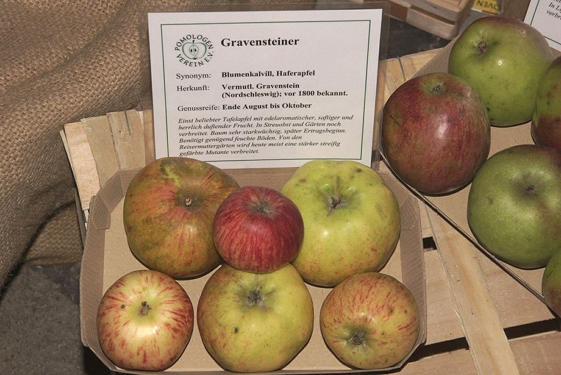
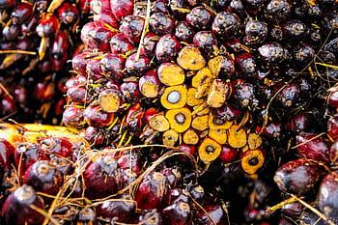
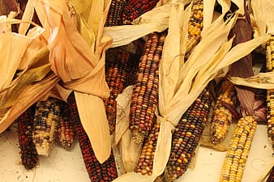
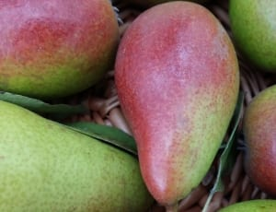
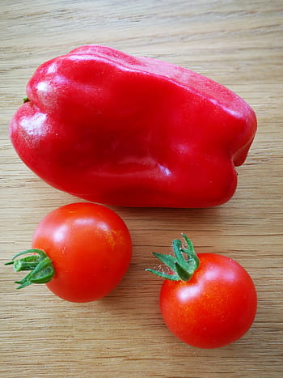
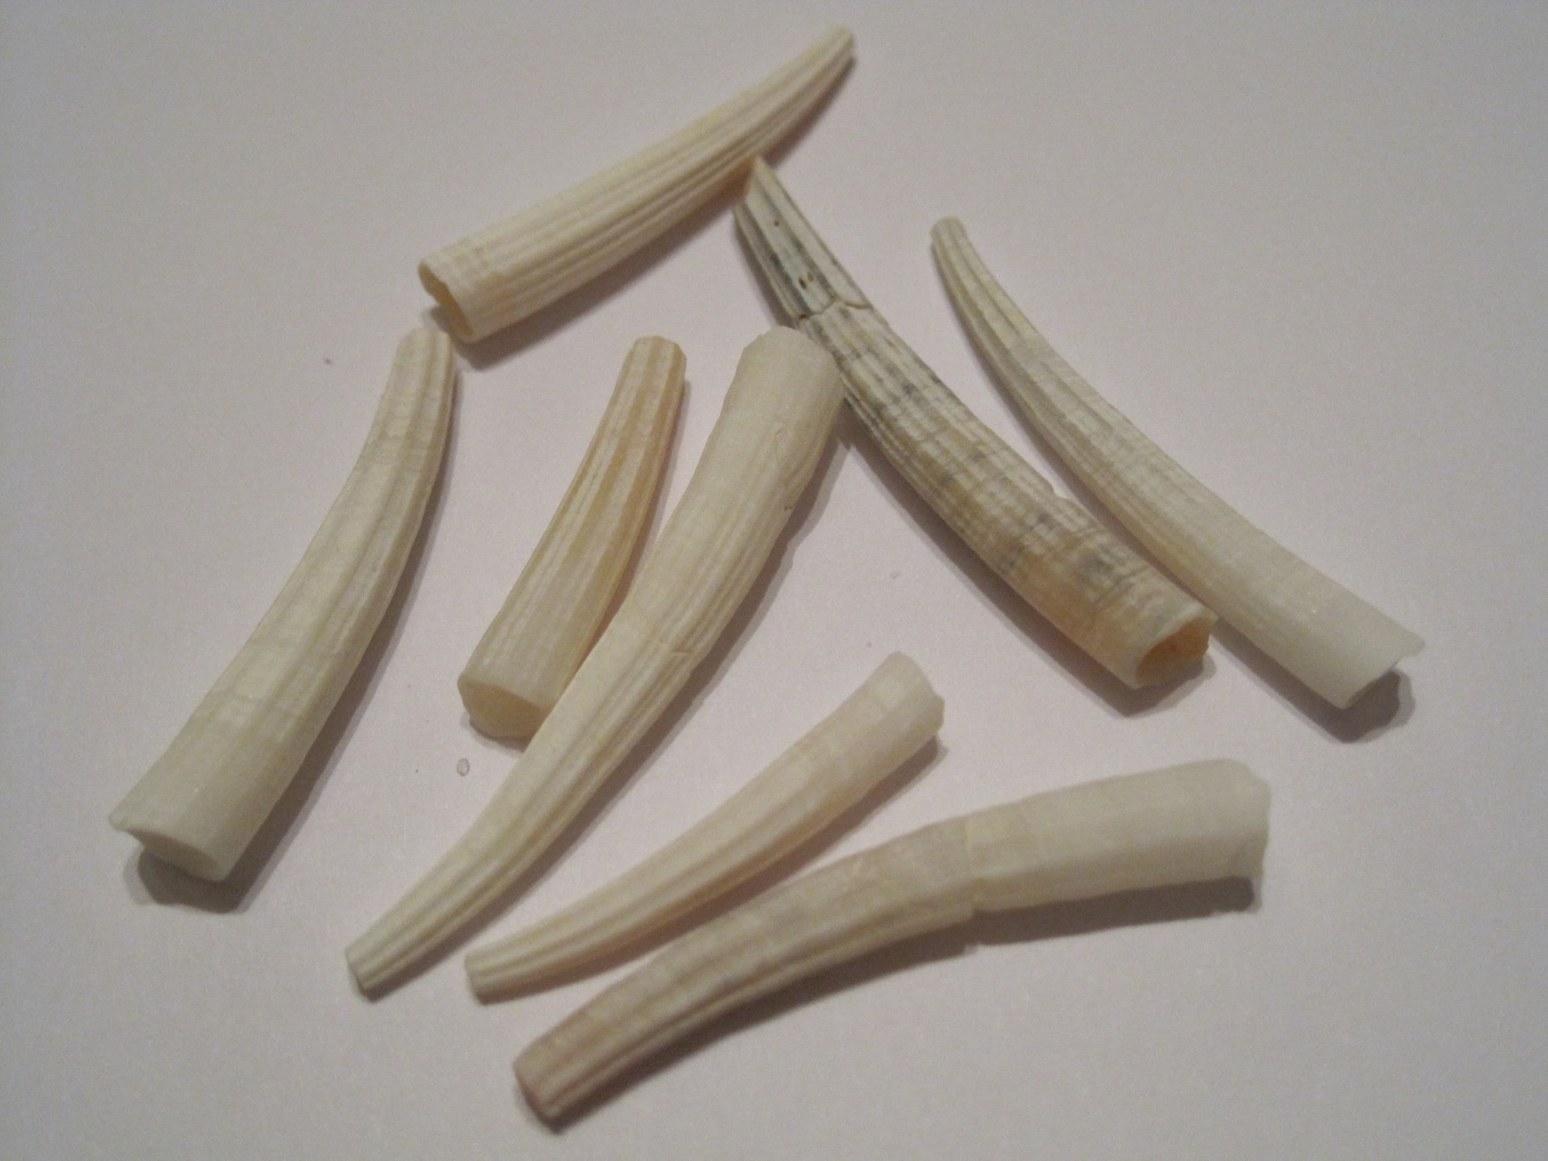
MORE INFORMATION ABOUT THE POMO TRIBE FOOD
The Pomo hunted and fished. They used traps for fishing and bow and arrow. For hunting birds,deers and other small animals.

Slide 8
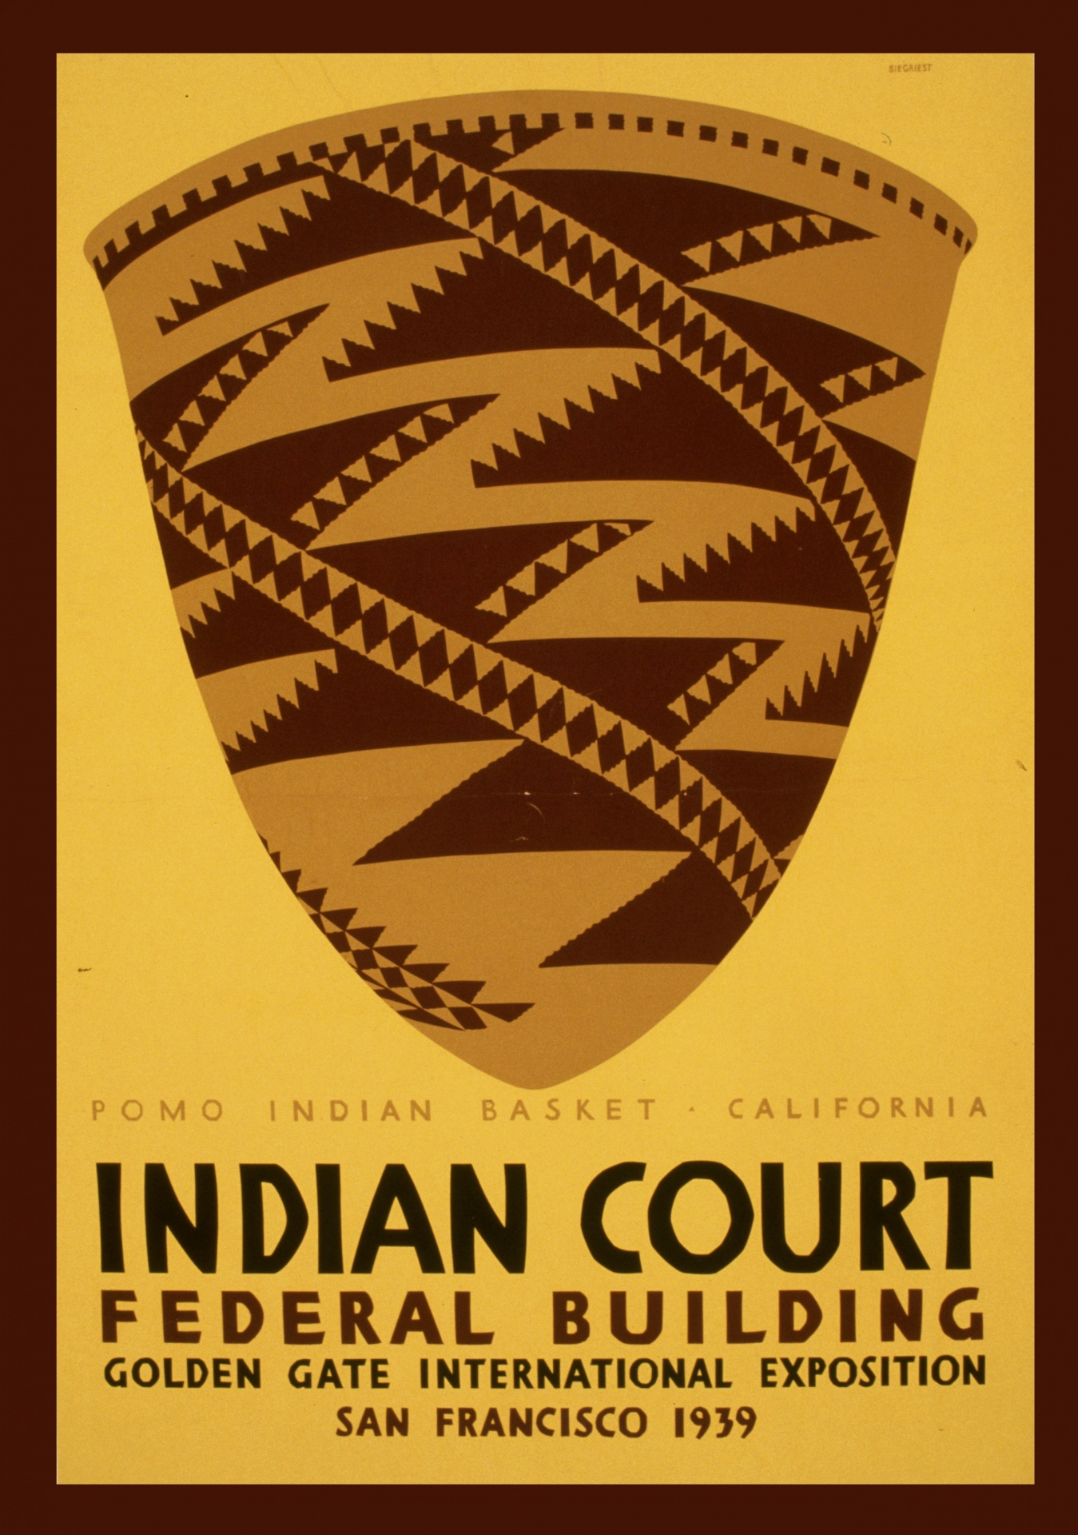
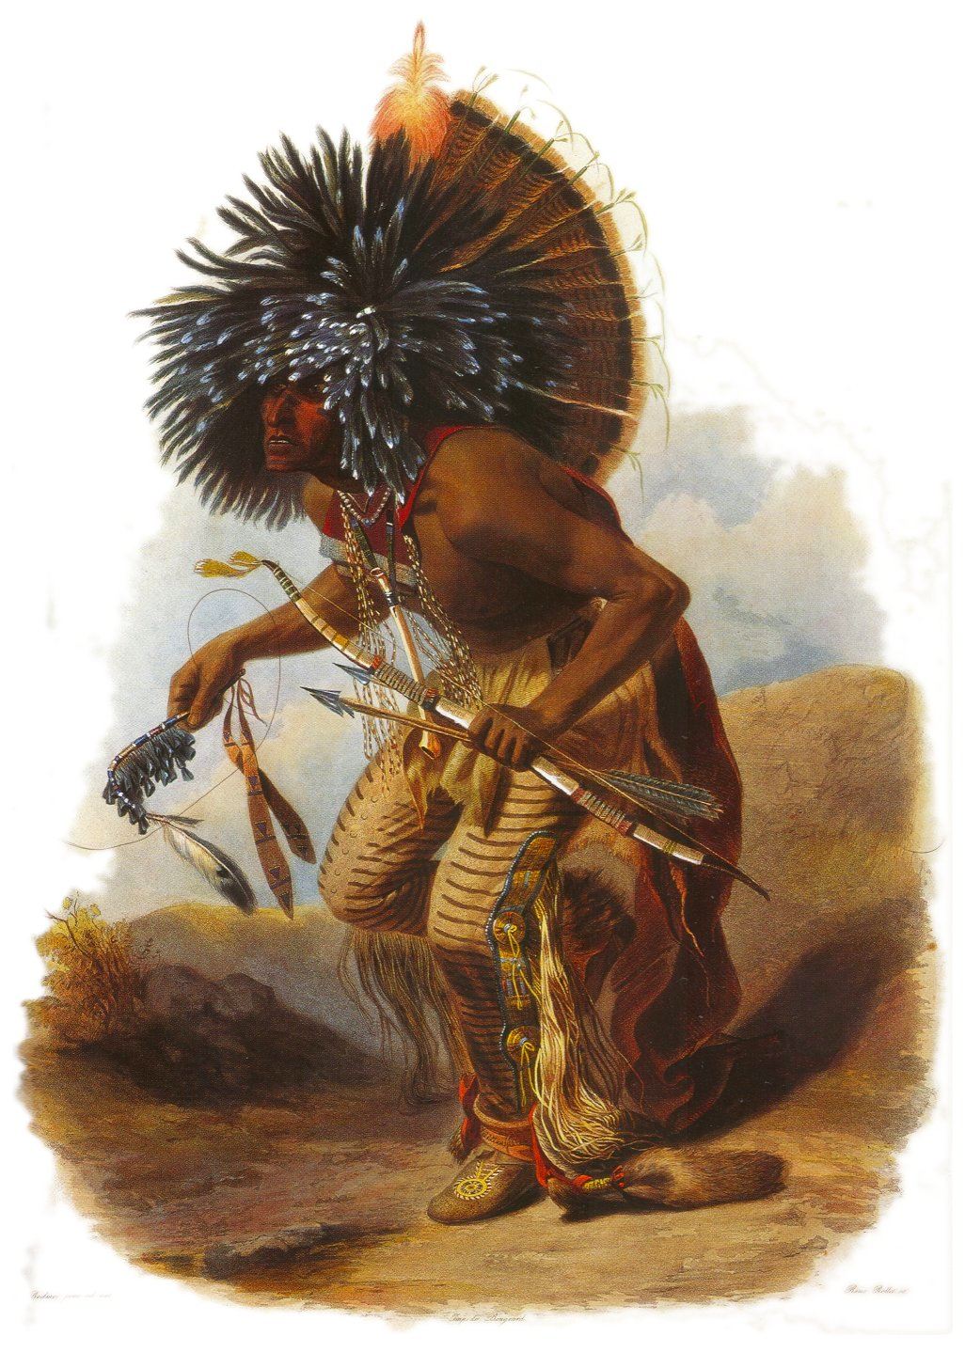
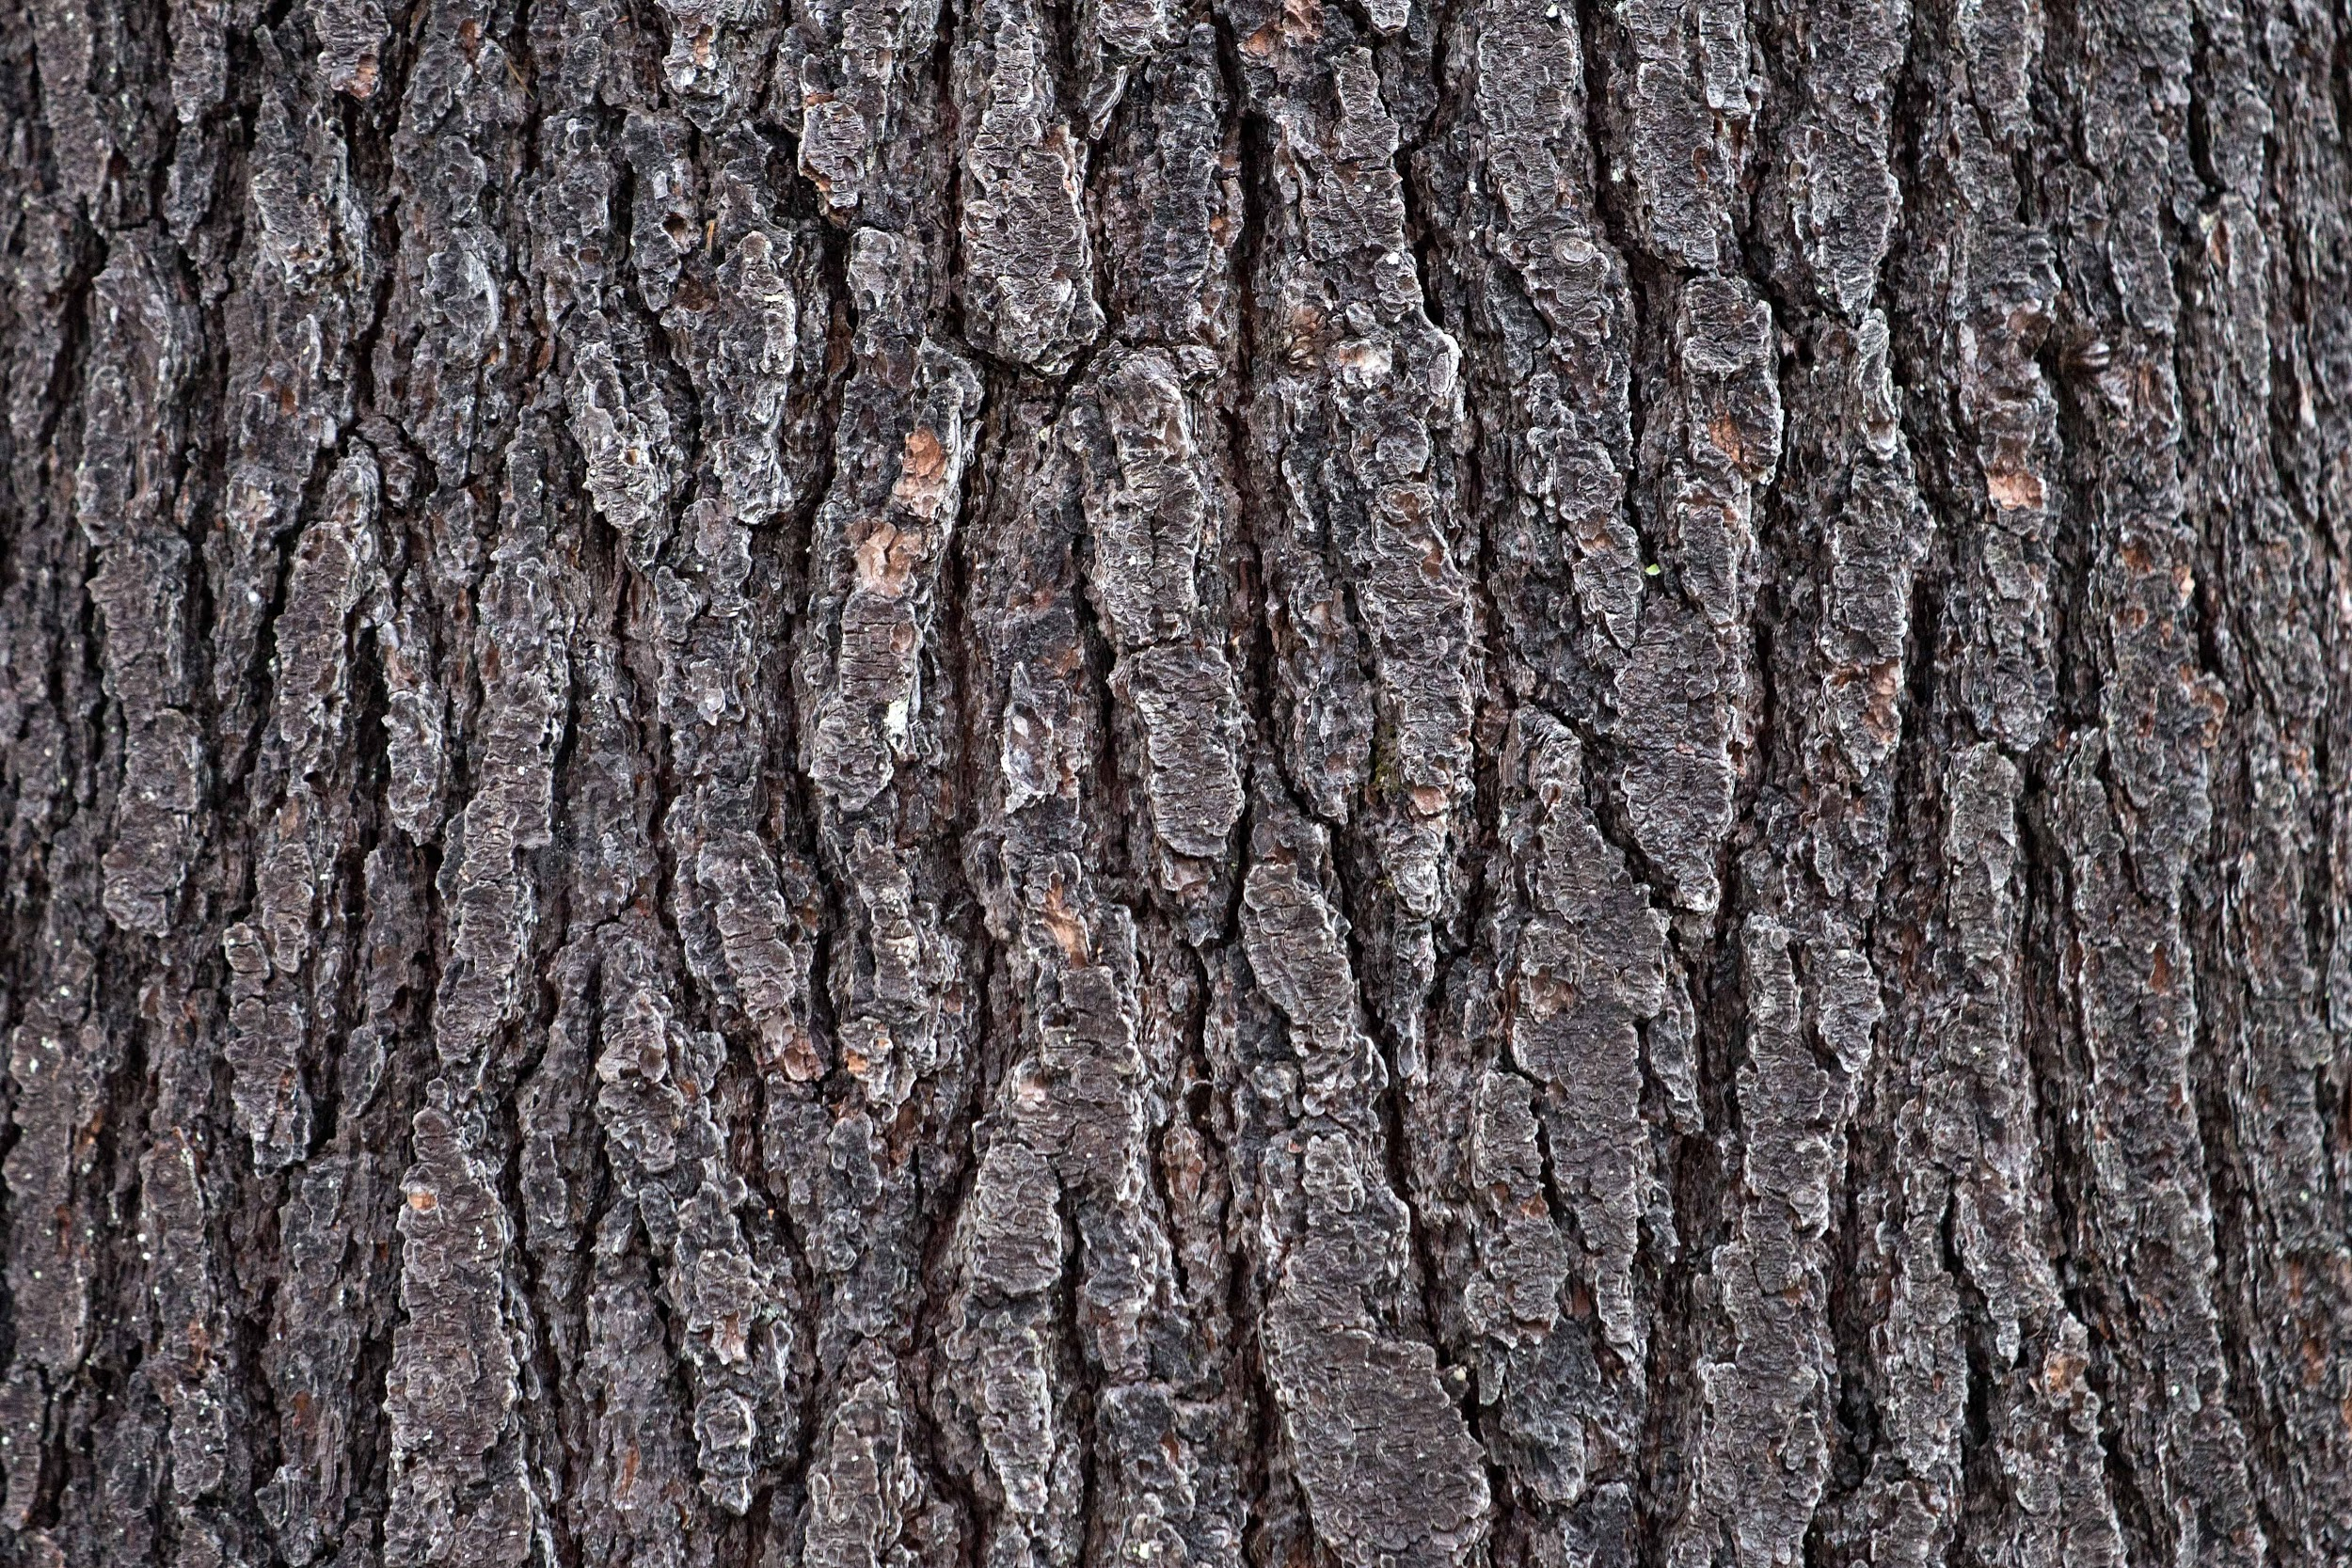
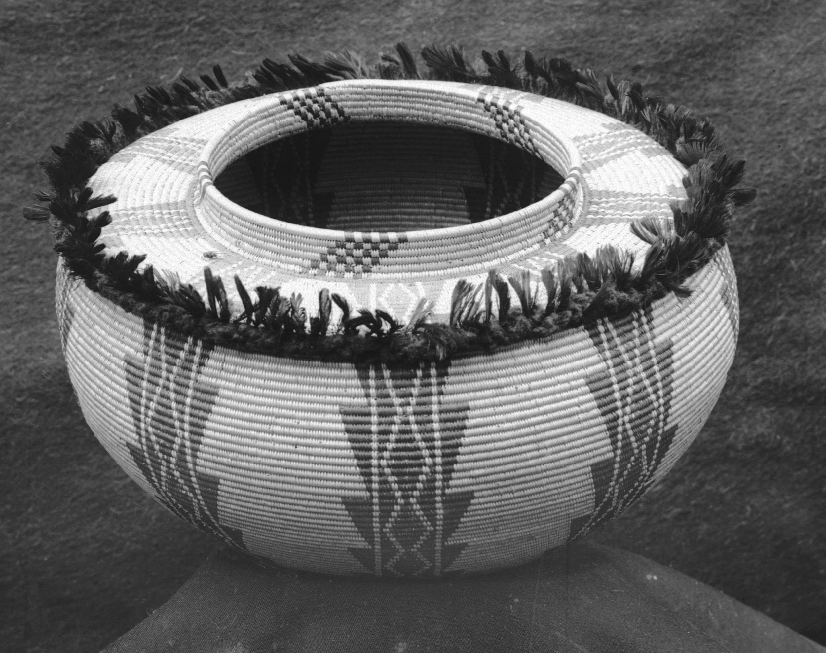
Culture
The culture of the Pomo is interesting. The rafts were made of weeds and plants. The baskets are made from willow shoots and redwood tree bark for the structure. In the winter the Pomo made blankets out of rabbit skins to stay warm. The pomo held feast where one group had extra food would invite others to come to a feast.
Notes:
Write about the art, customs, ceremonies, and responsibilities of the men, women and children.

Slide 9
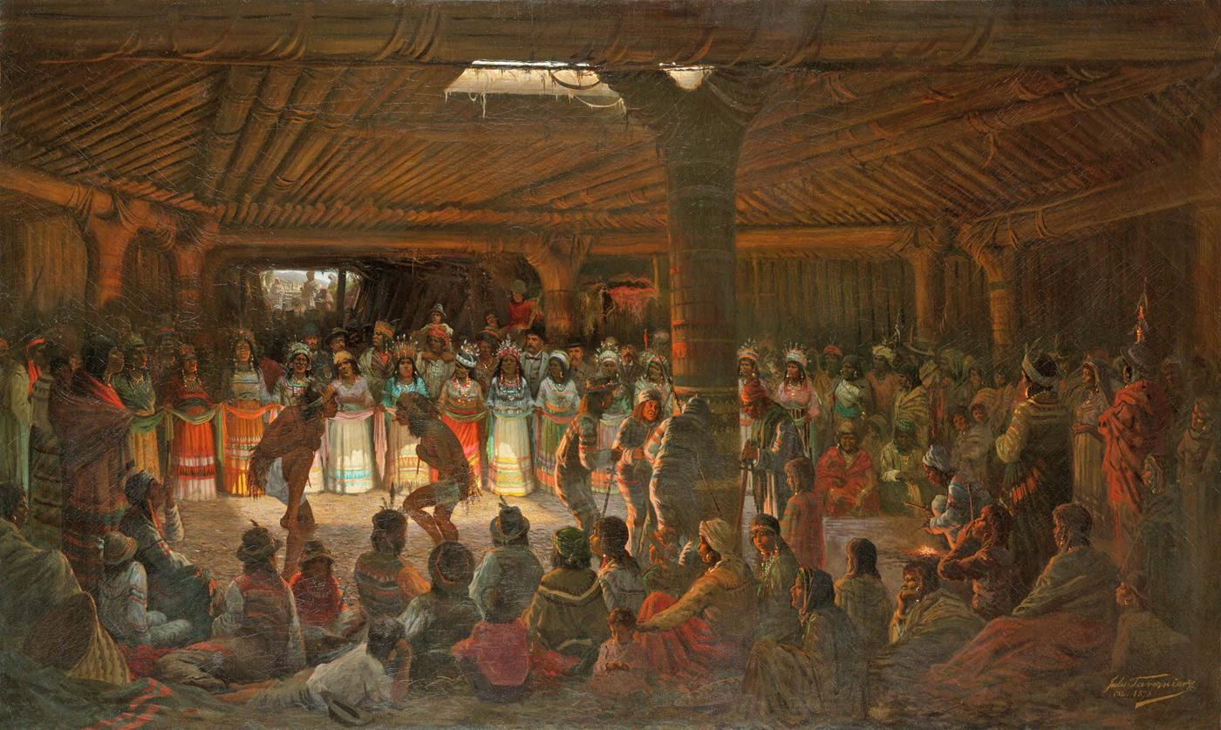
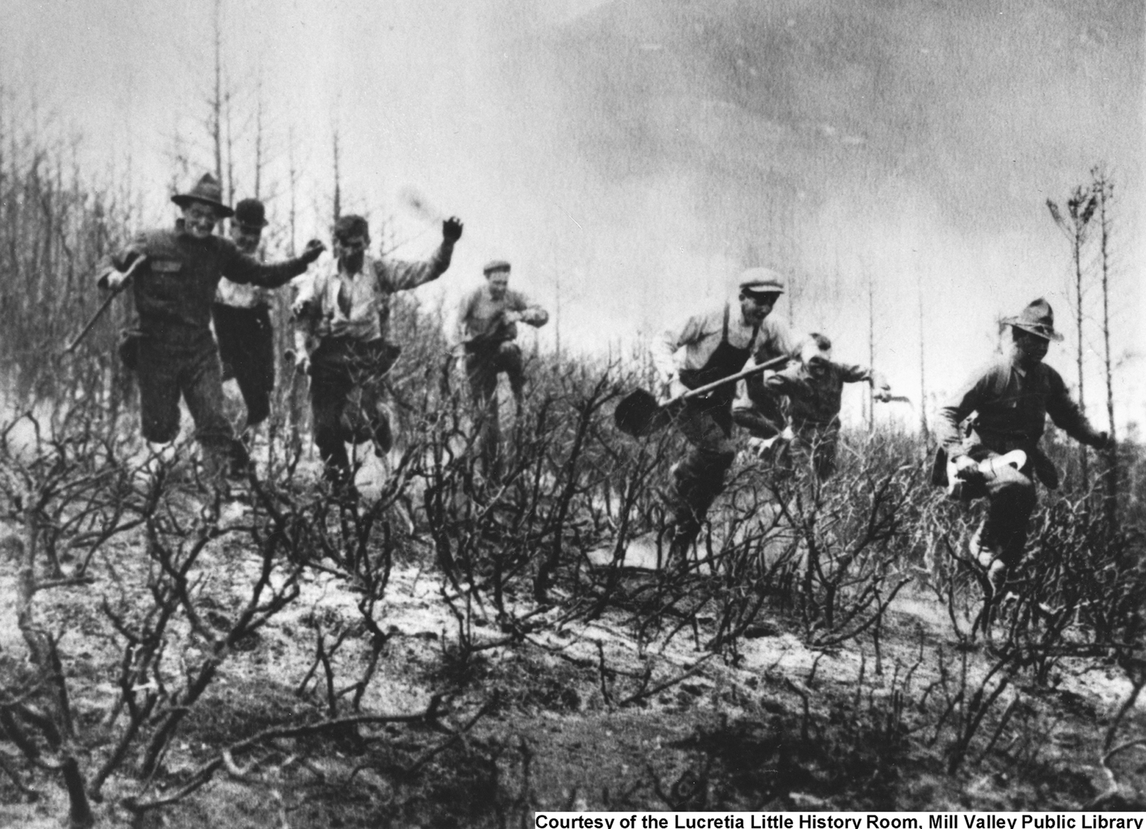
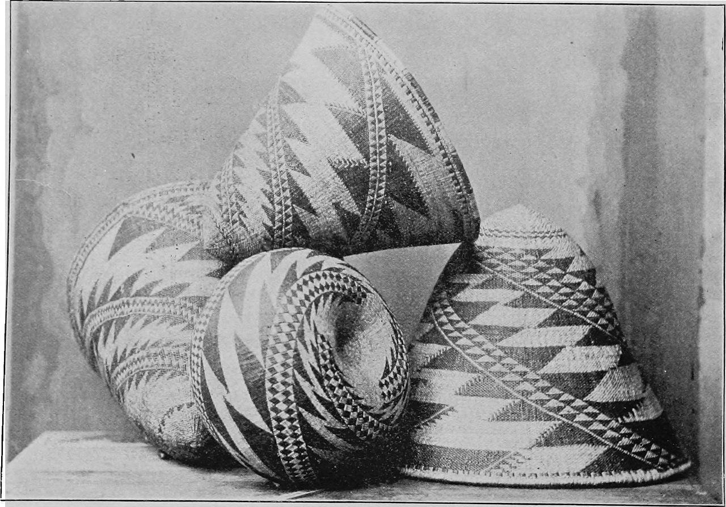
MORE INFORMATION ABOUT THE POMO TRIBE CULTURE
Traditional Pomo religion involved the kuksu cult,and a set of beliefs and practices involving. a private ceremonies and estotic dances and rituals and impression of spirits.
Also they had ceremonies for things as ghosts,coyotes, and thunder.

