Slide 1
GABRIELINO
BY: Janie Hunter

Slide 2
Gabrielino Tribe
The Gabrielinos had many villages and shelter on the coast, and rivers. They went to camping places in the foothills to get food.

Slide 3
GAbrielino location
•Southern California Coast part of California
• Lived on the coast of islands like San Clemente, San Nicolas, and Santa Catalina
°Very nice weather
•Villages were located in sheltered bays on the coast and along the rivers

Slide 4
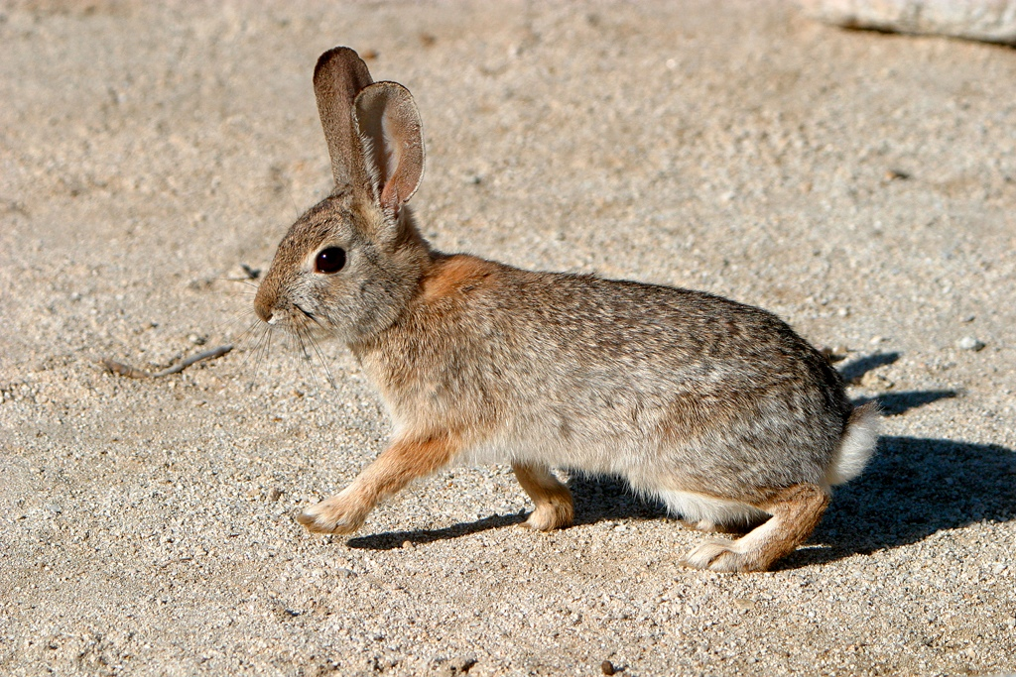
Culture
Gabrielino women had aprons made of deerskin. Men and kids did not wear clothing but in cold weather they had capes, rabbit fur, and feathers to keep them warm.

Slide 5
Gabrielino culture
Women made baskets to store and carry food. They made cooking utensils from shell , wood, and stone. They would carve pots, bowls, animals, and whales out of stone. Canoes were used to travel .

Slide 6
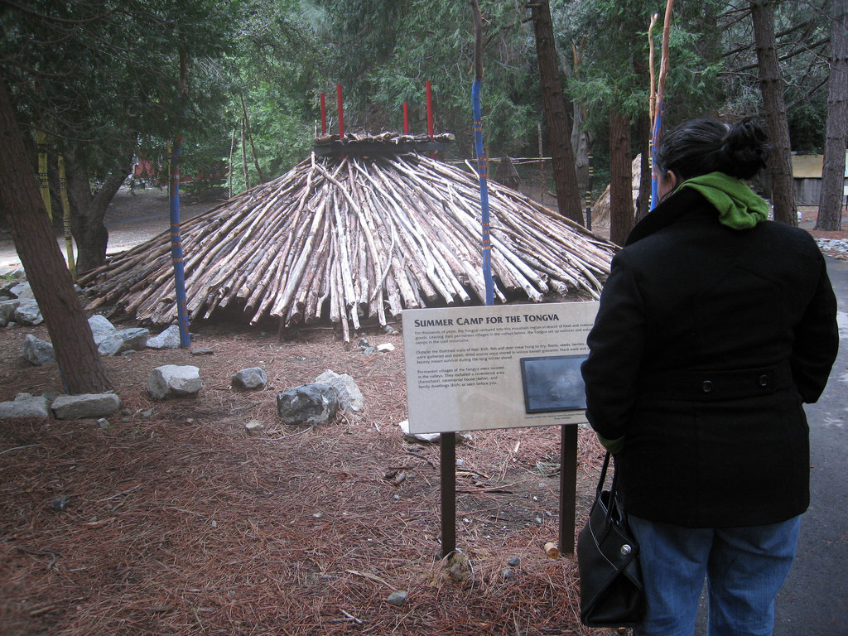
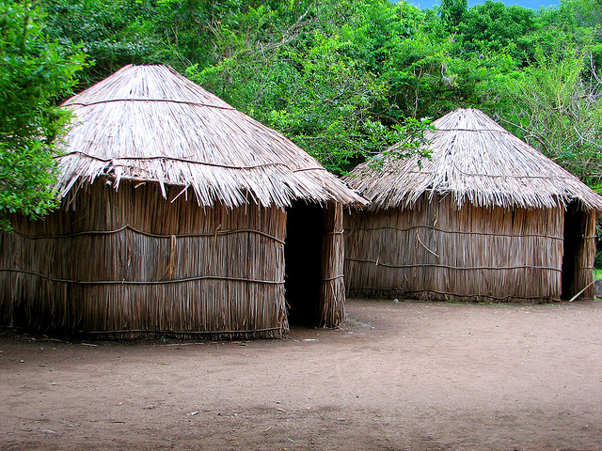
SHELTER
Men had sweathouses where they would talk and sweat. This house was also round and low to the ground with brush covering it.
Homes were made by bending poles in a circle. Poles were covered tule reeds, ferns, and mats. Many houses were big and could hold up to 50 people.

Slide 7
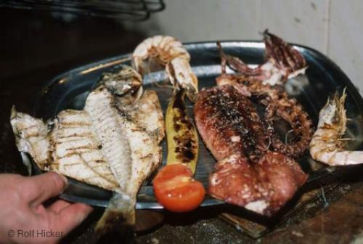
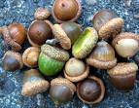
FOOD
They also found food outside of the water like acorns, nuts, sage, berries, and cacti. If they were lucky they could hunt deer, snakes, and birds.
°Gabrielino ate fish, sea mammals, shellfish, and sea birds.
°Sea lions, sea otters, and elephant seals kept them very full.
° They did not have many animals to feed off of on land

Slide 8
The end
The Gabrielino tribe was very interesting and unique tribe. It was interesting to learn about a tribe so close to home.

