Slide 1
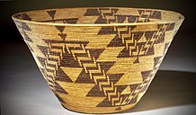
The Maidu
By Ella and Leo
.

Slide 2
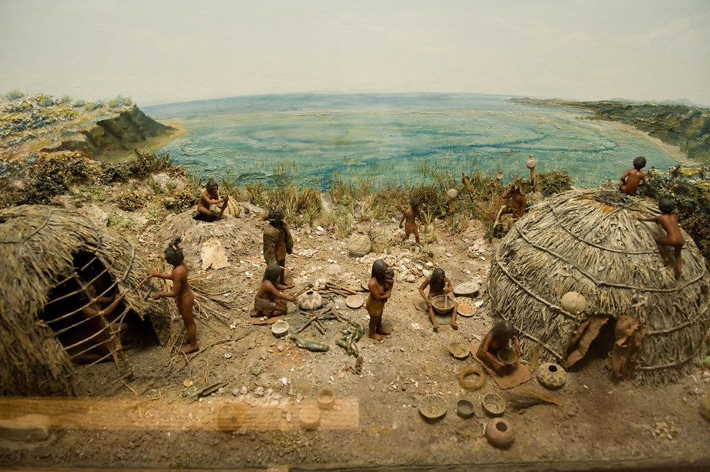
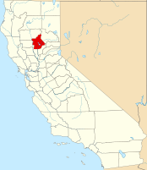
Location
They live in California .The area occupied
by the Maidu was
a series of mountain
Valleys.
They had a mild
climate
.
.
ThePhoto by PhotoAuthor is licensed under CCYYSA.

Slide 3
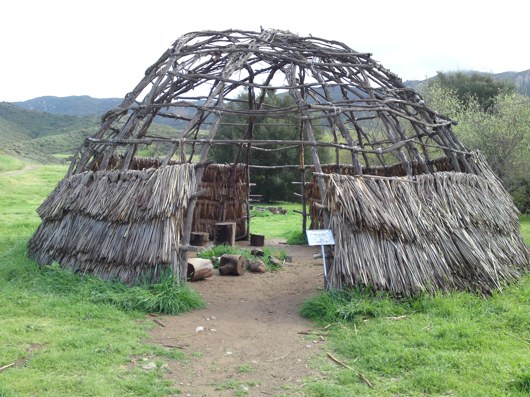
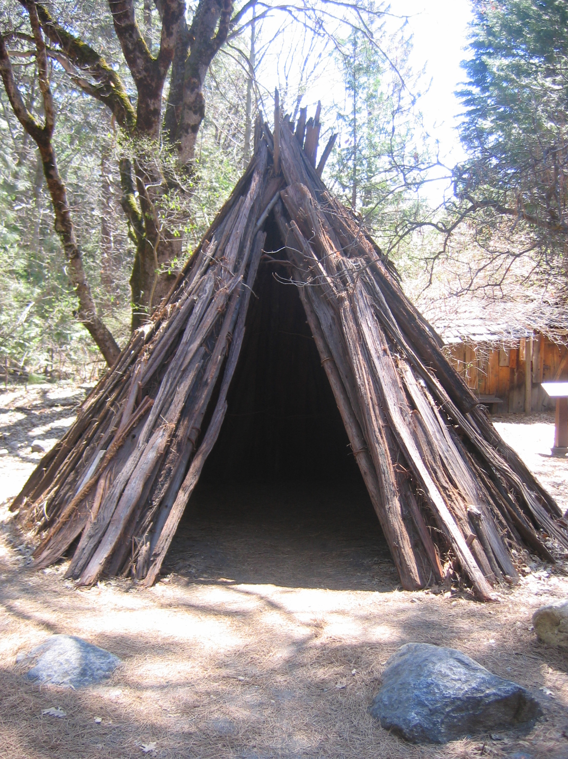
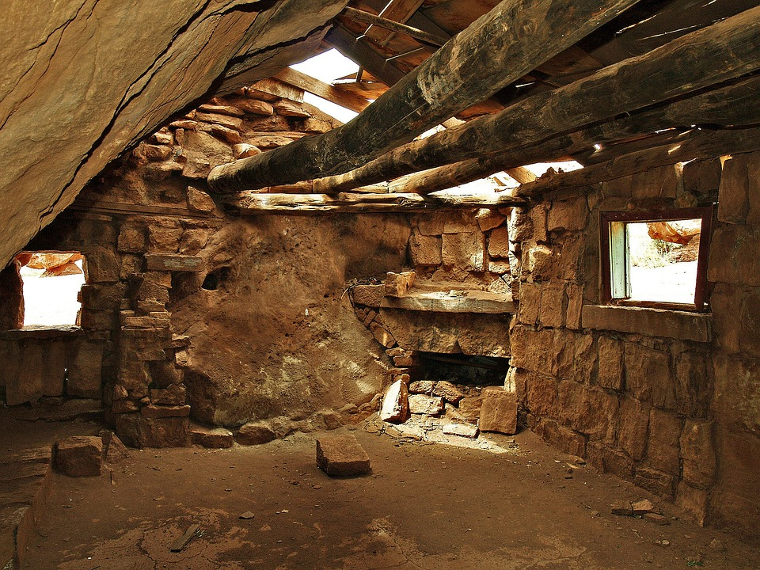
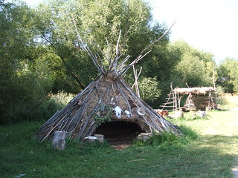
Shelter
The Maidu shelter protected them from the environment.
Some Maidu built cone shaped homes from poles covered in bark.
They are made from wood.
ThePhoto by PhotoAuthor is licensed under CCYYSA.
.

Slide 4
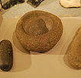
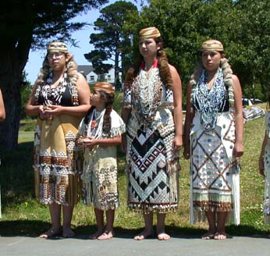
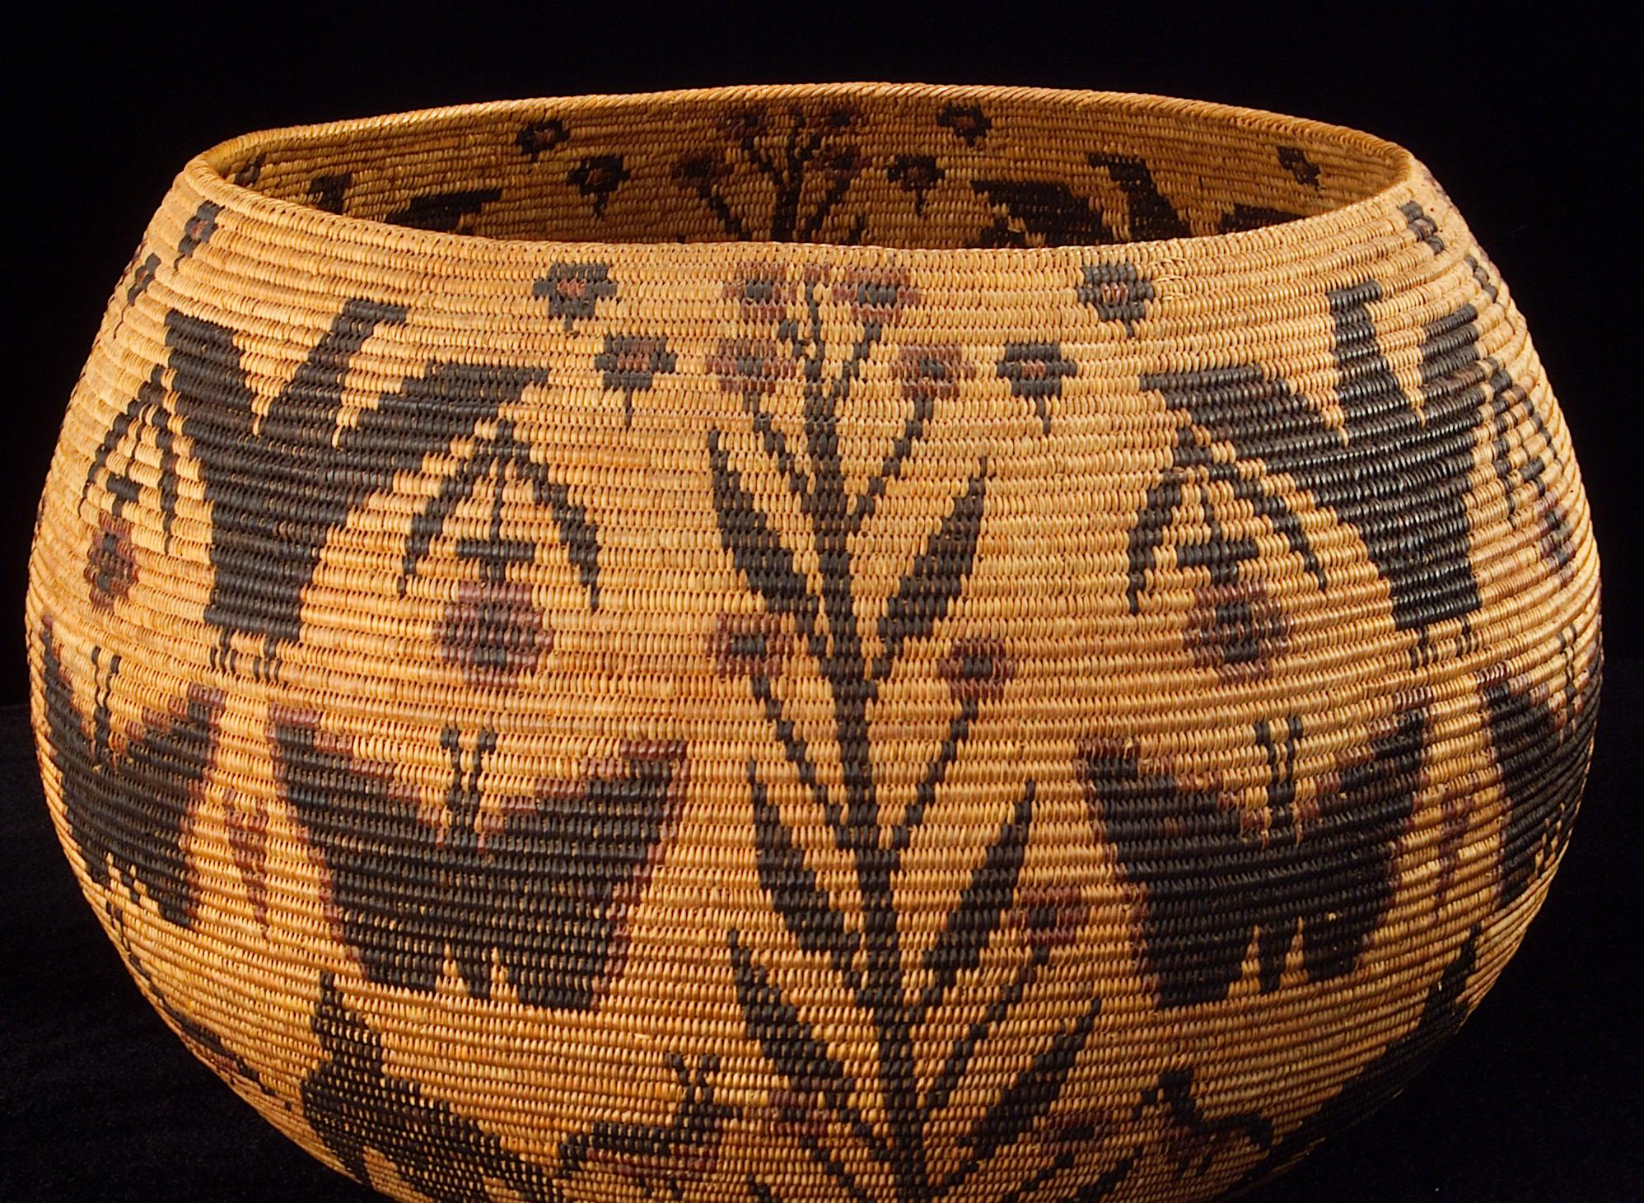
Culture
The men made knives and arrowheads from flint.
Women used deerskin and rabbit fur to make blankets.
Women made baskets out of reeds and grasses.
They collected and stored in them.

Slide 5
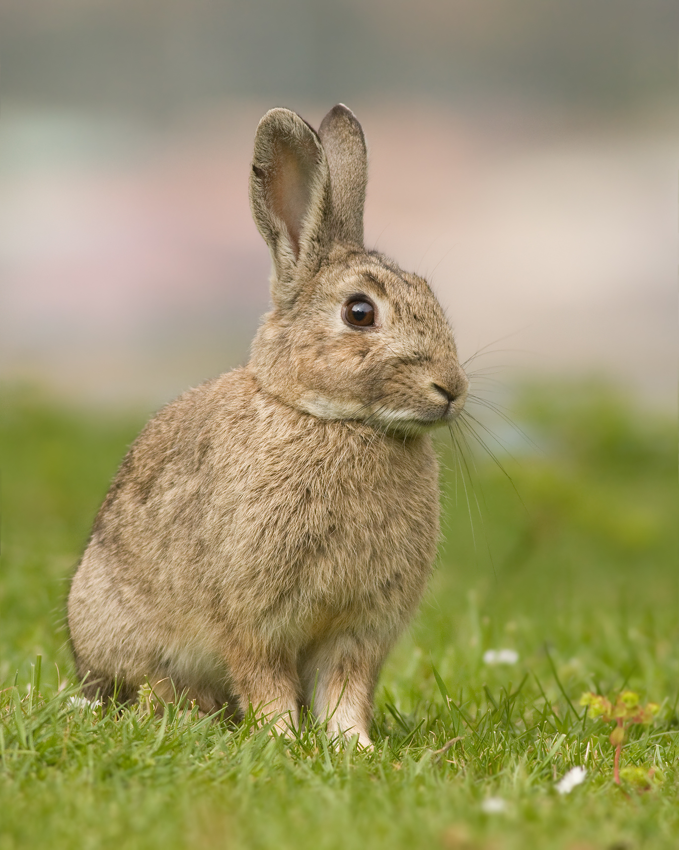
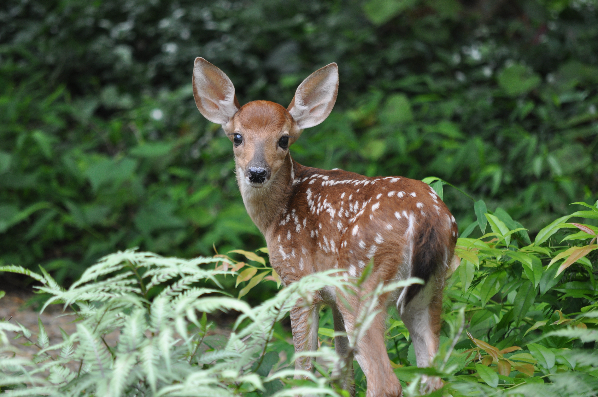
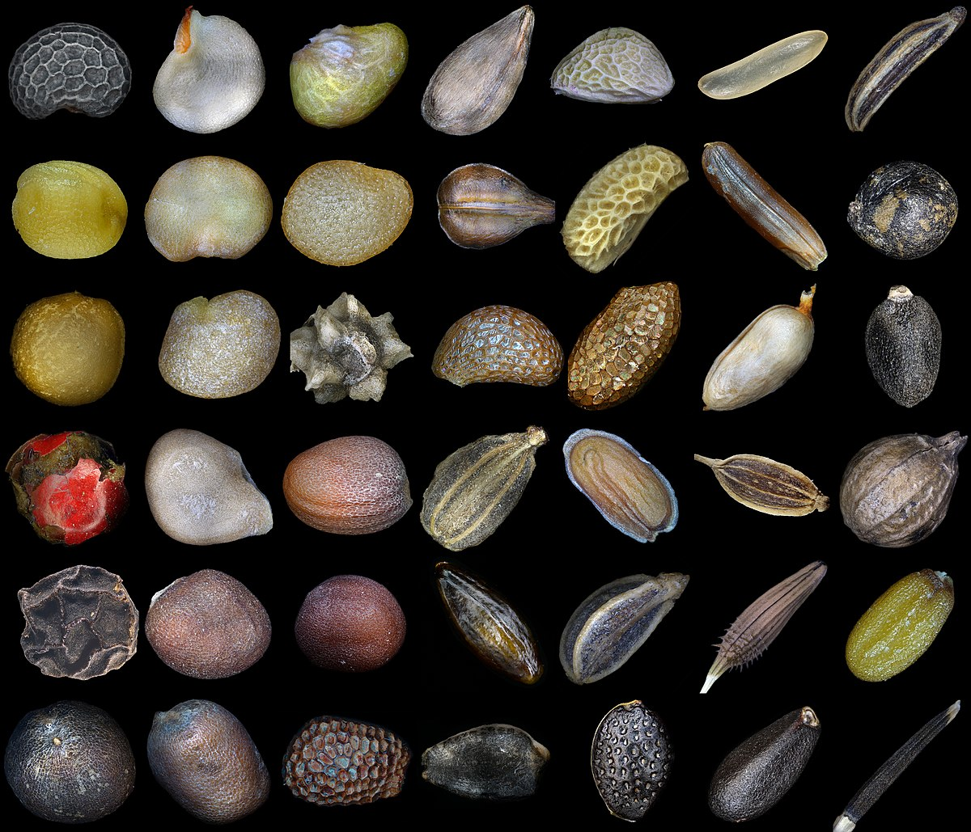
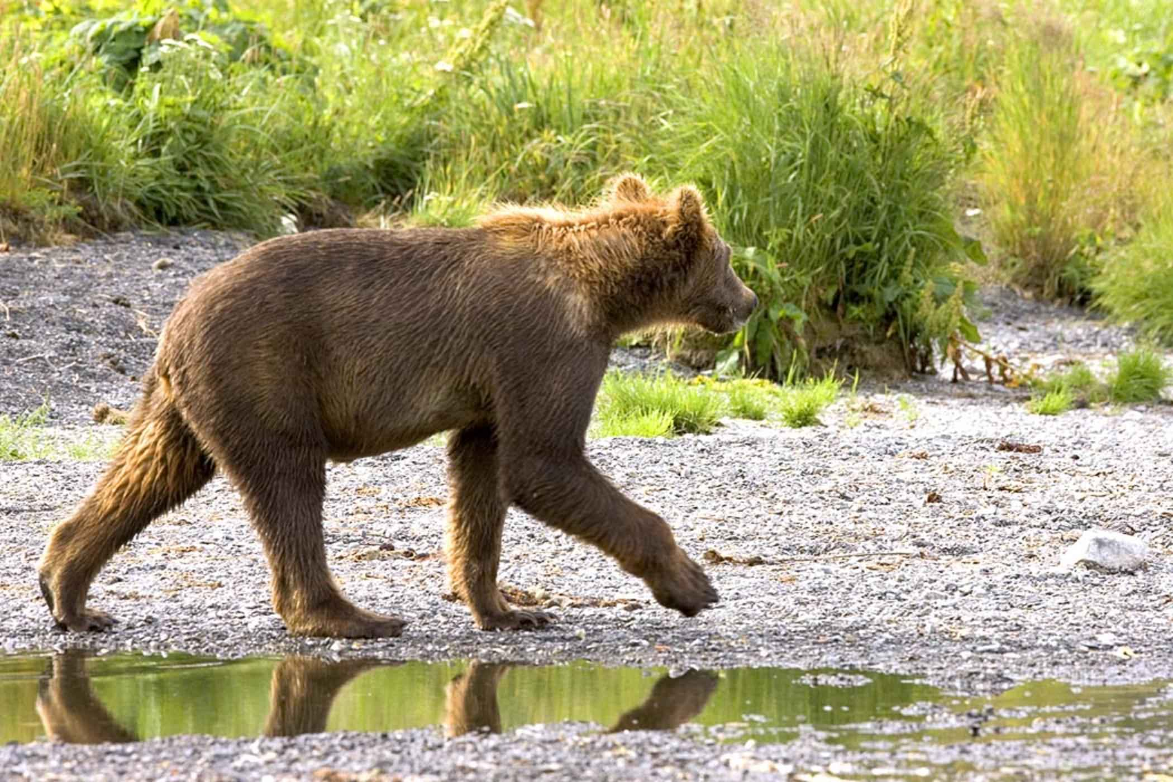
Food
They hunted deer, elk, rabbits, birds, and bears.
They gathered plants, seeds, roots, insects, and berries.
They fished for salmon, trout, and eels.

Slide 6
Thanks for watching!

