Slide 1
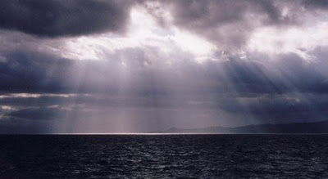
Weather & Climate
By Ezekiel and Zander

Slide 2
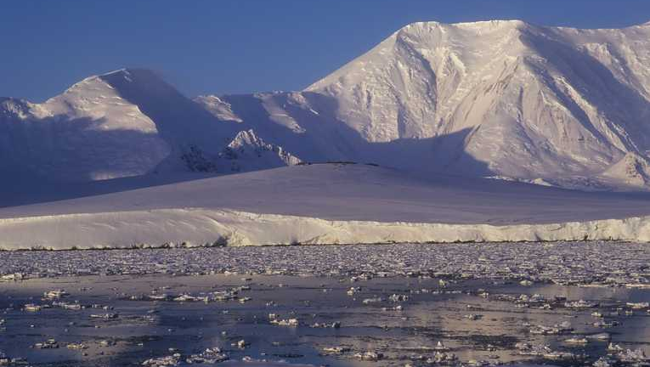
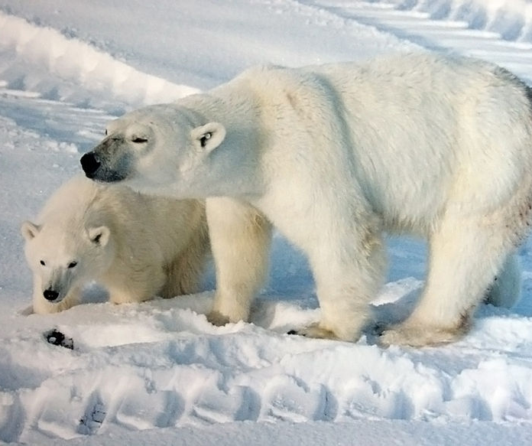
Polar Climate Zone
There are many animals like polar bear, whales , and wolves.
The winters are long and dark it is always cold.
Animals can survive because of their blubber and fur.

Slide 3
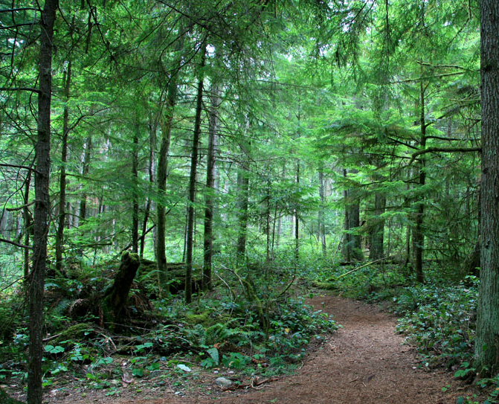
Temperate Climate Zone
The temperate forest is not the only forest the tropical climate zone too.
The temperate gets a lot of rain in summer and very cold winters.
A lot of animals hibernate and migrate.

Slide 4
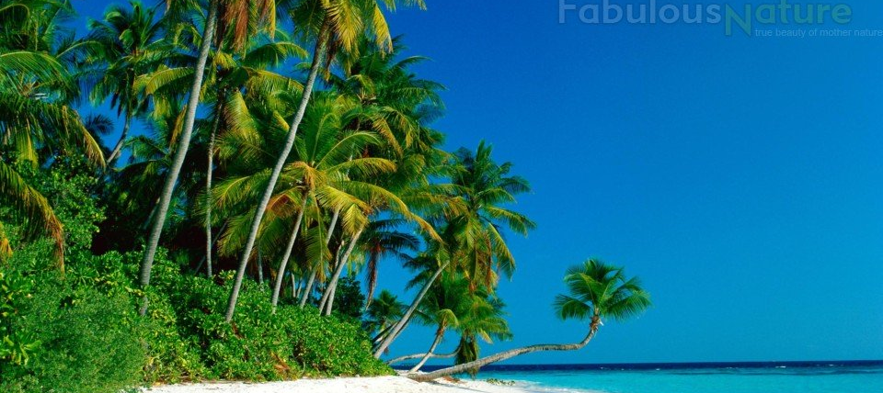
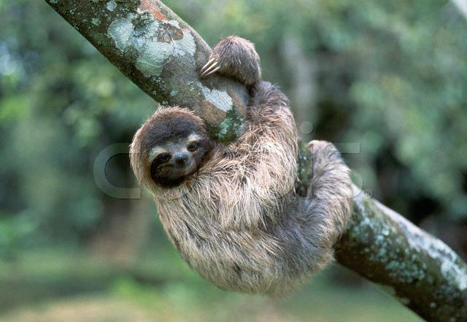
Tropical Climate Zone
Tropical forest are near the equator it is also humid year round.
Millions of bugs and plants live under moss.
The highest layers of branches are on these trees form a canopy.

Slide 5
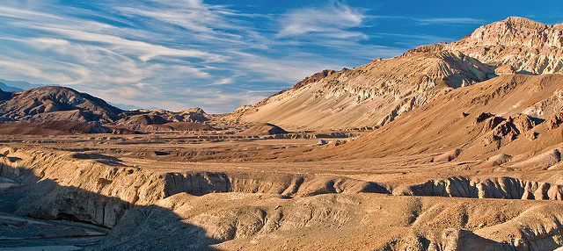
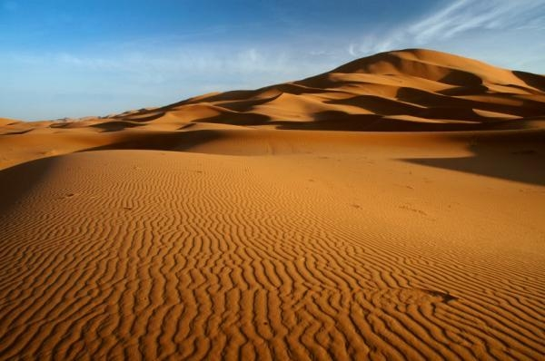
Desert Climate Zone
The ground can get so hot the air gets hot.
Many deserts are sandy and barren.
Desert are arid or dry.
During the winter months deserts get very little rain.

Slide 6
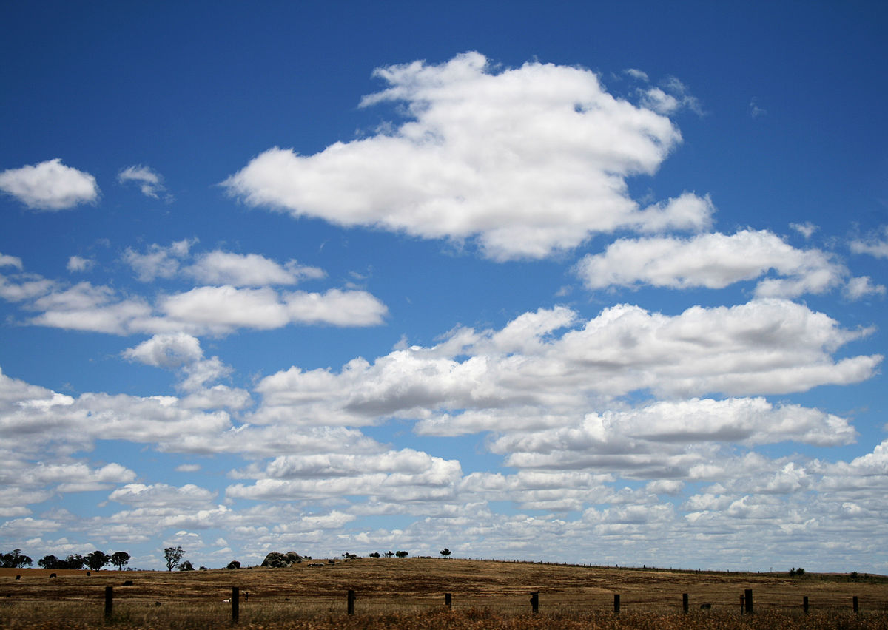
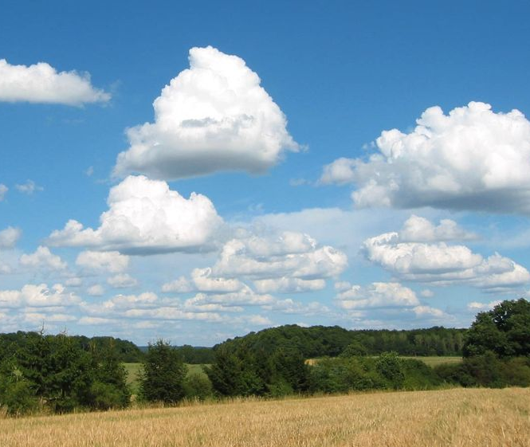
Cumulus Clouds
They are called fair weather clouds.
Cumulus clouds don't cause storms.
They are known to be floating cotton candy.

Slide 7
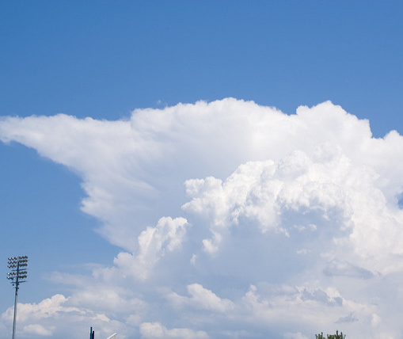
Cumulonimbus Clouds
Elevations of cumulonimbs clouds is 39,000 feet up.
Atmosphere is low level.
They are made of water droplets.
They are storm clouds.

Slide 8
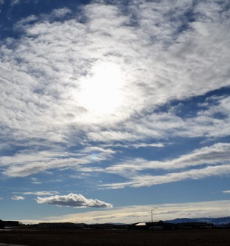
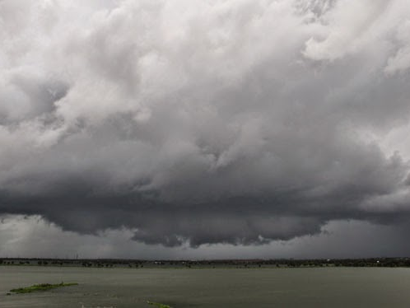
Stratus Clouds
Stratus clouds can cover the whole sky.
Stratus don't cause storm.
Stratus clouds are low lying clouds.

Slide 9
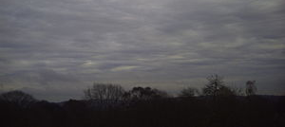
Stratonimbus Clouds
Stratonimbus clouds cause storms.
Stratonimbus storms can last all day.
They are very dark clouds.

Slide 10
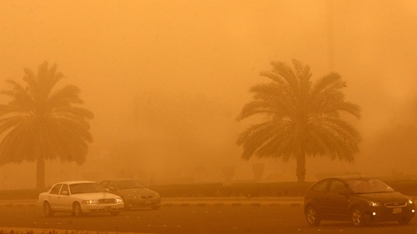
Extreme Weather - Sand Storm
Sandstorms are caused by a lot of sand coming up.
Sand storms can cover the hole sky.
Sand storms are so powerful they can cause power to go out.

Slide 11
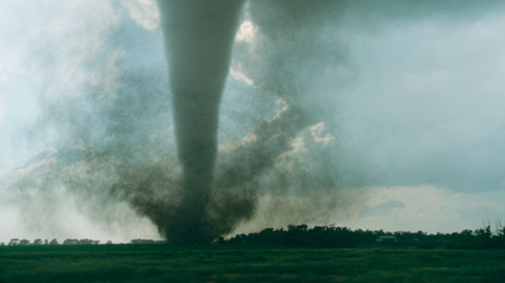
Extreme Weather tornados
A tornado is a whirlwind that hangs down from the sky.
Tornados can be 500 yards and 60 meters long.
Tornados pickup everything in sight.

Slide 12
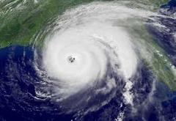
Extreme Weather -Hurricane
Hurricanes are large storms that form over the ocean
Hurricanes can damage up to 63000 damage to houses.
Hurricanes are caused when the sun heats the ocean surface and turns to mist and starts to spin.

