Slide 1
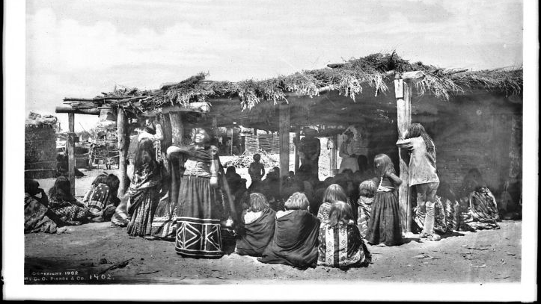
The Mojave tribe.
By Hope Pangelinan
This Photo by Unknown author is licensed under CC BY-SA-NC.

Slide 2
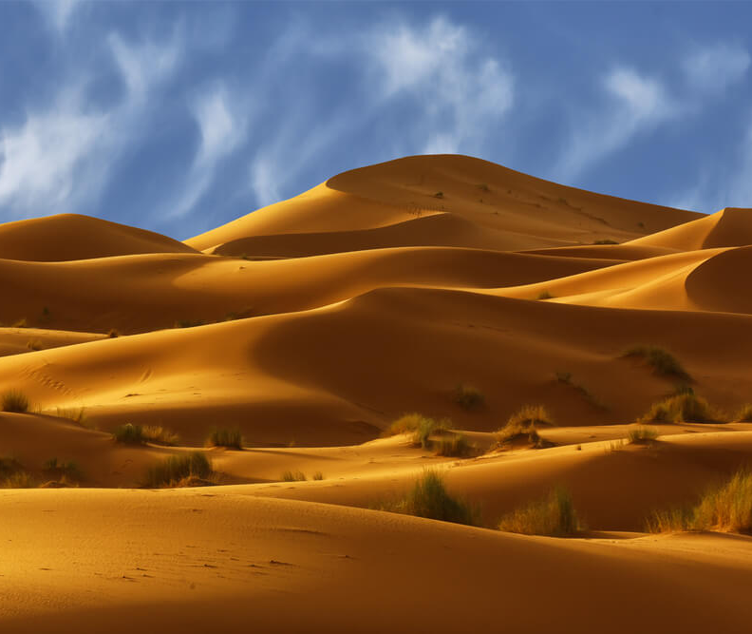
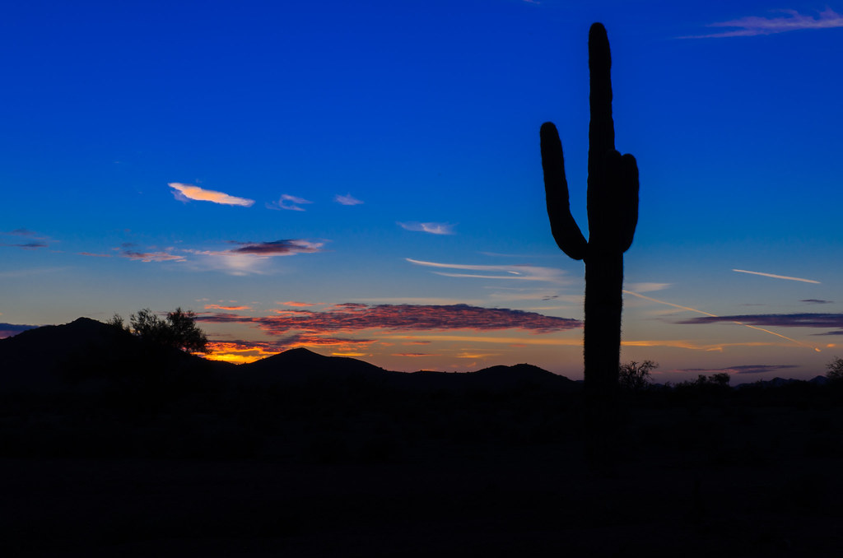
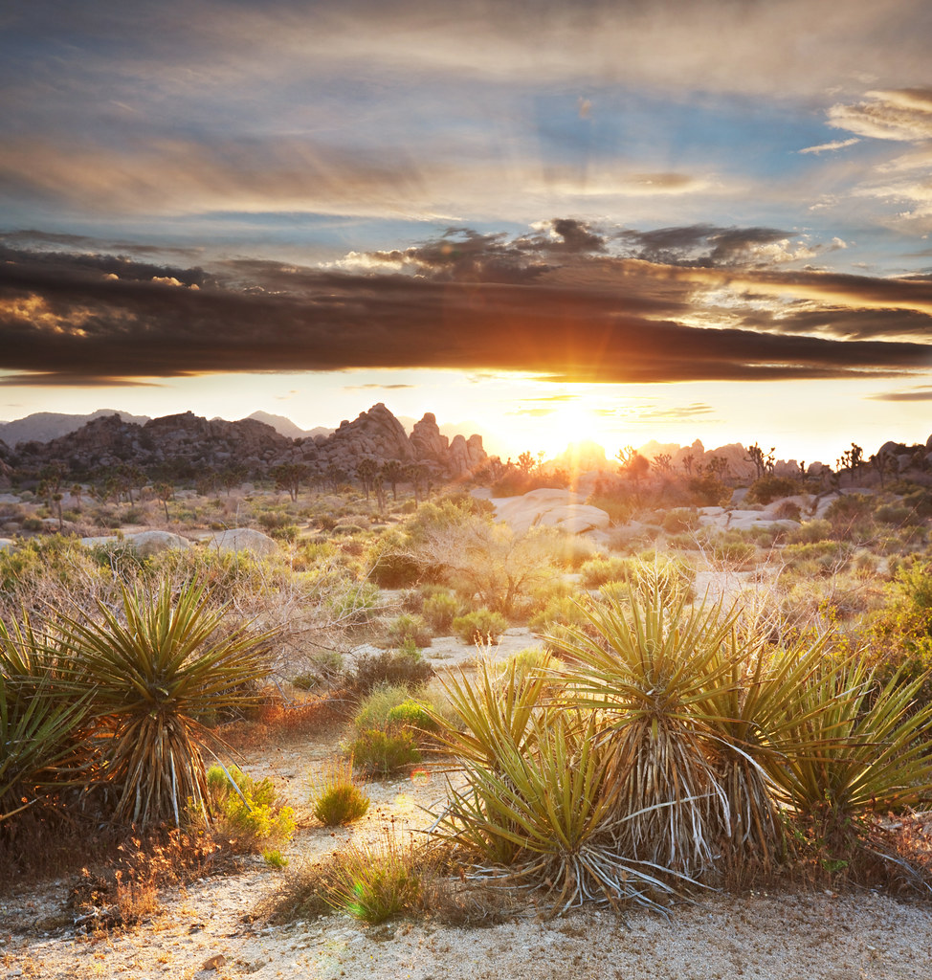
Location
The Mojave tribe lived in what is now Arizona or California.
They lived in the desert which is a hot and sandy place to live.
They lived the southeastern part of California.
This Photo by Unknown author is licensed under CC BY.
This Photo by Unknown author is licensed under CC BY-SA-NC.

Slide 3
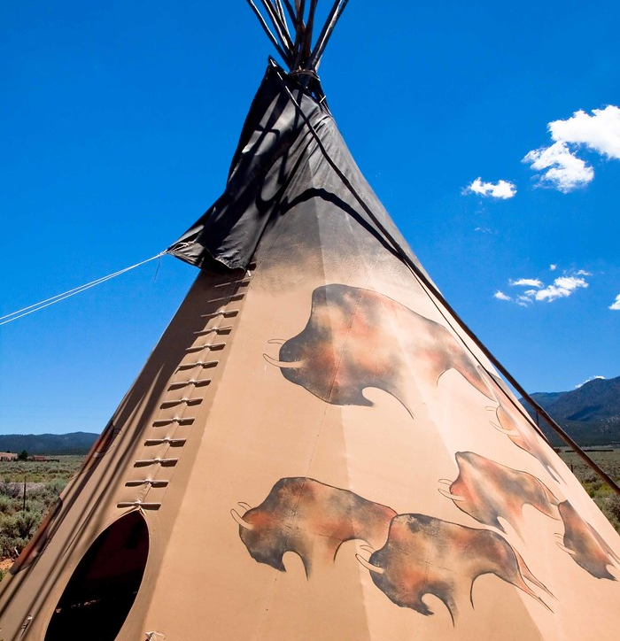
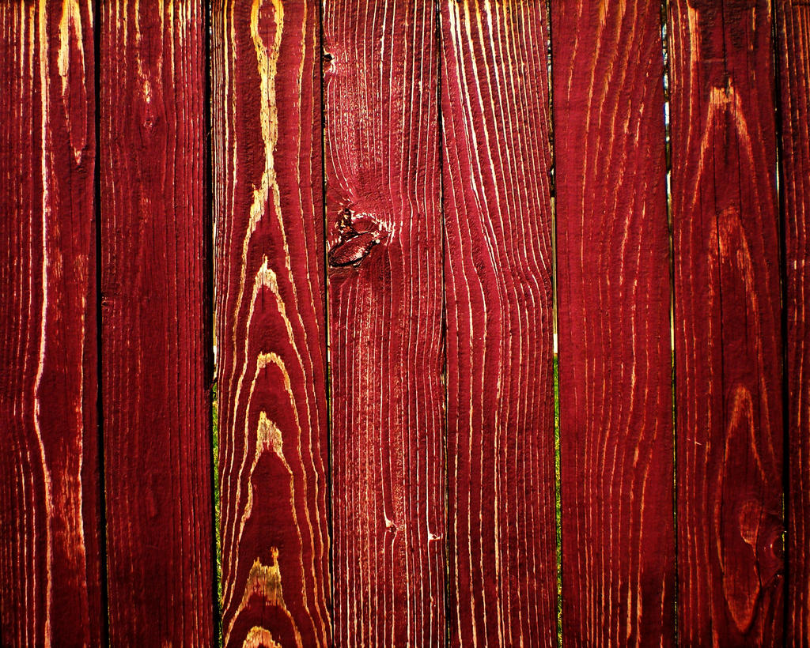
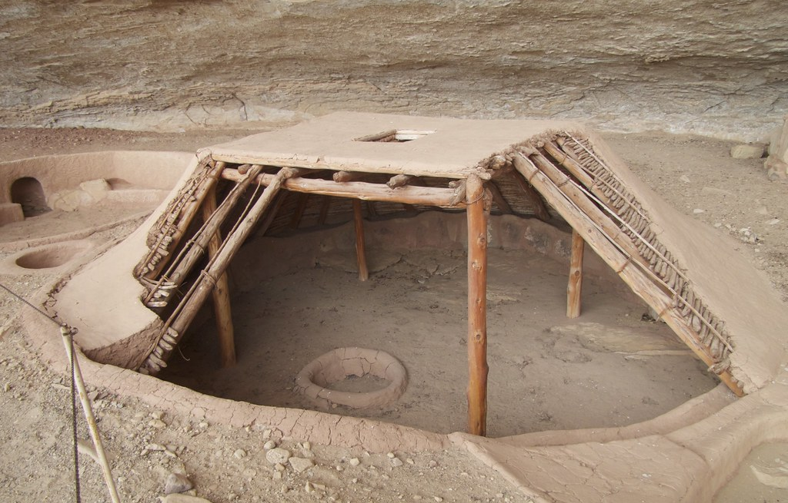
Shelter
Some of them lived​​ in a tepee. A tepee is shaped like a cone
Others live in a pit house but it's shaped like a trapezoid.
The Mojave tribe had a house called redwood plank.
This Photo by Unknown author is licensed under CC BY-NC.
This Photo by Unknown author is licensed under CC BY.
This Photo by Unknown author is licensed under CC BY-SA.

Slide 4
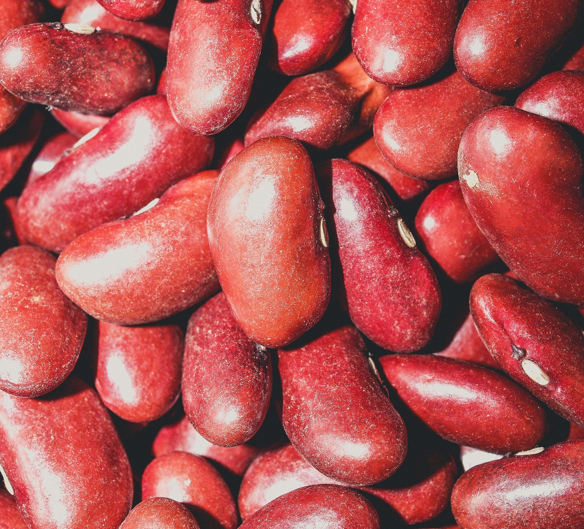
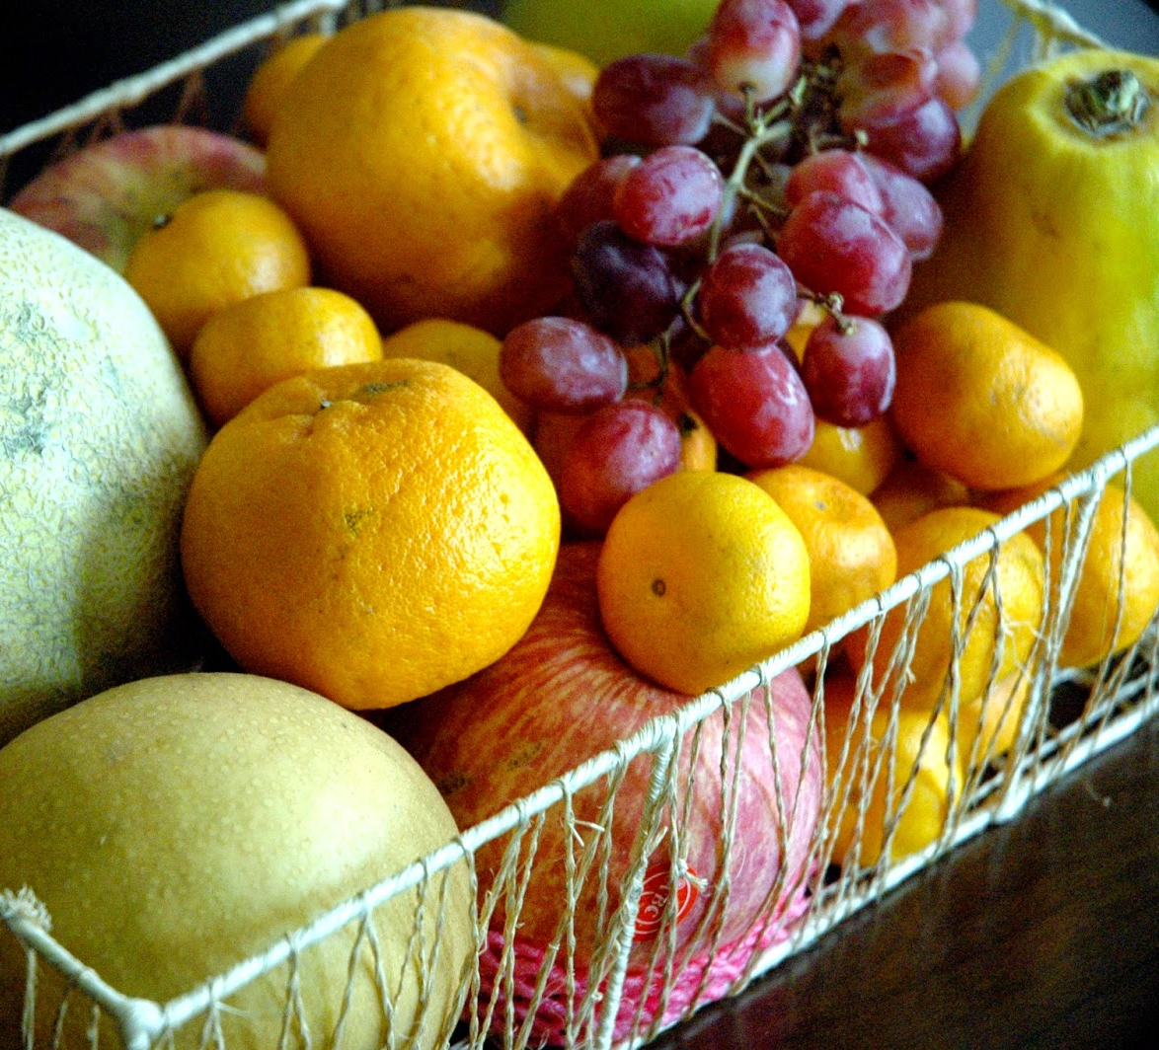
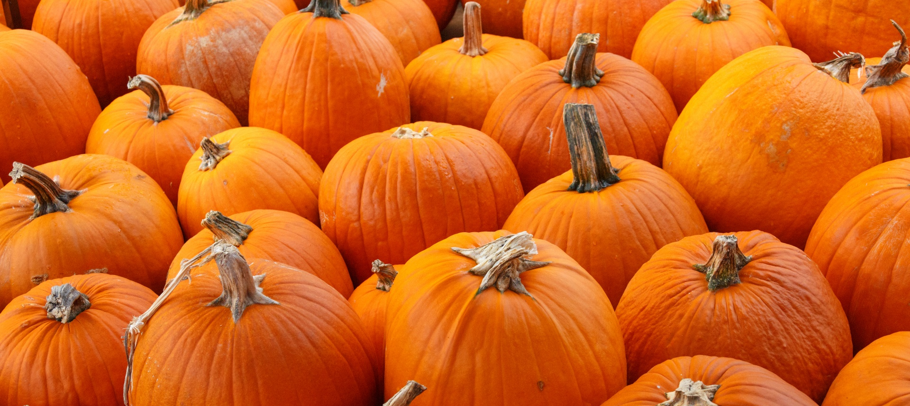
They gathered seeds, nuts, and herbs.
They hunted rabbits, fish, skunks.
The Mojave tribe used to be farmers, so they planted pumpkins, beans, fruits, and corn.
This Photo by Unknown author is licensed under CC BY-ND.
Food

Slide 5
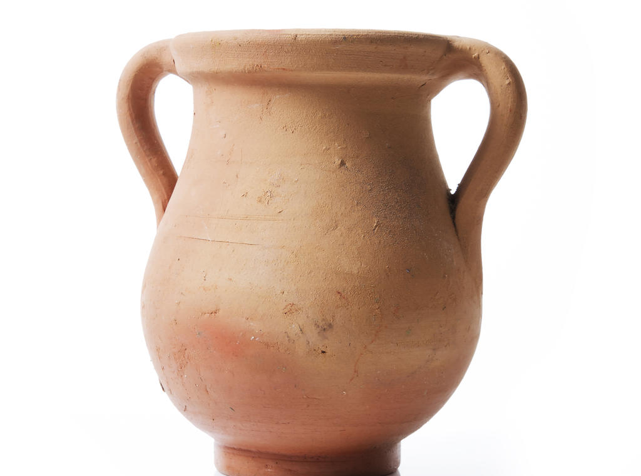
Culture
The Mojave tribe made clay pots to hold water.
They did a ceremony every year like a funeral.
They make a circle to remember the people that died.
This Photo by Unknown author is licensed under CC BY.
This Photo by Unknown author is licensed under CC BY-SA.

Slide 6
The END.
This Photo by Unknown author is licensed under CC BY-SA.

