Slide 1
CH 13 GENETIC ENGINEERING
13.1 CHANGING THE LIVING WORLD
13.2 MANIPULATING DNA
13.3 CELL TRANSFORMATION
13.4 APPLICATION OF GENETIC ENGINEERING

Slide 2
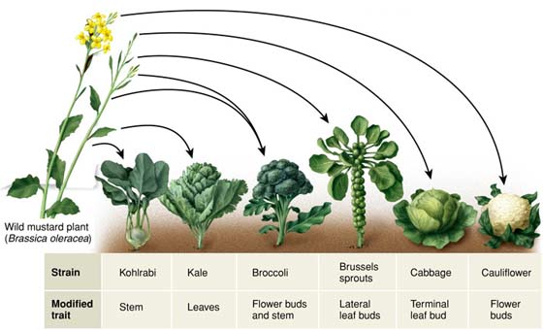
13.1 Changing the Living World
Selective Breeding is when humans only allow animals with desired characteristics to produce the next generation
Humans use selective breeding, which takes advantage of natrually occurring genetic variation in plants, animals and other organisms, to pass desired traits on to the next generation of organisms.

Slide 3
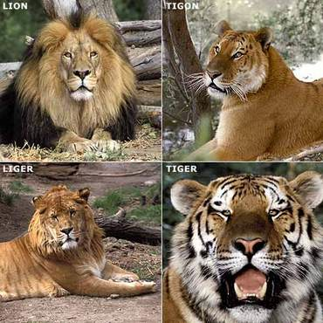
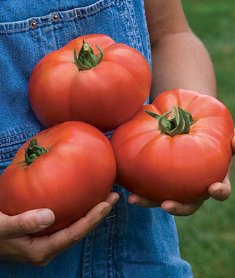
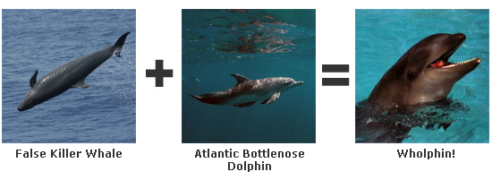
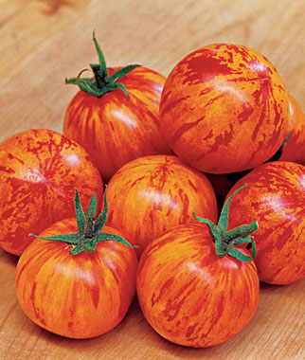
13.1 Changing the Living World
Hybridization is crossing dissimilar individuals to bring together the best of both organisms.
EXAMPLE-Cross a big fruit with a sweet fruit until you get a big and sweet fruit

Slide 4
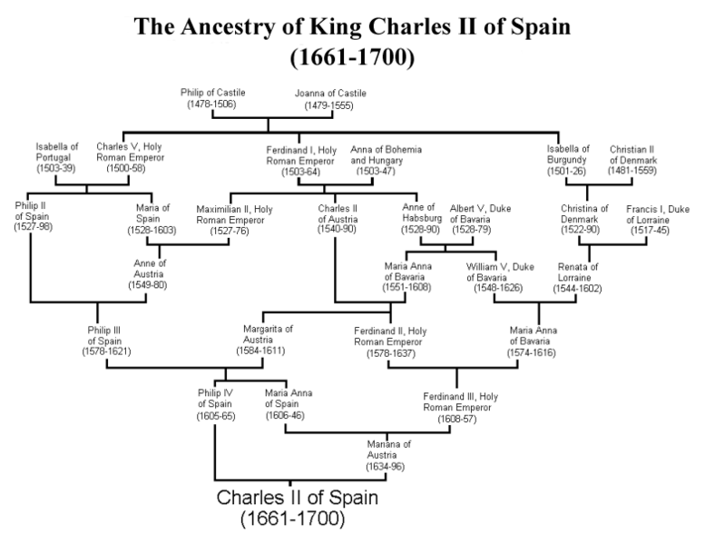
13.1 Changing the Living World
To maintain the desired characteristics of a line of organisms, breeders often use a technique known as inbreeding or breeding of similar characteristics.
Inbreeding leads to many problems due to the increased chance of having two recessive alleles for a genetic defect.

Slide 5
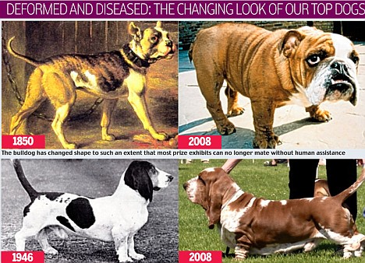
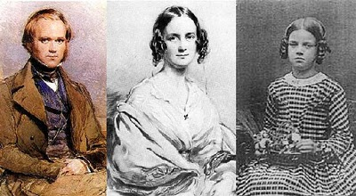
Inbreed problems
All white tigers come from 1 common Mutant descendant
Many dogs have been inbreed to the extent that they cant mate without human assistance
Darwin was married 6 times to relatives and over 50% of his children died before they were 10

Slide 6
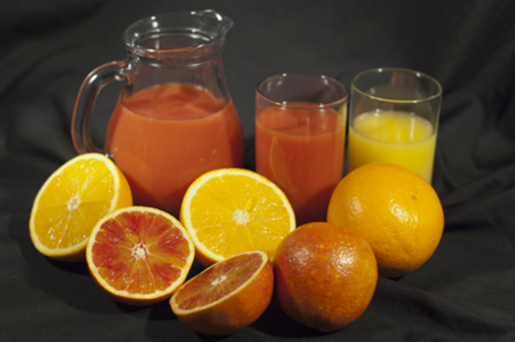
13.1 Changing the Living World
Breeders can increase the genetic variation in a population by inducing mutations, which are the ultimate source of genetic variability.

Slide 7
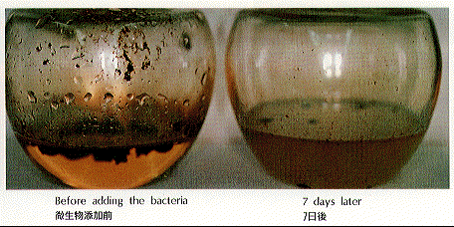
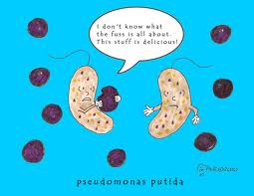
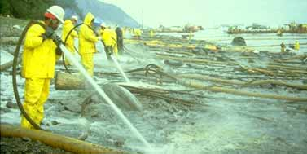
13.1 Changing the Living World
The small size and fast life cycle of bacteria enable scientists to produce new strains of productive bacteria.
Example- Bacteria strain produced to break down oil during spills

Slide 8
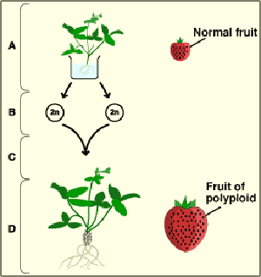
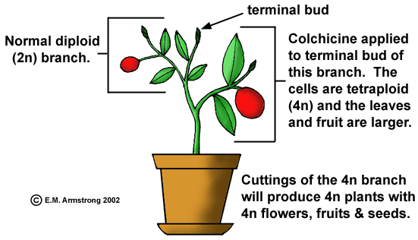
13.1 Changing the Living World
By using drugs that prevent the separation of chromosomes, scientist can create new plants with double or even triple the amount of chromosomes
Plants tolerate being polyploidy better than animals

Slide 9
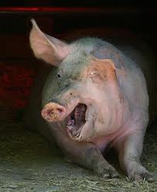
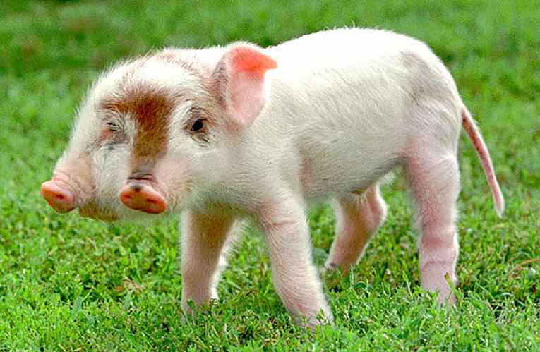
13.1 Changing the Living World
Notebook is due in 3 weeks at the end of the semester
The scores on your notebook is vital to your final grade in this class
DO YOUR QUESTIONS
PG 321 (1-5)
Inbreeding pigs to produce larger animals

Slide 10
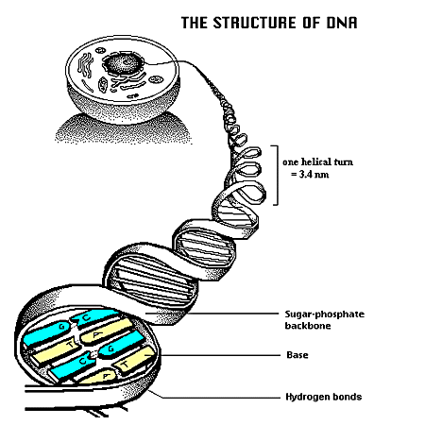
13.2 Manipulating DNA
Scientists use their knowledge of the structure of DNA and its chemical properties to study and change DNA molecules.
Different techniques are used to extract DNA from cells, to cut DNA into smaller pieces, to identify the sequence bases in a DNA molecule, and to make unlimited copies of DNA

Slide 11
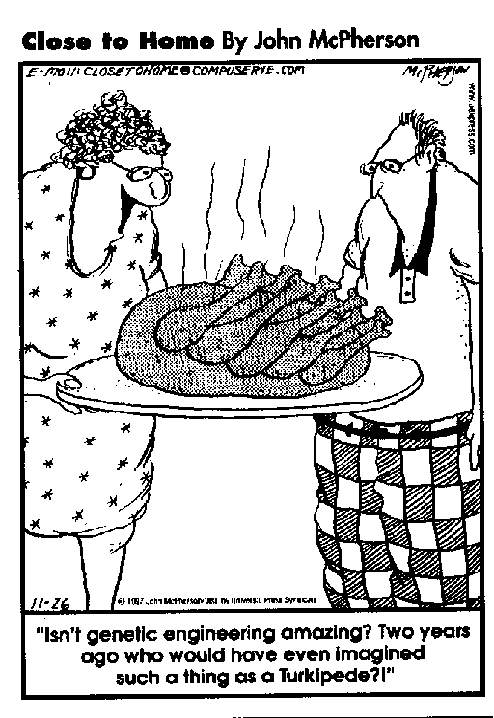
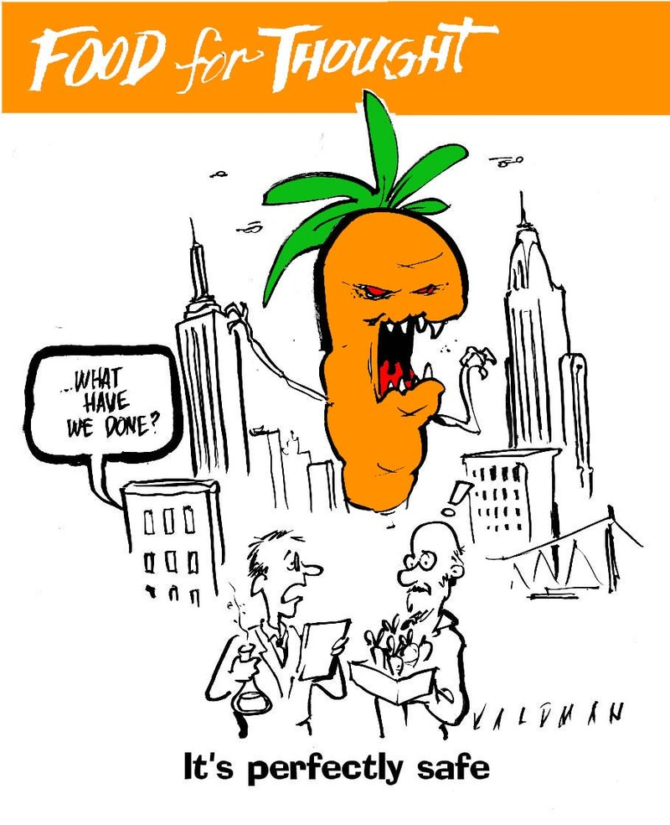
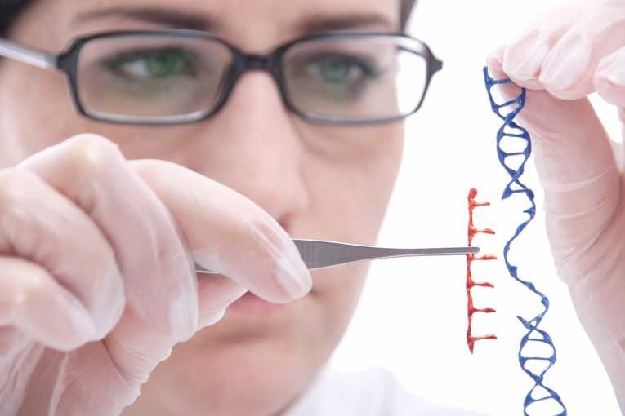
13.2 Manipulating DNA
The same way a software engineer removes a program, modifies the code and puts it back in, a scientist doing Genetic Engineering will remove DNA, change it and put it back

Slide 12
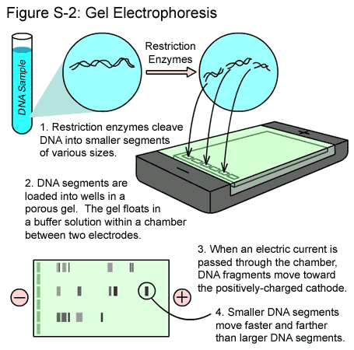
13.2 Manipulating DNA
DNA Extraction- DNA is chemically removed from cells
Cutting DNA- Hundreds of Restriction Enzymes are known and each one cuts DNA at a specific sequence of nucleotides
Separating DNA- A mixture of DNA fragments is placed at one end of a porous gel and an electrical charge voltage is applied to the gel in a process called Gel Electrophoresis

Slide 13
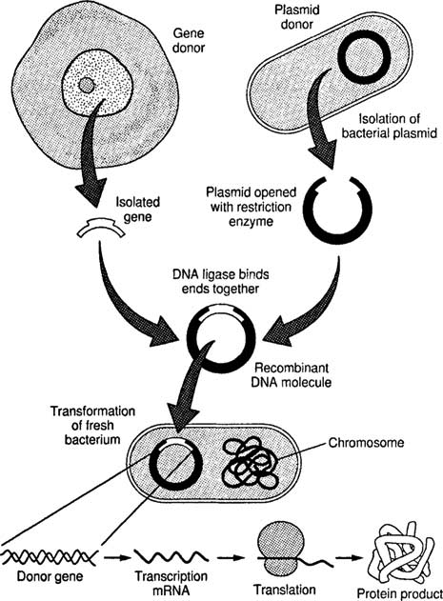
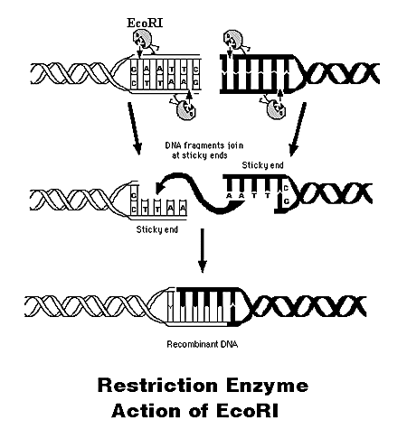
13.2 Manipulating DNA
DNA molecules are sometimes called Recombinant DNA because they are produced by combining DNA from different sources

Slide 14
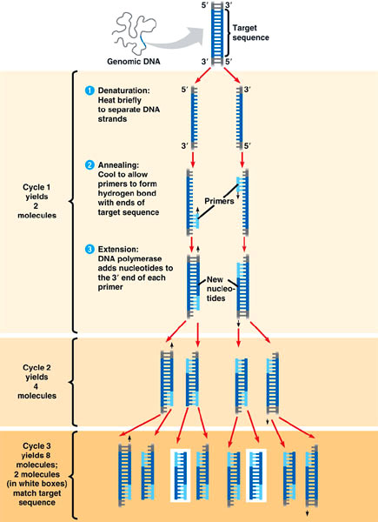
13.2 Manipulating DNA
To study genes, Biologists need to make many copies of a particular gene. They use a process called Polymerase chain reaction which is like keeping a copy machine on “print”
Pg 326 (1-5)

Slide 15
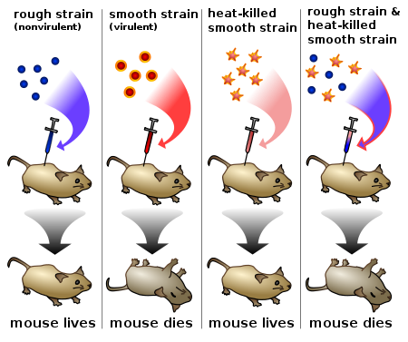
13.3 Cell Transformation
During Transformation, a cell takes in DNA from outside the cell. This external DNA becomes a component of the cell’s DNA
We seen it before→

Slide 16
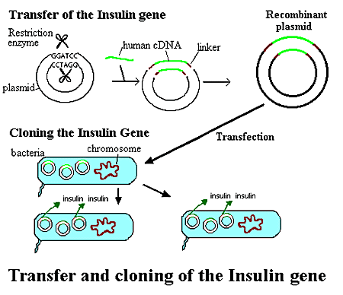
13.3 Cell Transformation
TRANSFORMING BACTERIA CELLS
The foreign DNA is first joined to a small circular DNA molecule called a Plasmid (formed naturally in bacteria)
The plasmid has a Genetic Marker or a gene that makes it possible to distinguish bacteria that carry the plasmid from those that don’t

Slide 17
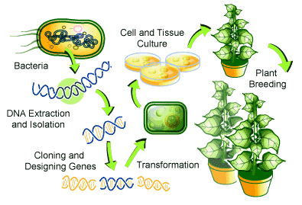
13.3 Cell Transformation
TRANSFORMING PLANT CELLS
If transforming is successful, the recombinant DNA is integrated into one of the chromosomes of the cell

Slide 18
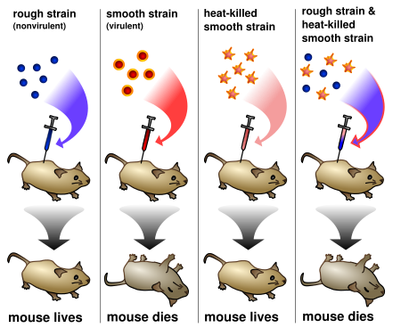
13.3 Cell Transformation
TRANSFORMING ANIMAL CELLS
Some eggs are large enough to directly inject DNA
Once inside the cell, enzymes that normally fix DNA will insert them into the host
Markers are also used to identify recombinant genes
Pg 329 (1-5)

Slide 19
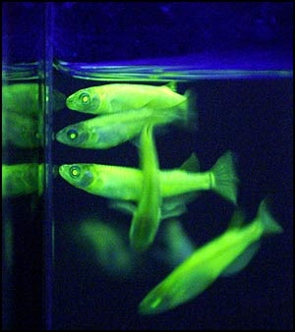
13.4 Application of Genetic Engineering
If an organism has genes from other species they are considered Transgenic
Genetic engineering has spurred the growth of biotechnology, which is a new industry that is changing the way we interact with the new living world
EX-Fish with Bacteria genes to glow

Slide 20
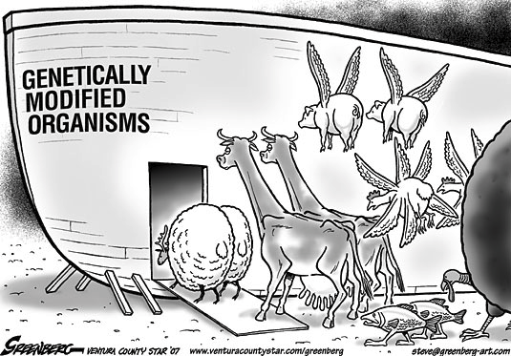
13.4 Application of Genetic Engineering
Transgenic animals
Chickens with bacteria resistance to prevent food poisoning
Mice with human immune genes to help scientists study medicine
Transgenic Plants
In 13 years ago 52% of soybeans and 25% of corns was transgenic
Plants that produce Insecticide
Scientists trying to add vitamins to rice since it is the most common food

Slide 21
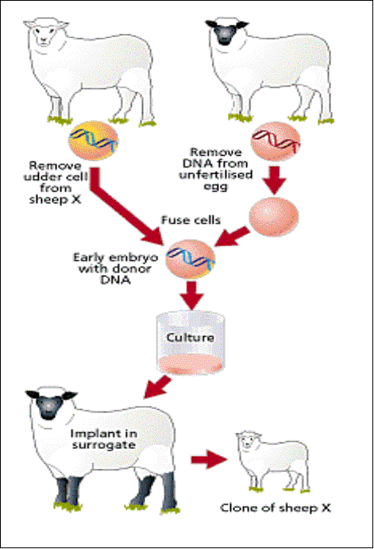
13.4 Application of Genetic Engineering
A Clone is a member of a population of genetically identical cells produced from a single cell
Pg 333 (1-4)

