Slide 1
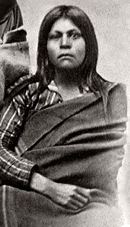
Gabrielino
By Lea Kimura

Slide 2
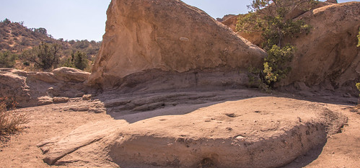
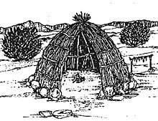
Shelter
The Indians of the southern coast lived by many shelters. They used poles upright in a circle to make the houses. They used reeds or ferns or mats woven from tules. They built sweat houses for men to sweat and talk.

Slide 3
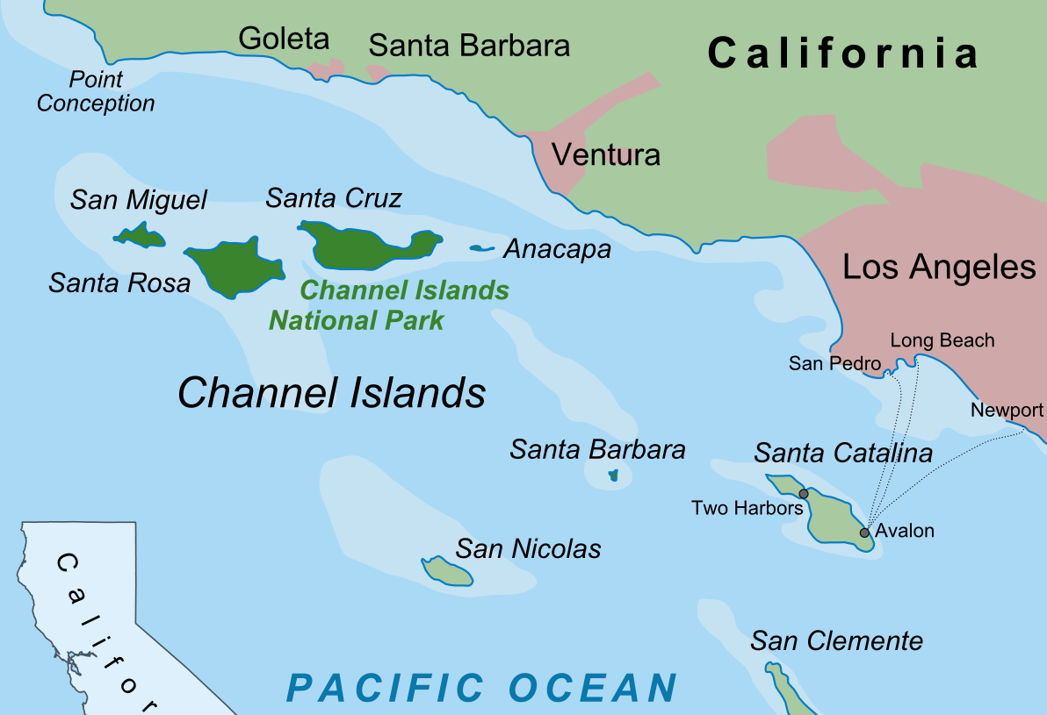
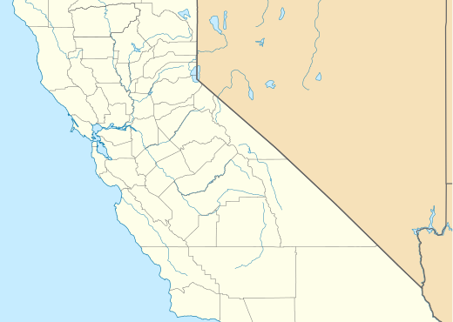
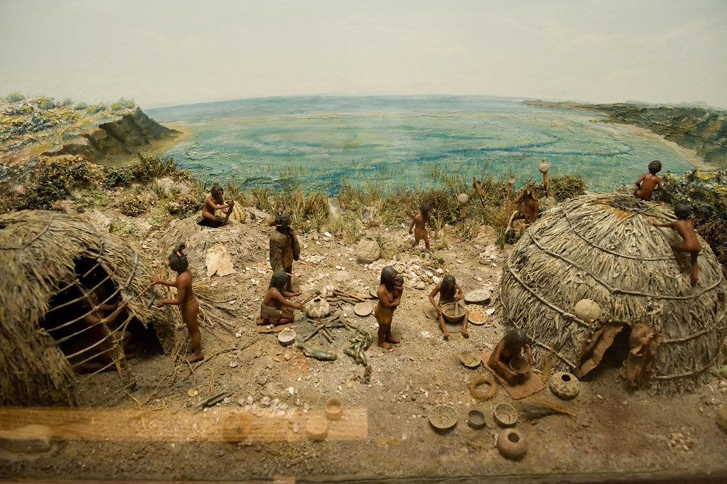
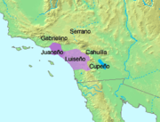
Location
The Gabrielino lived on the southern coast of California. They lived inland along the coast. They live on the island. They lived in western part of California.
This Photo by Unknown author is licensed under CC BY-SA.
This Photo by Unknown author is licensed under CC BY-SA.

Slide 4
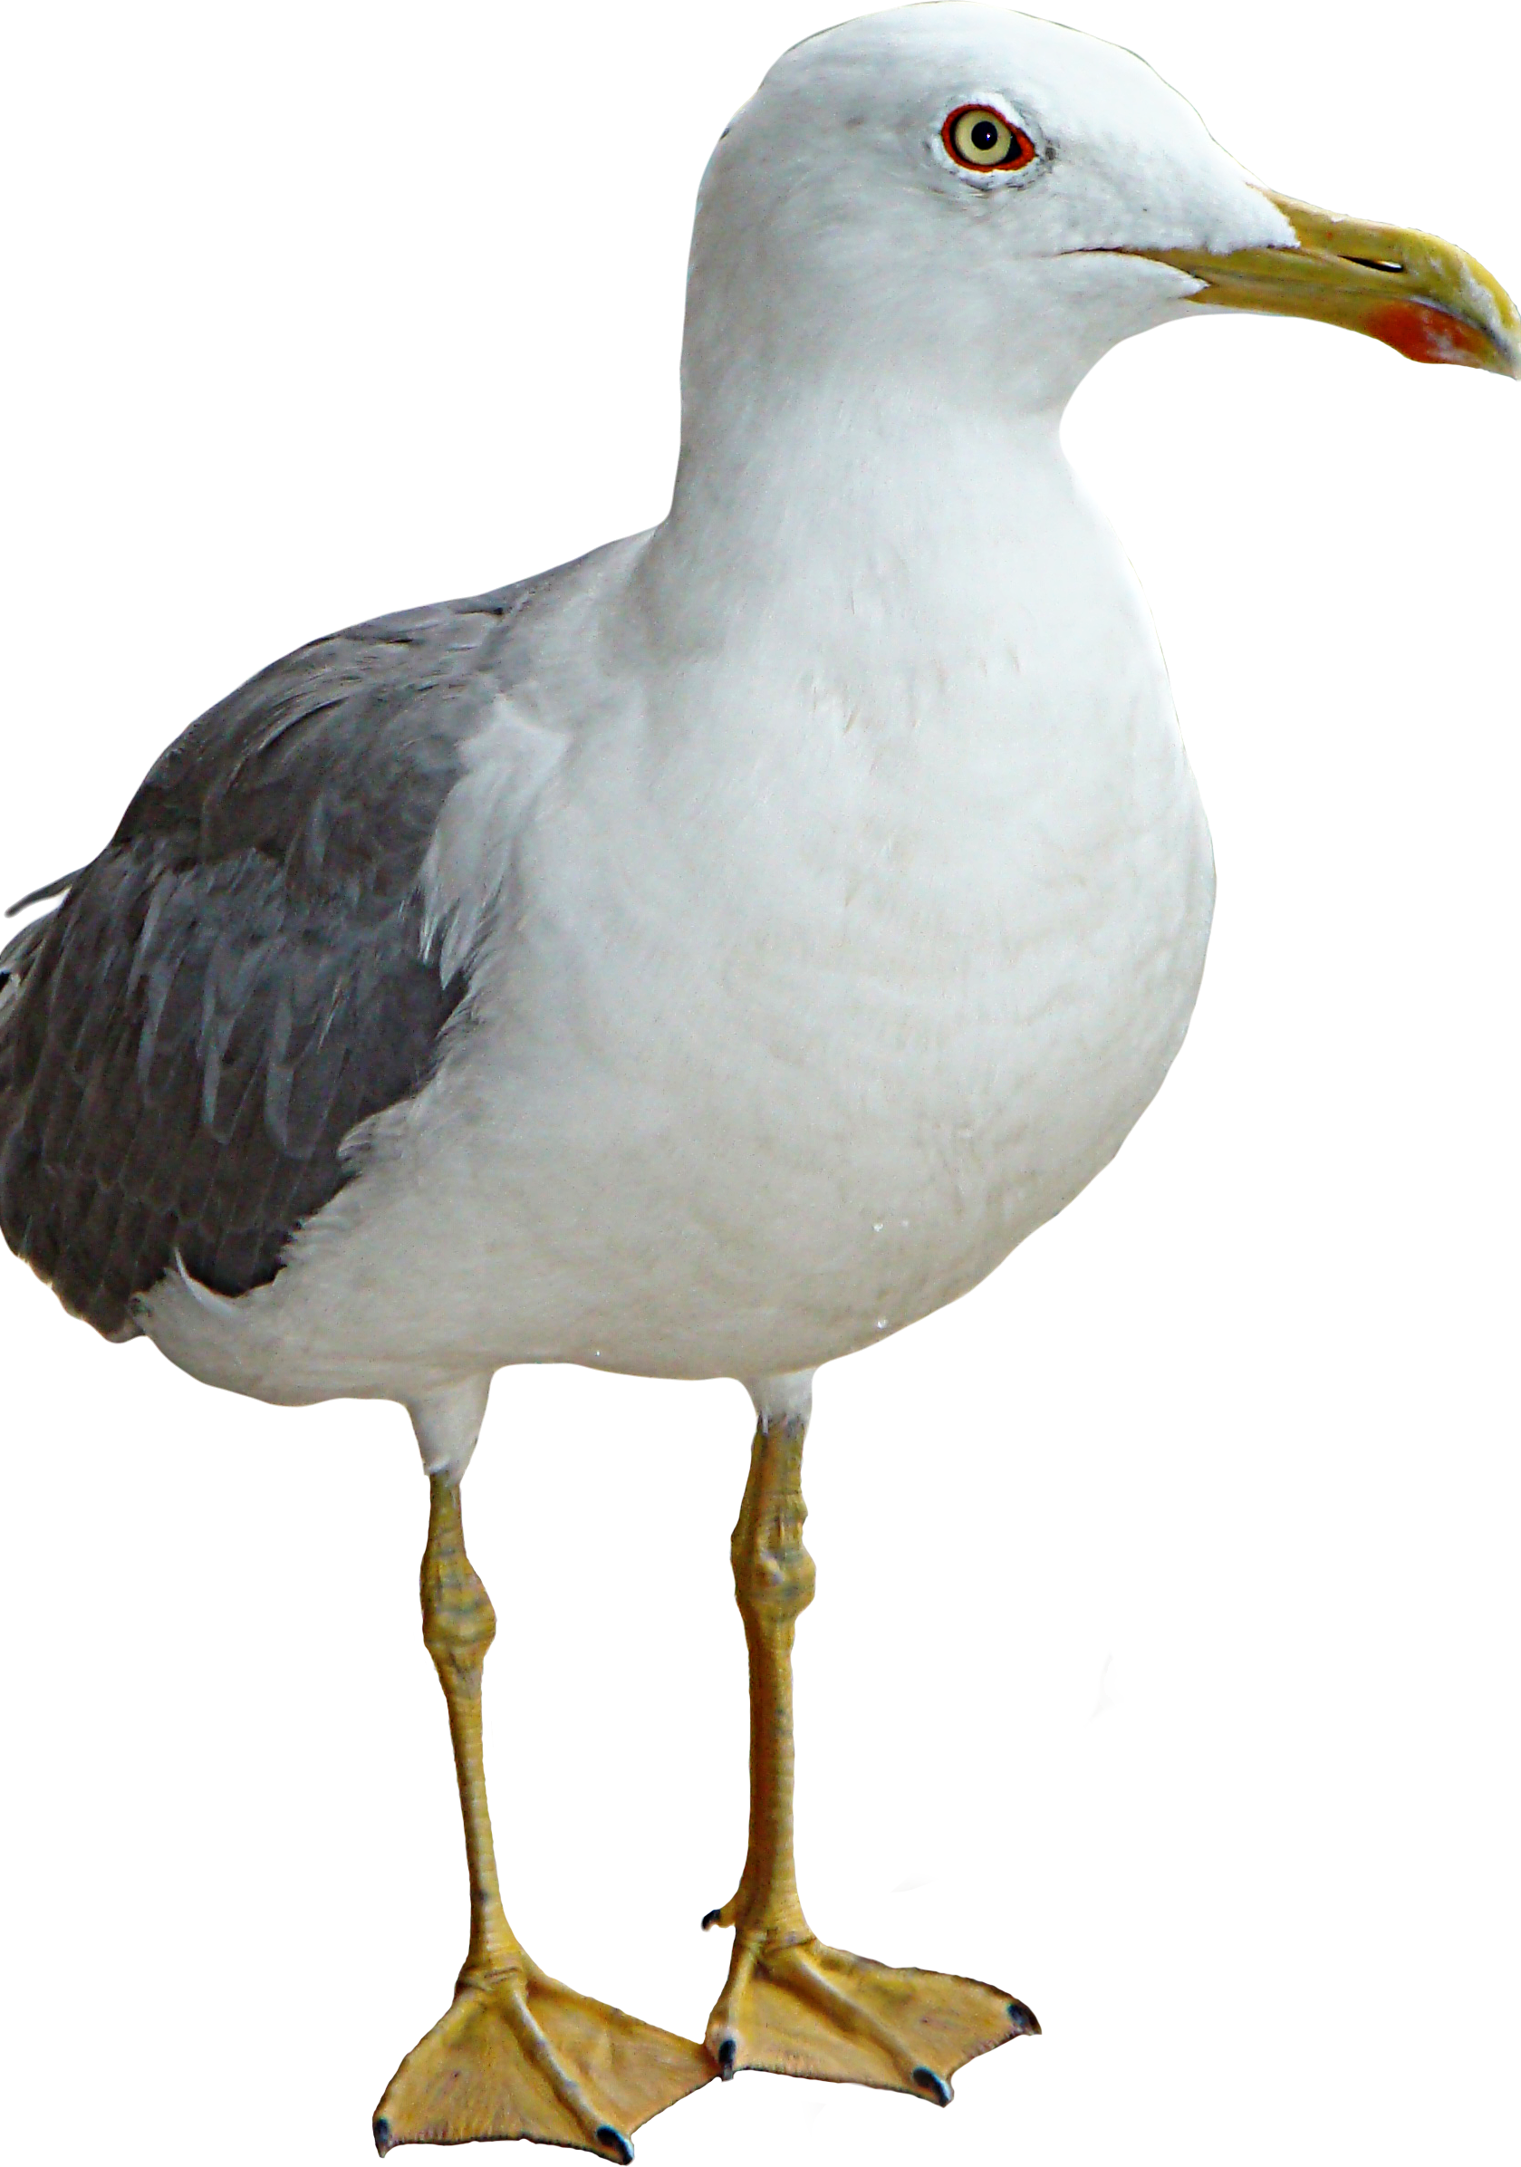
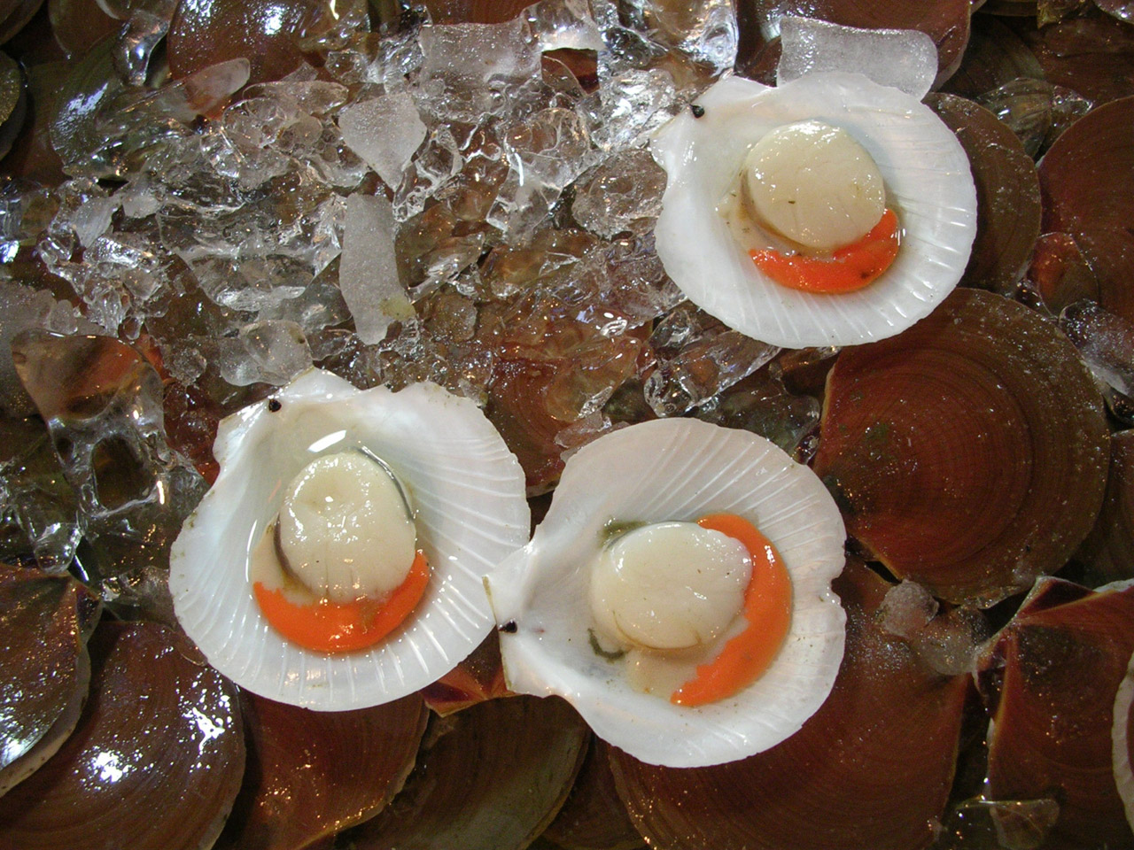
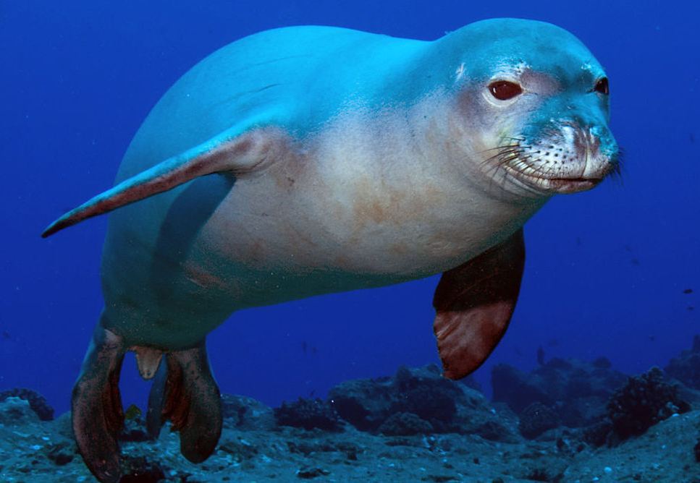
Food
The Gabrielino have a lot of food from the land and sea they ate acorns as a main food. They hunted animals such as shellfish, sea mammals, and sea birds.

Slide 5
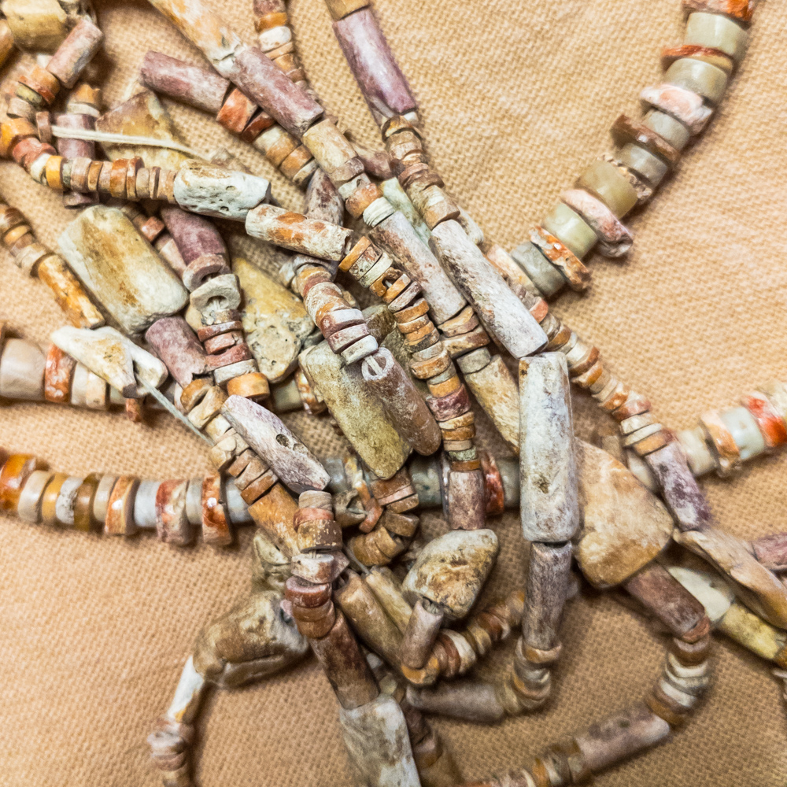
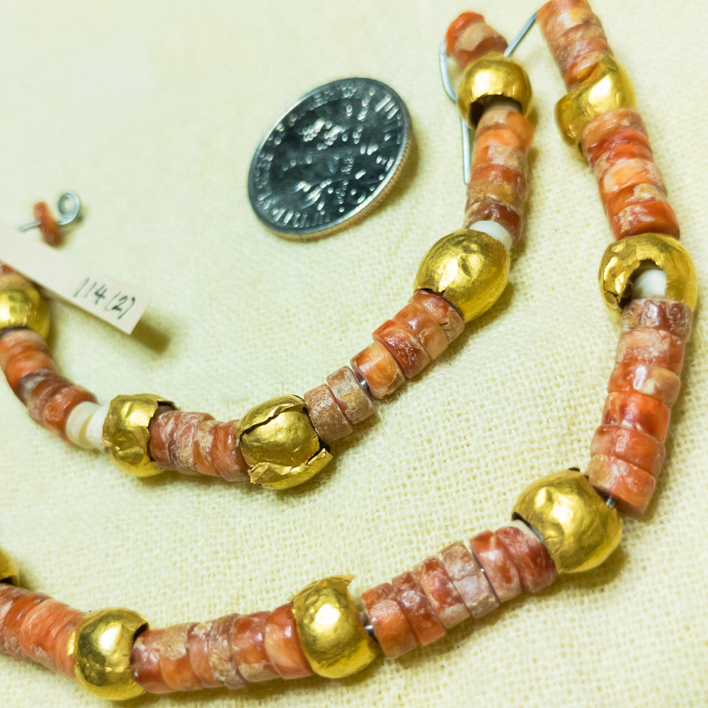
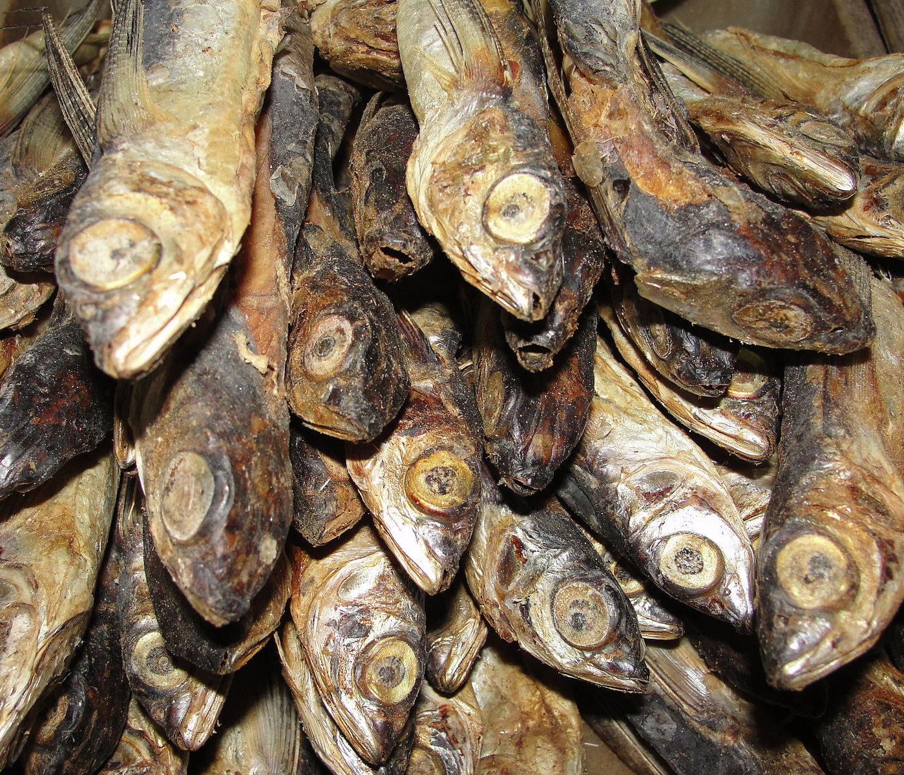
Culture
The Gabrielino culture has traditional and unique ceremonies. Men and children usually did not wear clothing. The biggest ceremony was held in the fall to remember those who had died. For people who lived away from the ocean they traded shell beads, dried fish, and sea otter skin.

Slide 6
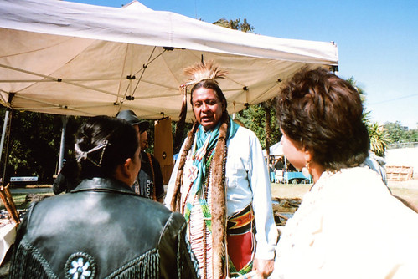
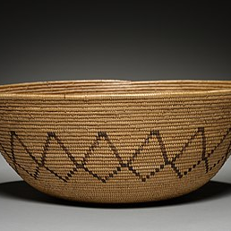
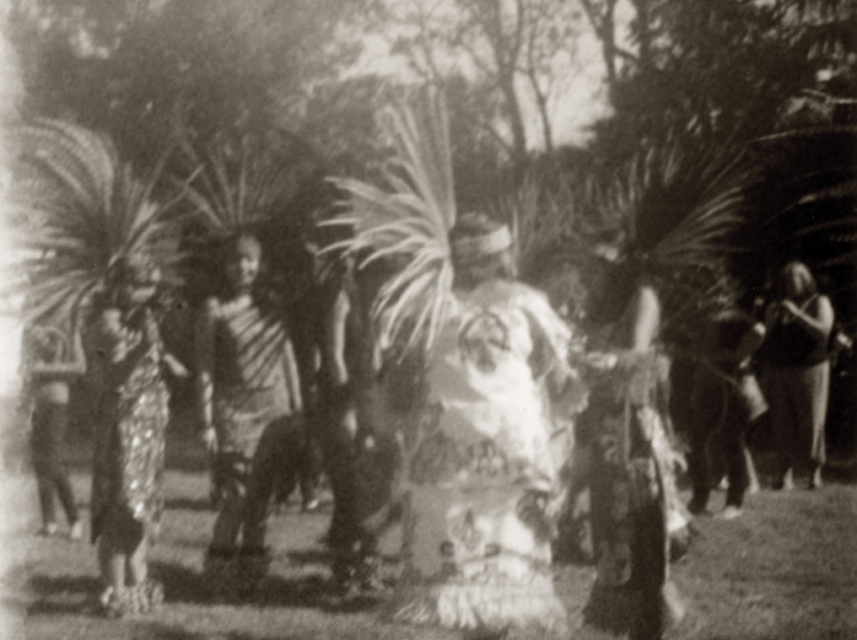
Extra!
This Photo by Unknown author is licensed under CC BY-SA.

