Slide 1
Weather & Climate
By Samantha and Arhianna

Slide 2
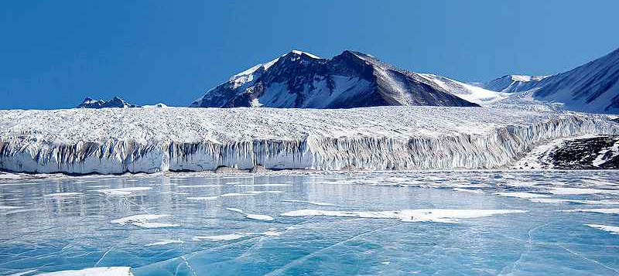
Polar Climate Zone
The Artic and Antartica are similar places at opposite ends of the Earth. They are both very cold with lots of snow and ice. Winters are dark, and in summer the sun shines 24 hours a day.

Slide 3
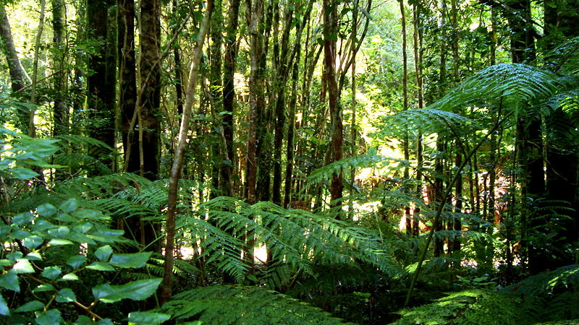
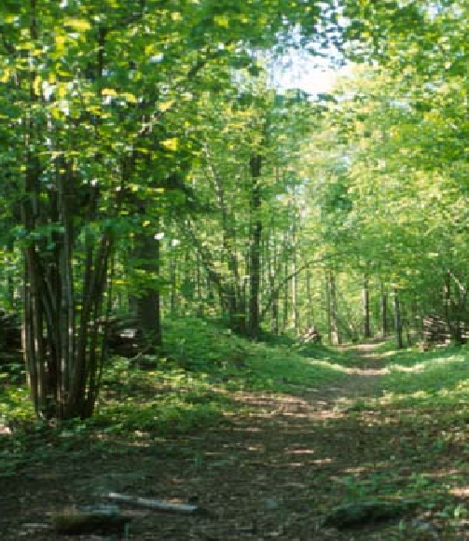
Temperate Climate Zone
Temperate is a synonym of moderate. The weather in Temperate climate is never too extreme. Summers are warm and wet. Winters are cold and dry. Neither seasons have very hot or very cold temperatures. many plants and animals species thrive in these moderate conditions. Most of the United States falls into the region of temperate climates.

Slide 4
Tropical Climate Zone
Right around the equator is the tropical climate zone. The zone is mostly found between the Tropic of Cancer and the tropic of Capricorn. In some places it extends as wide as thirty degrees north and thirty degrees south latitude. Tropical climates receive a lot of sunlight and are very warm. Rainfall is heavy so they are also very wet. This climate is perfect for rain forests.

Slide 5
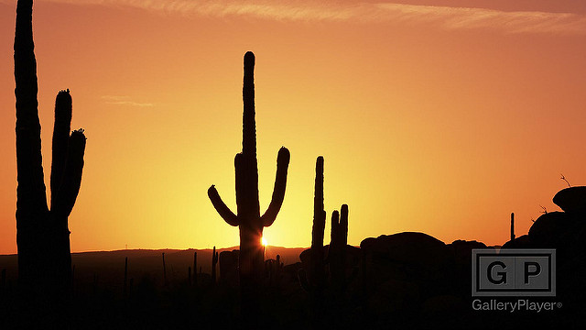
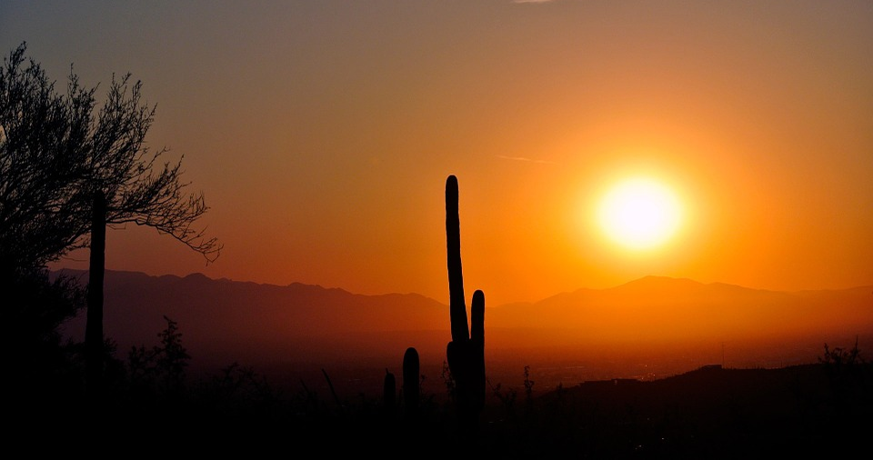
Desert Climate Zone
It's unusually hot in most desert climates. In fact, the ground gets so hot that it heats the air. You can actually see the air rise in waves. These wave can play tricks on your eyes. These are called mirages. They make people see things that are not really there. But, there is more to deserts than just high temperatures.

Slide 6
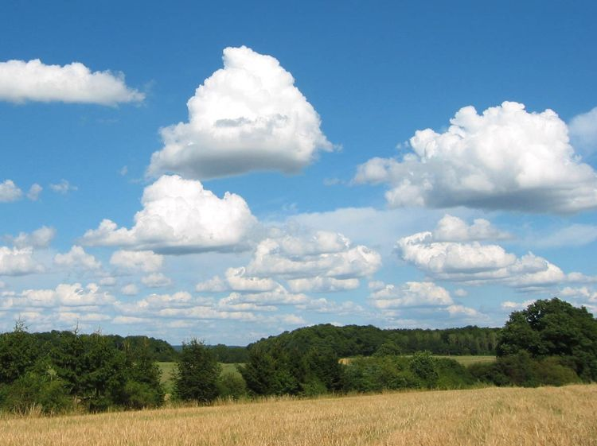
Cumulus Clouds
Cumulus clouds are also called fair weather clouds and look like floating cotton. They have very flat bases and are not very tall clouds. When cumulus clouds are first formed from droplets they have very distinct edges but as they move though the sky, air causes the edges to appear more ragged and broken apart.

Slide 7
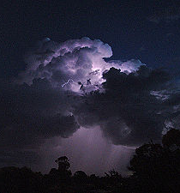
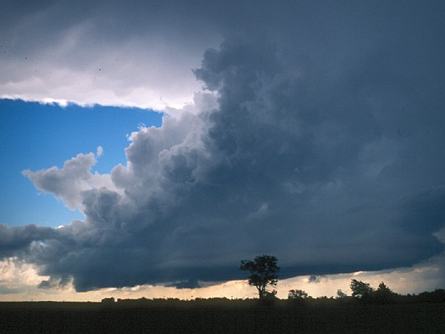
Cumulonimbus Clouds
Cumulonimbus clouds can take up several miles across the sky and can reach elevation of 39,000 ft or higher because of very strong updrafts in the atmosphere. Low level cumulonimbus clouds are made up of water droplets but at higher elevations, they consist of ice crystals. Cumulonimbus clouds are the type of clouds that bring lightning thunder violent tornadoes and other intense situations.

Slide 8
Stratus Clouds
Stratus clouds are among the low lying clouds. They are gray clouds that cover the entire sky and can be the result of very thick fog lifting in the morning.

Slide 9
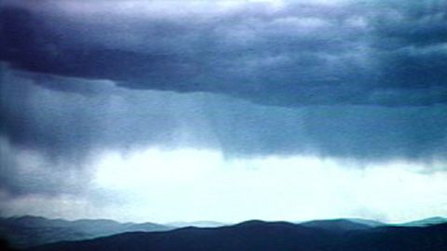
Nimbostratus Clouds
Nimbostratus clouds are dark gray clouds that produce falling rain or snow.

Slide 10
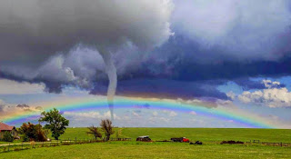
Extreme Weather- Tornado
Tornadoes aren't very big next to other storms. A thunderstorm can be several miles wide. Very big storms, called hurricanes, are often miles from one side to the other. The largest tornadoes are only about a mile wide. Most are even smaller. They don't travel very fast and many appear for only a short time.

Slide 11
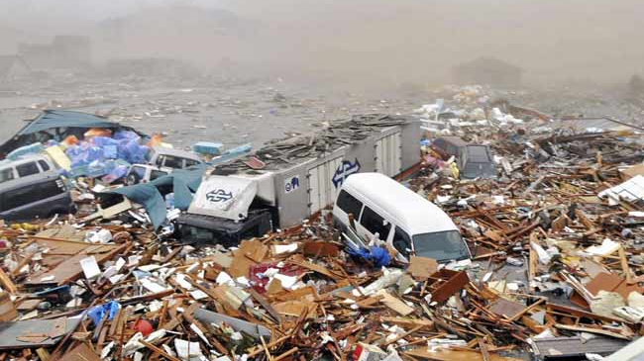
Extreme Weather- Tsunami
Tsunamis are caused by shifts in the ocean bottom Earthquakes, volcanoes, and landslides can cause Tsunamis. Tsunami's don't just happen far away. They have happened in the United States too. Another area where earthquakes occur is near Alaska. In 1946, an earthquake rocked the Aleutian Island. This island are right off the cost of Alaska. Just like with the earthquake in Sumatra, waves were created. These waves moved across the Pacific Ocean.

Slide 12
Extreme Weather- Hurricane
Warm moist air flows into a low-pressure area. As the air rises and condenses into clouds, more warm air is drawn in over and over the surface of the ocean. The destruction that the hurricane leaves behind is staggering. Uprooted trees block streets. Buildings are battered. Some have lost their roofs. The ground is littered with shingles, pieces of wood, and other debris. Broken glass is everywhere. A sailboat is beached in the middle of some railroad tracks.

Slide 13
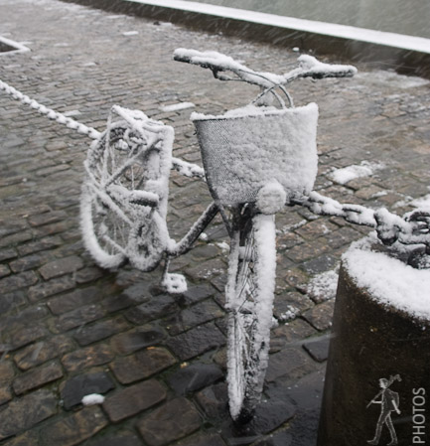
Extreme Weather- Blizzard
Most blizzards happen during December, January, and February. Sometimes, though, they occur as early as October or as late as May. In fact, the biggest snowfall in the U.S happened during April.

Slide 14
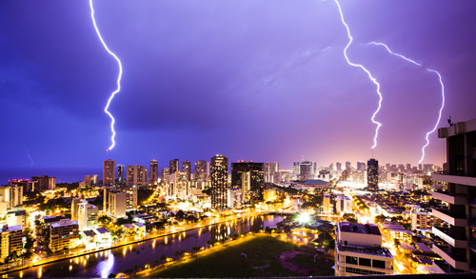
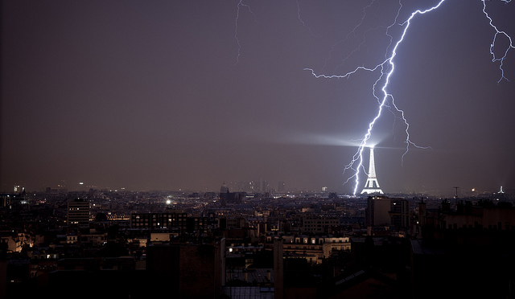
Extreme Weather- Lightning
To make an electric spark, you need electricity. But, how does electricity get into the clouds? Thunder clouds are made of ice crystals and water droplets all swirling around each other. Water droplets are blown up to the top of the clouds where it is very cold they freeze hailstones. The hailstones fall and crash into each other. This movement gives the hail a negative electrical charge. At the top of the cloud, the smaller ice crystals are left with a positive electrical charge.

Slide 15
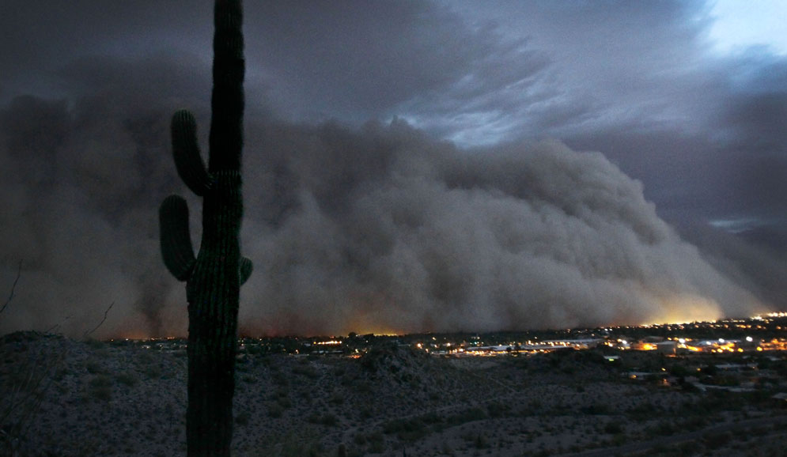
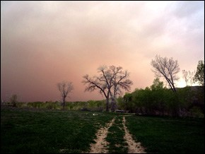
Extreme Weather- Dust Storm
Weather is the state of the air at a certain place and time. Most weather is mild. It may be sunny and warm. Or there may be tornadoes or a hurricane may blow through a city. A dust storm may consume a town. Blizzards may cover the entire city in snow. This wild weather is dangerous. It's important to study this weather so we can be prepared.

