Slide 1
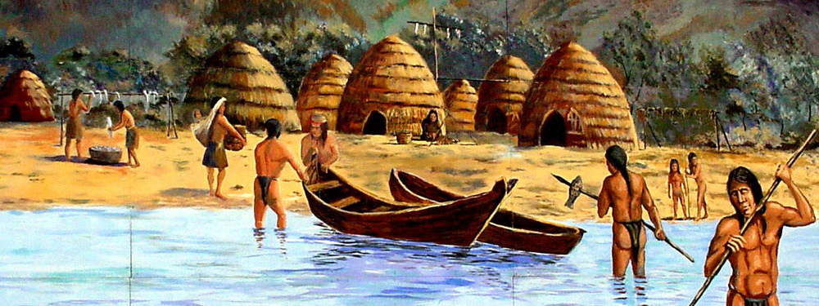
GABRIELINO TRIBE
By Leah Sanchez &
Emma Orosco

Slide 2
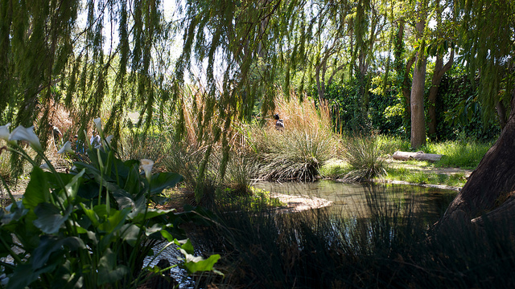
LOCATION
Lands of the Gabrielinos stretched from Topanga south to Laguna Beach and included what today is Los Angeles.
The Gabrielinos placed their villages in sheltered bays on the coast,
and along rivers or streams in the inland areas.
They lived in the Southern California coast and off shore islands.

Slide 3
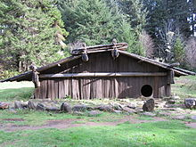
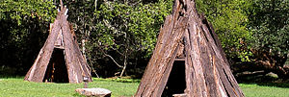
SHELTER
The homes of the Gabrielinos were made by placing poles up right in a circle and bending them to meet in the middle .
The framework of poles were covered with bundles of tule reeds or ferns
Some houses were large enough to hold 50 to 60 people with 3 or 4 families sharing one living space.
Notes:
o

Slide 4
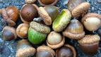
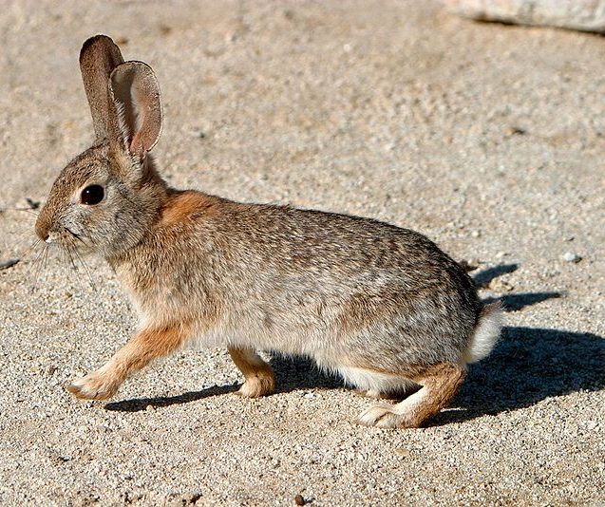
FOOD
The tribe hunted rabbits, squirrels, dears and ducks.
Men also fished for sea lions, sardines,
rockfish, halibut, black sea bass, tuna, swordfish, sharks, shellfish, sea mammals, sealions, harbor seals, sea otters, and elephant seal. They also baked and ate kelp.
The Gabrielinos also gathered nuts, beans, acorns, pine nuts, seeds and fruit.

Slide 5
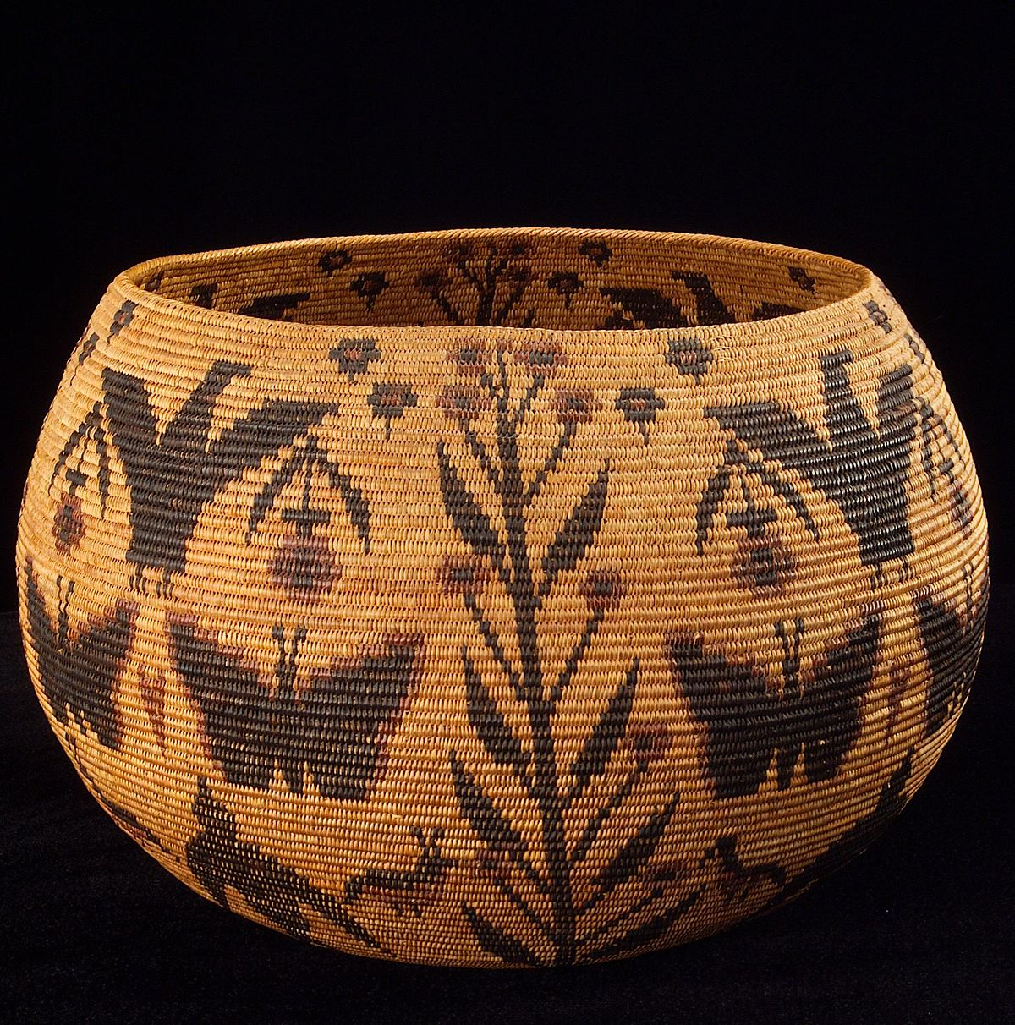
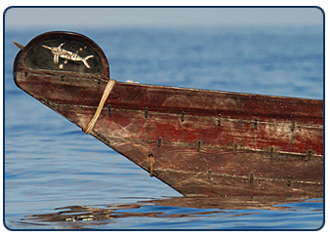
CULTURE
The Gabrielino tribe were expert basket makers. Women did most of thechildcare, cooking and gathered herbs and food from the wilderness.
Those living on the islands used otter skins to make their robes and blankets.
Women wore aprons made of deer skin , or bark from the willow or cotton wood.
Women wore skirts woven of reed-like grass.
Notes:
E wilderness

