Slide 1
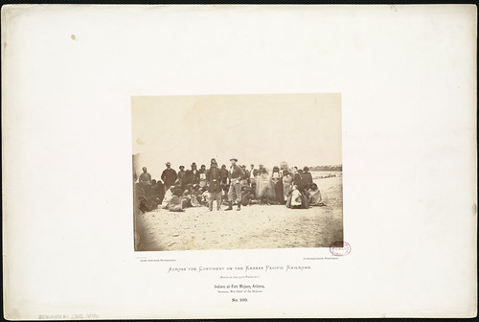
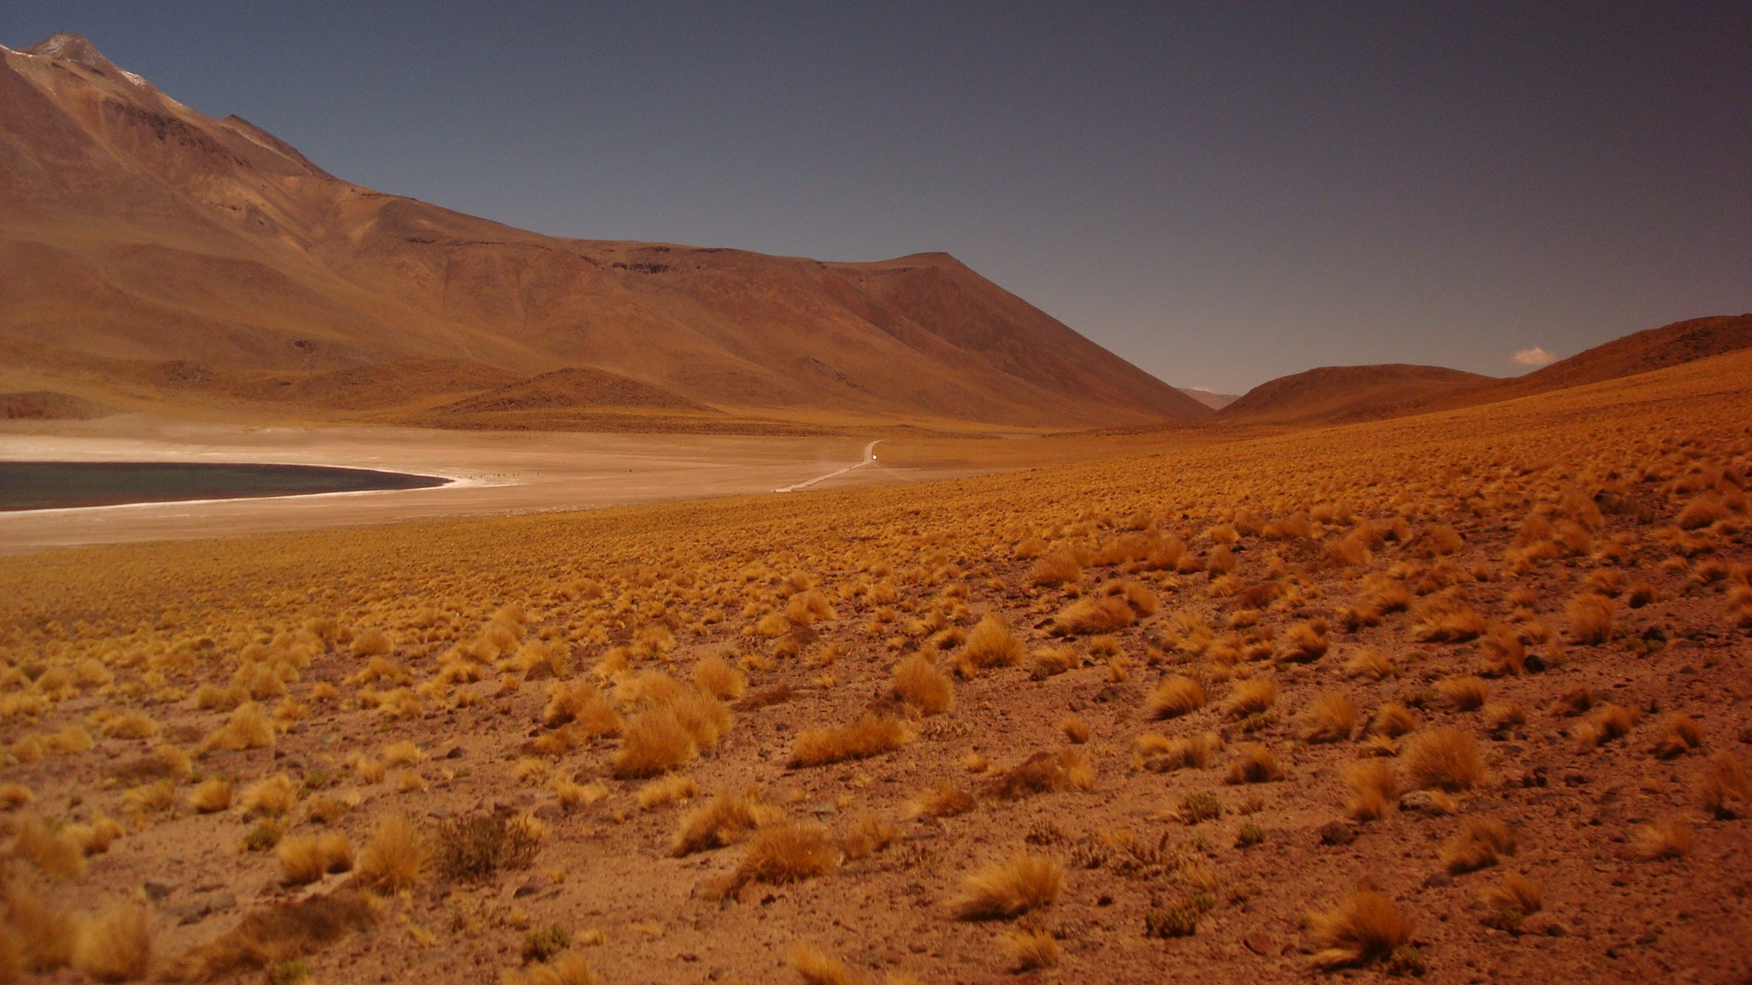
Mojave
This Photo by Unknown author is licensed under CC BY.
By Estella

Slide 2
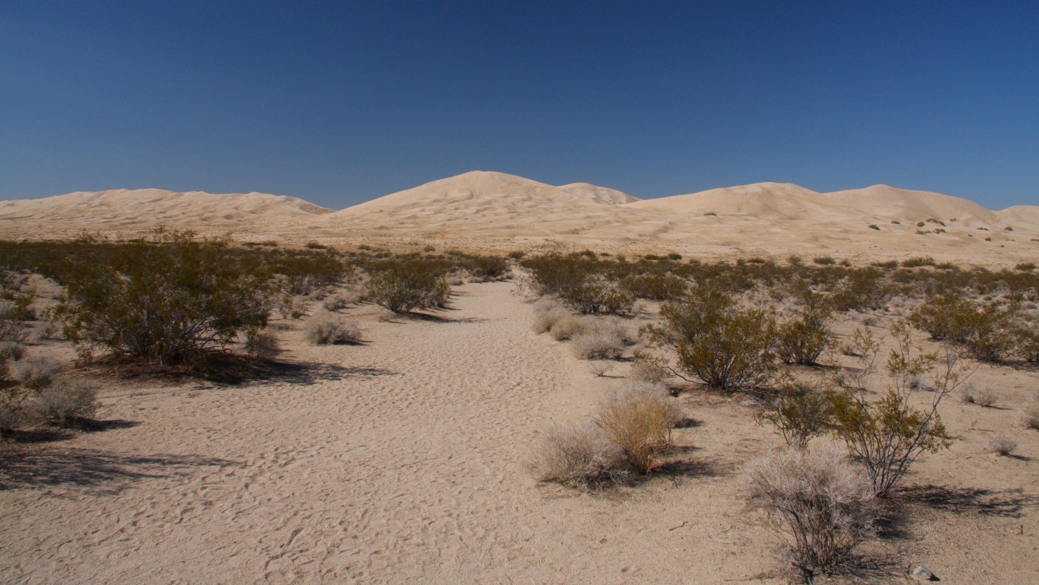
Location
The Mojave tribe lived the southwestern part of California. The dessert tribe lived in the Mojave desert. Mojave people lived in arid deserts but with rivers . Mojave tribe lived in southwestern Arizona and southwestern California.
This Photo by Unknown author is licensed under CC BY-NC-ND.

Slide 3
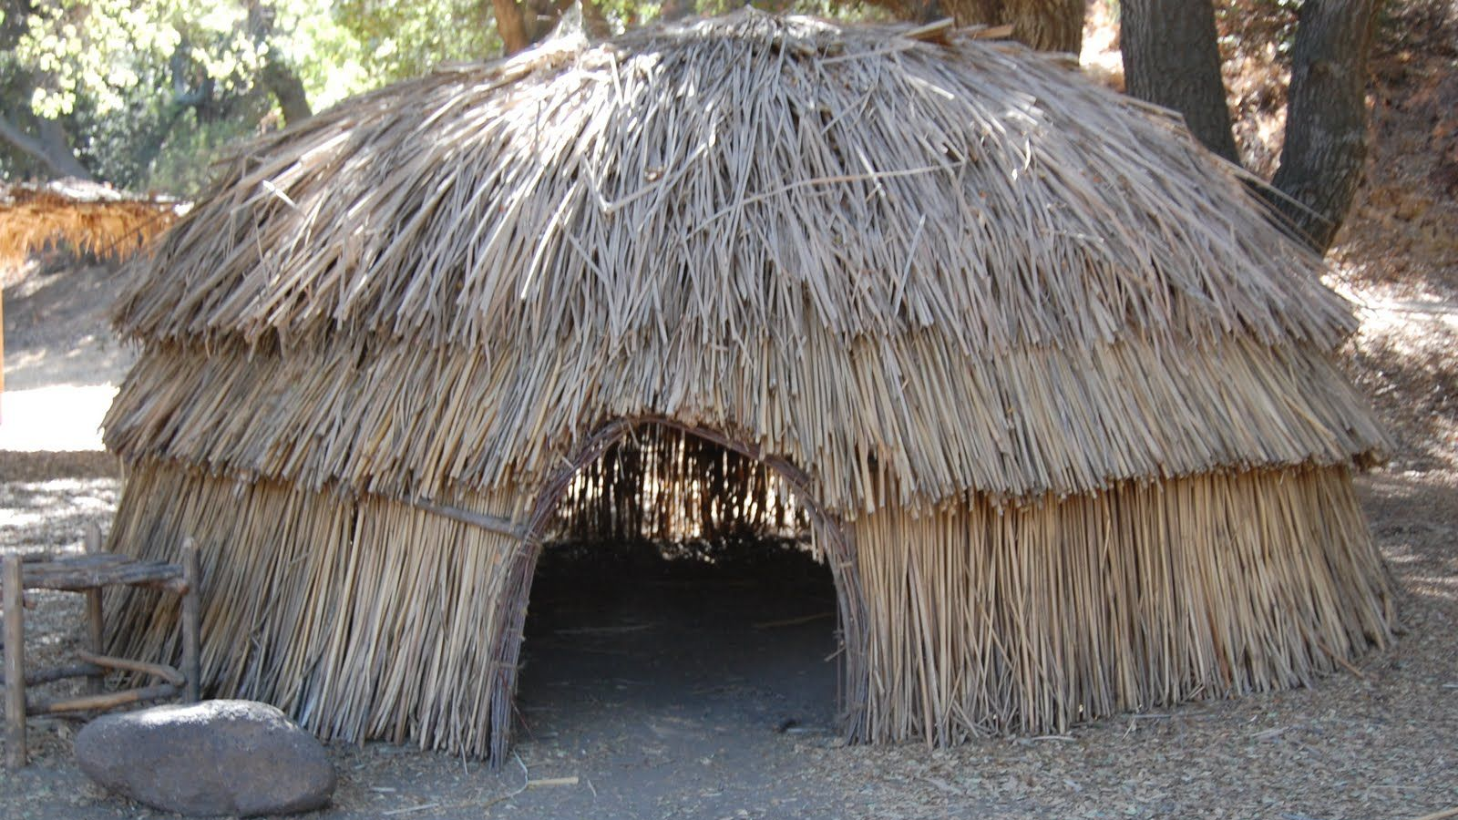
Shelter
The homes of the Mojave tribe protected them from the environment Mojave people built two different types of houses one for the warm and one for the cold. They built very simple houses that were made of grass or bush . Houses made in this desert tribe were usually just shade roofs and 6 poles.

Slide 4
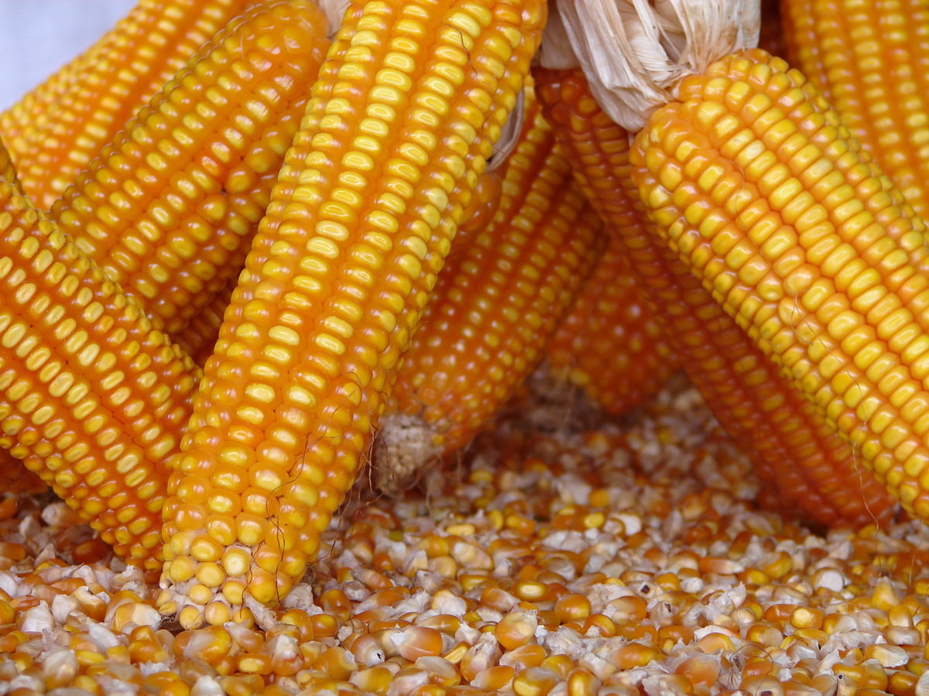
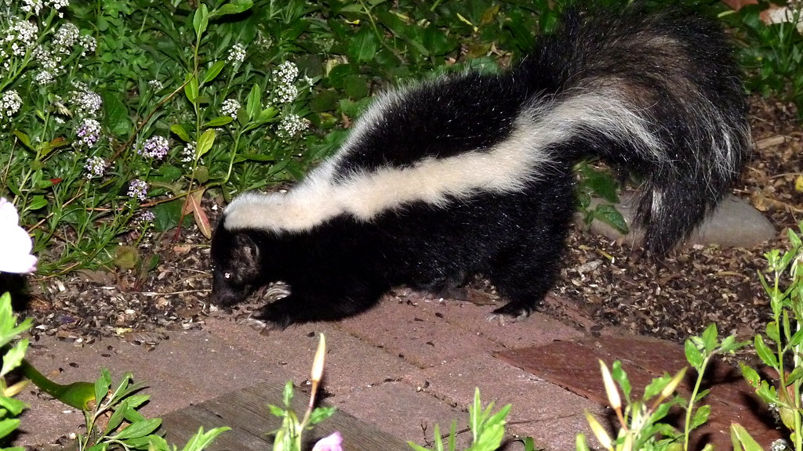
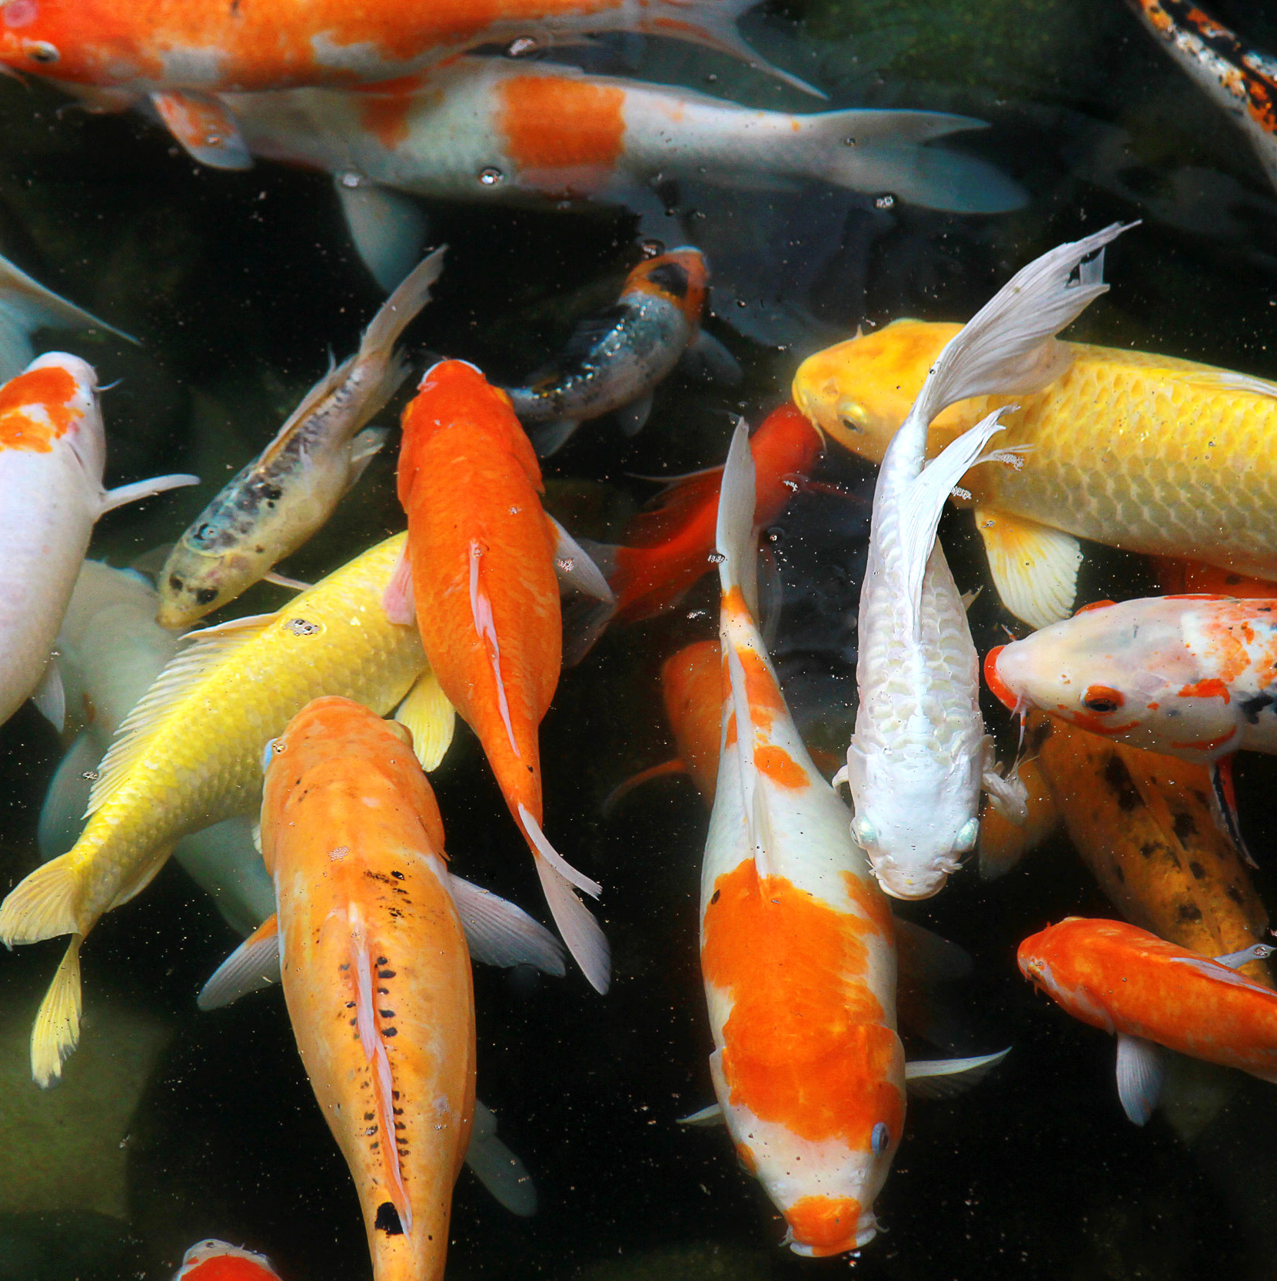
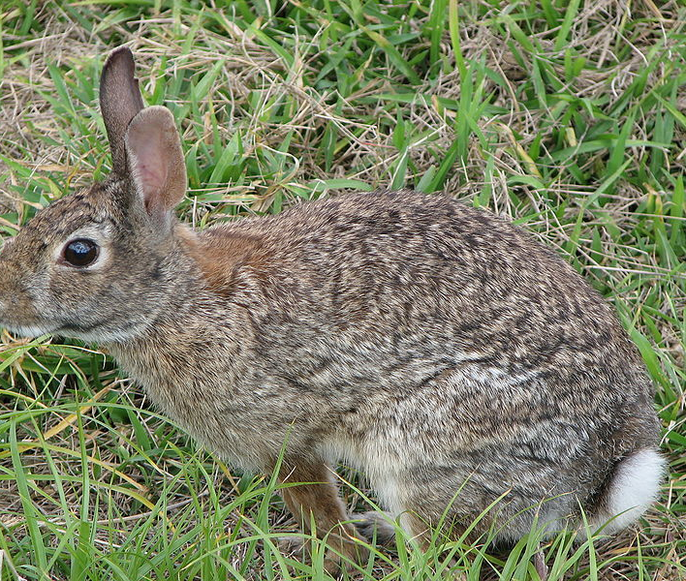
Food
The Mojave used the land to find food to survive. The Mojave tribe ate fish if they lived by the Colorado river. They Also were farmers so they would eat their crops. They trapped animals like rabbits and skunks.
This Photo by Unknown author is licensed under CC BY.
This Photo by Unknown author is licensed under CC BY-NC-ND.
This Photo by Unknown author is licensed under CC BY-SA.

Slide 5
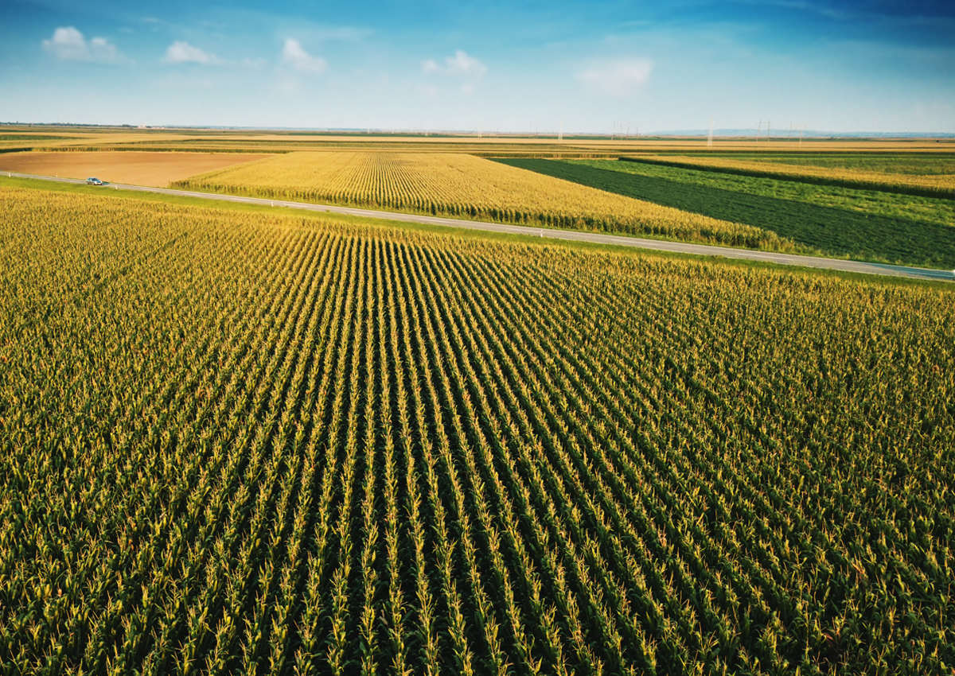
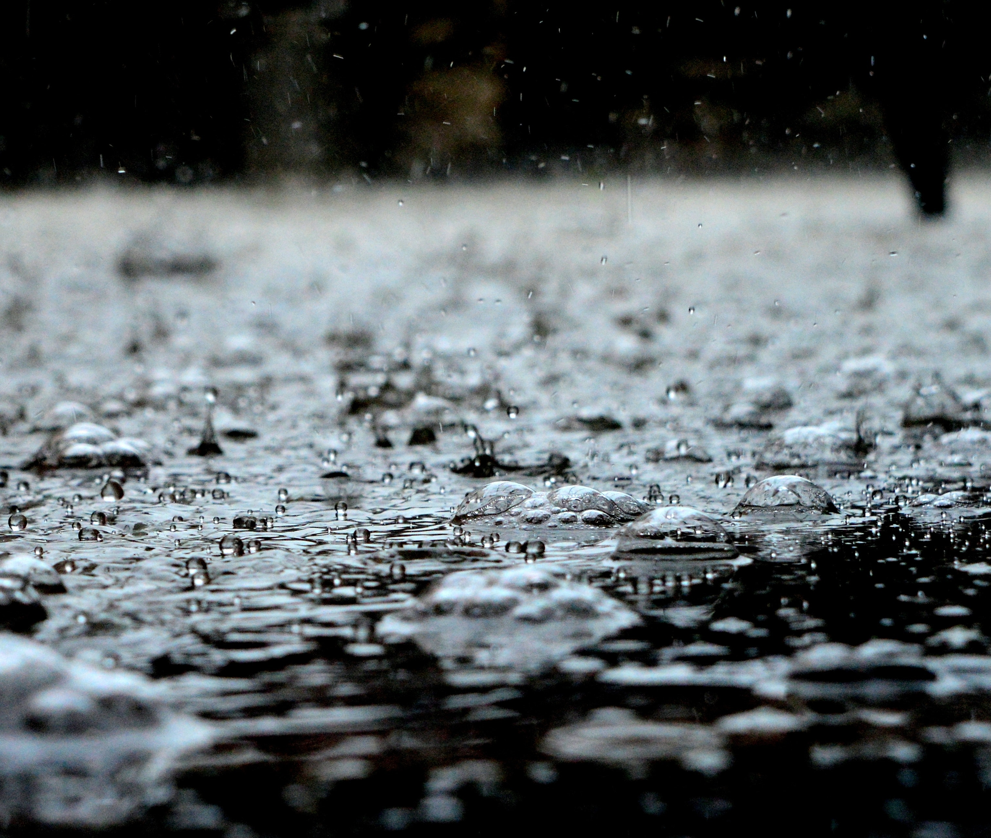
Culture
The culture of the Mojave is unique and interesting. Mojave people didn’t need to wear much clothing. The Mojave people speak Yuman which is spoken by some southwestern tribes. Even with their knowledge of how to use the land they believed rain dances would help bring the rain they needed to grow their crops.
This Photo by Unknown author is licensed under CC BY-NC-ND.

Slide 6
.

