Slide 1
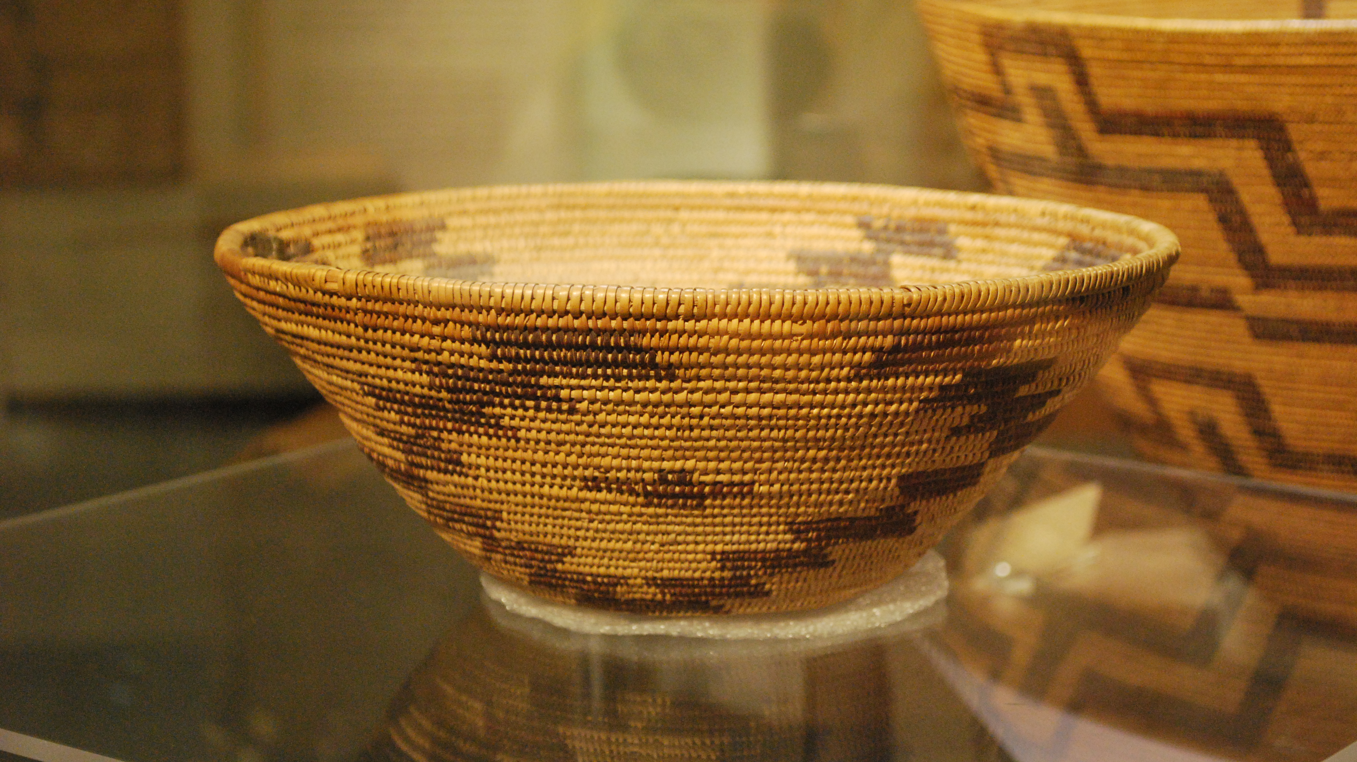
Maidu
By Sophie Sanchez
and Ryan Kang

Slide 2
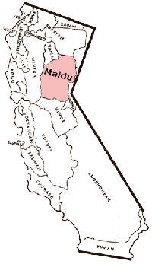
Location
They lived in the Northern Central Valley part of California.
Lived near Sacramento.
They lived around the Sierra Nevada mountains.

Slide 3
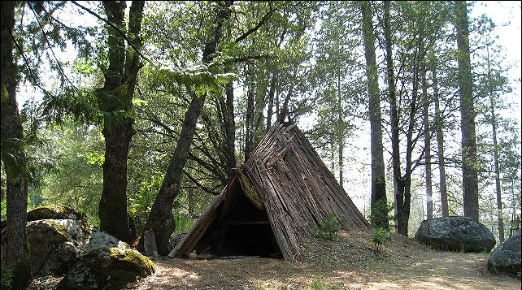
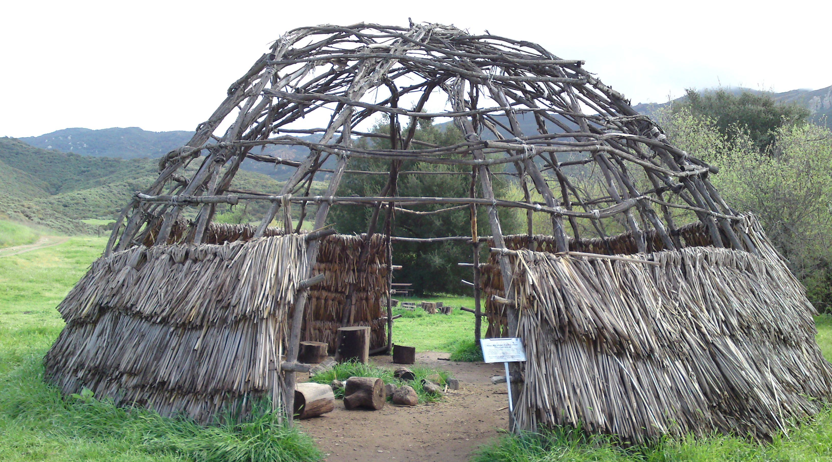
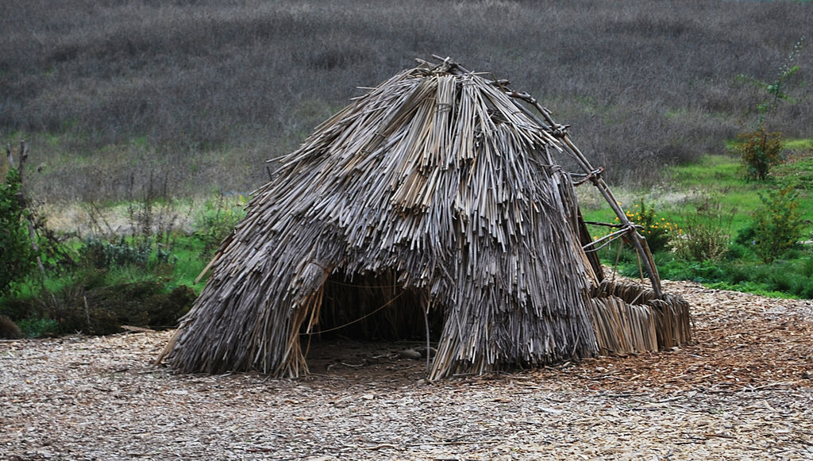
Shelter
They lived in lodges made of wood.
Their shelters were open air in summer.
Some houses had poles covered with grass and mud.

Slide 4
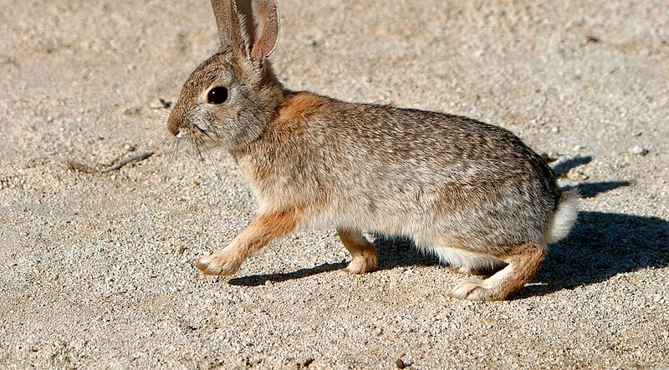
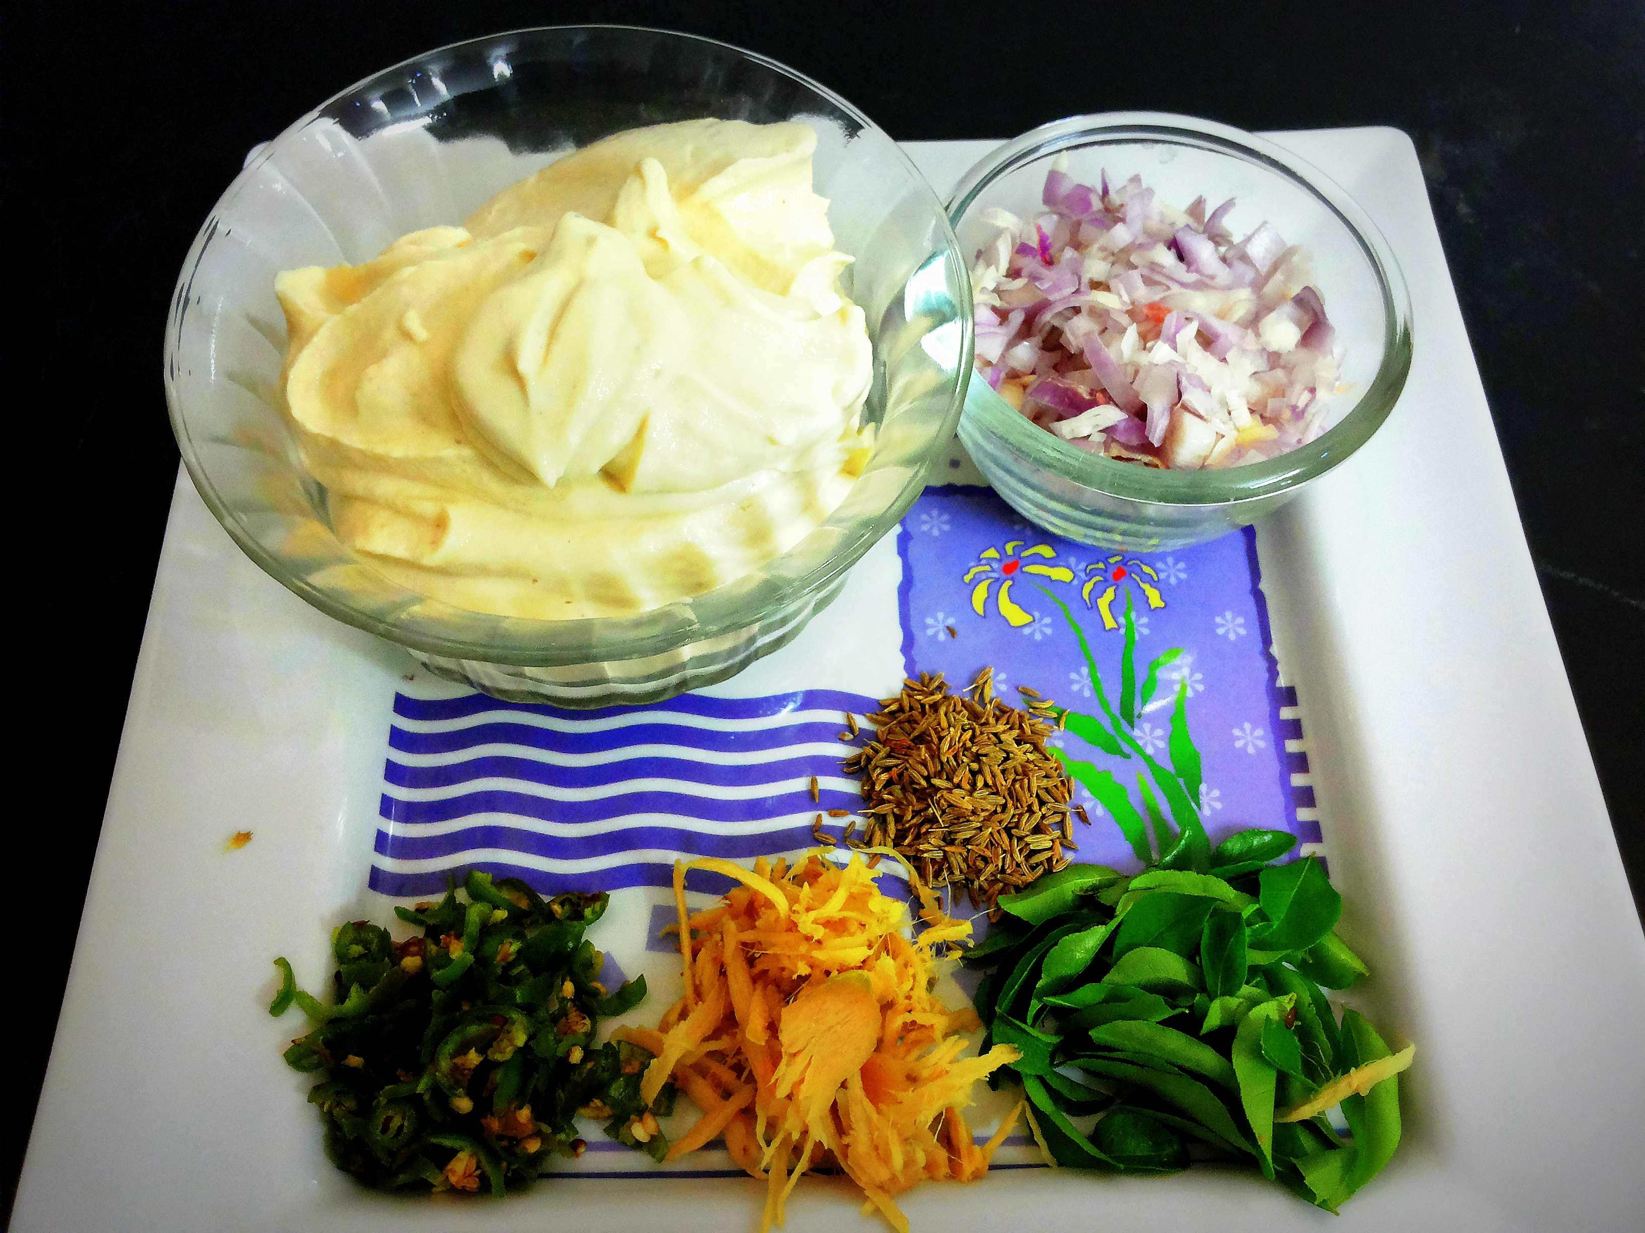
Food
They would smoke a deer or an elk.
They hunt rabbits and squirrels.
They ate birds and bears.
They had companions to help them hunt.

Slide 5
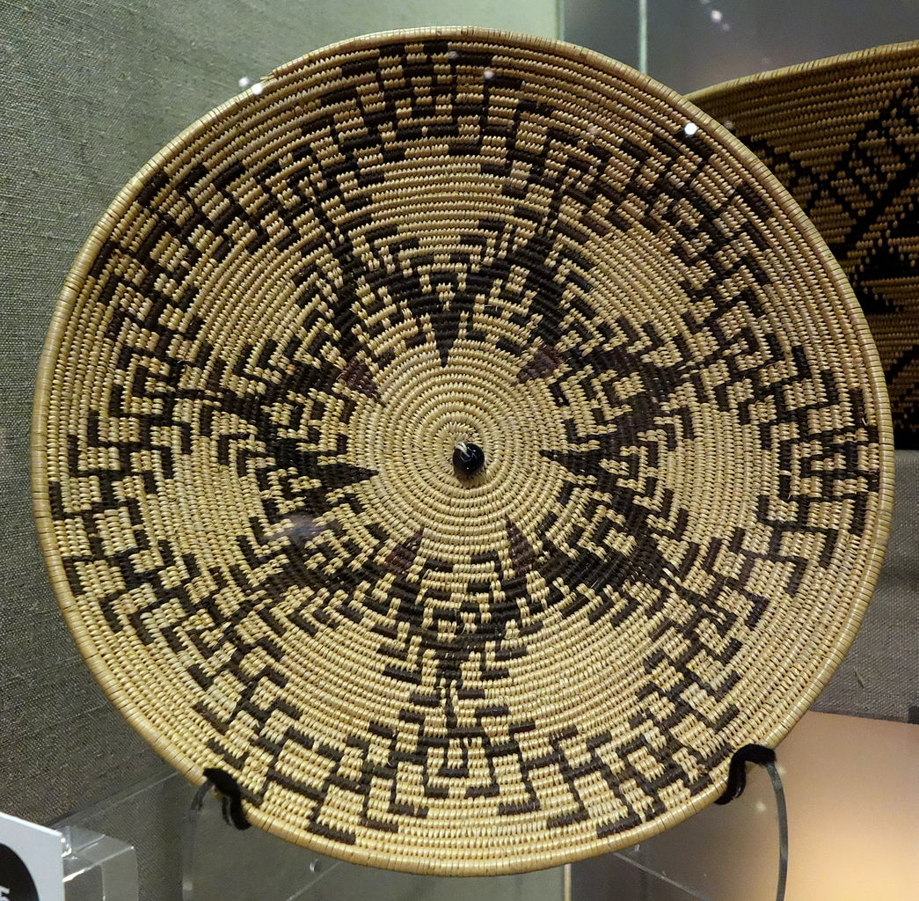
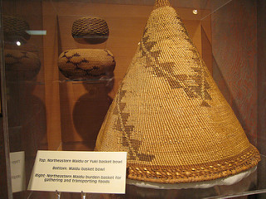
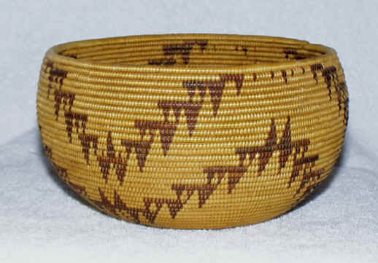
Culture
They held dances.
They held ceremonies for fun.
They weaved baskets for food gathering.
They made their own instruments.

Slide 6
