Slide 1
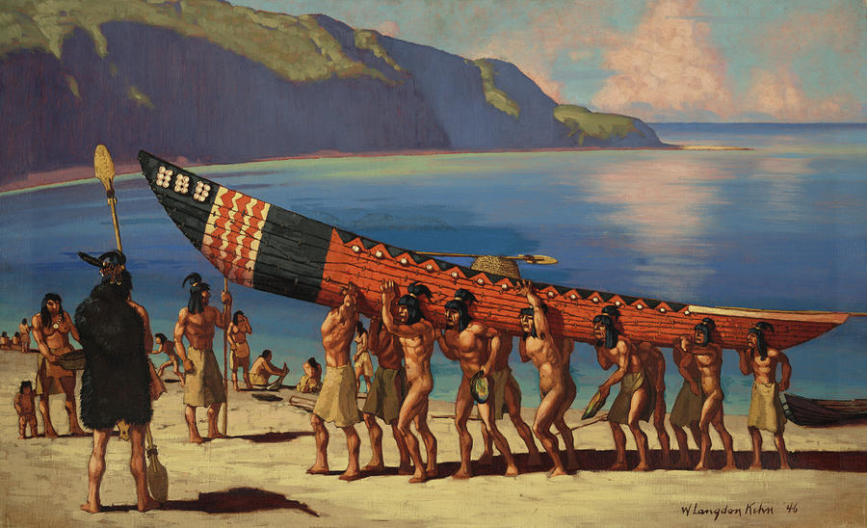
Gabrielino
Sophia Goytia
This Photo by Unknown author is licensed under CC BY-NC-ND.

Slide 2
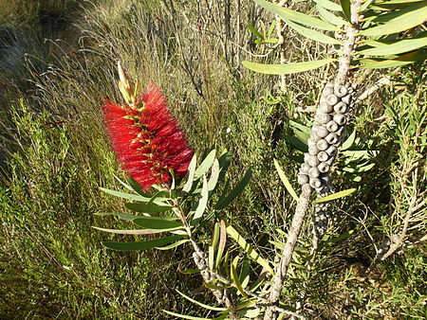
Location
This Photo by Unknown author is licensed under CC BY-SA.
This Photo by Unknown author is licensed under CC BY-SA.
Built their homes along rivers and streams
Lived on islands and near rivers
Built their homes in sheltered bays along the coast
Had pleasant weather and food

Slide 3
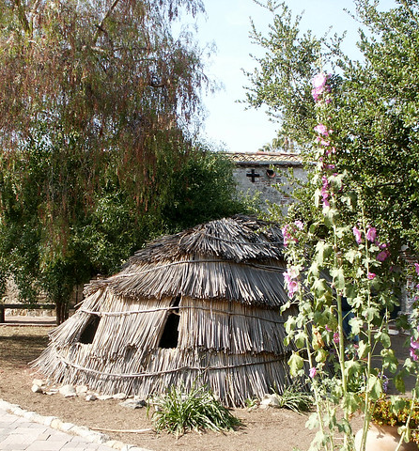
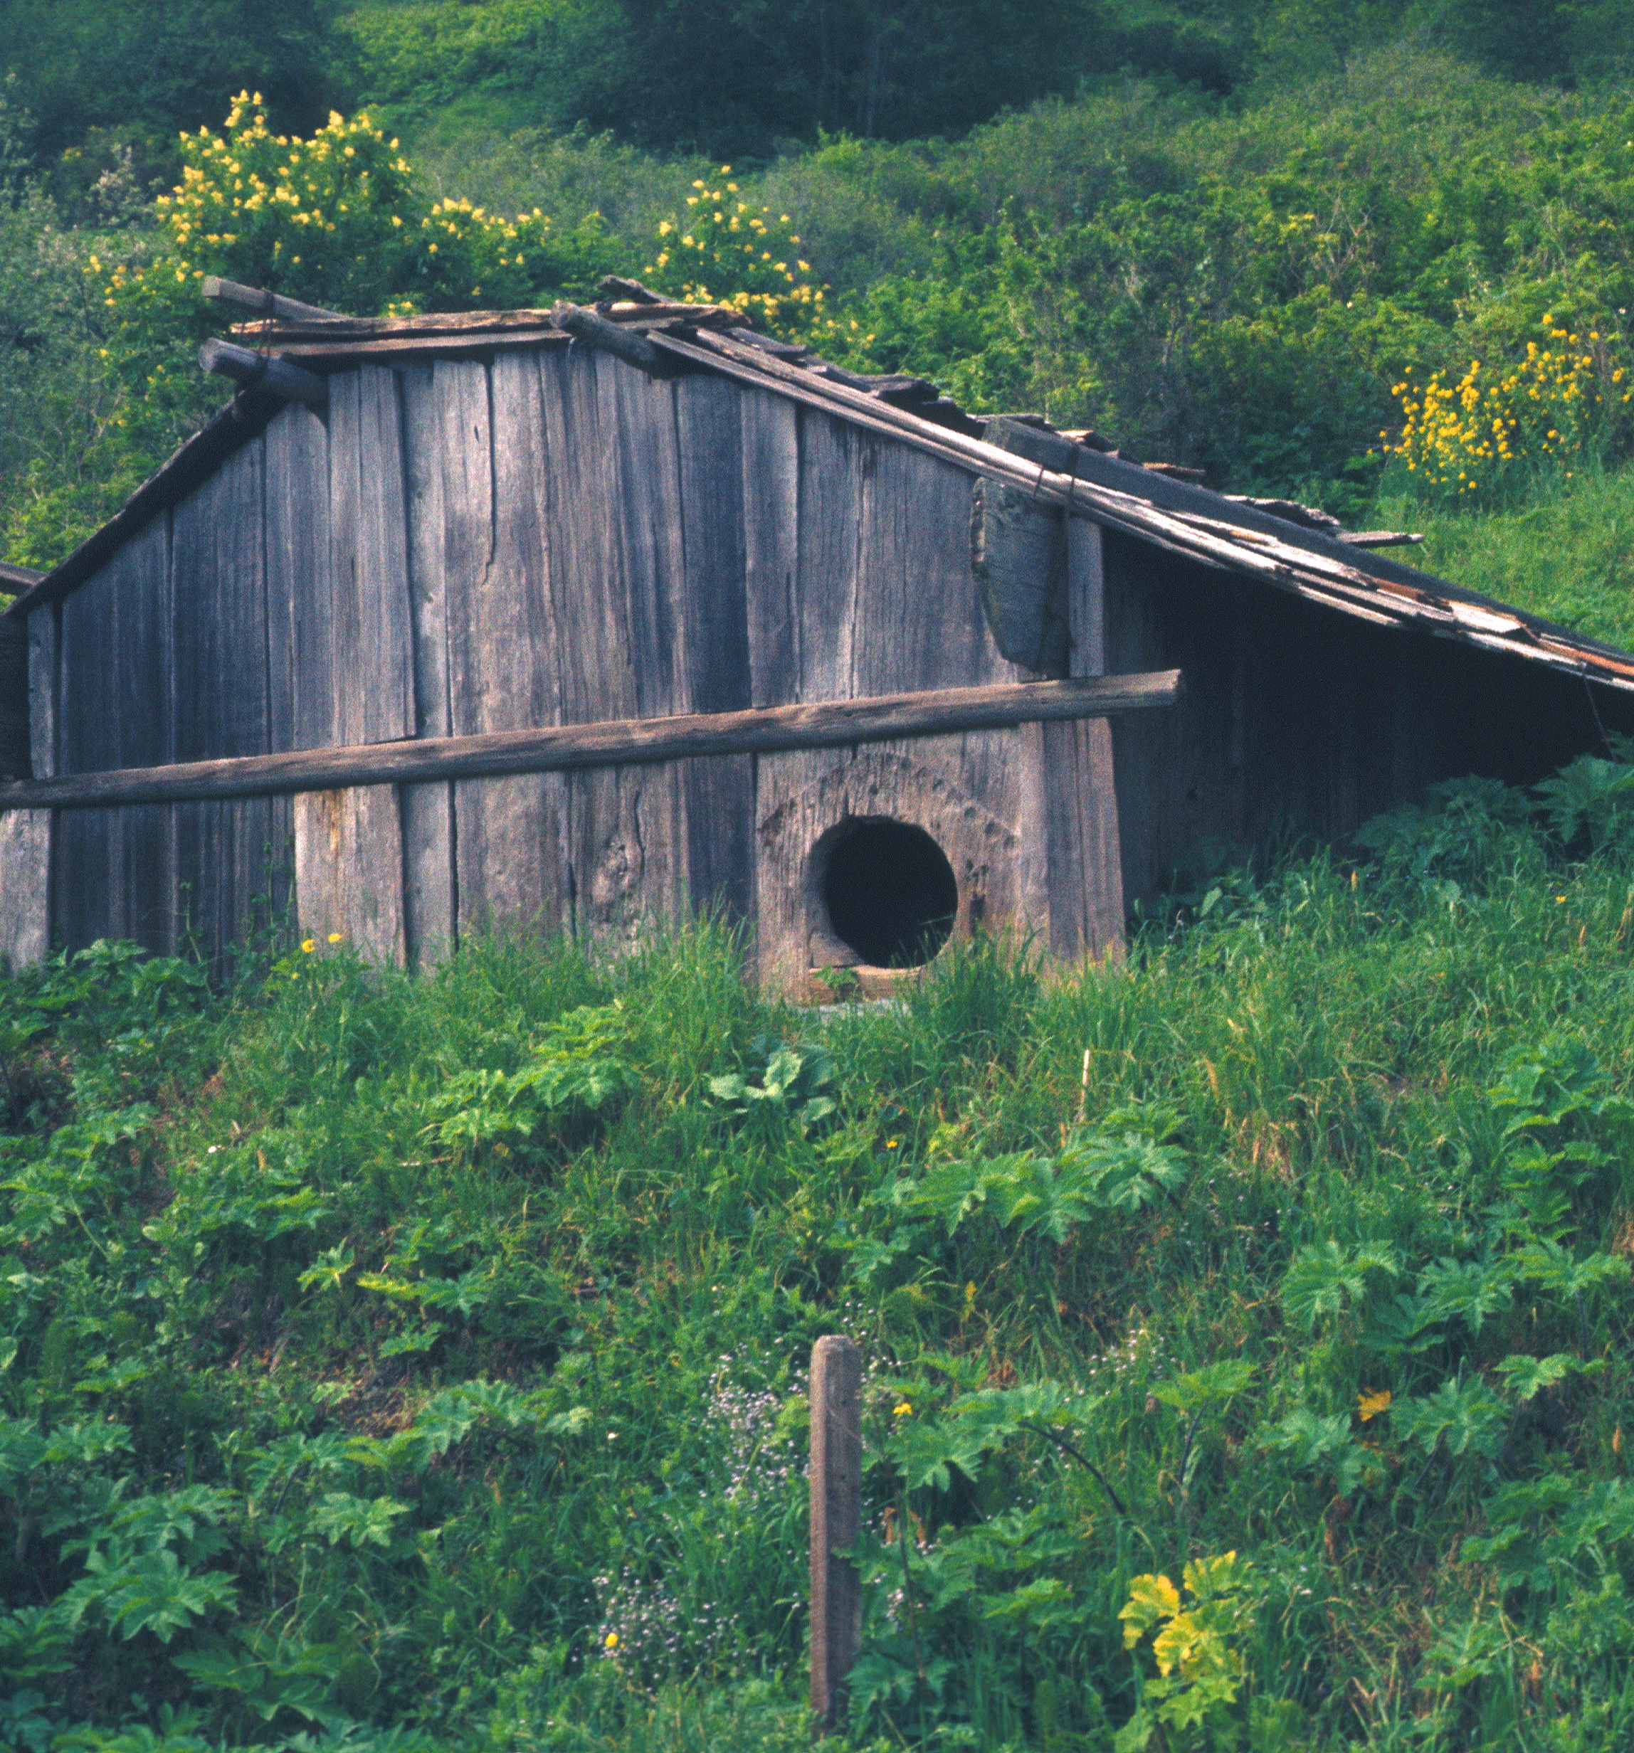
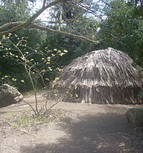
Shelter
This Photo by Unknown author is licensed under CC BY-SA.
This Photo by Unknown author is licensed under CC BY-SA.
This Photo by Unknown author is licensed under CC BY-SA.
Had poles upright in a circle and they were bent to meet in the middle
Were made with tule reeds or mats woven with tule
Sweathouses were covered with brush and earth
Their homes were large enough to hold 50 to 60 people

Slide 4
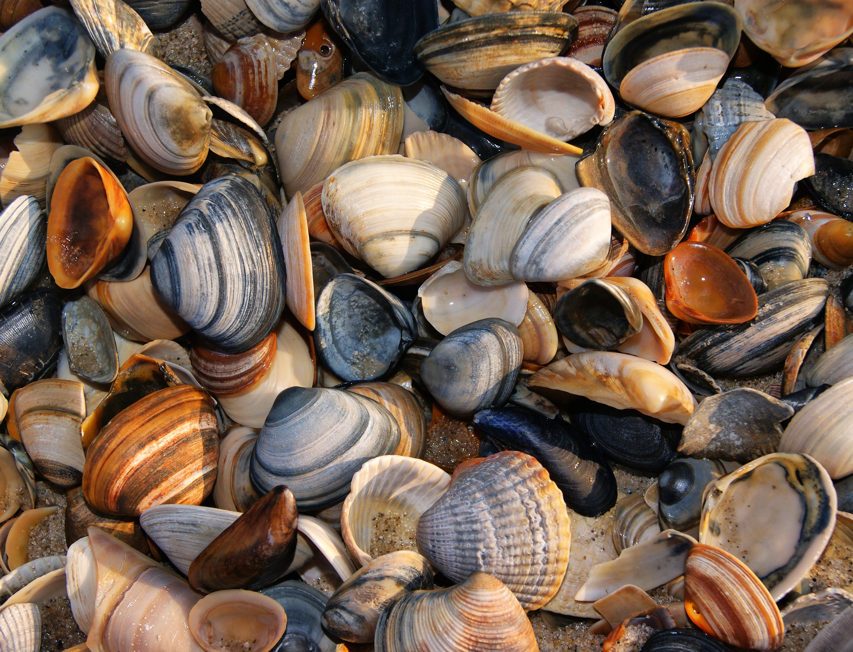
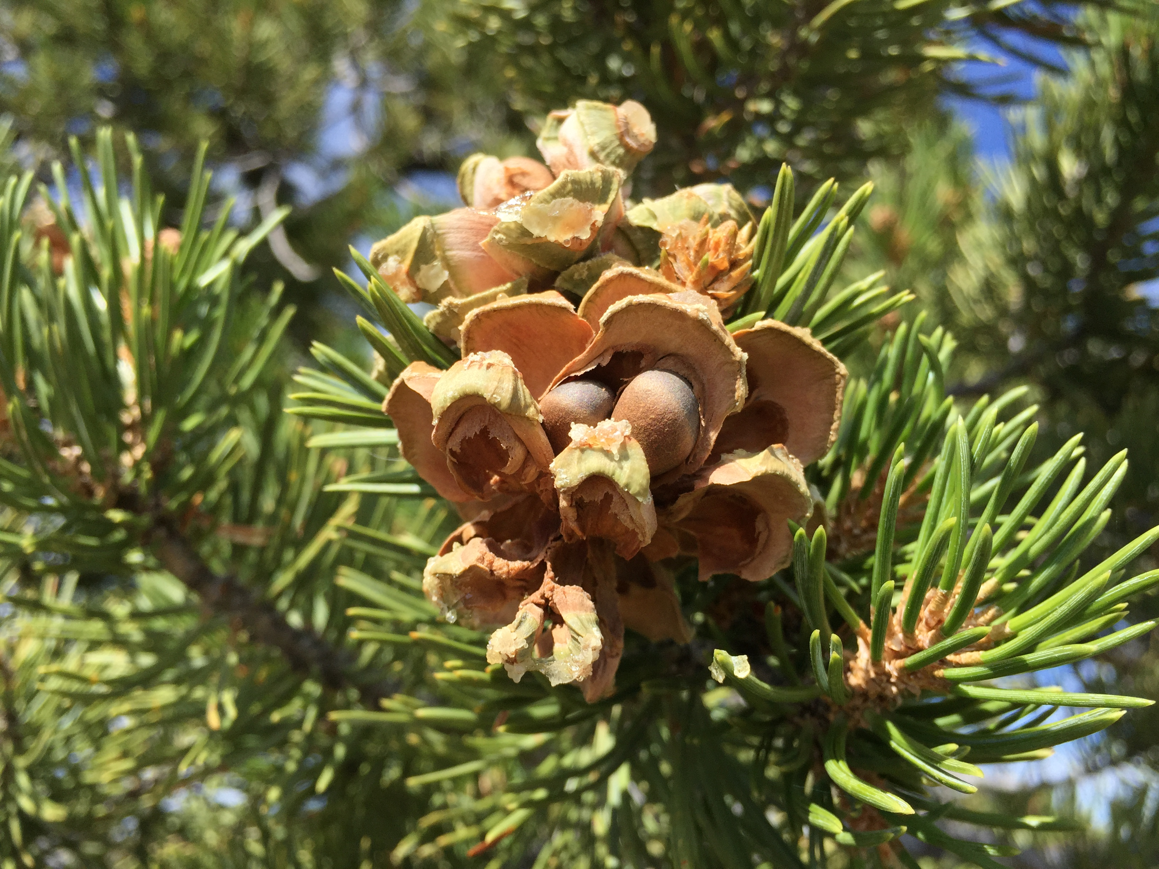
Food
Ate tuna, fish, swordfish, shellfish, sea mammals, and sea birds
Rock scallops, mussels, limpets, and sea urchins were gathered along the shore
Also ate sea lions, harbor seals, sea otters, and elephant seals
Gathered pinon nuts, sage, berries, and edible cacti
This Photo by Unknown author is licensed under CC BY-SA.

Slide 5
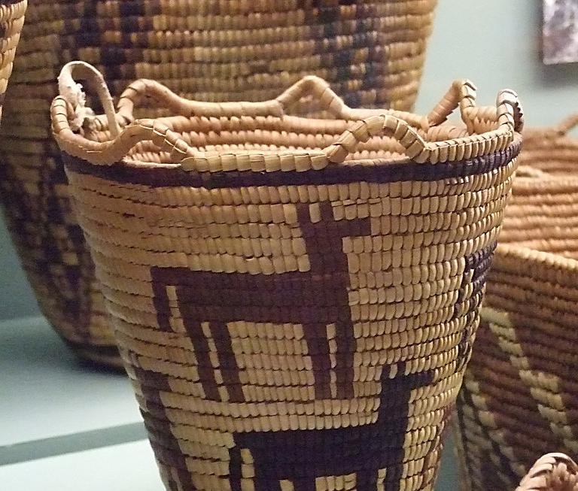
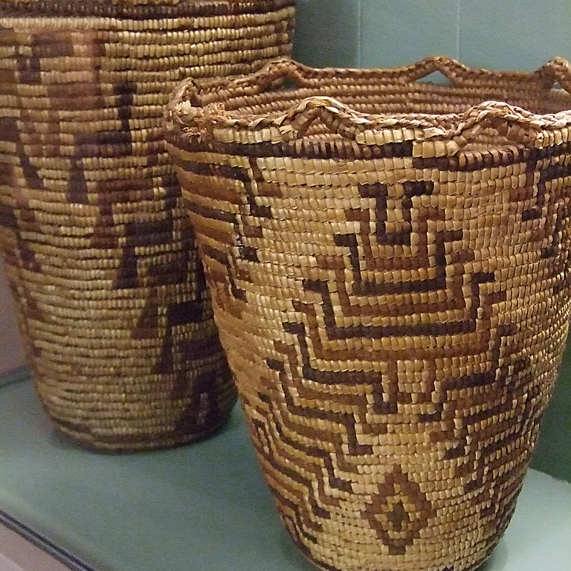
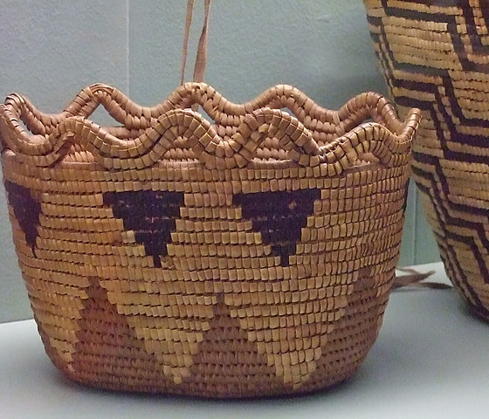
Culture
Women were expert basket weavers
People held baskets on their heads
Also, they wore aprons made out of deer skins
Women wore red ocher paint on their faces to protect them from the wind and sun
Carved pots, bowls, cooking utencils, and animals out of steatite
This Photo by Unknown author is licensed under CC BY-SA-NC.
This Photo by Unknown author is licensed under CC BY-SA-NC.
This Photo by Unknown author is licensed under CC BY-SA-NC.

Slide 6
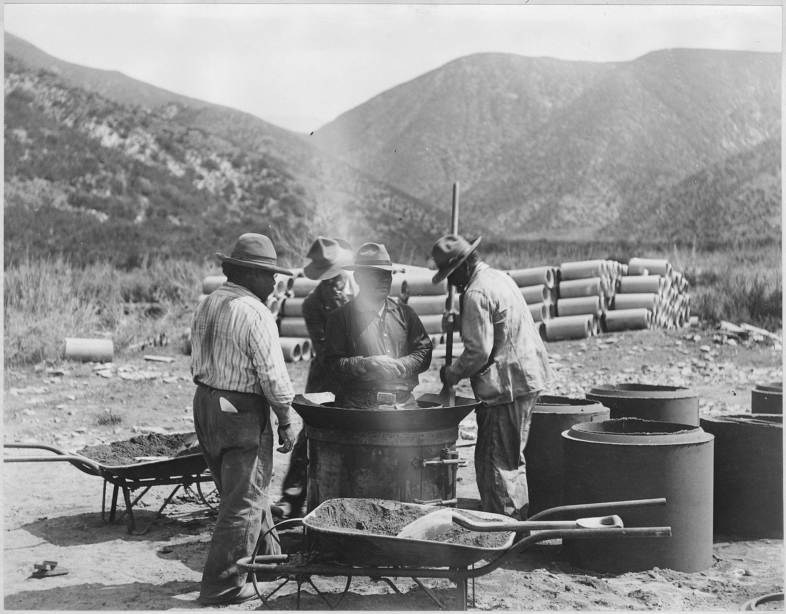
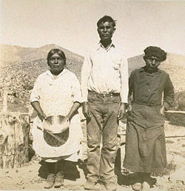
Gabrielino Tribe
This Photo by Unknown author is licensed under CC BY-SA.
This Photo by Unknown author is licensed under CC BY-SA.

