Slide 1
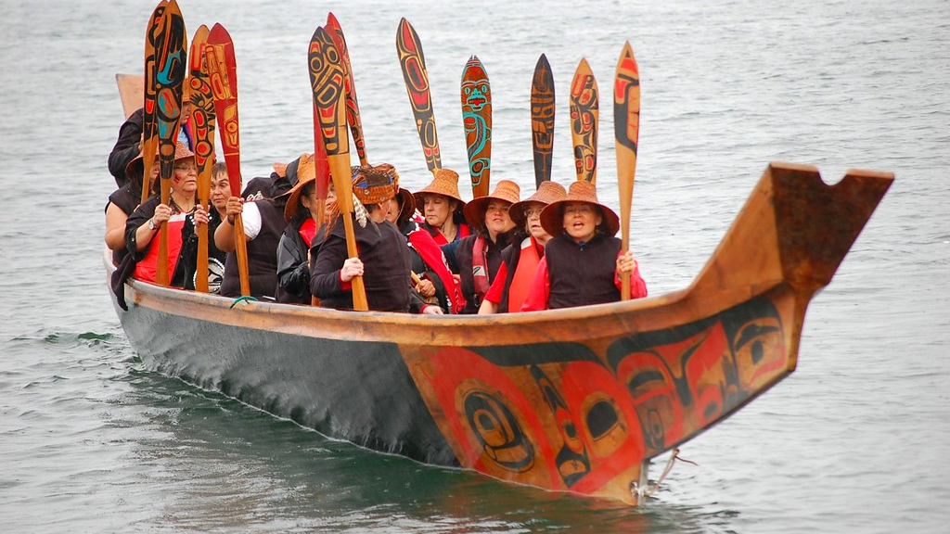
Maidu tribe
by Fiona Wu

Slide 2
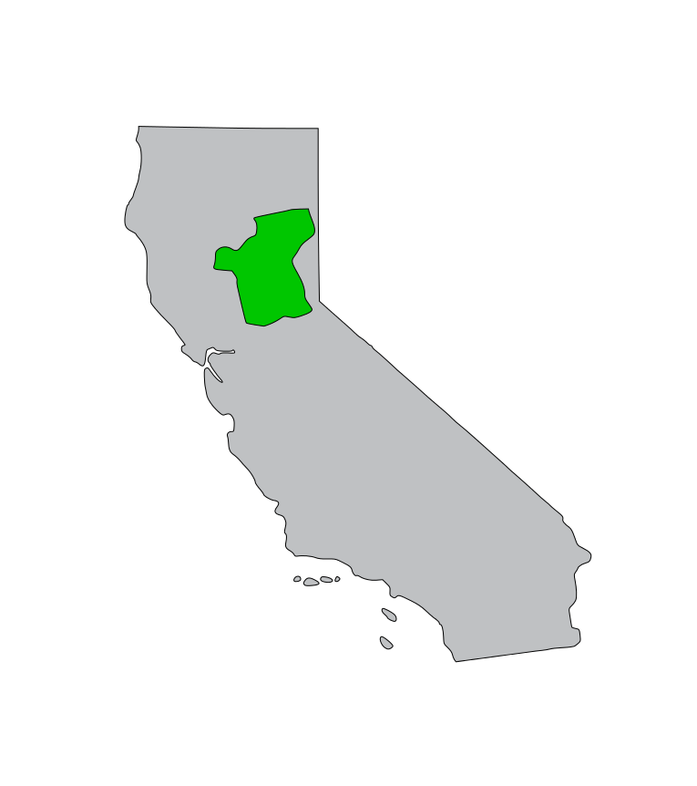
Geographical location
The Maidu tribe lived in cold areas and mountains. They lived in the Northeastern California (Plumas County and southern Lassen County.) The Maidu tribe were neighbor with the Wintun tribe. They also lived in the mountains, valleys, rivers, and near oceans and lakes. Their weather was a mild climate. Mild means it's kind of the same weather every day and it doesn’t change a lot.

Slide 3
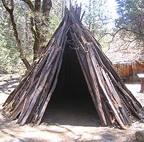
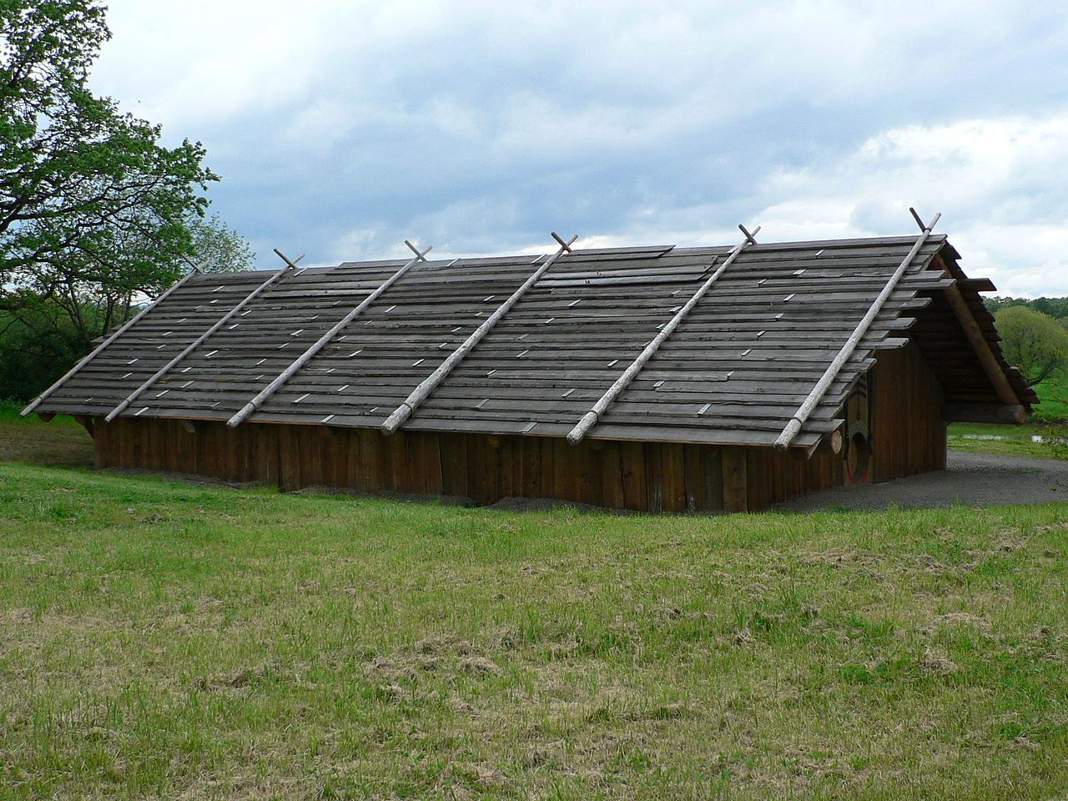
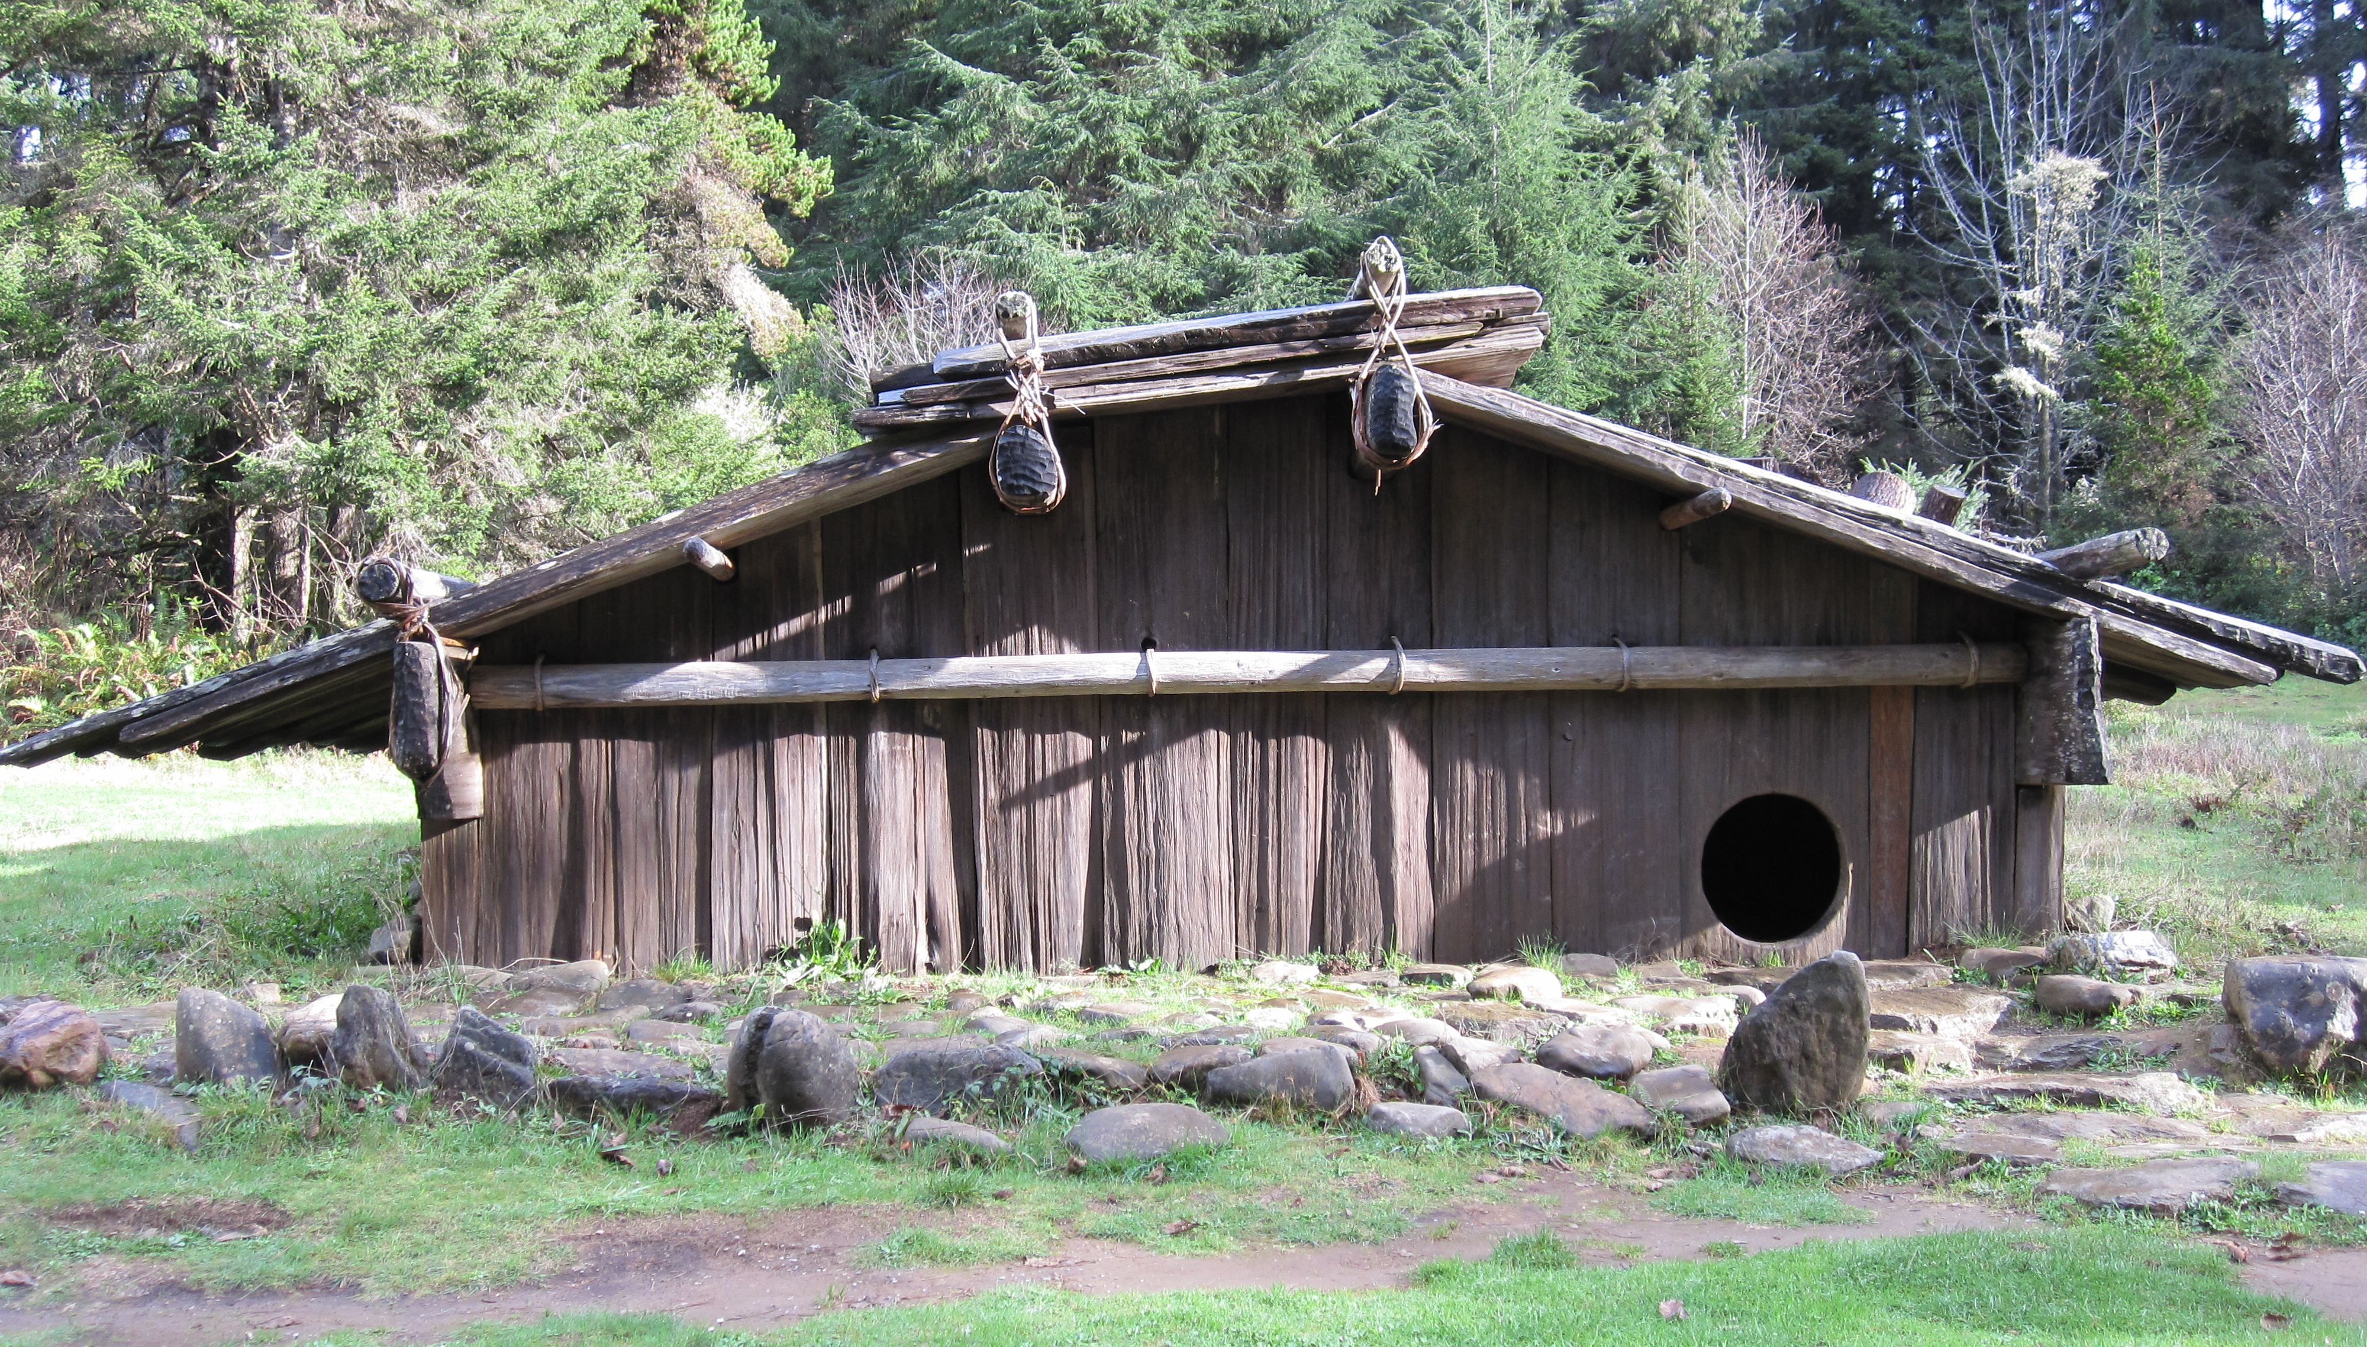
Shelter
The Maidu shelters were made from natural resources. Their houses were underground during the winter. They also built cone shaped houses in the summer. The houses were dug about 4 feet deep. There are three types of shelters and they are cedar barks, tepees, and pit houses. They built near hunting places because they needed food.

Slide 4
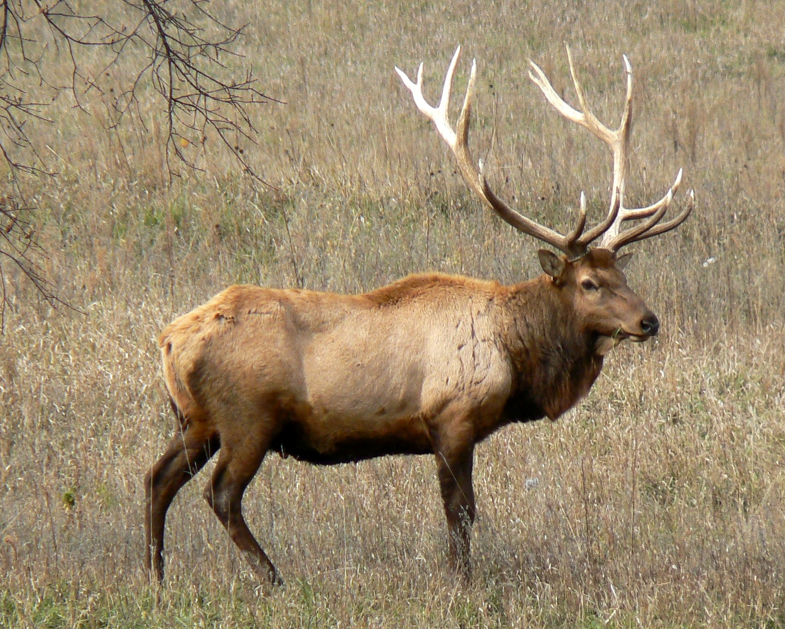
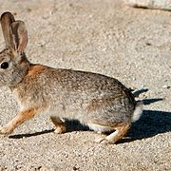
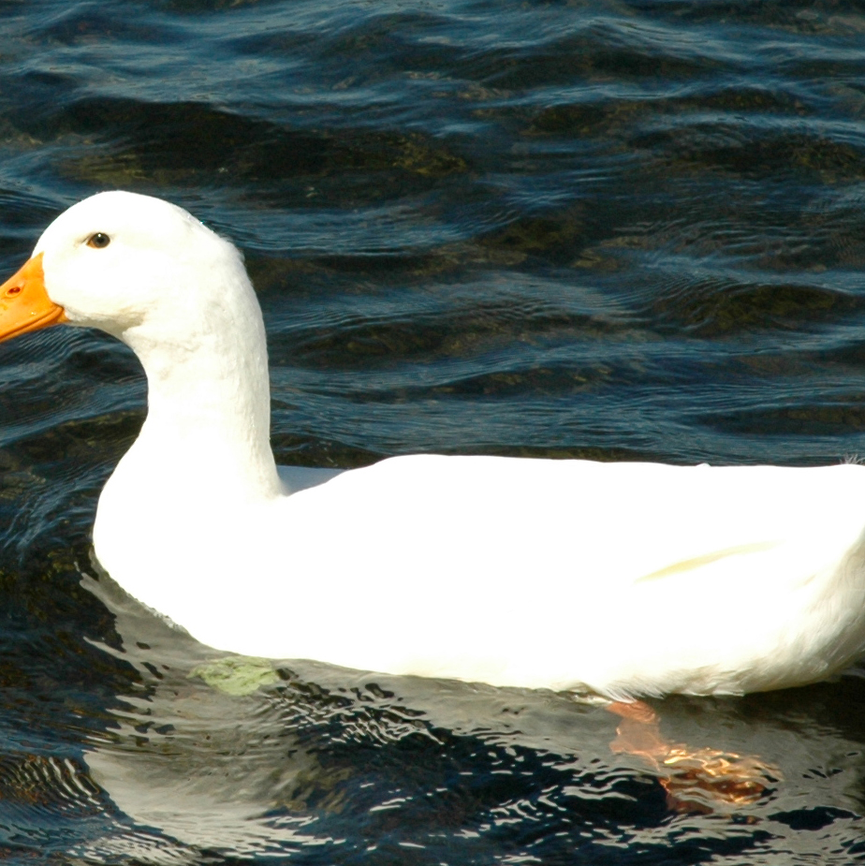
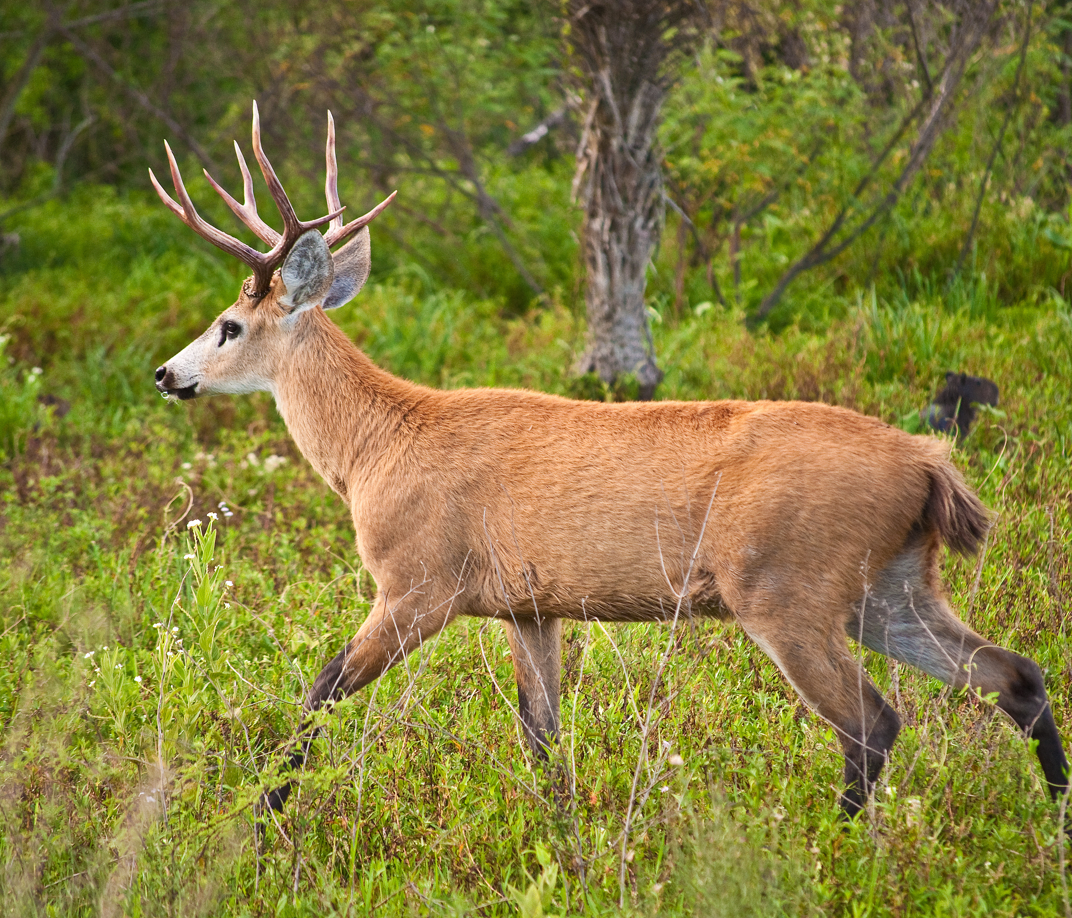
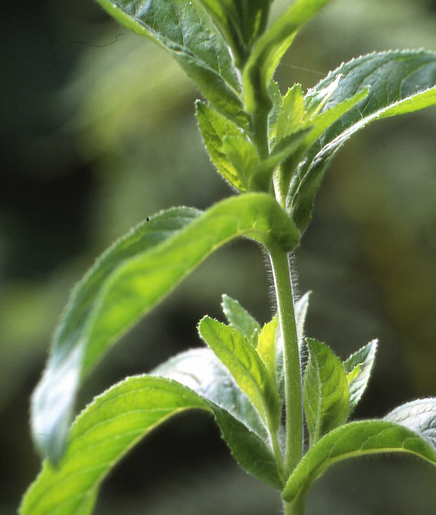
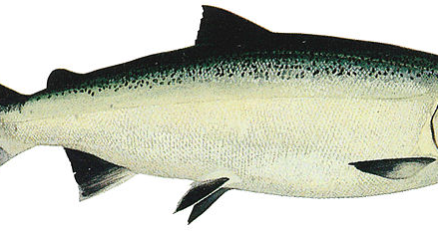
Food
The Maidu tribe ate food from nature. They hunt, fished, and gathered. They at deer, elks, insects, ducks, meat, and rabbits. They didn’t eat eagles because they were prey animals. For the plants, they also ate roots, leaves, stems, and seeds of plants.

Slide 5
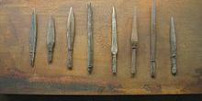
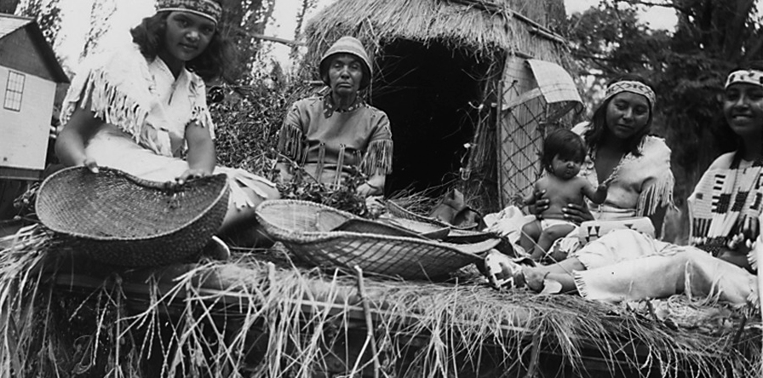
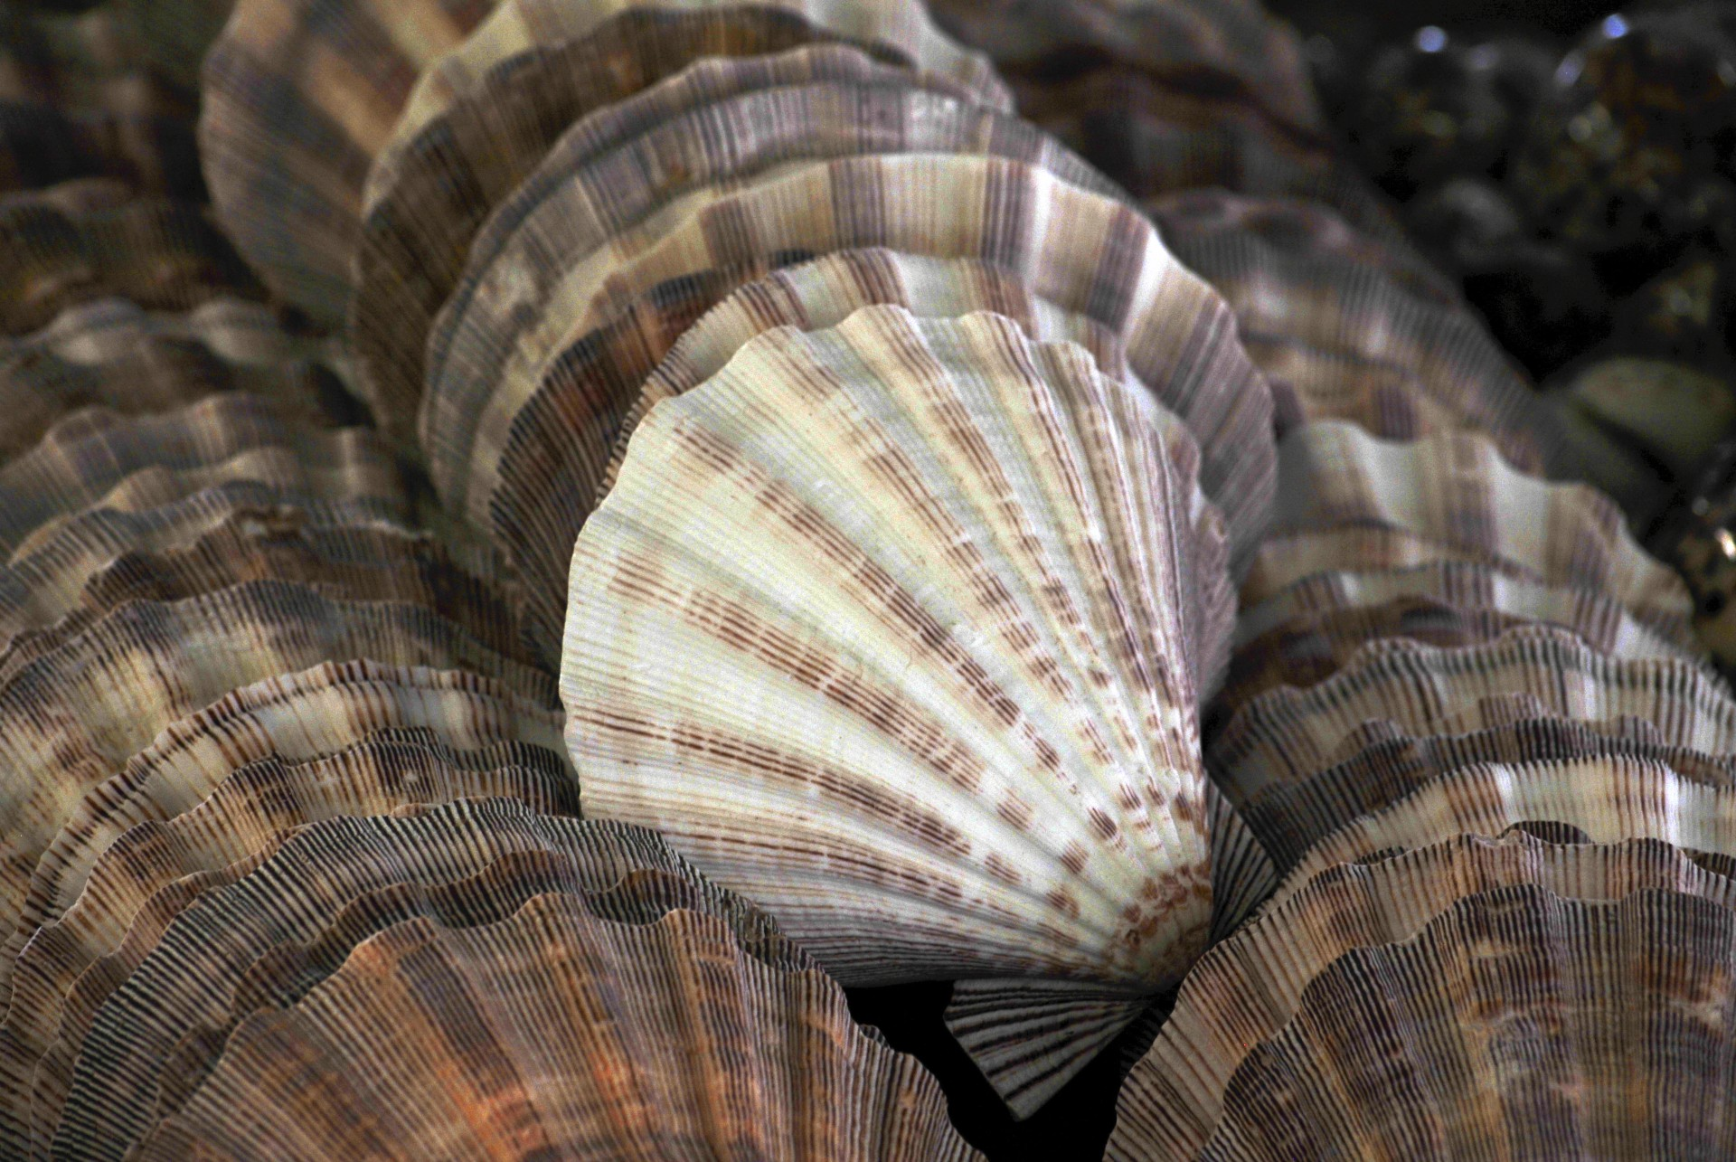
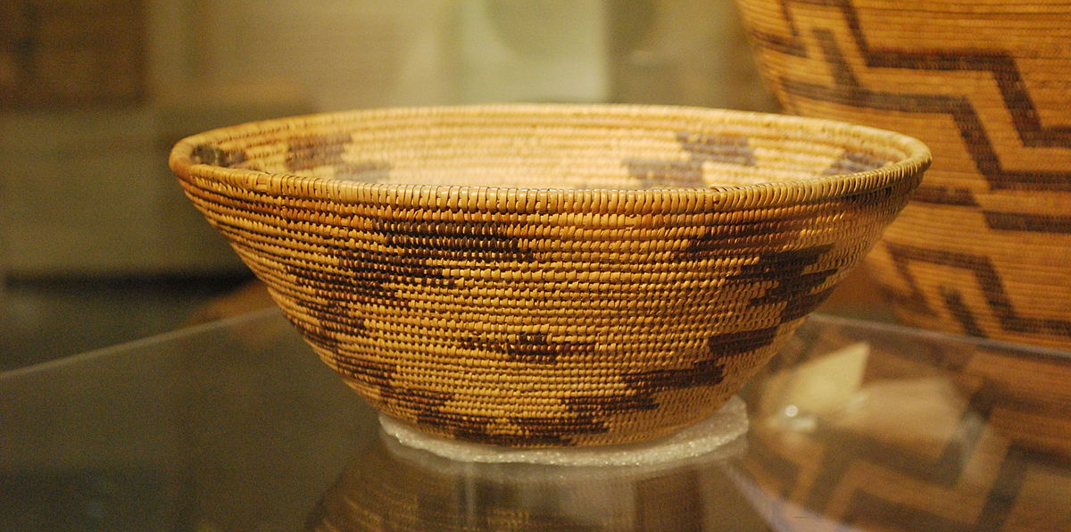
Culture
The tribe had an interesting culture. They made baskets, bundles of 3 slender, stem, knives, arrowheads, and spear. A spear is a stick that you can catch fish with. The Maidu tribe had dances and used a rattle called Wasoso;. They Traded clamshells. Clamshells were made into beads. They also traded Magnetite. (A type of stone.)
This Photo by Unknown author is licensed under CC BY-SA.

Slide 6
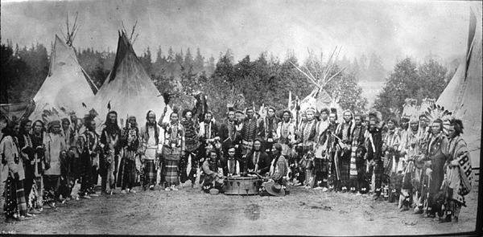
Conclusion
By Fiona

