Slide 1
Congressional Membership
Ch 5 sec 1

Slide 2
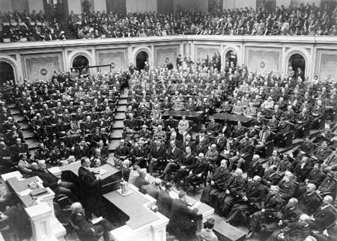
I. Congressional Sessions
Each term of Congress has two sessions.
Sessions last until Congress votes to adjourn.
Notes:
http://instruct1.cit.cornell.edu/courses/govt307/Congress-Session.jpg

Slide 3
II. Membership of the House
Members must be at least 25 years old, citizens for at least 7 years, and residents of their states.
Members serve for 2 year terms.
Rep. Gil Cisneros 39th District
Notes:
http://www.house.gov/garymiller/images/GaryMiller_highres.jpg

Slide 4
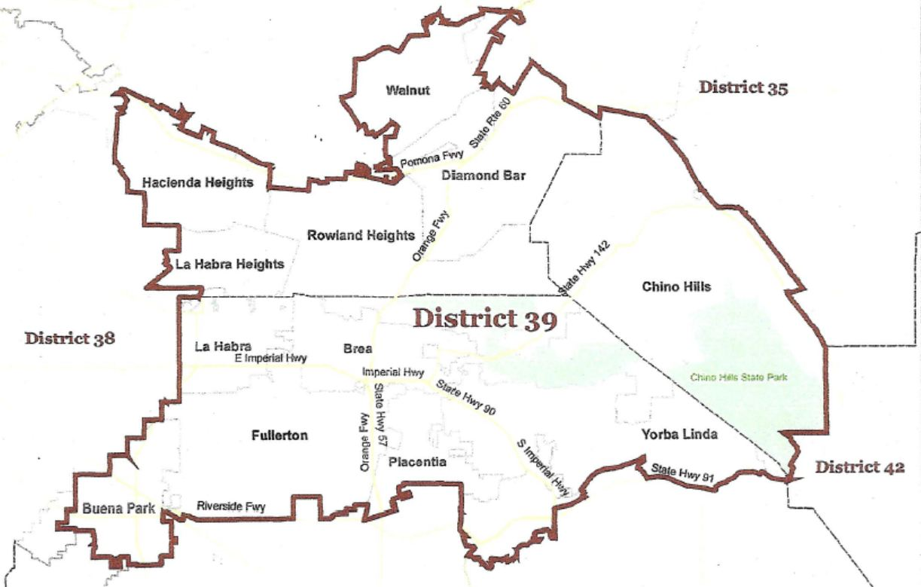
II. Membership of the House
The number of representatives from each state is determined by the census population count every 10 years.
State legislatures set up congressional districts after the census count – one representative for each district.
Notes:
https://electdmarie.files.wordpress.com/2012/03/district-39-map.jpg

Slide 5
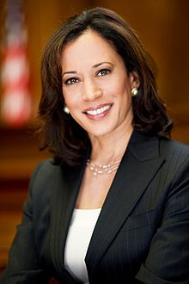
III. Membership of the Senate
Senators must be at least 30 years old, citizens for at least 9 years, and residents of their states.
Senators serve for 6 years; one-third are elected every two years.
Each state elects two senators.
Notes:
http://boxer.senate.gov/news/i/photo_2005.jpg

Slide 6
III. Membership of the Senate
The Senate and the House set members’ salaries, and receive numerous benefits, allowances for office staffs and business trips, tax breaks for maintaining two residences, and pensions when they retire.
Notes:
http://www.mypaycare.com/images/PayCare_check.jpg

Slide 7
III. Membership of the Senate
Both House and Senate members enjoy immunity from arrest, in cases not involving a felony or treason, or being sued for libel when Congress is in session.

Slide 8
III. Membership of the Senate
Both the Senate and House may refuse to seat a member and may censure or even expel members.

Slide 9
IV. The Members of Congress
Nearly half of the members of Congress are lawyers.
White, middle-aged male members are being joined by members reflecting the ethnic, racial, and gender makeup of the general population.
Notes:
http://www.smh.com.au/ffximage/2006/11/20/simpson_galanter_narrowweb__300x351,2.jpg
http://files.blog-city.com/files/A05/141484/p/f/cynthia_mckinney.jpg

Slide 10
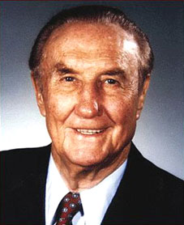
IV. The Members of Congress
Most incumbent members of Congress win reelection to office because they are well known, find it easier to raise campaign money, and often represent districts gerrymandered in favor of their parties.
Notes:
http://www.nndb.com/people/928/000023859/strom.jpg
http://www.nospeedbumps.com/wp-images/racial_gerrymander.JPG

Slide 11
IV. The Members of Congress
In the 1990’s incumbents came under heavy criticism from the public, resulting in the greatest turnabout in membership in 50 years, though incumbents won again in the 1996 election.
Notes:
http://www.c-spanstore.org/shop/images/Pictures/Programs/182730/182730-w.jpg

Slide 12
In your notebooks
Draw an advertisement to recruit members of Congress. Include the qualifications for being a Senator and Representative. Use color pictures and descriptions. Full page, with color.

