Slide 1
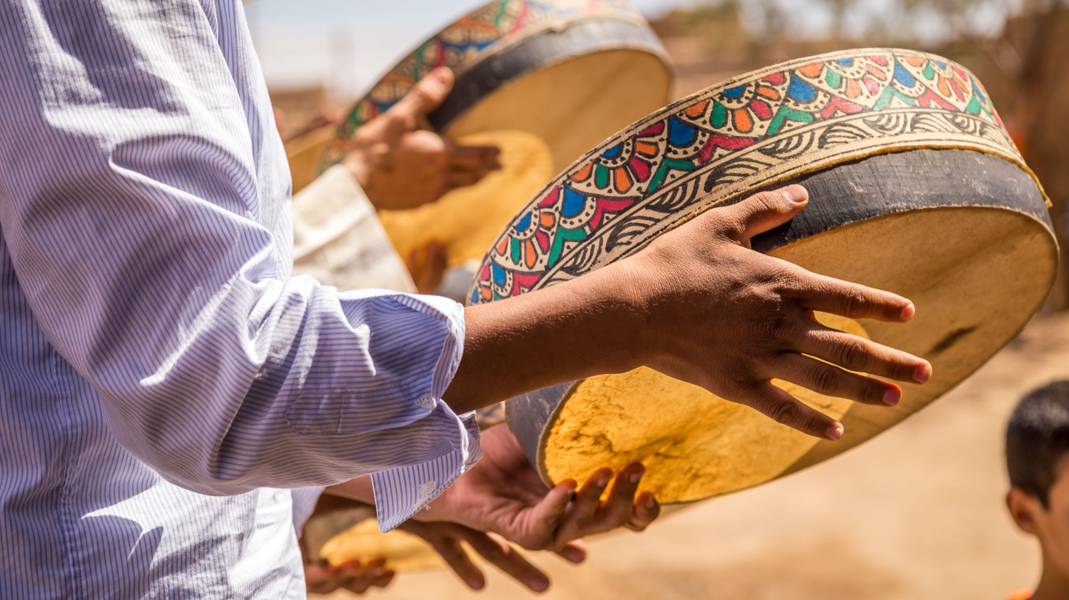
Maidu tribe
By: Ana Clara and Layla

Slide 2
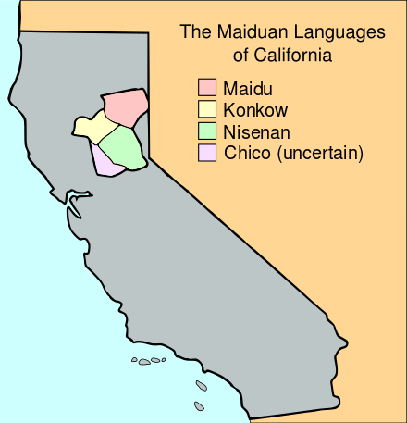
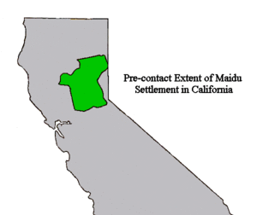
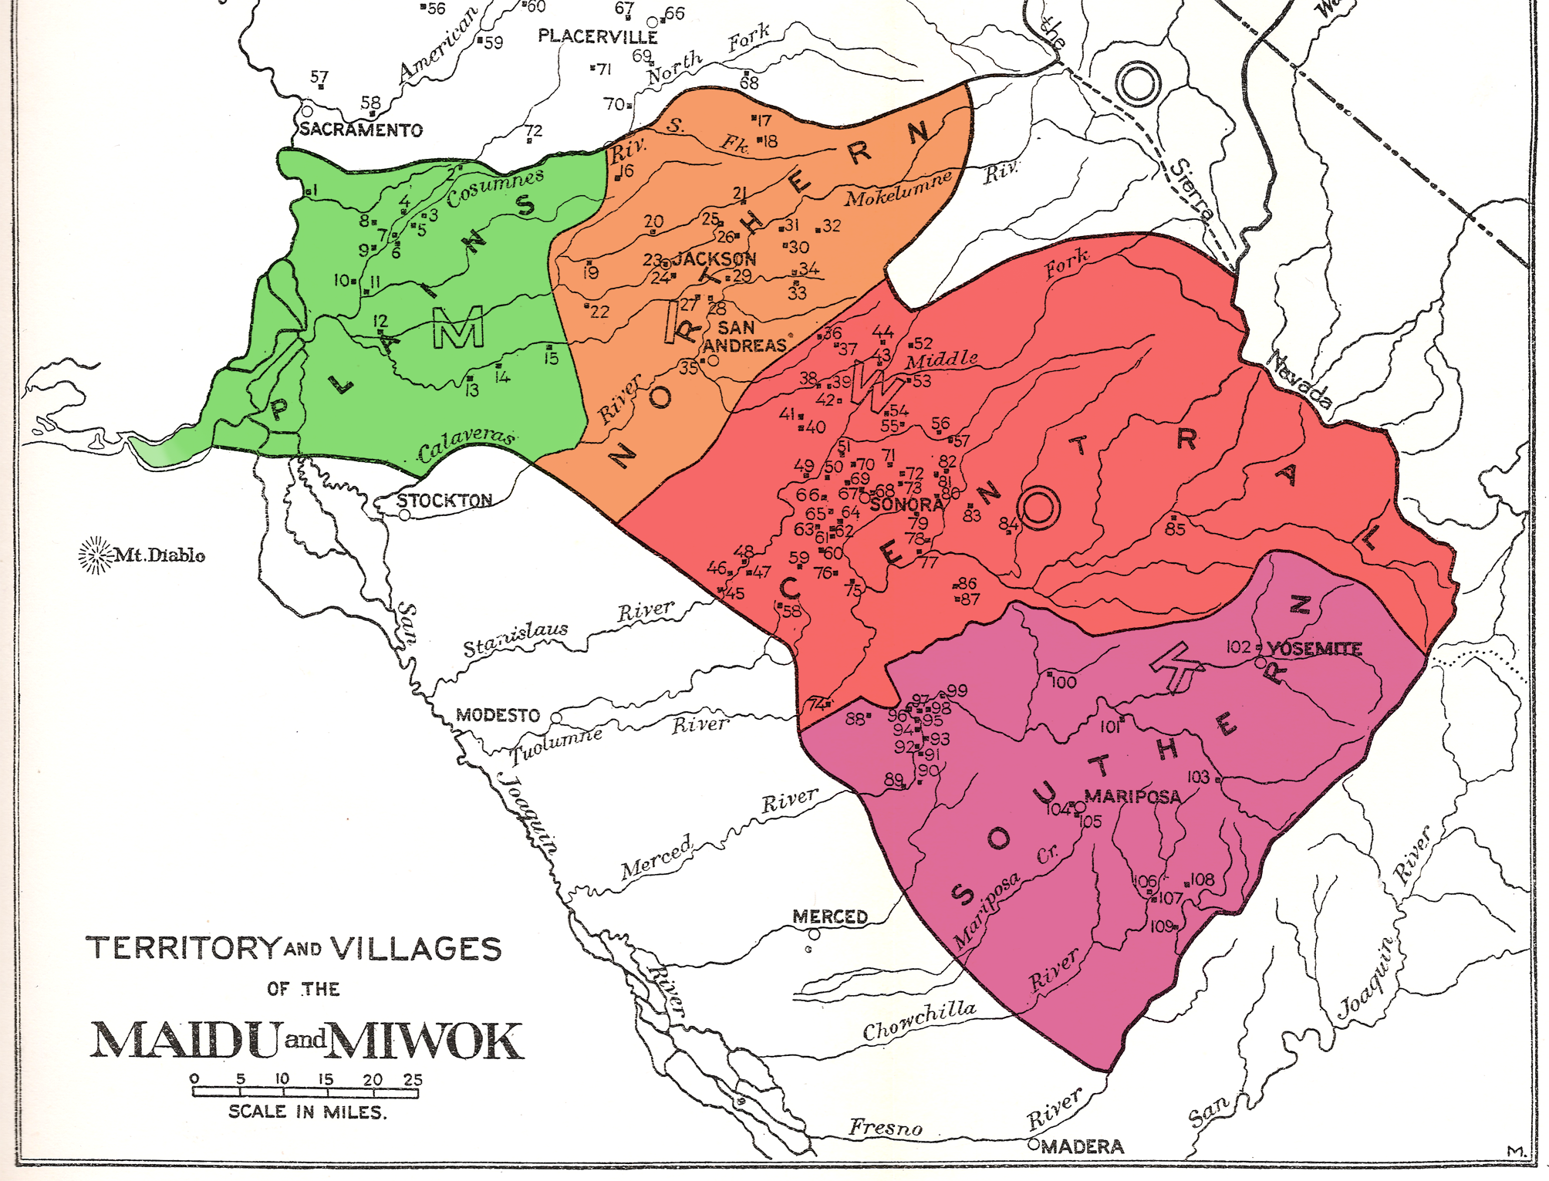
Location
The Maidu live in the northern part of California.
They live in the center of California.
They had a mild Climate.
The valleys bottoms were often wet from melting snow.

Slide 3
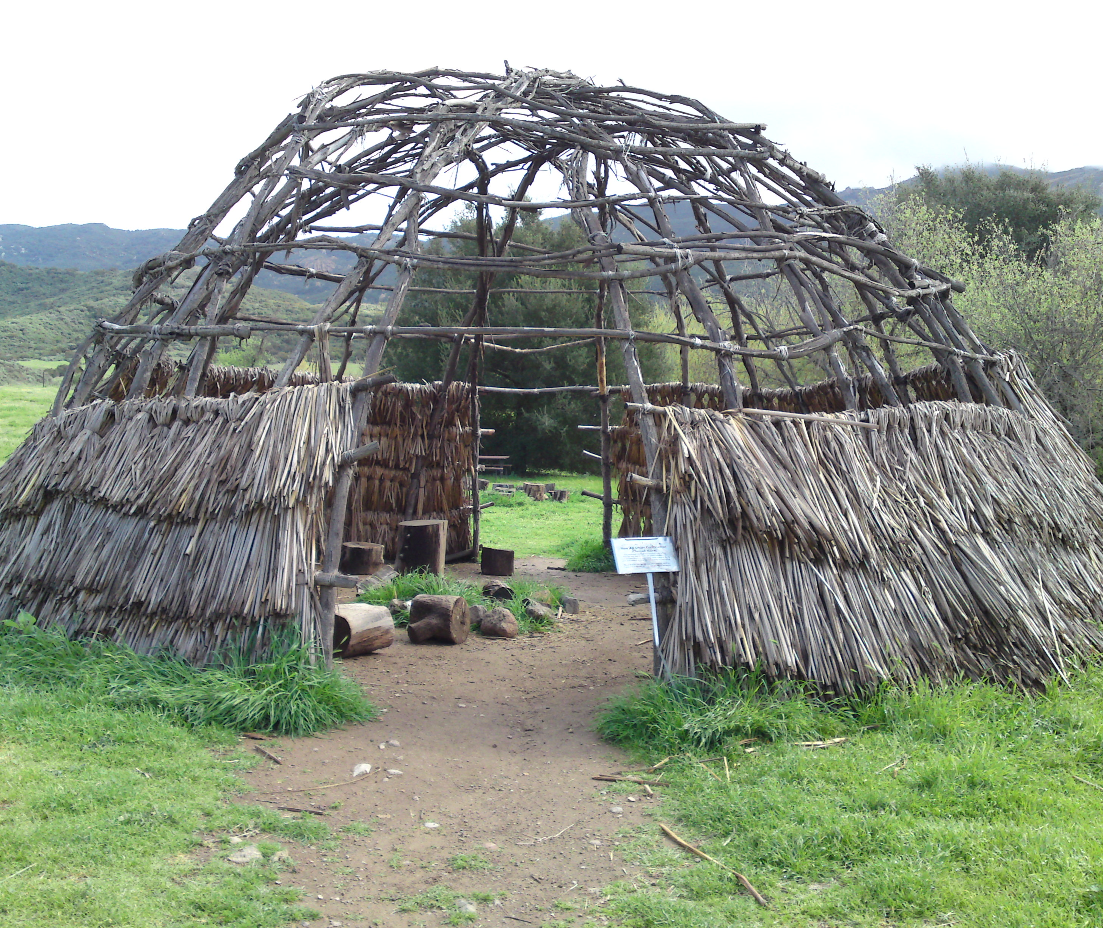
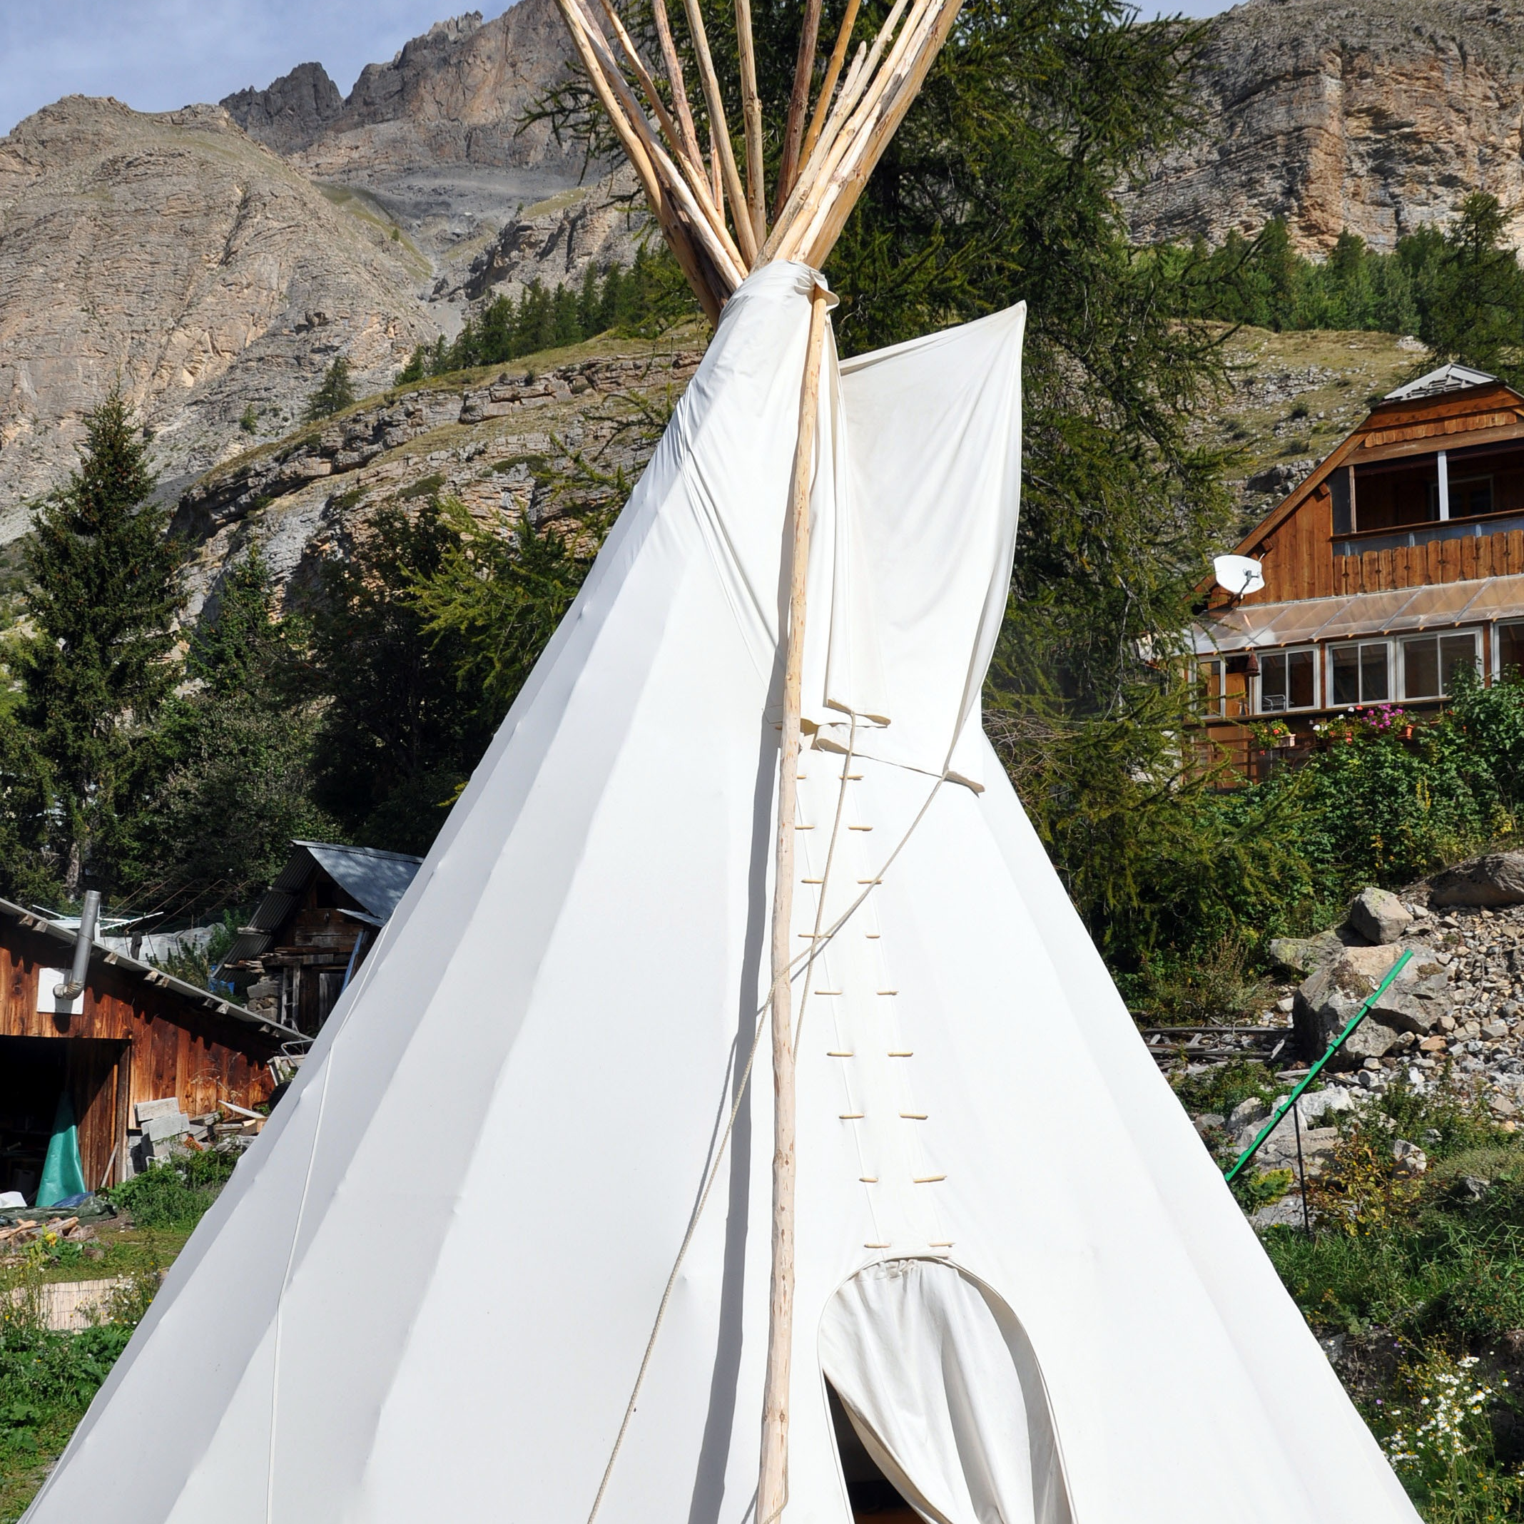
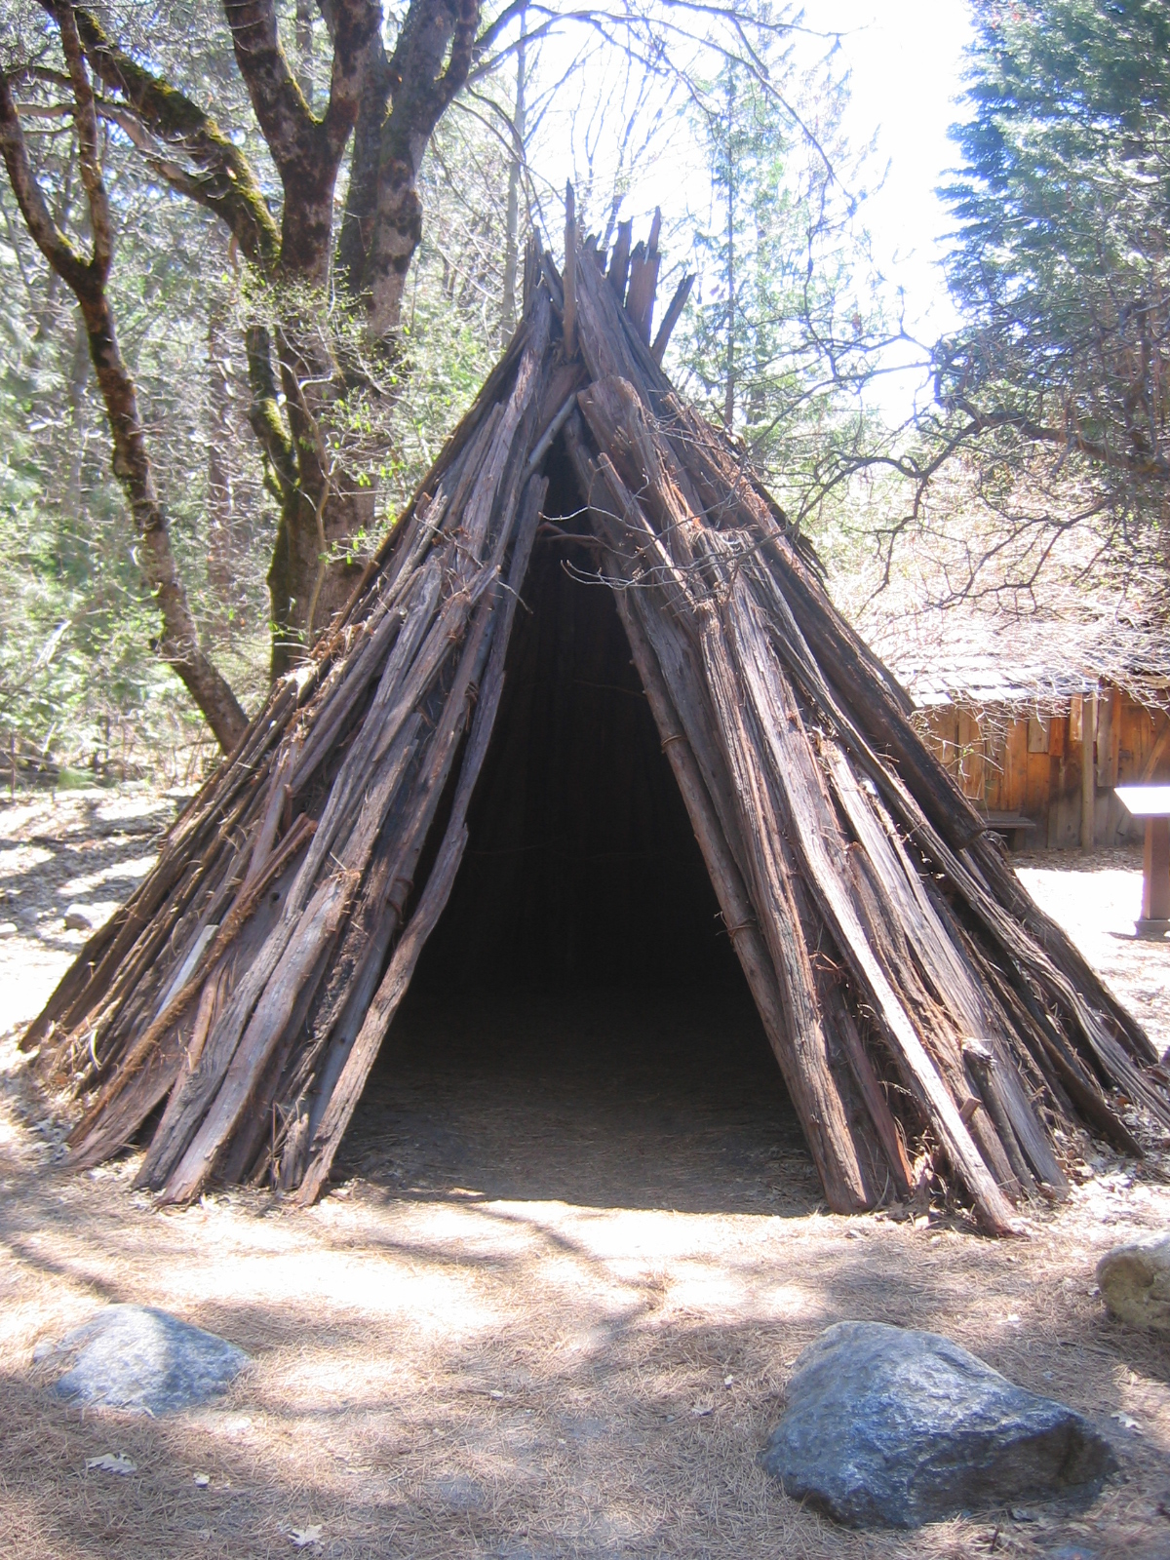
Shelter
The shelter of the Maidu tribe protected they from the environment.
Some Maidu built cone shaped homes from poles covered in bark.
Several families shared a house.
They were called the hubo.
ThePhoto by PhotoAuthor is licensed under CCYYSA.
ThePhoto by PhotoAuthor is licensed under CCYYSA.

Slide 4
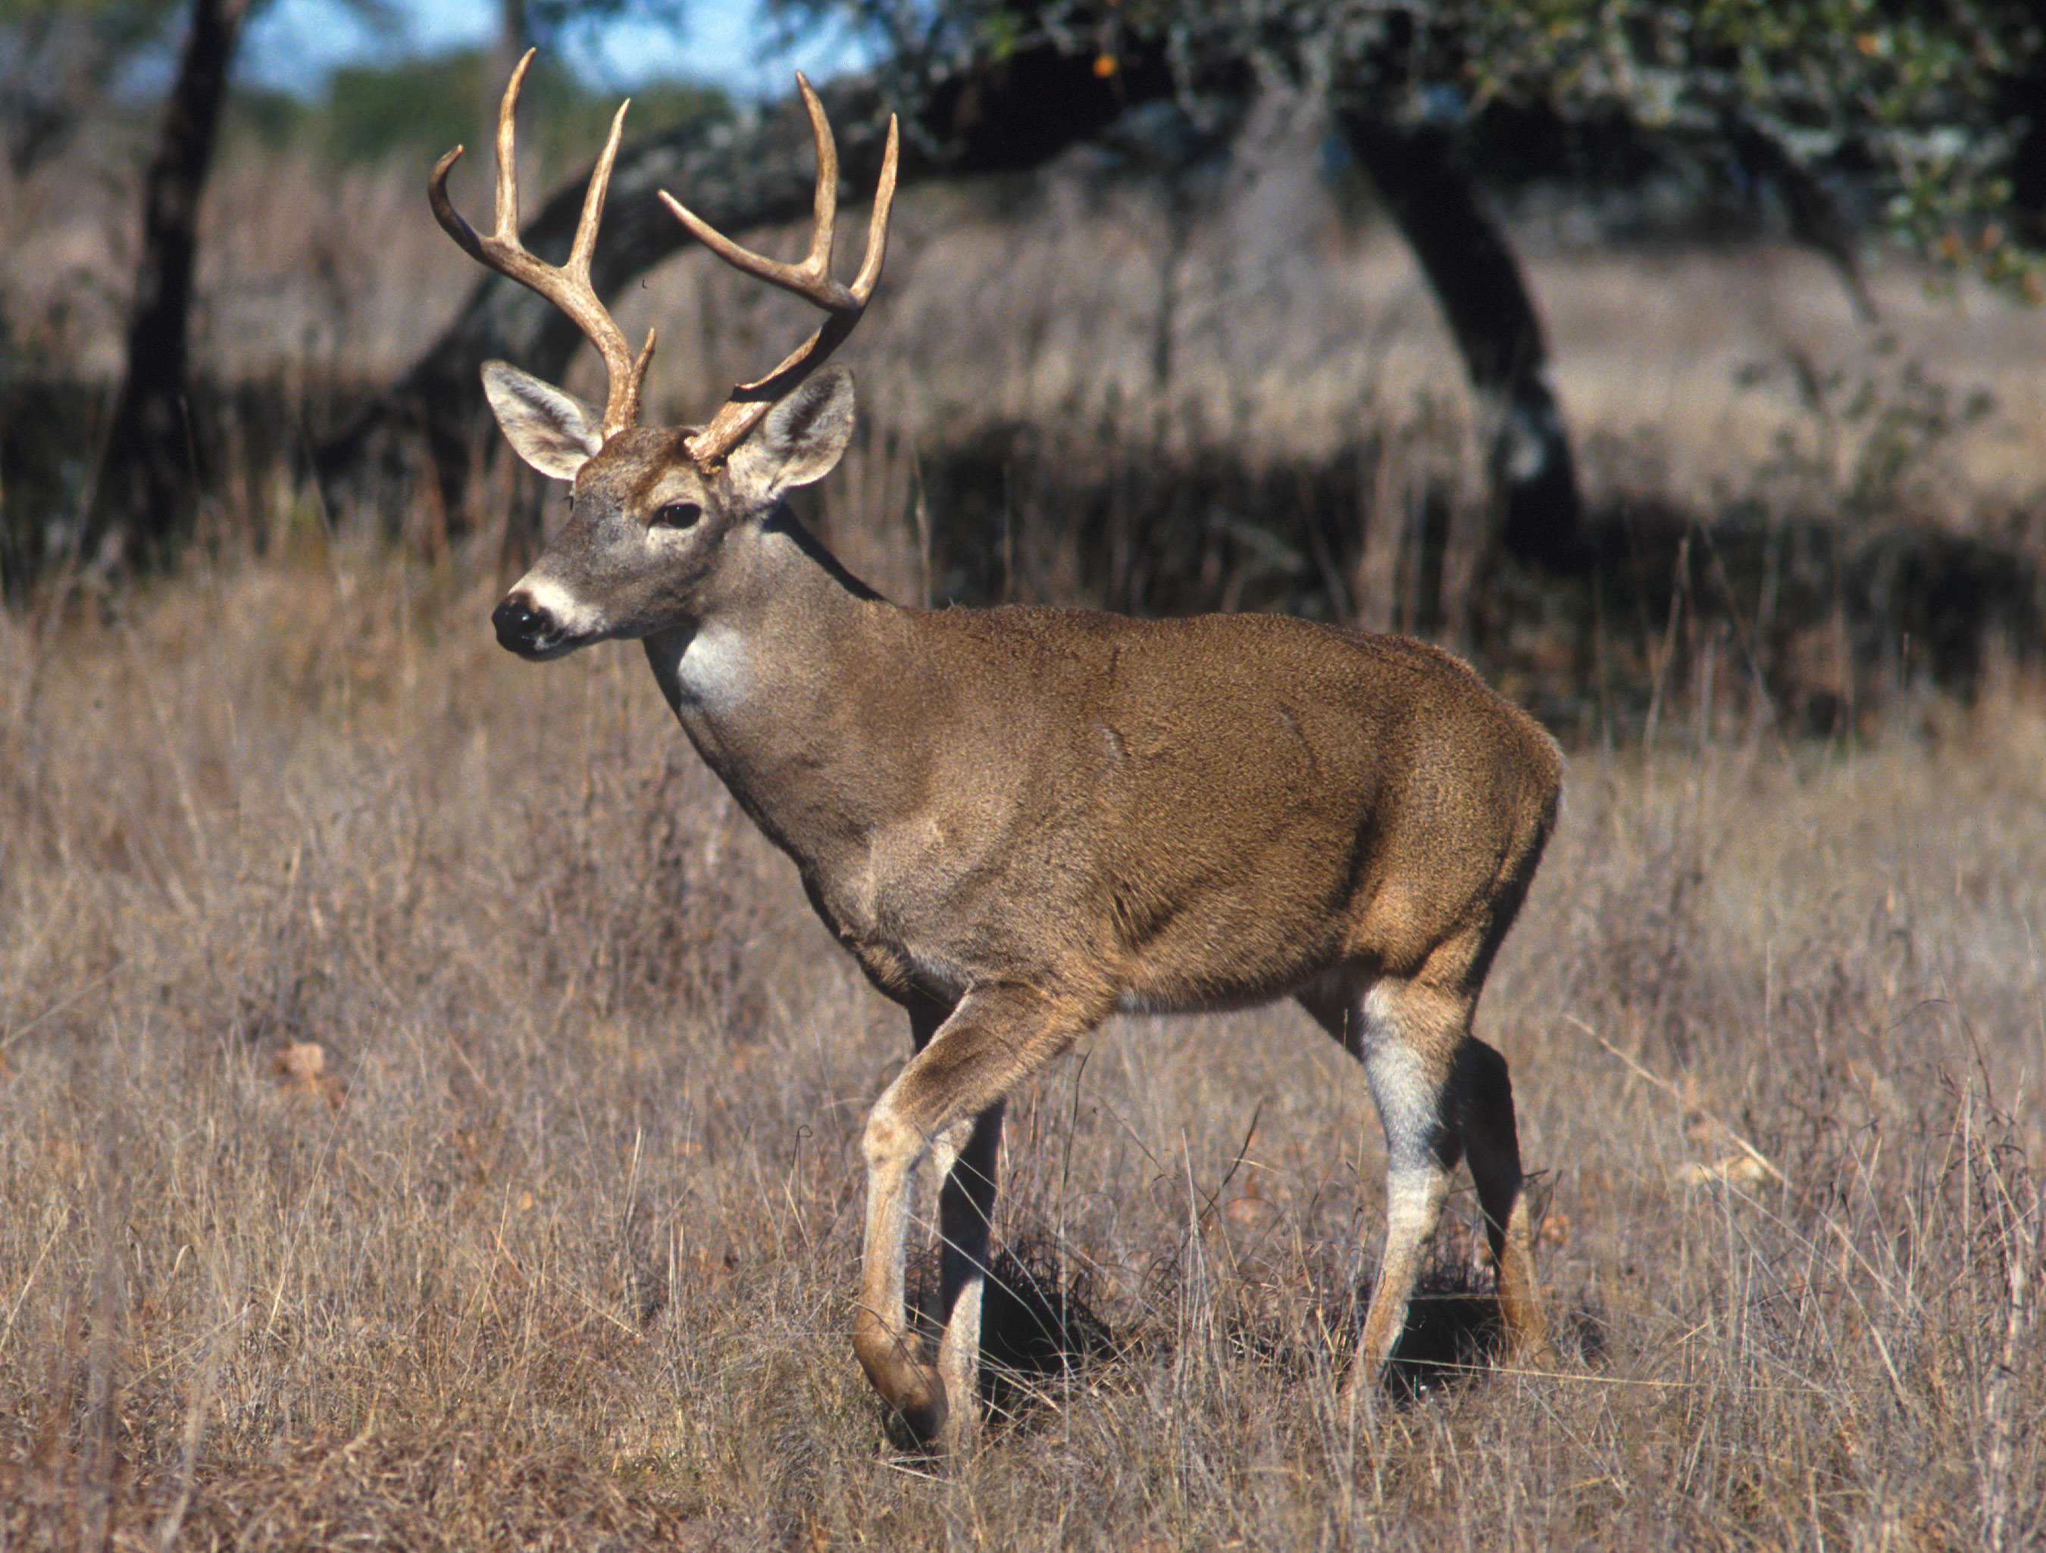
Food
The Maidu tribe used nature to find food in order to survive.
They gathered acorns, berries, seeds, nuts and wild plants.
They fished for salmon, trout and eels.
They hunted deer, squirrels rabbits, elk and birds

Slide 5
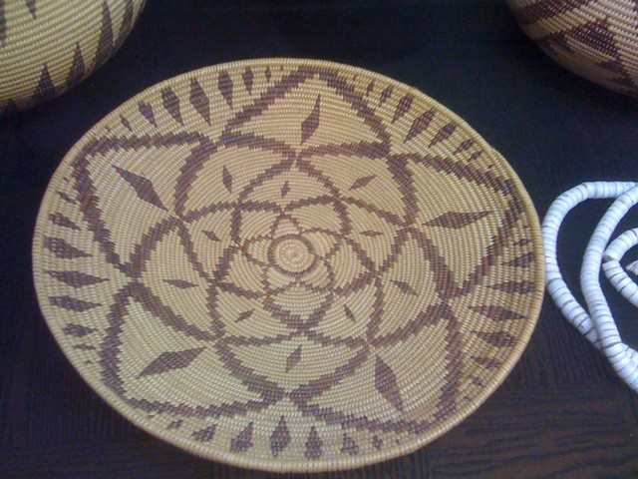
Culture
The Maidu made baskets to find seeds in water.
They collected, stored and cooked in baskets.
The Maidu made simple clothes out of deer and bear skin and used feathers for decoration.
They carried, stored and cooked in woven baskets from reeds and grasses

Slide 6
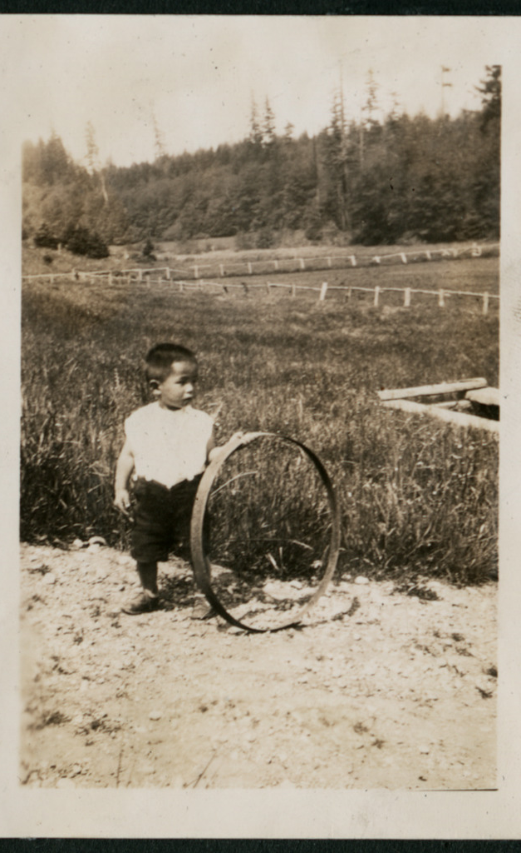
Activities of the Maidu
They play together by playing the hoop game.
Many Maidu children like to go hunting.
In the past Maidu kids had more chores than playing.

Slide 7
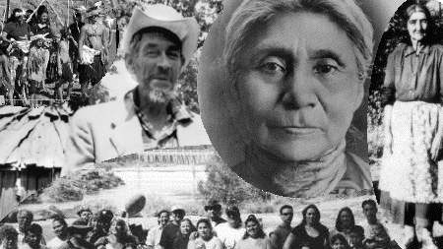
Thanks for watching

