Slide 1
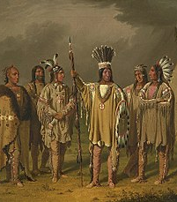
The Pomo Tribe
By kaedn wu
This Photo by Unknown author is licensed under CC BY-SA.

Slide 2
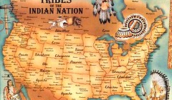
Location
The Pomo lived in North central California.
The Pomo lived near lakes, rivers, the ocean, and mountains.
Weather was mild.

Slide 3
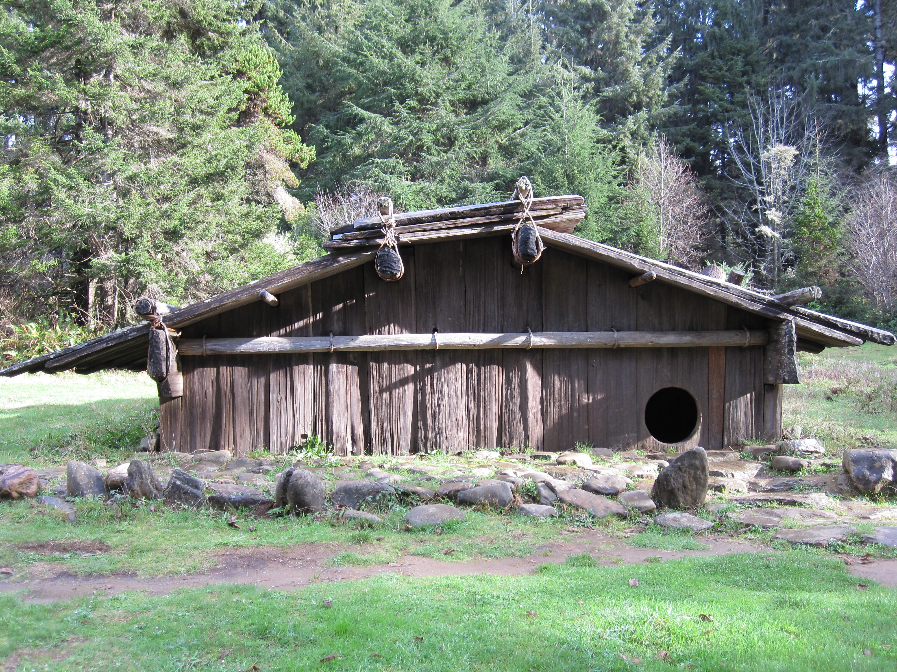
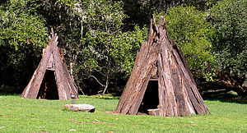
Shelter
The Pomo's shelter was made from poles covered in bark.
Their home were made of tall grasses and plants.
Their small round houses were built over a hole in the ground

Slide 4
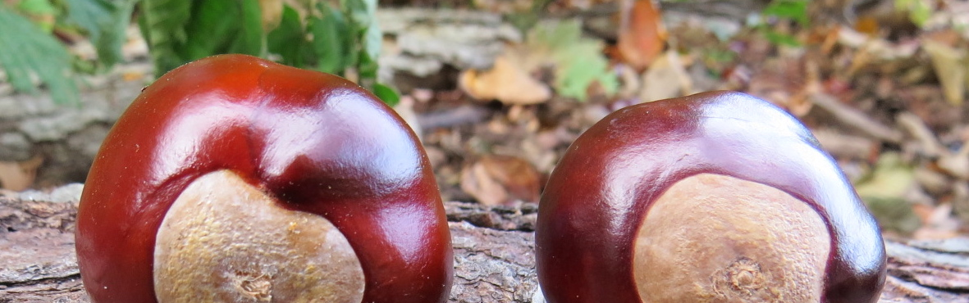
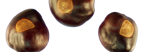
Food
From the ocean, they ate fish, shellfish, seals, sea lions, and seaweed.
They also ate elk, deer, grass-hoppers, rabbits, squirrels, caterpillars, birds, and antelope.
The Pomo gathered corn, bulbs, roots, seeds, berries, and buckeye nuts.

Slide 7
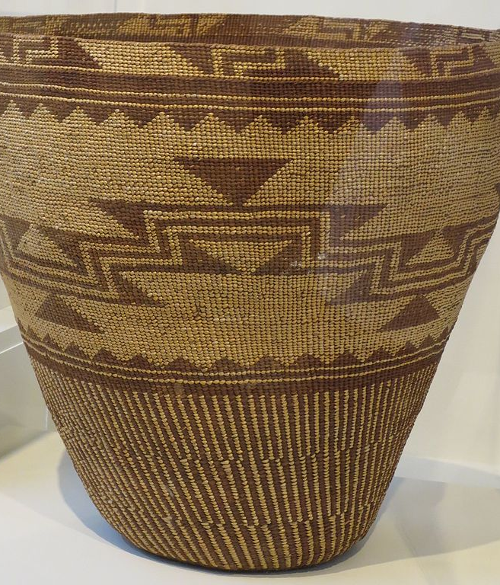
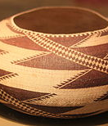
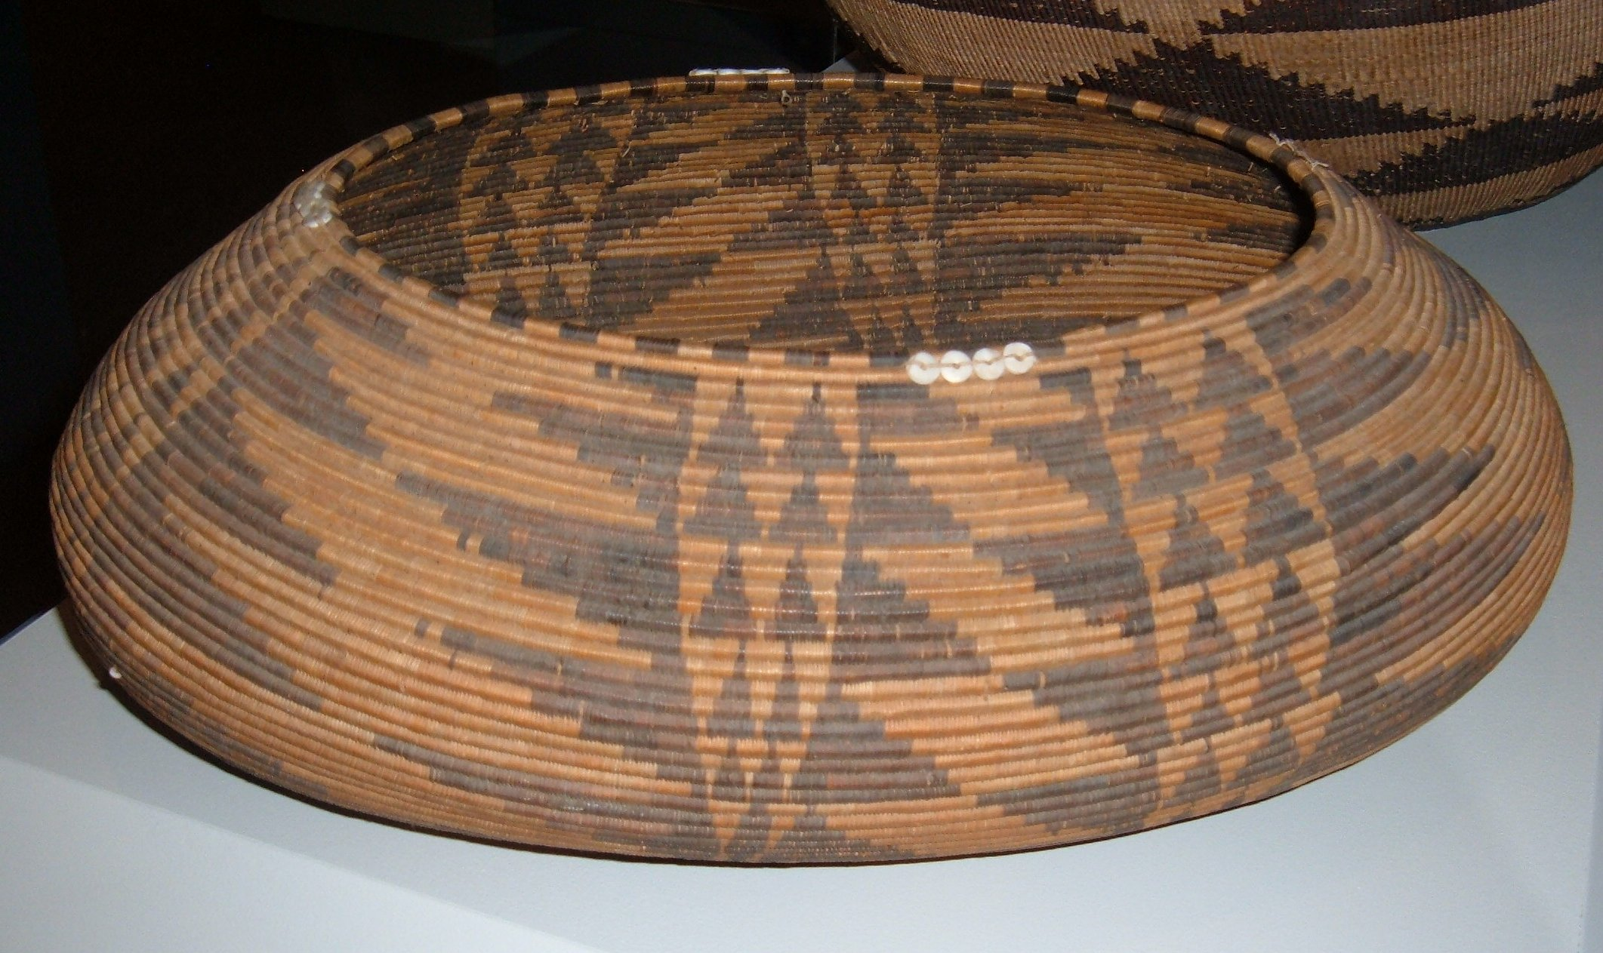
Culture
Their culture is unique.
The men fished and hunted.
The women planted and cooked.

Slide 8
Indians

