Slide 1
Styles of Leadership
Ch 9 sec 3

Slide 2
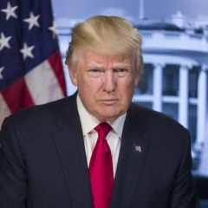
I. Increased Responsibilities
Modern presidents have provided strong leadership for the nation, even though the Founders envisioned Congress leading the nation.
Presidents provide leadership in introducing bold new ideas as well as responding to crises both at home and abroad.
Notes:
https://www.google.com/url?sa=i&rct=j&q=&esrc=s&source=images&cd=&ved=2ahUKEwjpkuCp0tjlAhVmIDQIHYH_Cm4QjRx6BAgBEAQ&url=https%3A%2F%2Fwww.cnbc.com%2Fdonald-trump%2F&psig=AOvVaw3E0t_JiCKGGC9f46ATQEKC&ust=1573234750733676

Slide 3
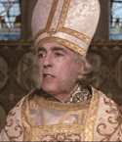
II. Leadership Qualities and Skills
Presidents must know and understand the people of the United States.
Presidents must be able to communicate effectively and to explain their policies clearly in order to gain public support.
Notes:
http://theu.com.s3.amazonaws.com/images/celebs/priest_impressive.gif

Slide 4
II. Leadership Qualities and Skills
Presidents must know when the time is right to introduce new policies and make decisions.
Successful presidents must:
Be flexible and open to new ideas;
Be able to compromise;
Have political courage and be willing to go against public opinion in matters they believe are vital to the nation’s interests.
Notes:
http://haacked.com/images/haacked_com/WindowsLiveWriter/OnHiringBloggersandOpenSourceDevelopers_1135/605480_thumbs_up_with_clipping_path%5B9%5D.jpg

Slide 5
III. Presidential Isolation
The special treatment given to modern presidents risks isolating them from information and advice they should have to carry out their duties effectively.
Presidents may discourage staffers from disagreeing with them or giving them unpleasant advice.
Notes:
http://thefullblog.files.wordpress.com/2008/01/hear-no-evil.jpg

Slide 6
III. Presidential Isolation
Access to the president often forces top staffers and advisers to flatter the president and provide good news and favorable opinions.
Top staffers control access to the president.
Dealing with White House staff requires much of the president’s time and makes it more difficult to keep in touch with the public.
Notes:
http://www.petpro.com/images/products/53800.jpg

Slide 7
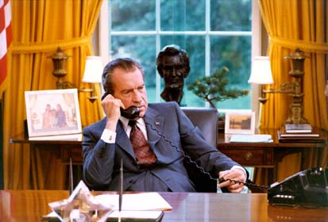
IV. The Use of Executive Privilege
To keep White House discussions and advice secret, presidents invoke executive privilege to avoid giving such information to Congress or the courts.
Notes:
http://nixon.archives.gov/virtuallibrary/images/c9461-18.jpg

Slide 8
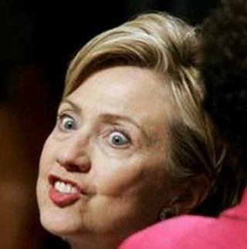
IV. The Use of Executive Privilege
Modern presidents have claimed that executive privilege also protects their communication with other members of the executive branch.
The Supreme Court has ruled that executive privilege is constitutionally based.
Notes:
http://www.techshout.com/images/hillary-clinton.jpg

Slide 9
Assignment
Write a half-page summary of today’s lecture in your notebooks.

