Slide 1
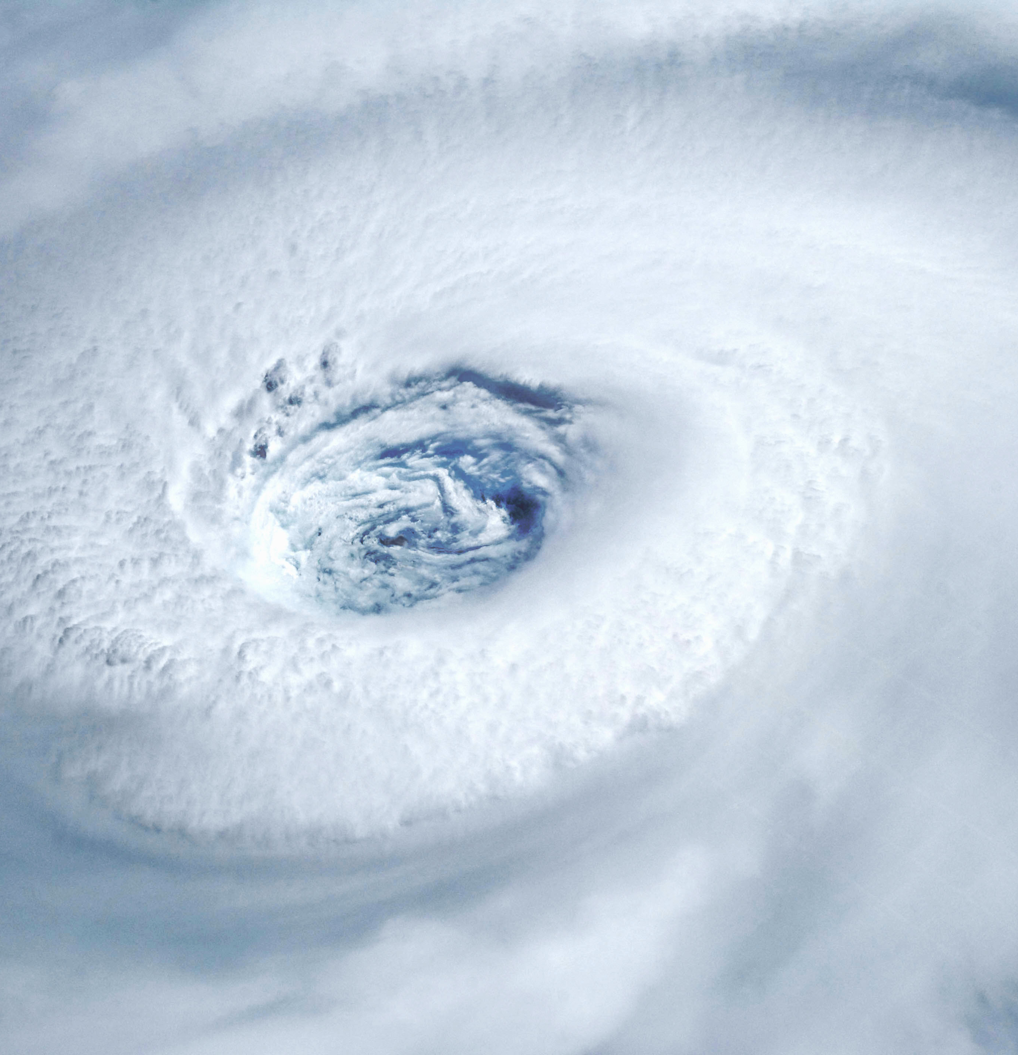
Weather and Climate
By: Noah D. and Bradley
This Photo by Unknown author is licensed under CC BY-SA.

Slide 2
Tropical Climate Zone
Only cover around 2 percent of the total surface area of the Earth
But really about 50 % of the plants and animals on the Earth live there
Rainforests are the forests that receive high amounts of rainfall.

Slide 3
Temperate Climate Zone
Temperate climate zones are those without extreme temperature and precipitation (water and snow)
The temperate zone has just moderate amount of rain and snow.
Temperate climate zones are found around the sea or around warm water.

Slide 4
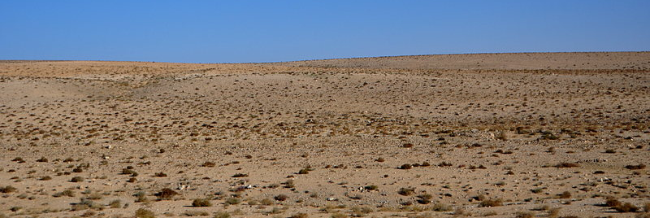
Desert Climate Zone
Deserts get less than 10in. Of rain a year.
Deserts are the hottest places on earth.

Slide 5
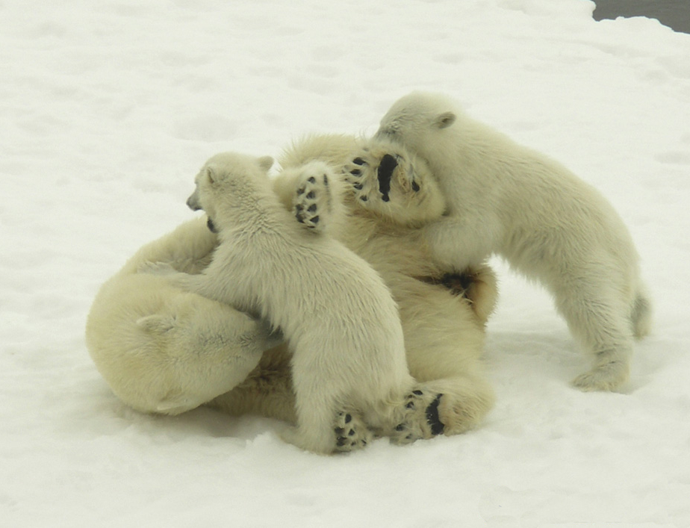
Polar Climate Zone
Polar climate zones are the coldest places on earth.
Regions with polar climate cover than 20% of the earth's surface area.
A polar climate consists of cool summers and very cold winters, which results with treeless tundra, glaciers, or a permanent or semi-permanent layer of ice.
/
'
This Photo by Unknown author is licensed under CC BY-SA.

Slide 6
Cumulus Clouds
Cumulus are 5,000 ft high.
They are large piles of white clouds that can billow high in the sky. they appear during fair weather
The top of the cloud has rounded towers
This Photo by Unknown author is licensed under CC BY-SA.

Slide 7
Cumulonimbus Clouds
Cumulonimbus clouds are found 5,000 ft. in the air.
Cumulonimbus clouds are dark towering clouds.
They are known as thunder clouds because they bring thunder storms.
Cumulonimbus cloud storms don't last more than an hour.

Slide 8
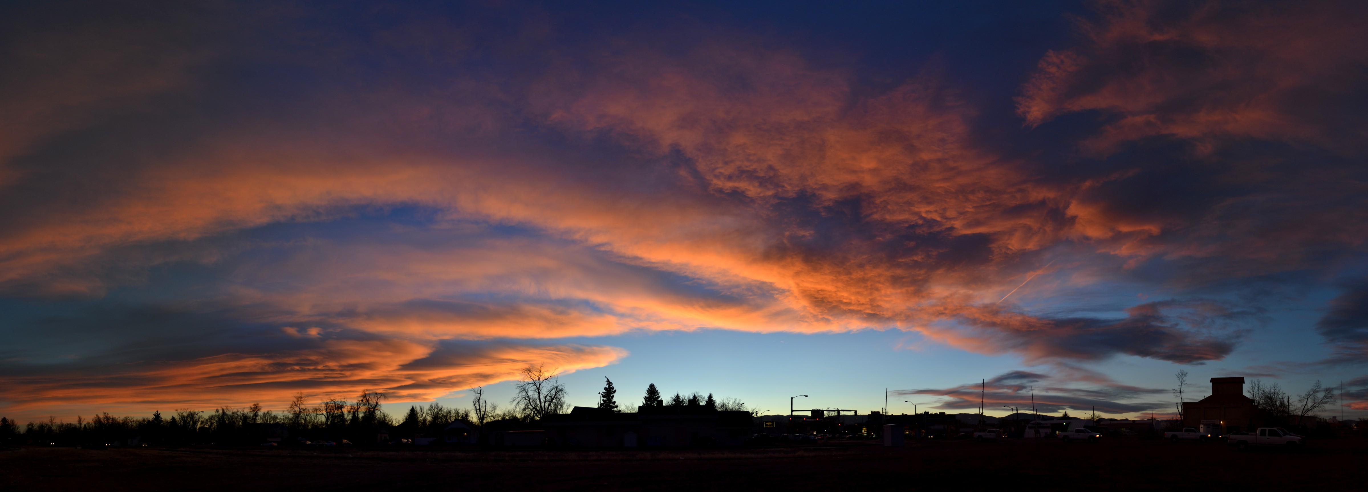
Stratus Clouds
Stratus clouds could be around 1,000 ft or even to the ground.
Stratus clouds are thick, low sheet clouds that cover the sky and are a sign of rainy weather.
Stratus clouds are not rain clouds.
Stratus clouds cover the whole sky.

Slide 9
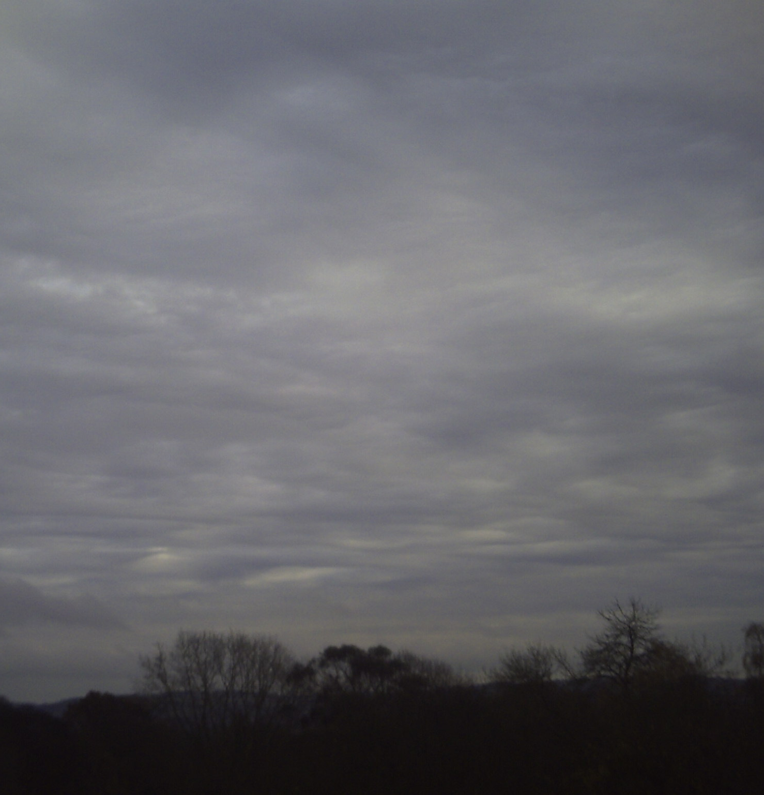
Stratonimbus Clouds
Stratonimbus usually have a thickness of about 2000m to 4000m.
Often, when an altostratus cloud thickens and descends into lower altitudes, it will become a stratonimbus cloud.
A stratonimbus storm last for hours and hours.
When temperatures are cold enough, these clouds may also contain ice particles and snow.
Notes:
z

Slide 10
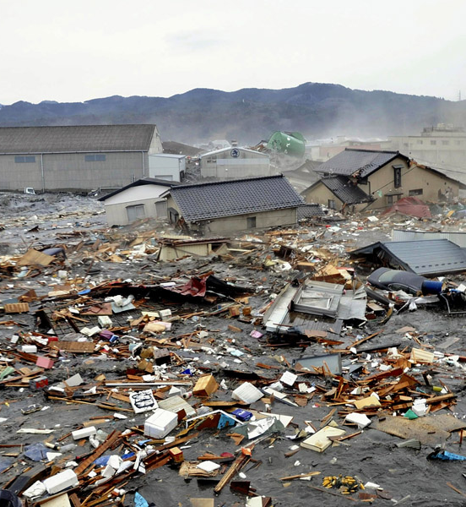
Extreme Weather - Tsunami
Tsunamis aren't caused by tidal waves.
Tsunamis are caused by shifts in the bottom of the ocean, earthquakes, and volcanos.
Two of a tsunami's crests can be 100 miles apart.
When tsunamis reach the surface it forces energy to break down into smaller pieces.
A-NC.

Slide 11
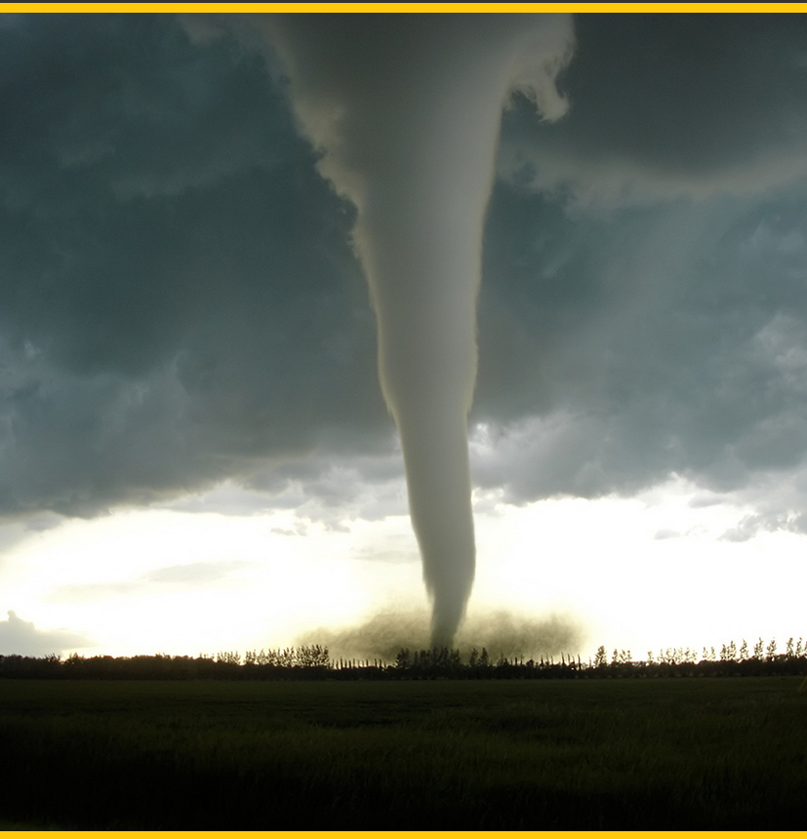
Extreme Weather -Tornadoes
Tornadoes form in flat lands, and in areas called fronts.
A Tornado can spin to 300 mph.
A tornado forms when 2 different mixtures of air collides
Tornadoes uproot trees, destroy houses, and throw cars flying like toys.
This Photo by Unknown author is licensed under CC BY-SA-NC.

Slide 12
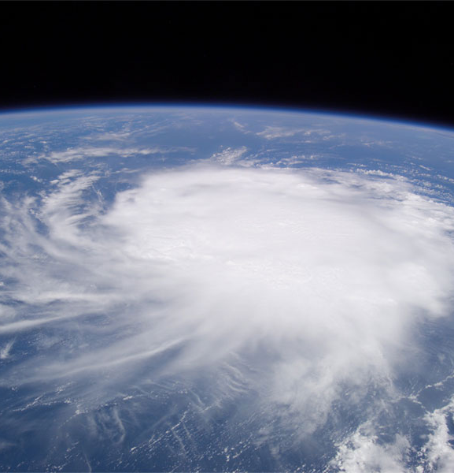
Extreme Weather-Hurricanes
Hurricanes are huge spinning storms that develop in warm areas around the equator.
Hurricanes are one of the three kinds of storms called tropical cyclones.
Tropical storms are cyclones of heavy clouds and strong thunder storms that spin at steady wind speeds of 39 to 73 miles per hour.
Most of the violent winds are in the eye of a hurricane.

