Slide 1
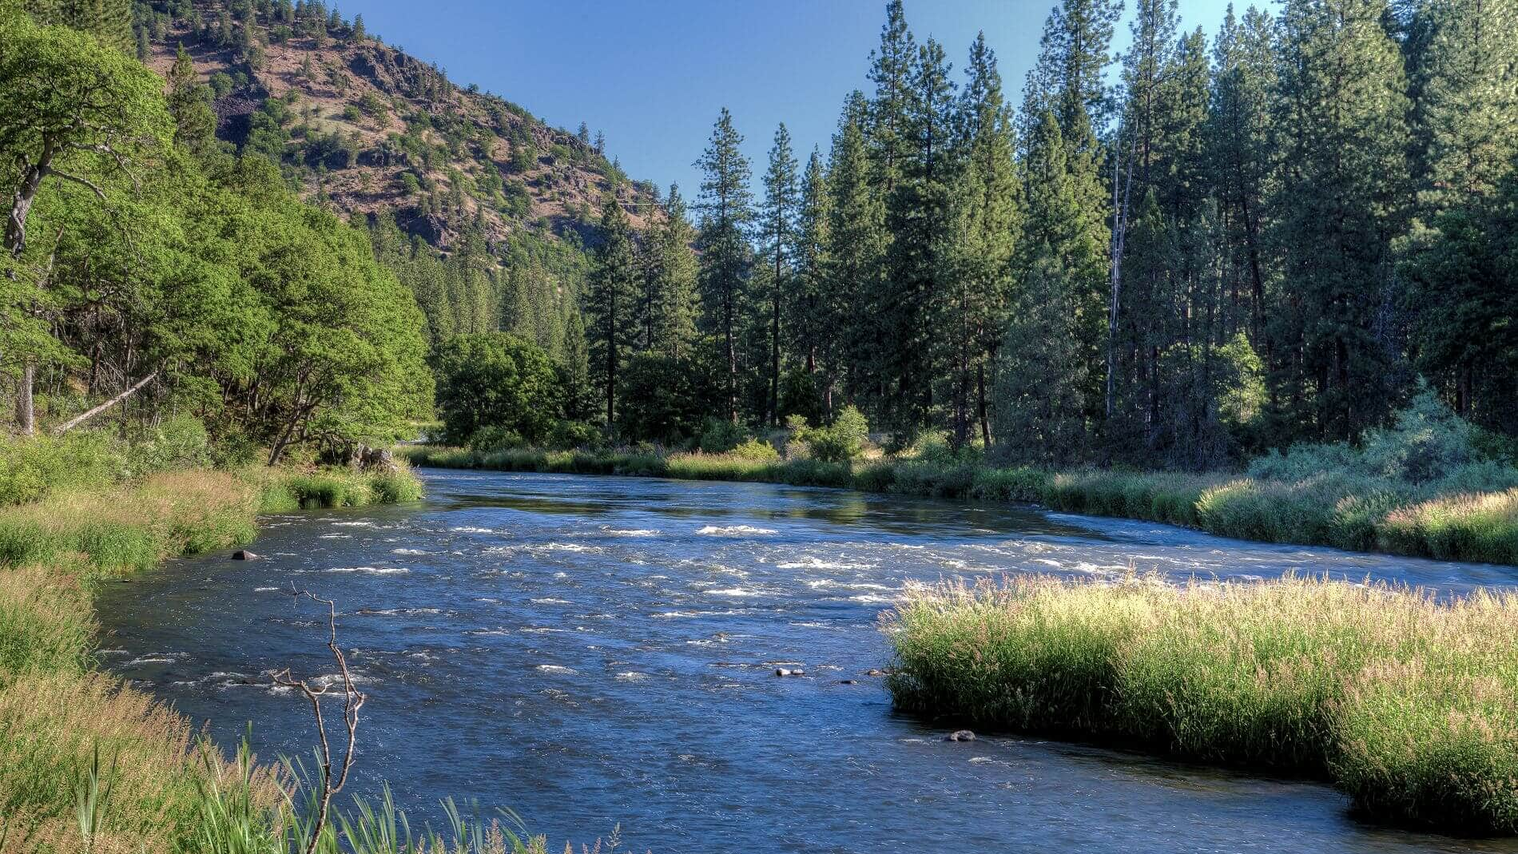
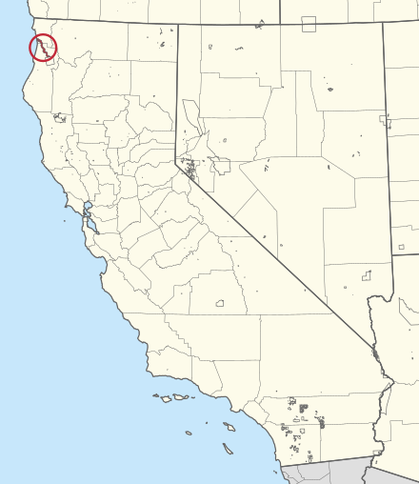
Yurok
By Edward

Slide 2
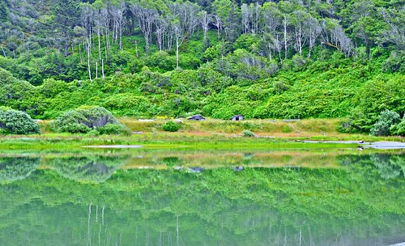
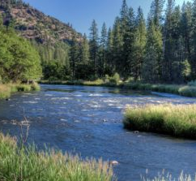
Location
The Yurok tribe live along the Klamath river or by the beaches. The weather had sunshine, rain, snow, wind and storm. Yurok home lands were located in present-day California.

Slide 3
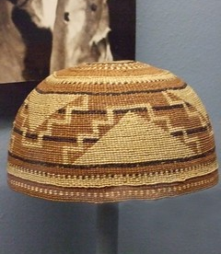
Culture
They made fancy blanket hats. They carried baskets that the women made. Women were in charge of several important tasks for their family and village.

Slide 4
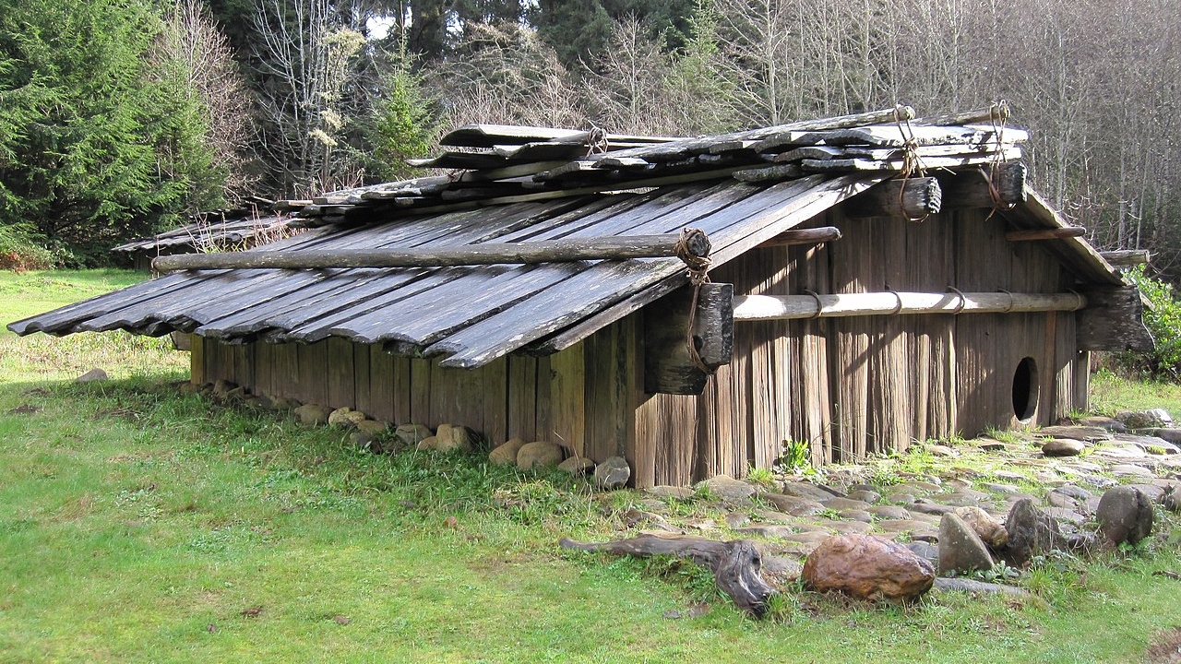
Shelter
The materials to build it was red wood planks. Their houses were rectangular. The name of their homes were called "plank homes".

Slide 5
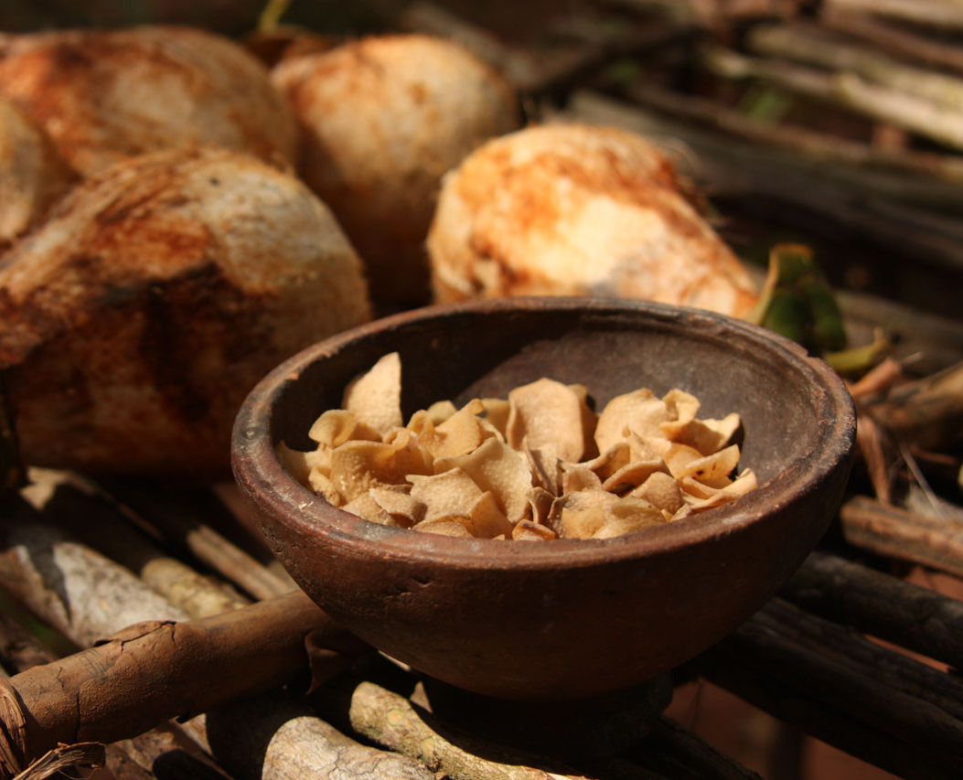
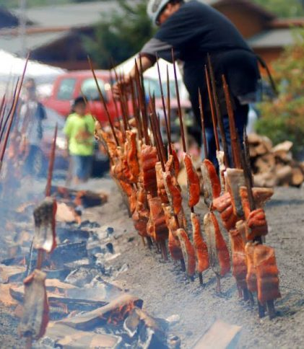
Food
The basic source of food were acorns. They ate fish, seals, and sea lions from the ocean. They gathered berries, wild plants, seed, and acorn.

Slide 6
😃
Thank you for listening

