Slide 1
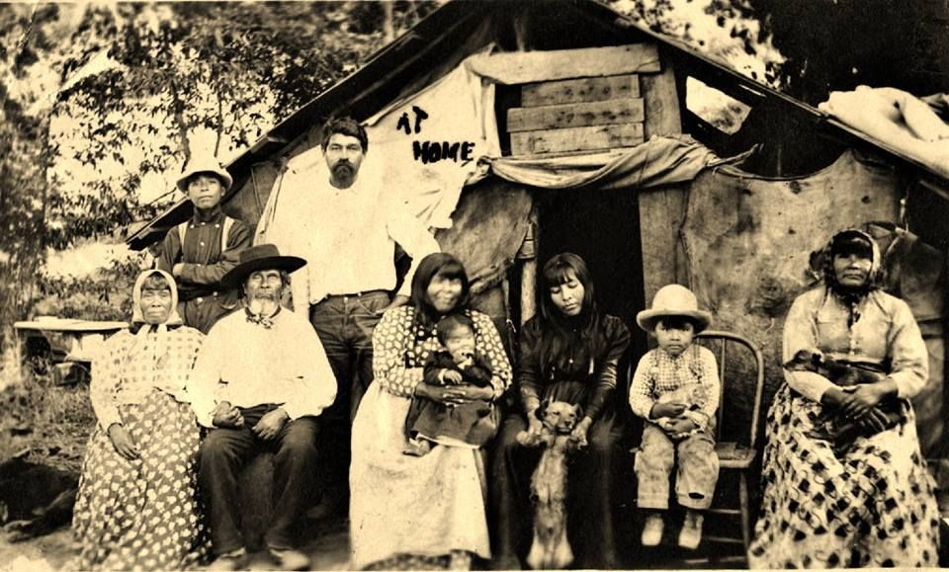
Pomo
By Vincent and Evelyn

Slide 2
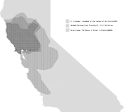
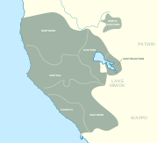
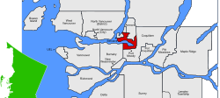
Location
Pomo live in north central
California on the coast.
The land has rivers, forests, and lakes.
The weather was cold in the winters and cool in the summers.
This Photo by Unknown author is licensed under CC BY-SA.
This Photo by Unknown author is licensed under CC BY-SA.
This Photo by Unknown author is licensed under CC BY-SA.

Slide 3
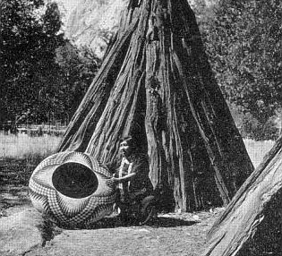
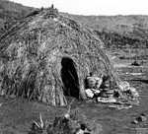
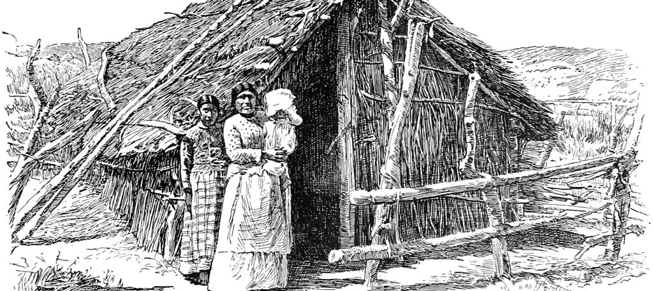
Shelters
The homes of the Pomo tribe protected them from environment. Pomo dug a hole in the ground to help them get warm in the winters. The homes were small and round. Sweathouses covered with brush or tule.
This Photo by Unknown author is licensed under CC BY-SA.
This Photo by Unknown author is licensed under CC BY-SA.
This Photo by Unknown author is licensed under CC BY-SA.

Slide 4
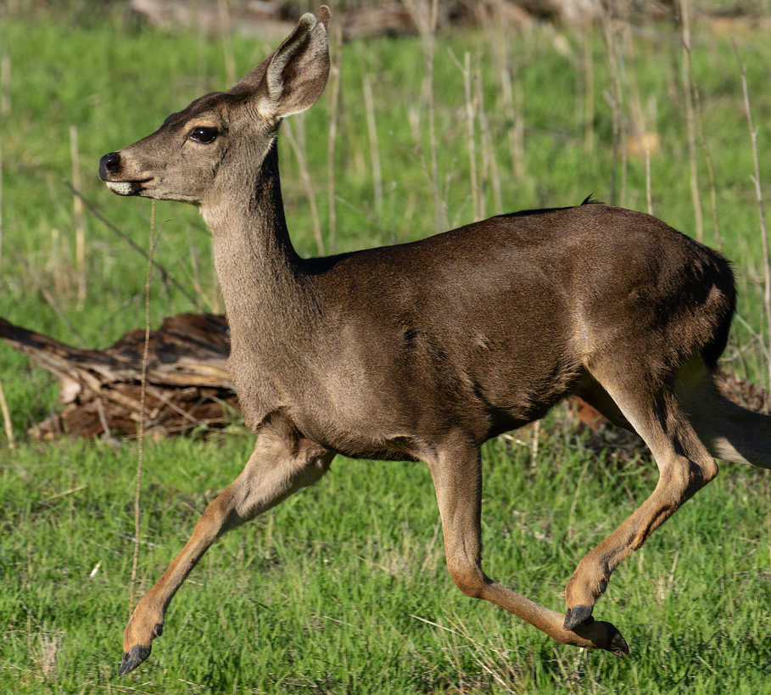
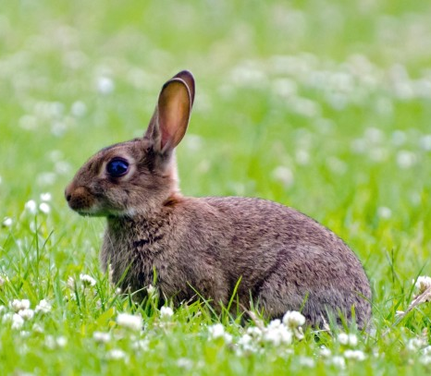
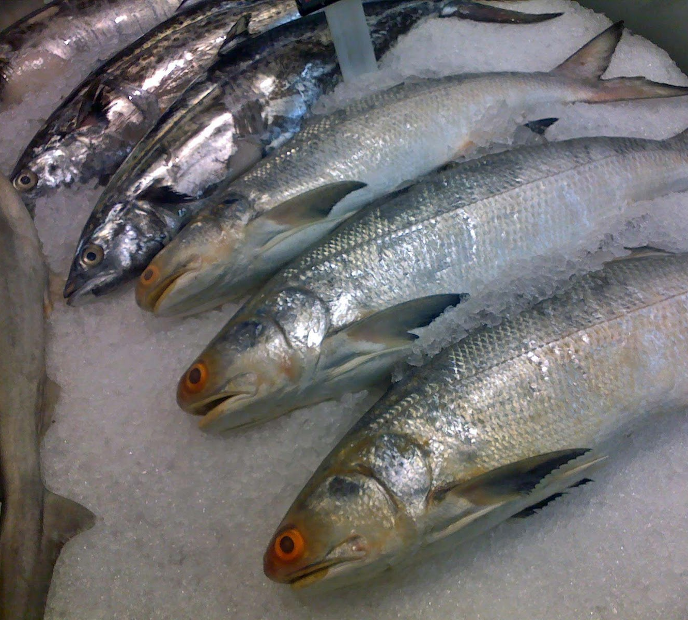
Food
The Pomo used the land to find food in order to survive. Man hunted deer, elk, antelope, squirrel and rabbits. The Pomo ate grasshoppers and caterpillars. From the sea they ate fish, shellfish, and sealions.
This Photo by Unknown author is licensed under CC BY.
This Photo by Unknown author is licensed under CC BY.

Slide 5
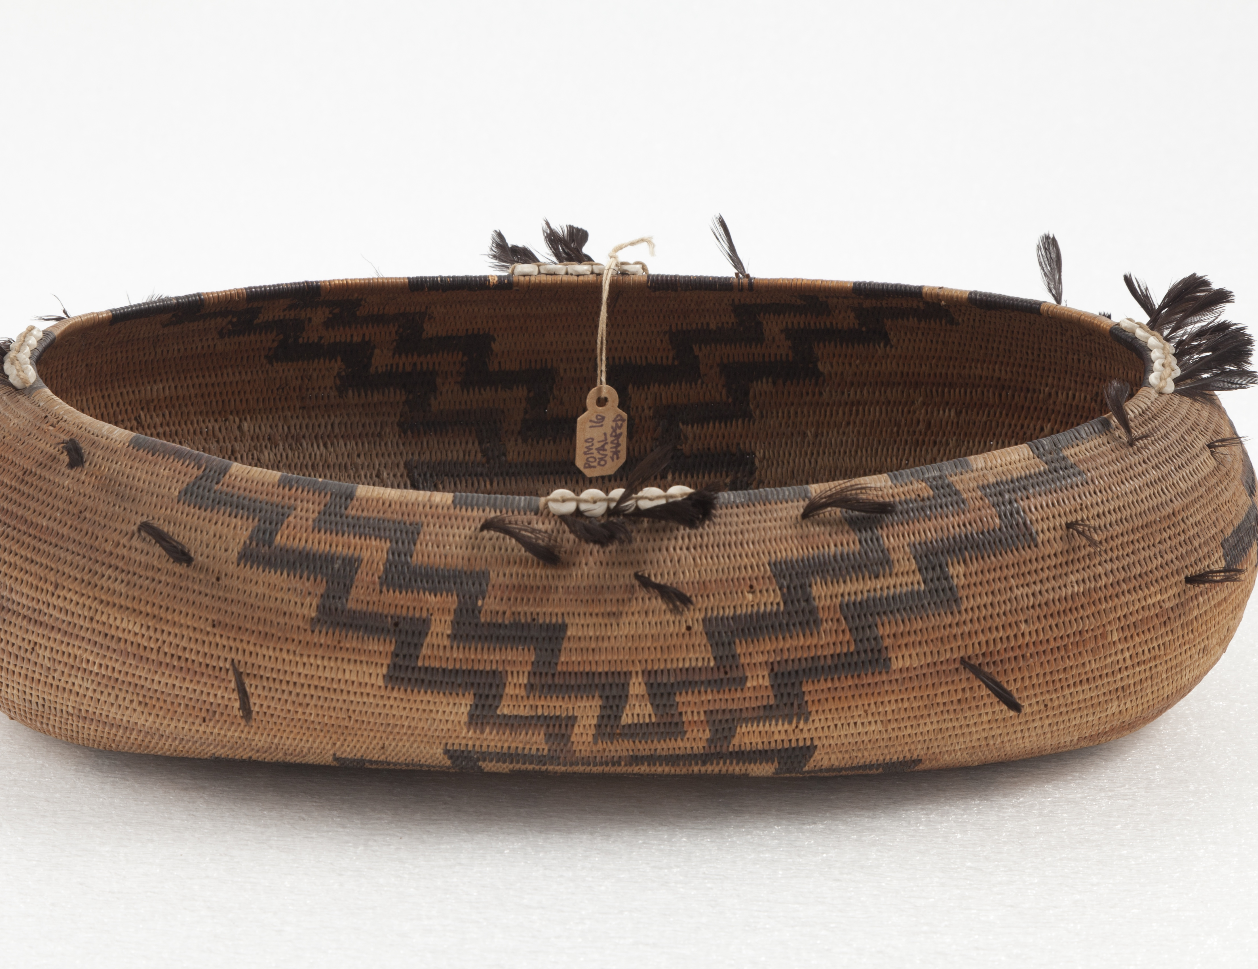
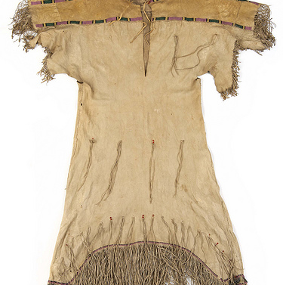
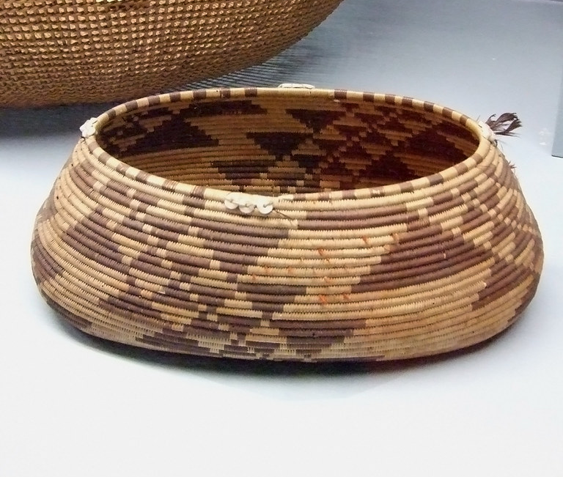
Culture
The culture the Pomo tribe was unique and interesting. People used shredded bark from redwood trees to make their clothing. They wore capes over their shoulders. They made tools out of stone and wood.
This Photo by Unknown author is licensed under CC BY-SA-NC.
This Photo by Unknown author is licensed under CC BY-SA-NC.
This Photo by Unknown author is licensed under CC BY.

Slide 6
The end
This Photo by Unknown author is licensed under CC BY-SA.

