Slide 1
Conflict, Stress, and Coping
Ch 16 part 2

Slide 2
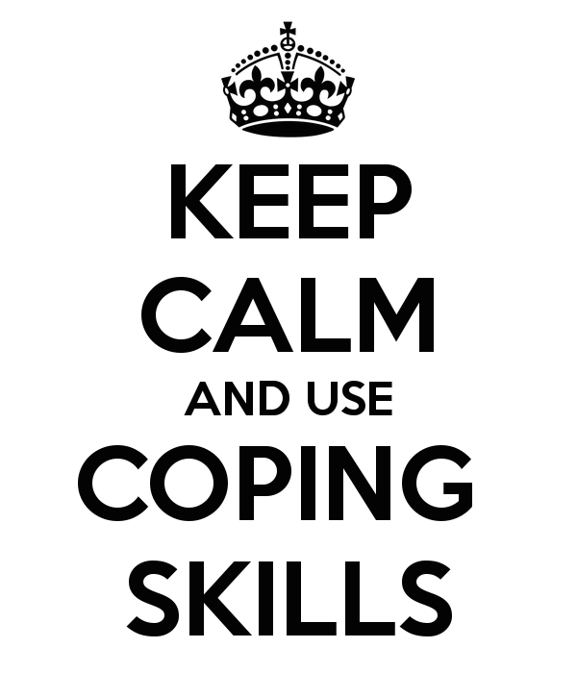
I. Coping with Stress
How much control you feel about your life can affect how much stress you feel. The more control you feel you have, the less stress you will be under.
If you feel completely helpless and at the mercy of others or situations, then your stress level will be very high.
how we view ourselves affects how we react to situations. The more confident we feel about ourselves, the more confident we will be in life.
Notes:
https://bringchange2mind.org/2017/06/22/breaking-out-ones-coping-skills/

Slide 3
I. Coping with Stress
Our view of ourselves can be very different from how others view us. If there is a large gap between our view and others, we may not be looking at ourselves in a true light.
Our self view can also be affected by how others view us. We believe what influential people in our lives say about us, whether it is positive or negative. That can have a lasting affect on our self-esteem.
We use defense mechanisms to keep ourselves psychologically balanced and to keep those outside influences from throwing us out of balance.
Notes:
https://www.healthline.com/health/stress-relief-blogs

Slide 4
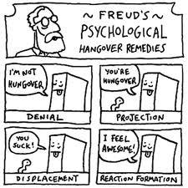
I. Coping with Stress
Repression – pushing painful events or thoughts out of our consciousness.
Denial – refusing to admit there is a problem.
Displacement – venting our feelings at something or someone other than the actual target.
Reaction formation – expressing the opposite of what we feel.
Notes:
https://limbicdiaries.wordpress.com/2016/04/15/defence-mechanisms-the-brains-shield-against-its-own-manifestations/

Slide 5
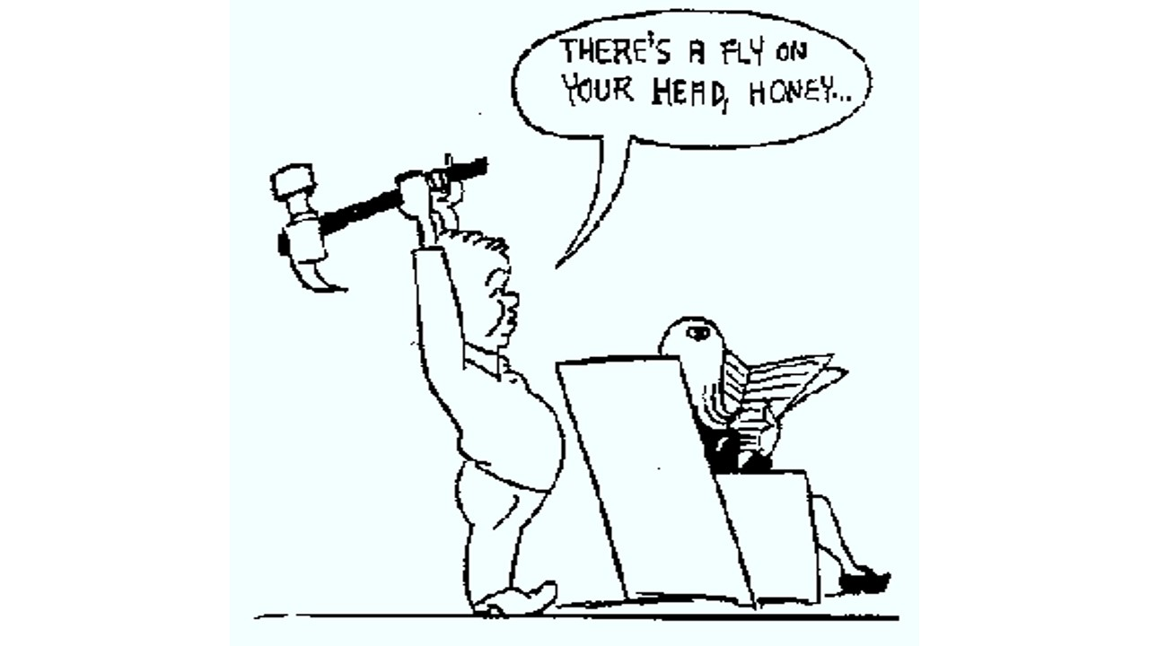
I. Coping with Stress
Intellectualization – removing emotion and discussing feelings in a cold, rational way.
Identification with the aggressor – taking on the characteristics of someone who has mistreated us to psychologically avoid the abuse.
Regression – moving backwards to be childlike, at a time when we were taken care of.
Notes:
https://www.psychmechanics.com/2014/10/subconscious-ego-defense-mechanisms.html

Slide 6
I. Coping with Stress
Rationalization – explaining away the problem so we don’t have to accept responsibility.
Projection – attributing our thoughts to someone else.
Sublimation – channeling the emotional energy into something constructive or beneficial. The only healthy defense mechanism.
Notes:
https://www.eatthis.com/how-long-it-takes-to-lose-muscle-after-you-stop-working-out/

Slide 7
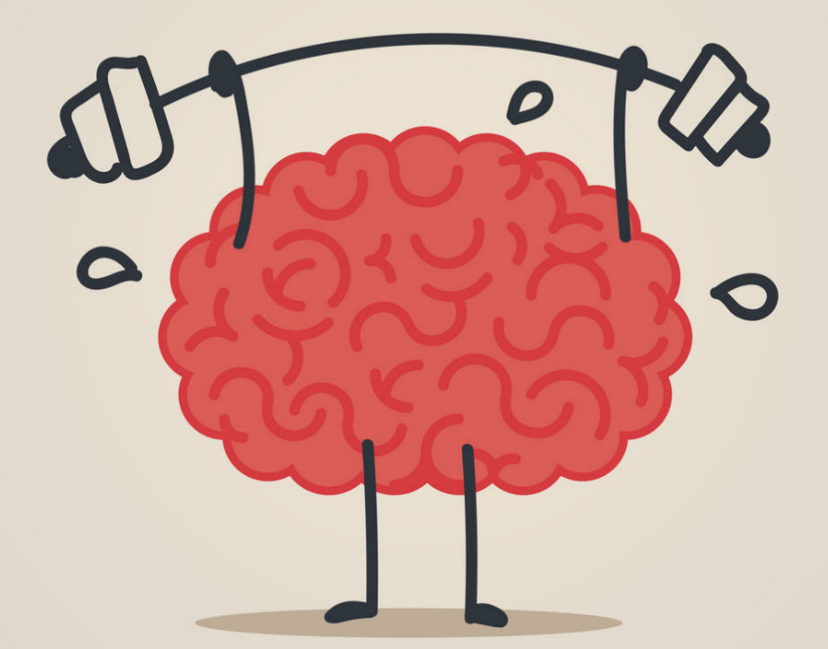
II. Healthy Characteristics
People who cope with life well usually accept themselves and accept and are interested in others. They are able to perceive things accurately for the most part as well.
People feel like they are basically in control of their lives and can tolerate different points of view. They also solve problems and are proactive in dealing with potential issues.
Notes:
https://www.empowher.com/mental-health/content/mental-health-just-important-physical-health-heres-why

Slide 8
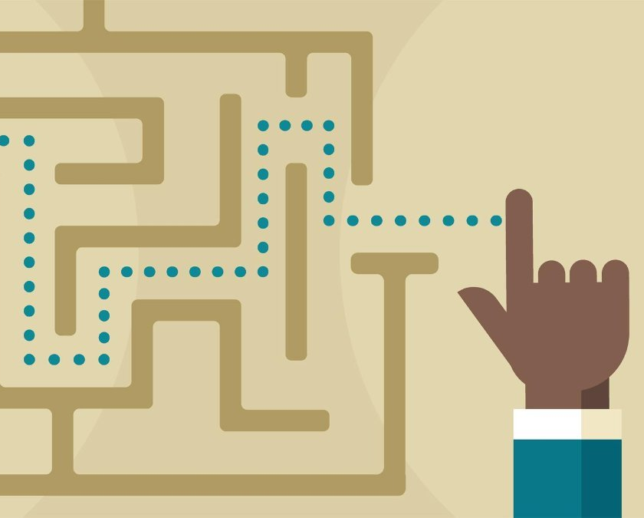
II. Healthy Characteristics
Steps to solving problems:
Define the problem
List ways to approach the problem
Evaluate how workable the approaches are
Select the best approach
Figure out the steps to implement that approach
Evaluate your success at the end
Notes:
https://www.linkedin.com/learning/problem-solving-techniques

Slide 9
In your notebook
Think of an actual problem you need to solve and go through the steps to solve it.

