Slide 1
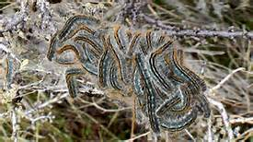
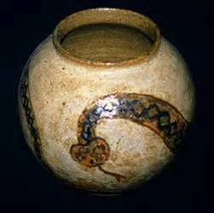
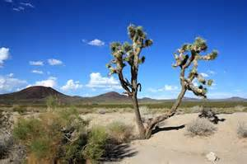
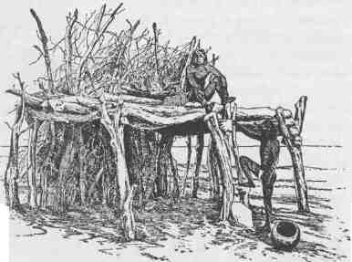
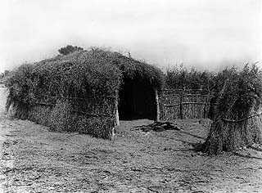
Mojave
By Grace and Nicole

Slide 2
Location
They lived in the Mojave desert.
They lived in Southeastern California.

Slide 3
Shelter
They built homes out of willow poles covered with grass and sticks.
They built small shelters and doors.

Slide 4
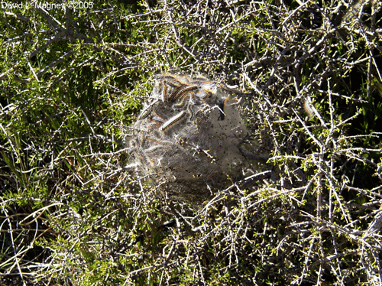
Food
They ate toasted tent caterpillars, ducks, rats, wild plants and roots.

Slide 5
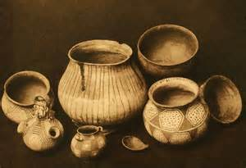
Culture
They wove baskets from plants.
They made clay pots.

Slide 6
