Slide 1
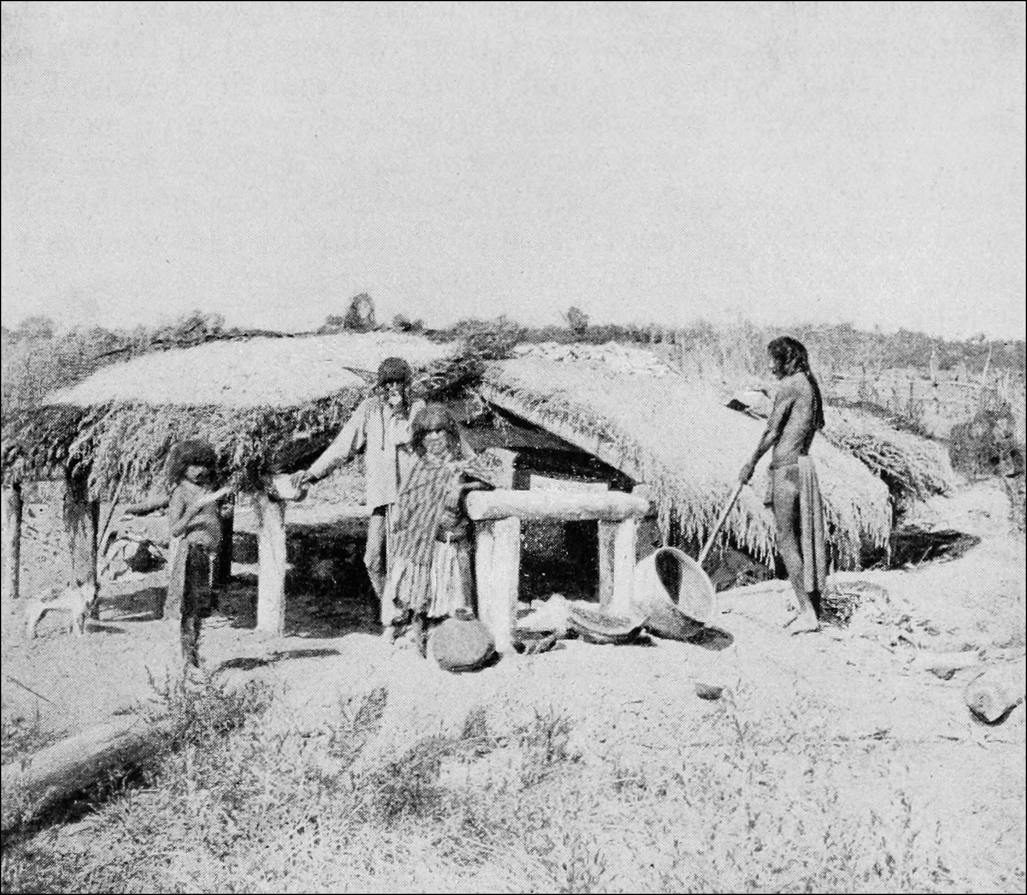
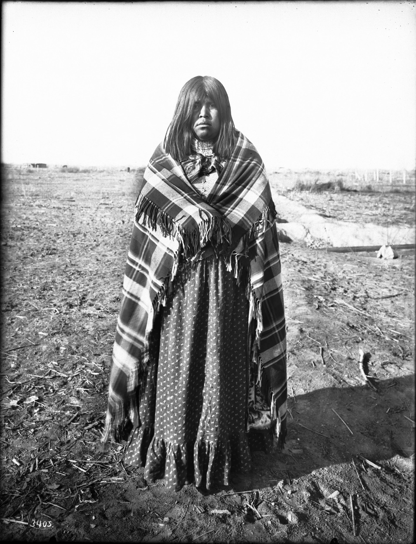
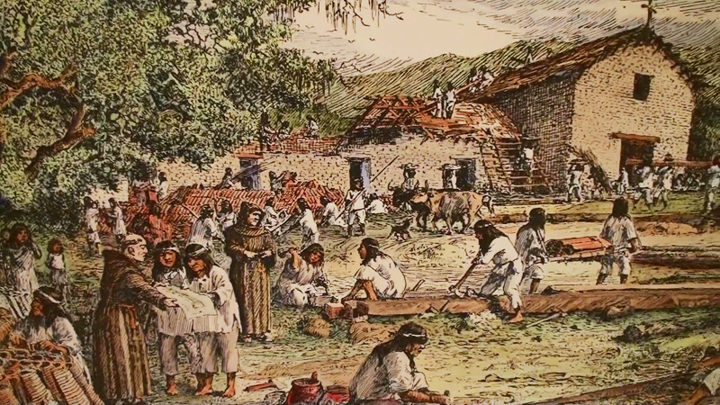
The Mojave Tribe
By Cambria,Jayleen,& Raelynn

Slide 2
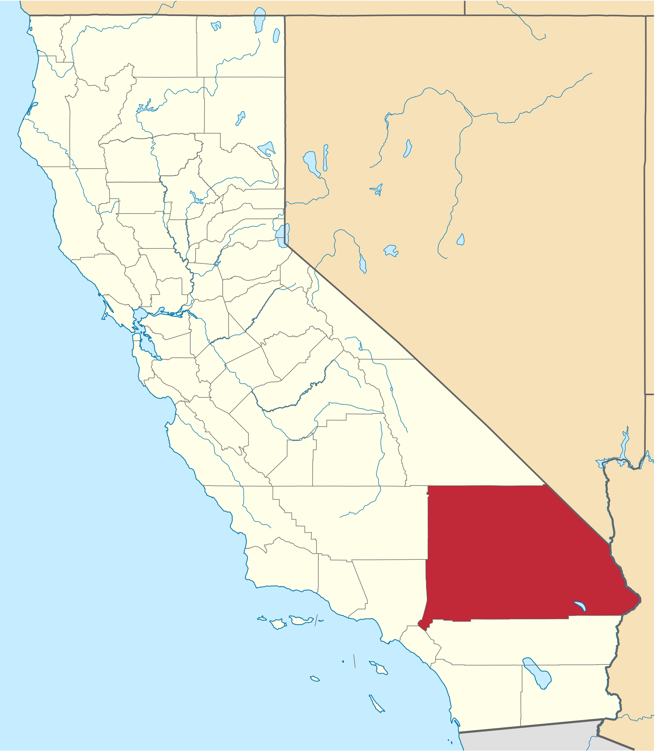
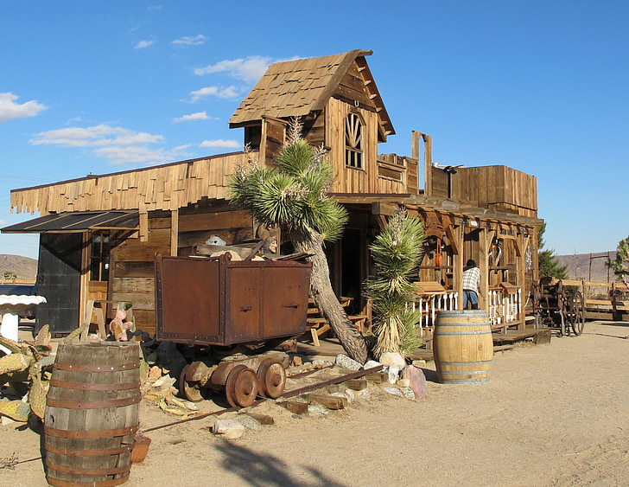
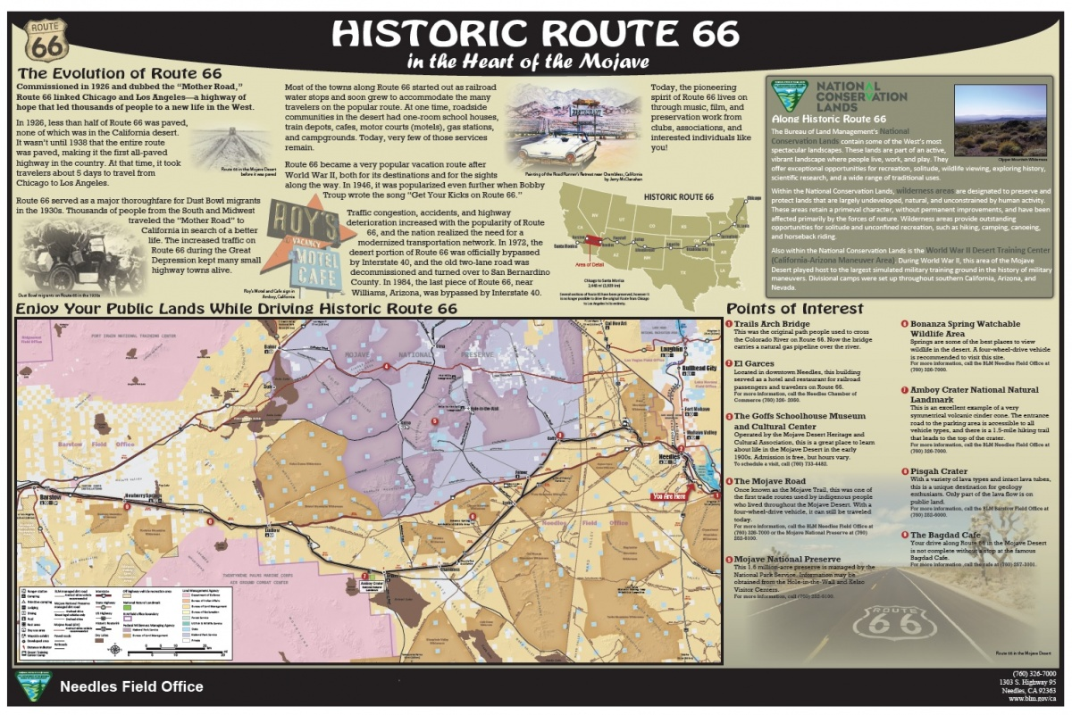
Location
The Mojave Tribe lived in the Mojave Desert in Southeastern California. It is hot where they live their clothes are meant for the hot weather. Unlike other tribes they lived. where the clay is good to make pots. They found perfect land for farming.
Notes:
Write about the landforms, geographical location, and climate unique to the area.

Slide 3
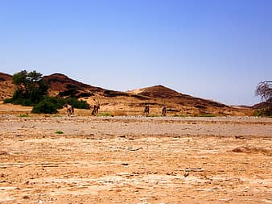
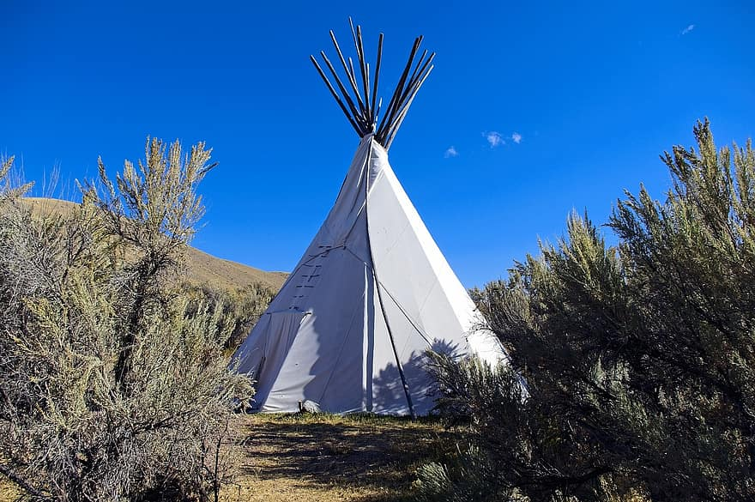
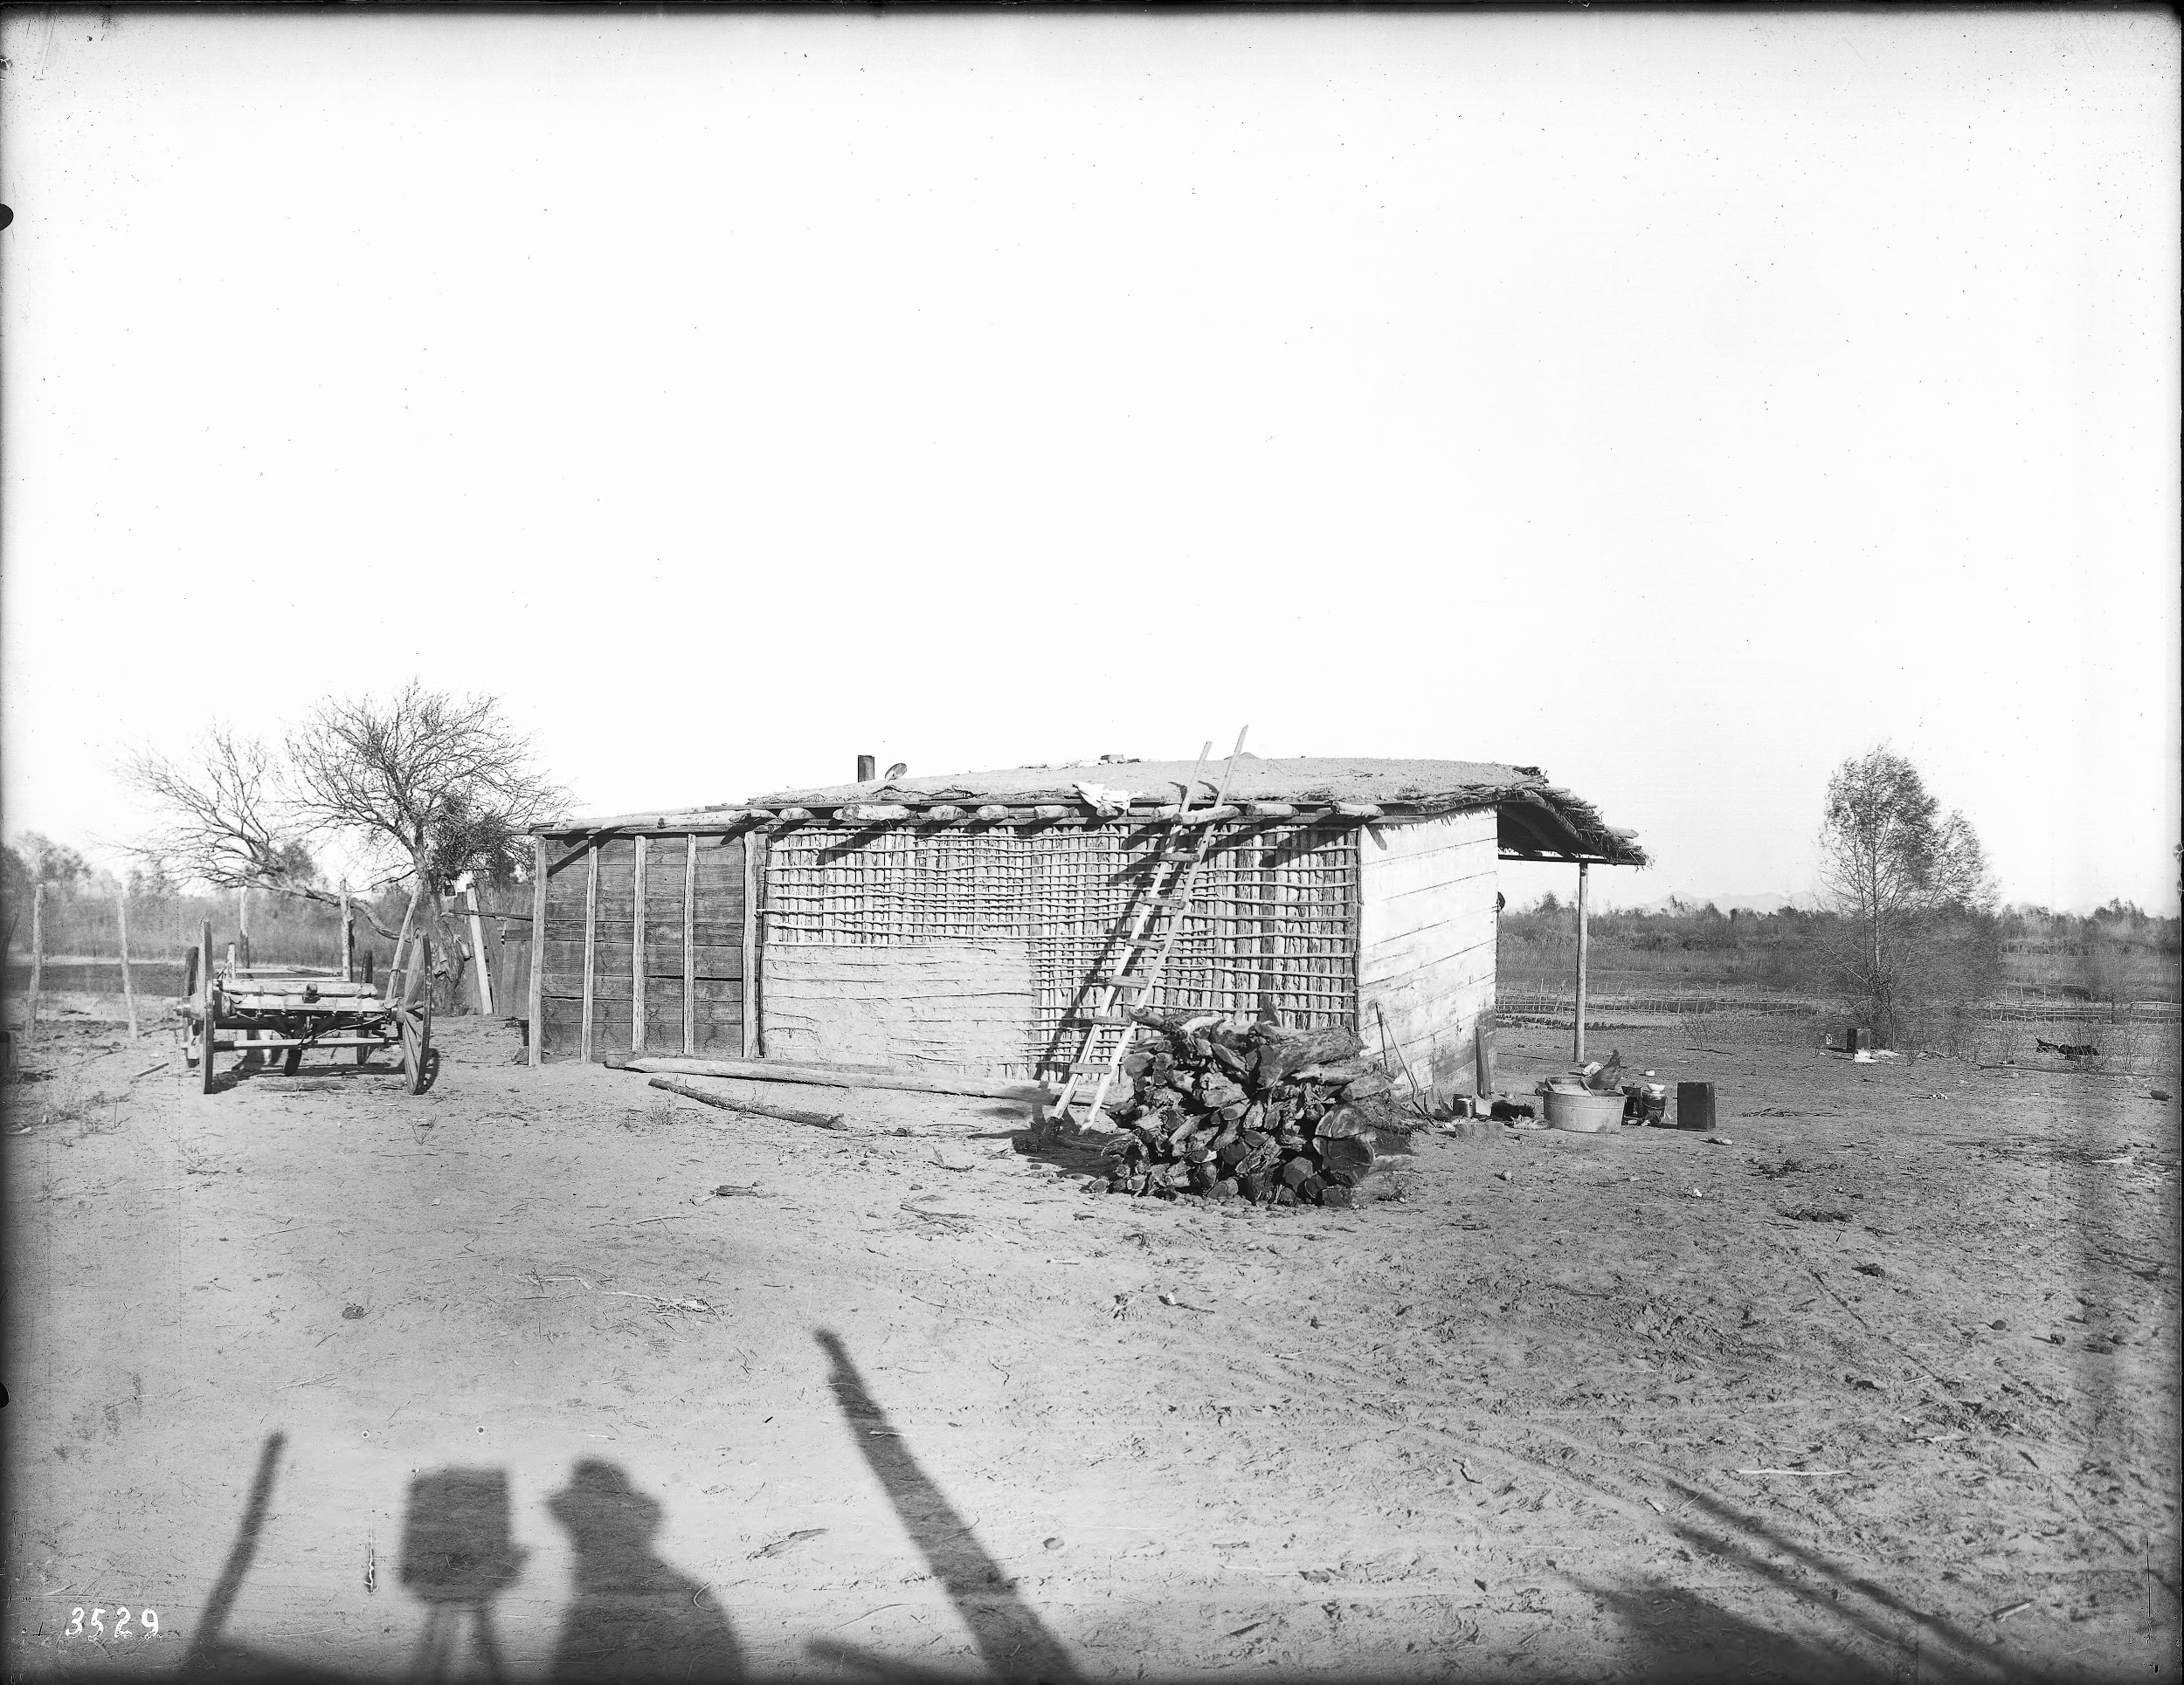
Shelter
The Mojave shelters were made out of willow. This tribe did not live in villages instead, they built simple shelters where they found good land for farming. They made their houses out of willow poles that were covered in grasses.
Notes:
Write about the materials, shape, name, and unique features of the structure.

Slide 4
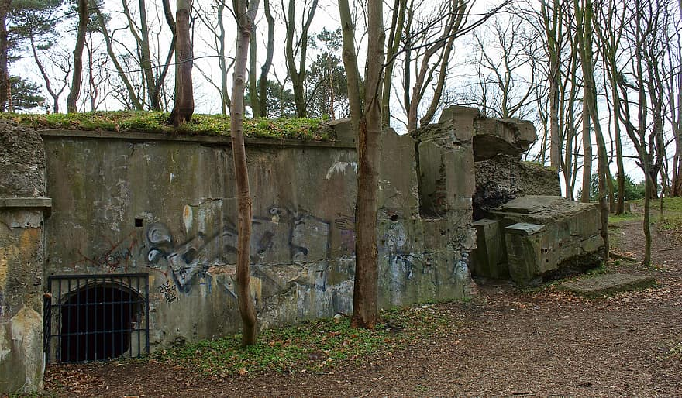
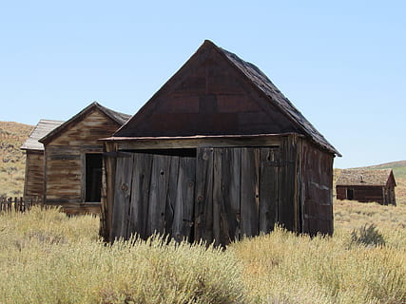
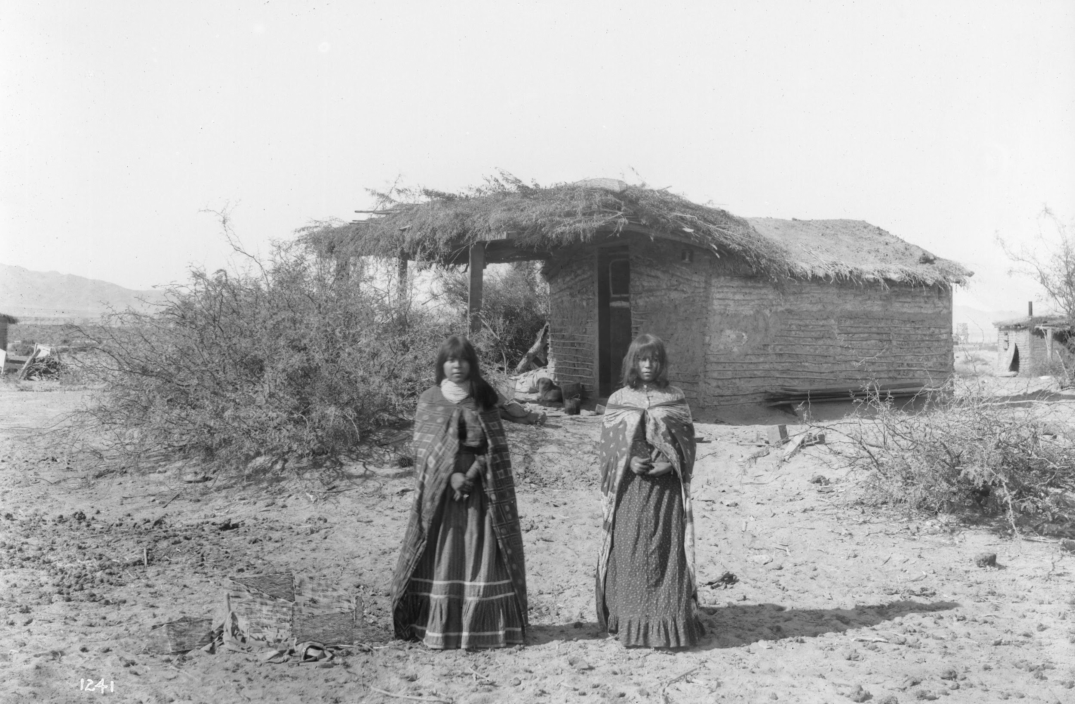
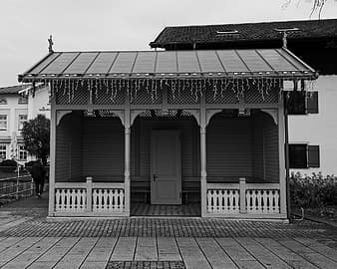
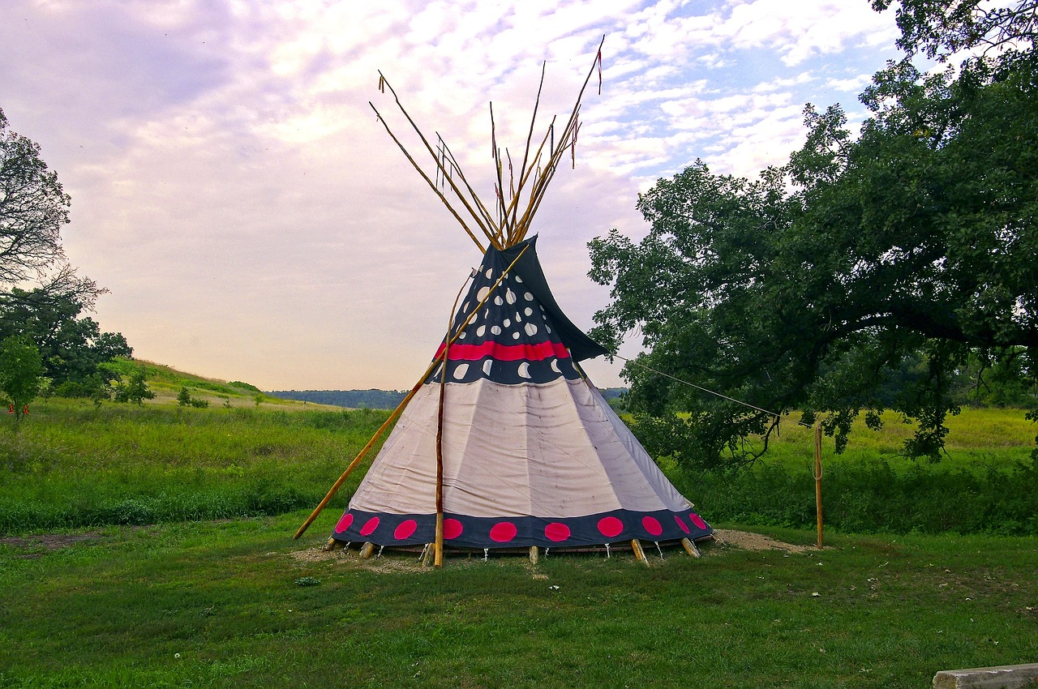
Shelter

Slide 5
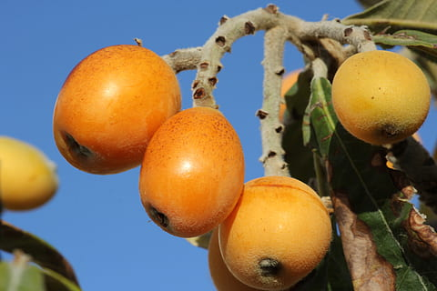
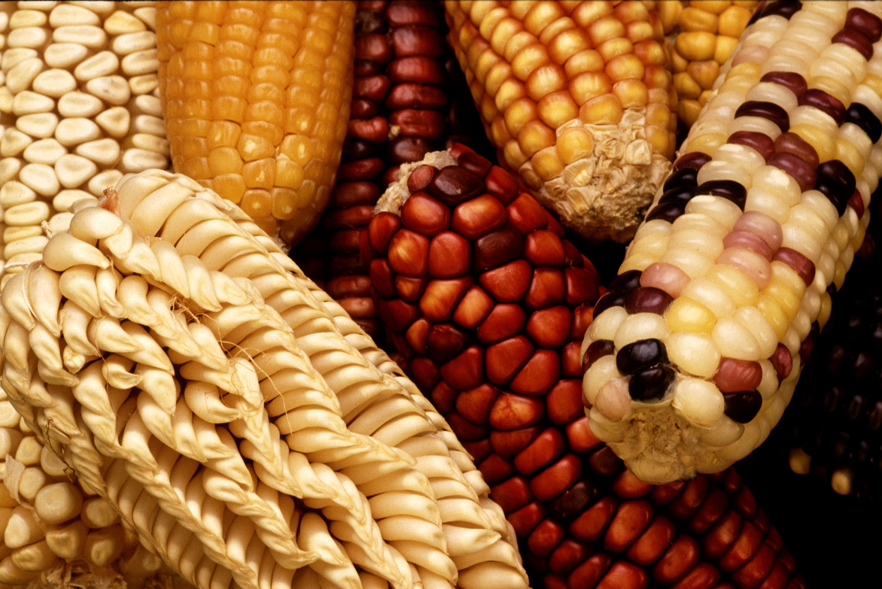
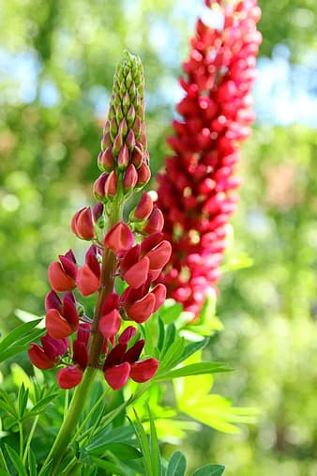
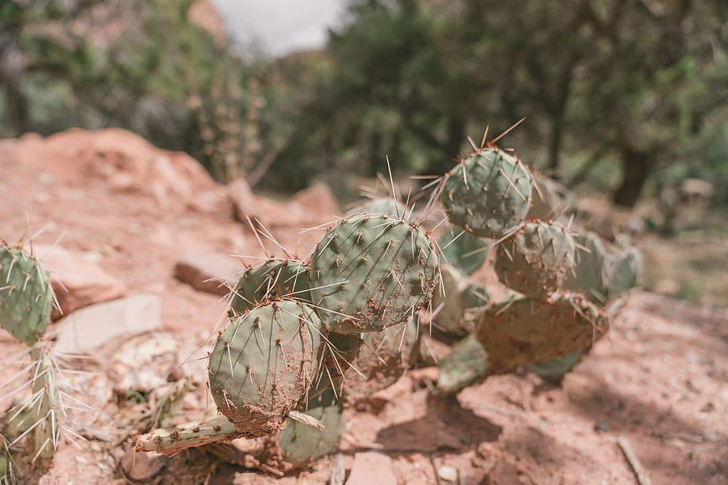
Food
The Mojave tribe gathered wild plants, seeds, and roots to eat. They trapped small animals like rabbits, skunks, and beavers. They fished in the Colorado River for fish. They are farmers so they plant corn and other stuff to eat.
Notes:
Write about the food the tribe ate, crops they grew, hunting & gathering skills, and ways to prepare meals.

Slide 6
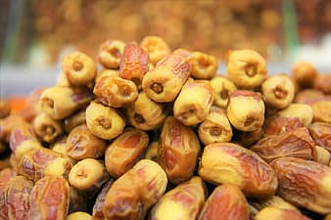
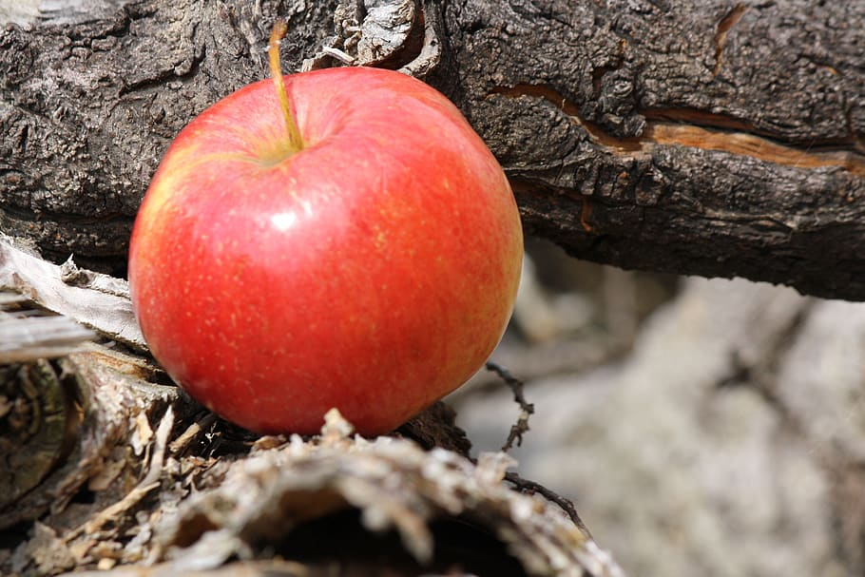
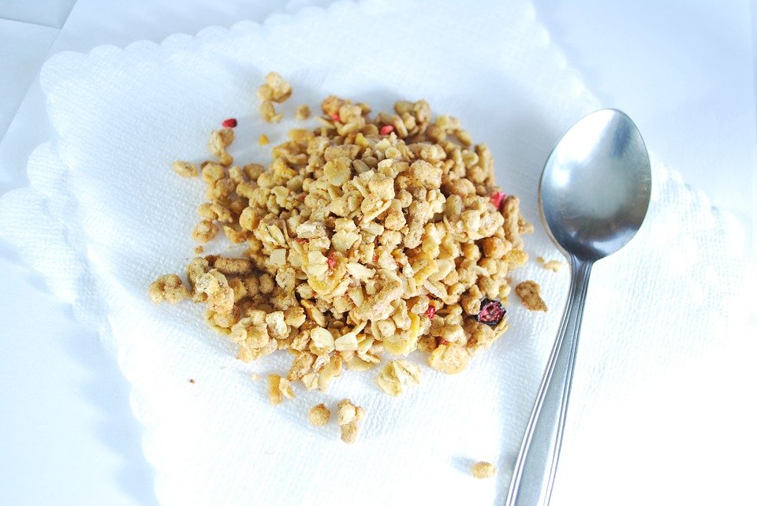
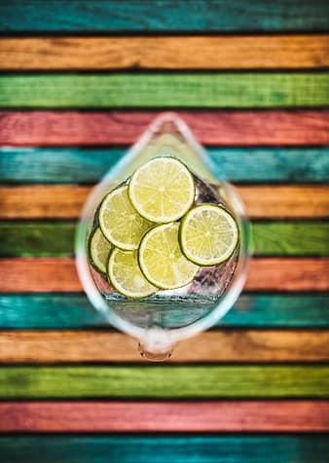
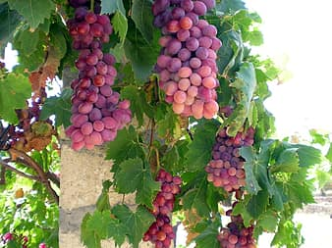
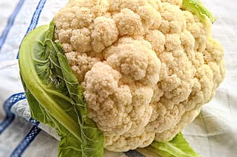
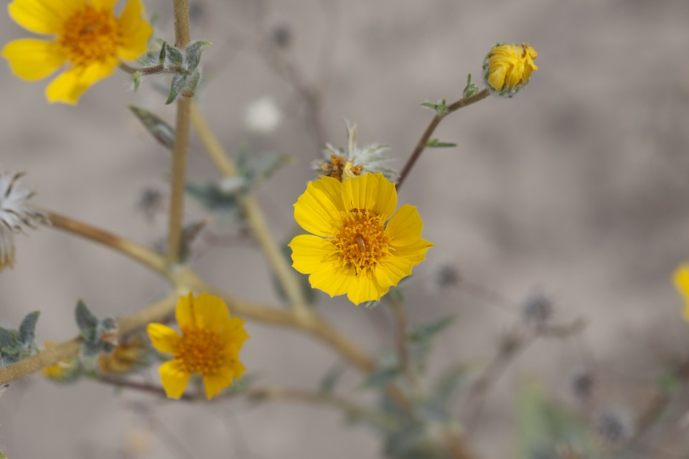
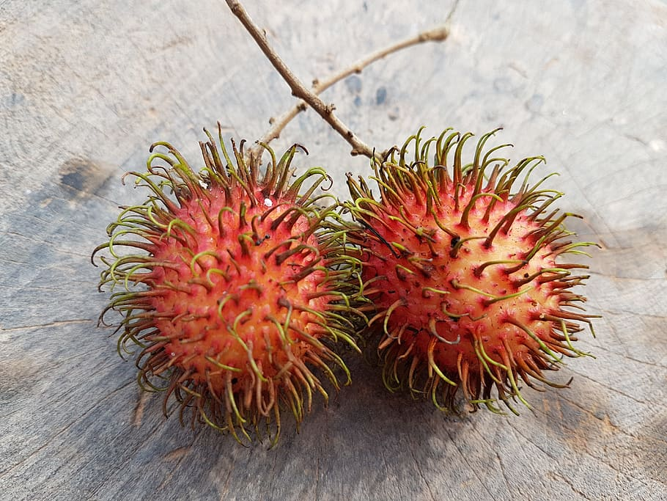
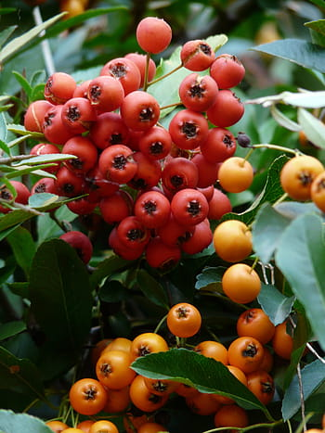
Food

Slide 7
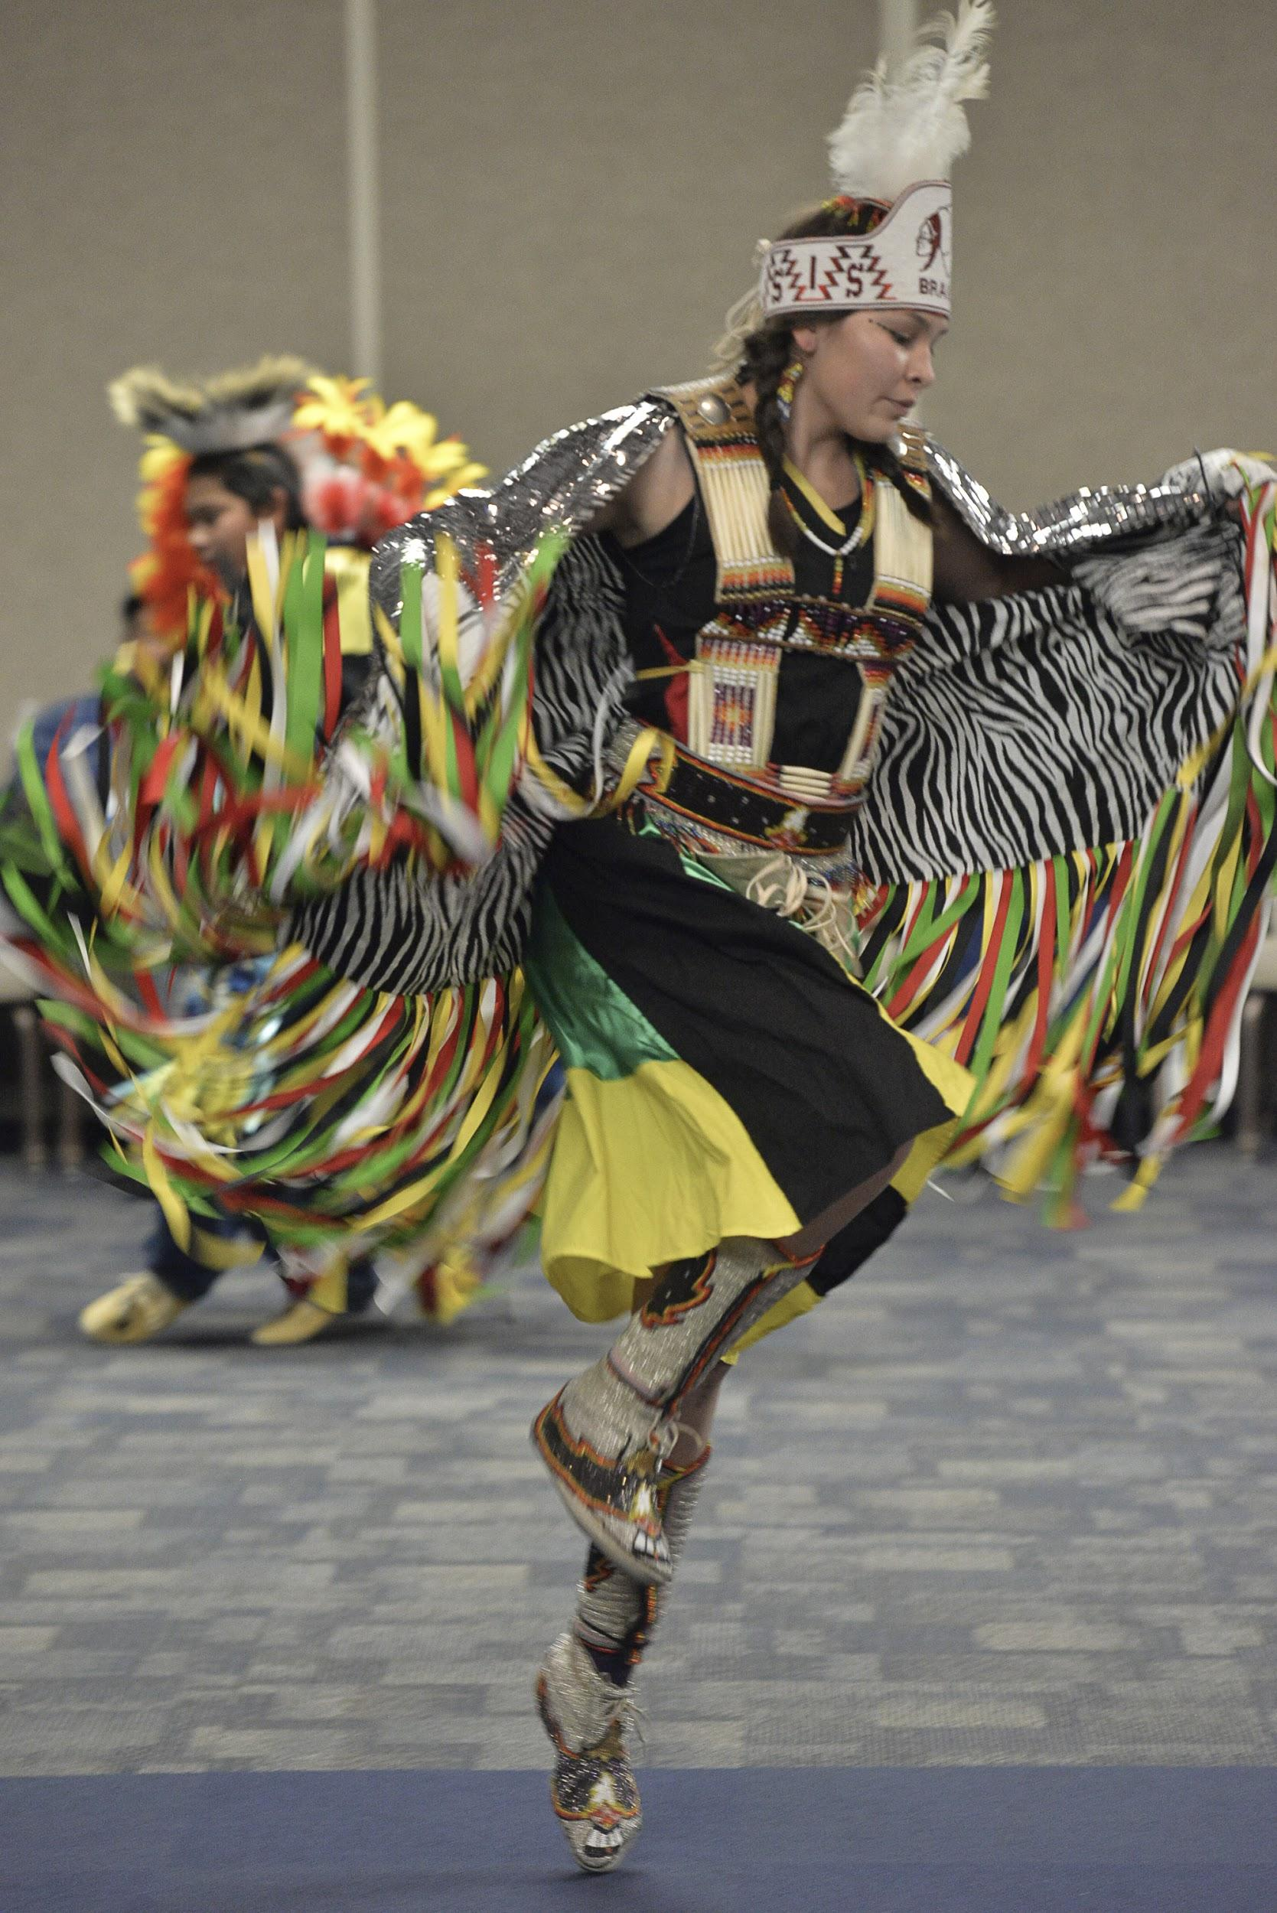
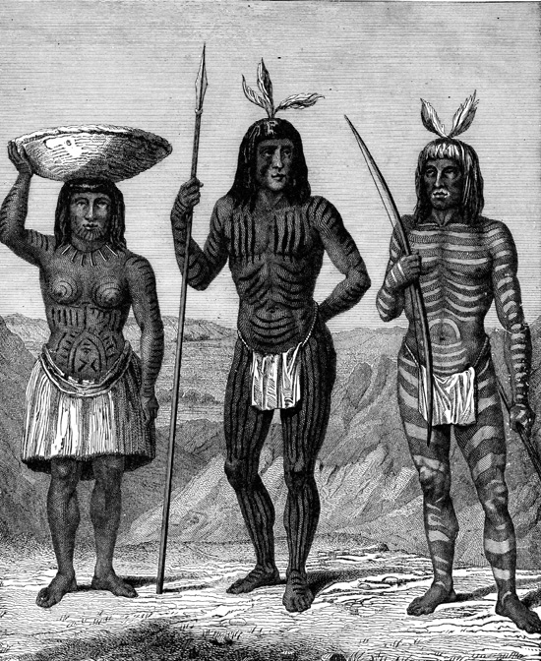
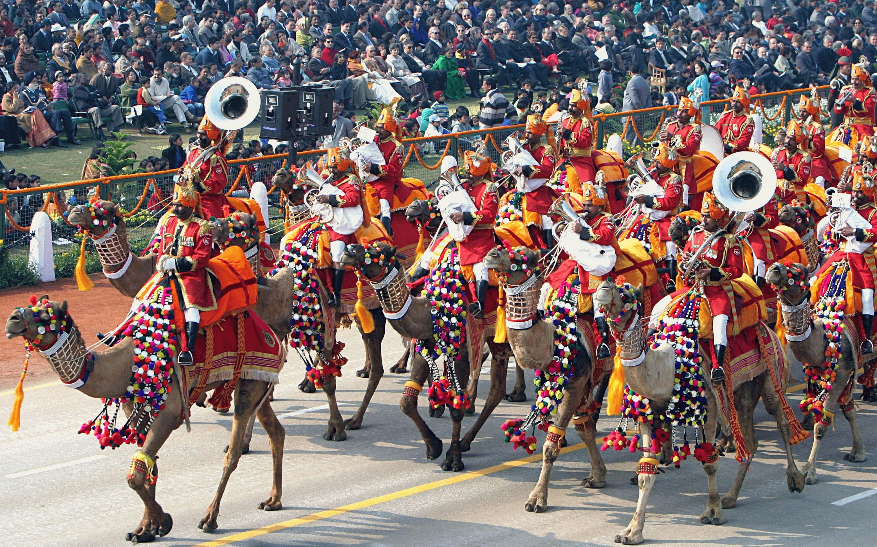
Culture
The Mojave culture is unique.The Mojave culture traded for animal skin so it would keep them warm at night.The Mojave tribe traded their crops such as beans,corns and melons.The Mojave tribe were fishers,hunters and farmers who mainly inhabited California.The Mojave Tribe called themselves Hamakhav meaning people living along the water.

Slide 8
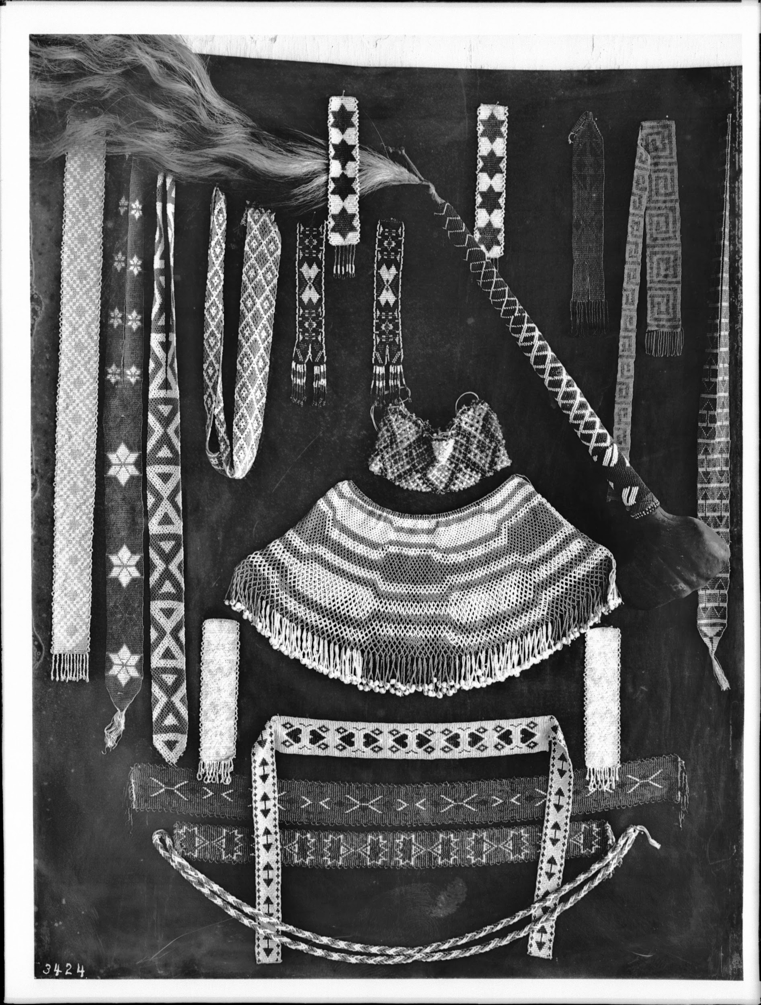
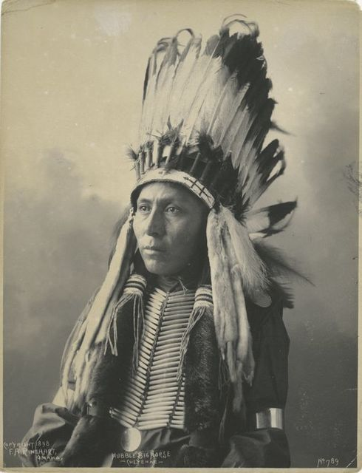
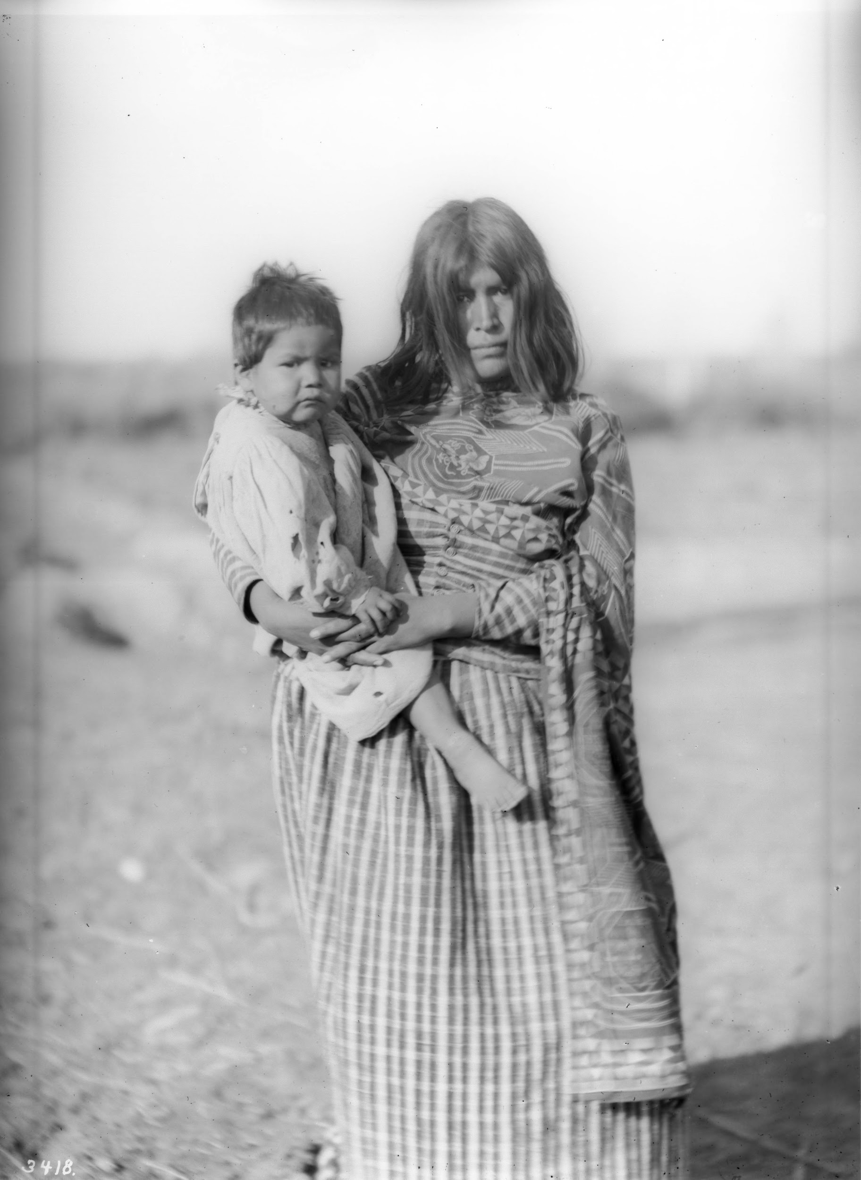
Culture
Sometimes men would wear clothing tied around their hips that were made out of animal skin to keep them warm. Sometimes women wore knee length shorts of woven willow bark.

Slide 9
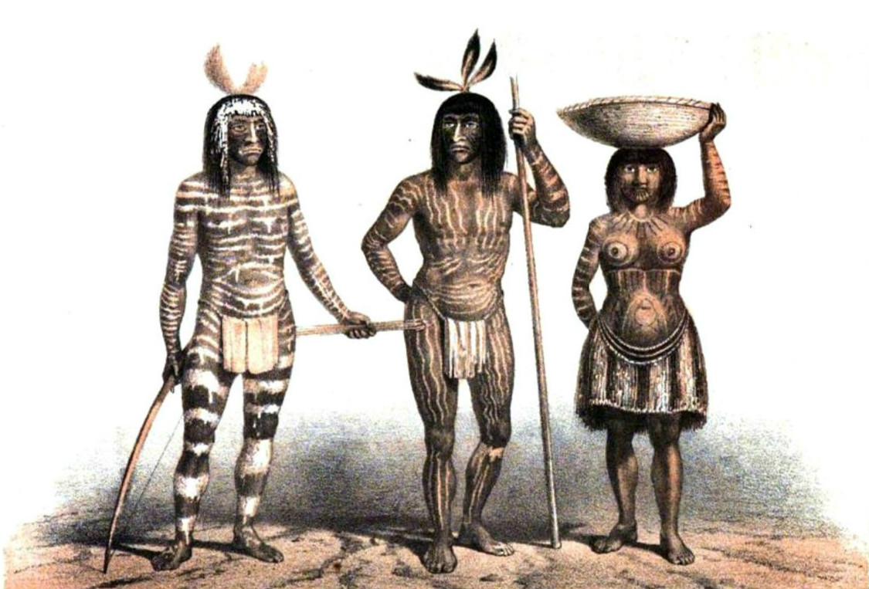
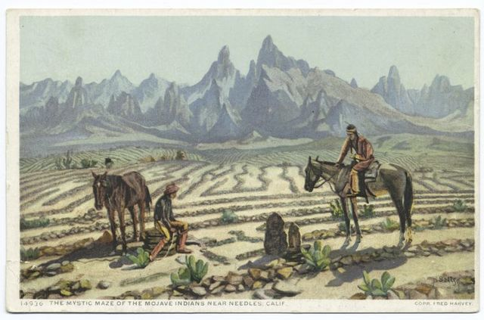
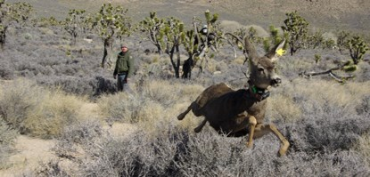
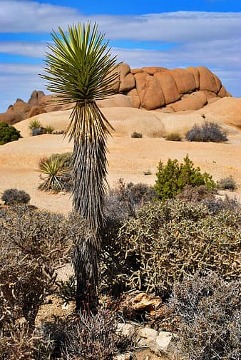
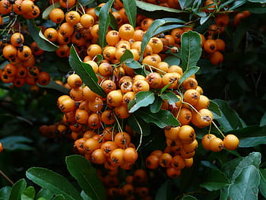
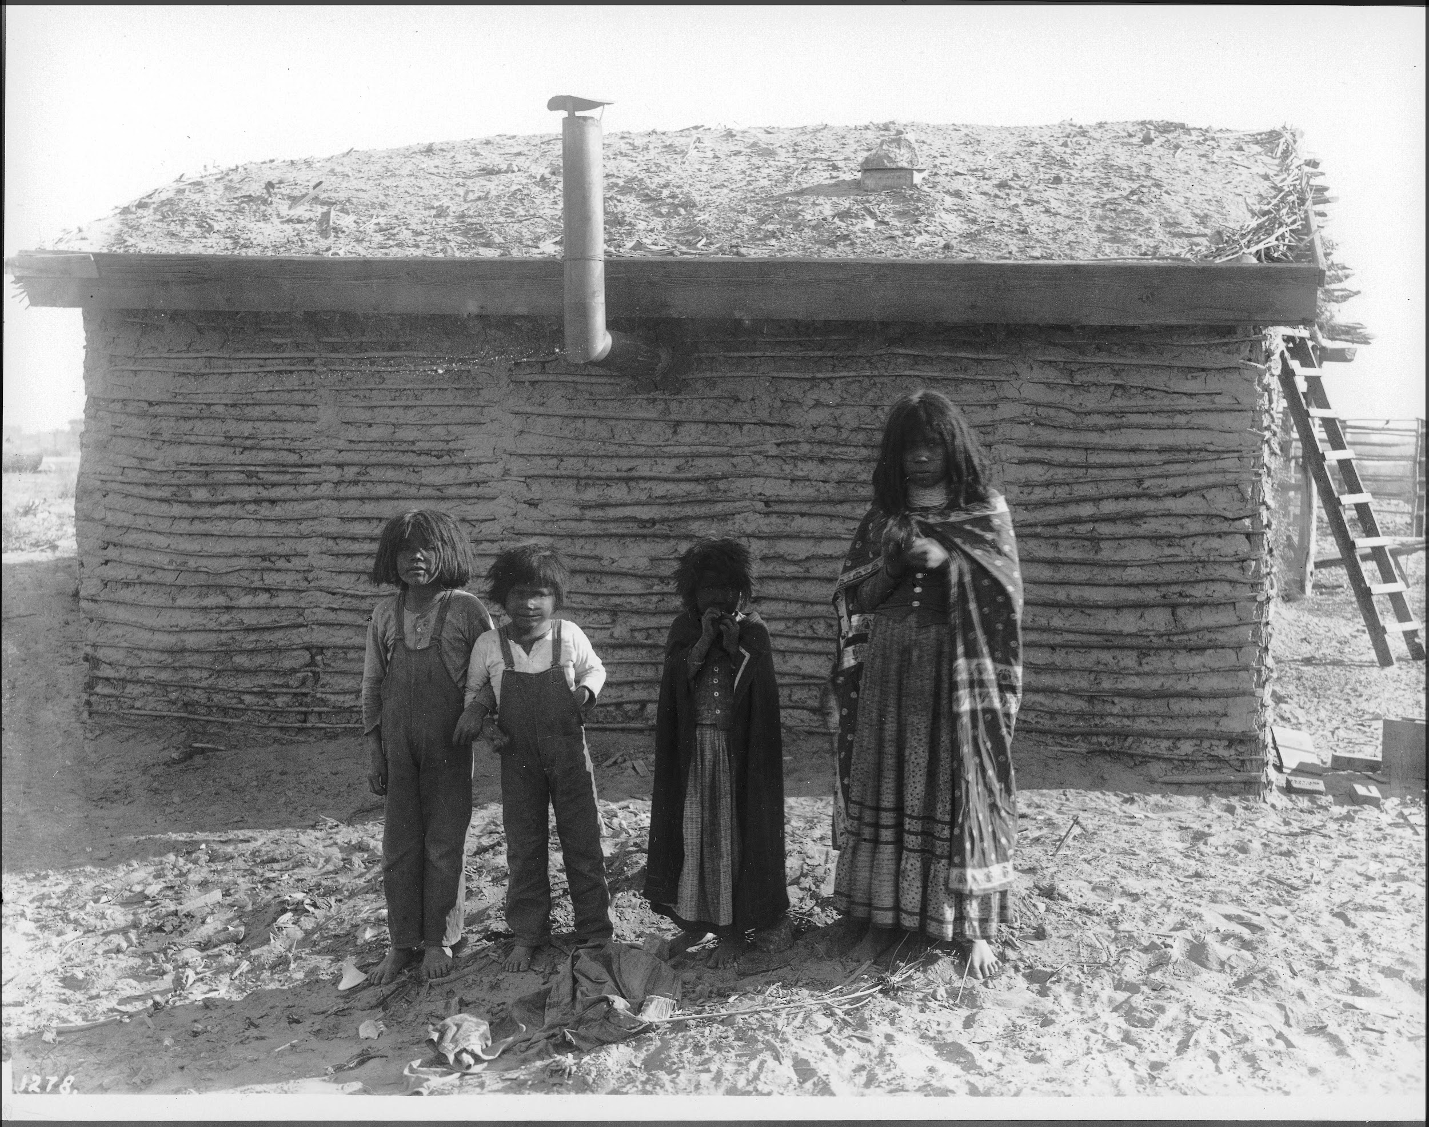
Pictures Of Mojave Tribe People,Food and culture

Slide 10
Children
The children liked to played with dolls, but mostly they go hunting and fishing with their father. They are excellent swimmers and runners. They Mojave children also liked to play with each other but they had more chores than enough time to play. They like to have foot races with each other. They children also help around the house to clean up.

Slide 11
Language
Most people in the Mojave tribe speak Spanish today. A long time ago they made up their own language called the Mojave language one of the words they made up was kwichkamaduum. They made up this language so they could understand each other. In the 16th century when Spanish was made they decided to switch languages so now they speak Spanish instead of their language. Some people from the mojave tribe still speak their own language but most of them today don’t.

Slide 12
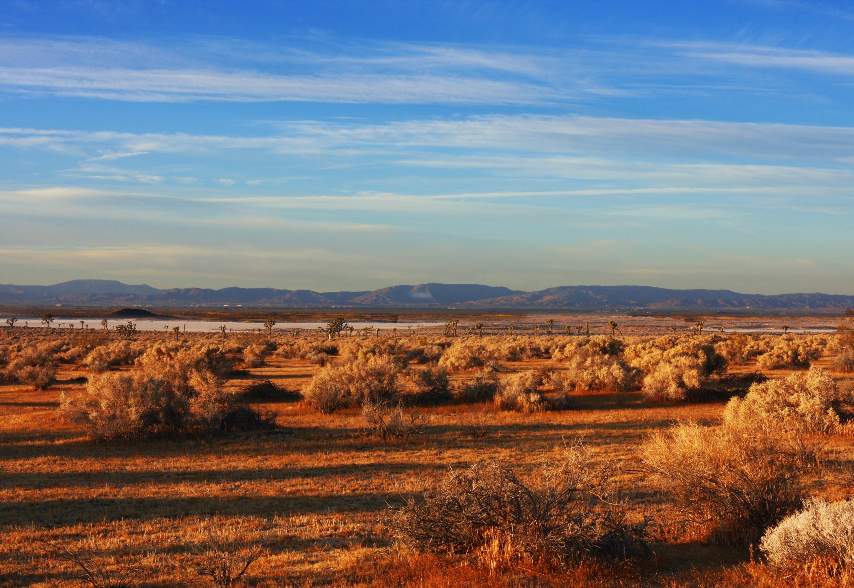
All in all the Mojave *Tribe is very amazing*
Notes:
This slide is the last slide. You can add a picture or several pictures as an ending to your presentation.

