Slide 1
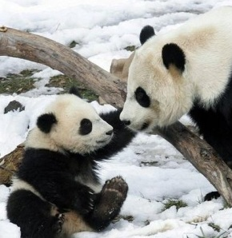
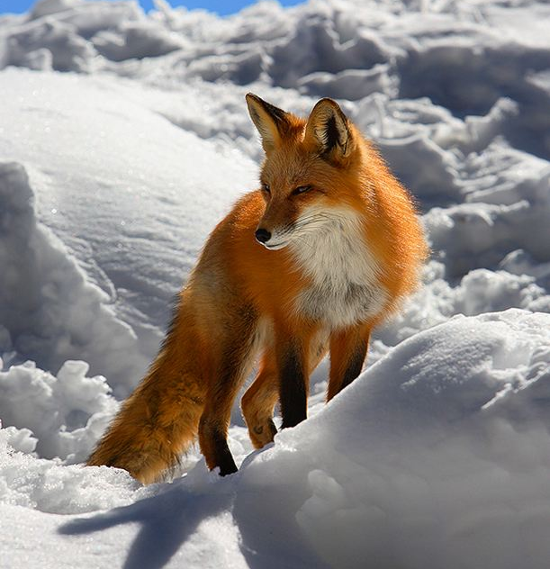
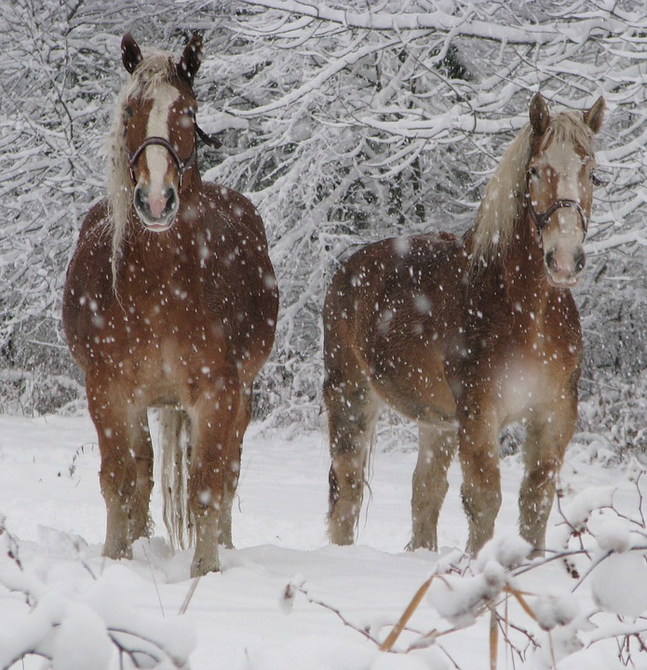
Climate and Weather
By: Aneela , Chloe and Janie

Slide 2
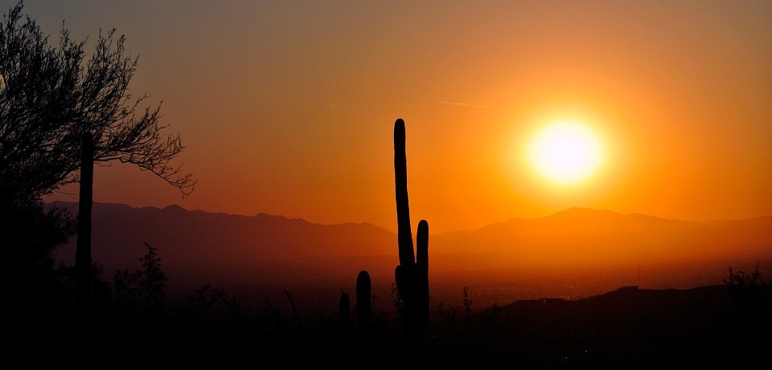
Desert Climate Zone
It's unusually hot in most desert climates. In fact, the ground gets so hot that it heats the air. Deserts barely receive any rain .Some years it may not rain at all. At night deserts can be extremely cold. The soil in a desert is dry and often sandy. Deserts are in Cancun, Georgetown, Juba, Bangalore, Darwin, and more places.

Slide 3
Polar Climate Zone
The climate is extremely cold in the polar climate. Polar climates occur only above 60 degrees north latitude or below 60 degrees south latitude. Polar climate is the coldest climate on Earth. Polar in Barrow, Daneborg, Tiksi, and the Antarctica Research Station and more.

Slide 4
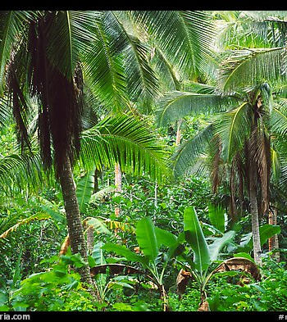
Tropical Climate Zone
The tropical climate zone is around the equator. Tropical climate receive a lot of sunlight and are very warm. Every day it rains in the tropical zone.

Slide 5
Temperate Climate Zone
Temperate climate zone is never too extreme. Summers are warm and wet. There Winters are cool and dry. Temperate is a synonym of moderate. Temperate climates occur in Atlanta, Rome, Casablanca, Cairo, Hong Kong, Ayers Rock,
Sydney, Madagascar, Cape Town, Windhoek, Tacna, and Buenos Aires and more.

Slide 6
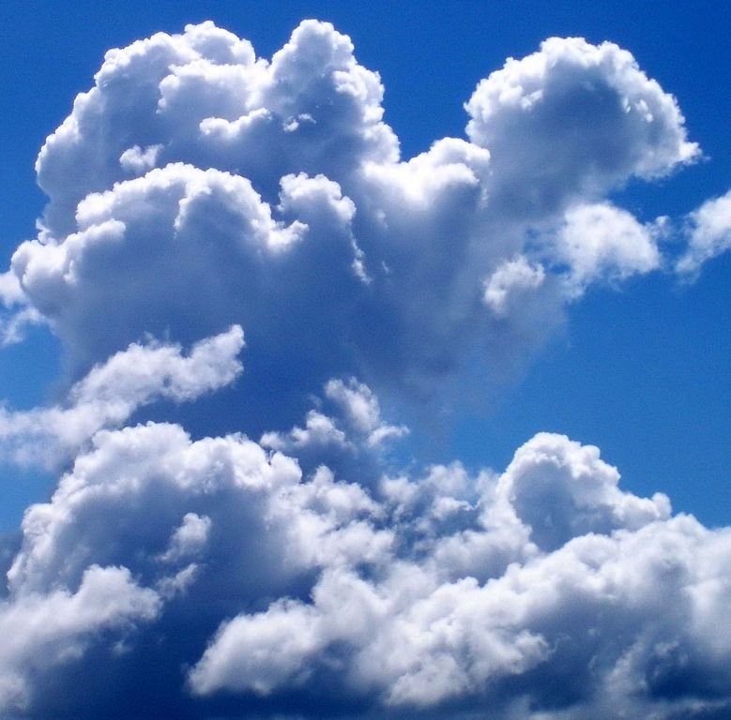
Cumulus Clouds
Called fair weather
Are vertical clouds
Like floating cotton
Nice weather
No storm
Can change
Very fluffy

Slide 7
Cumulonimbus Clouds
Cumulonimbus cloud can take up several miles across the sky and can reach elevations of 39,000 feet or higher because of very strong updraft in the atmosphere.

Slide 8
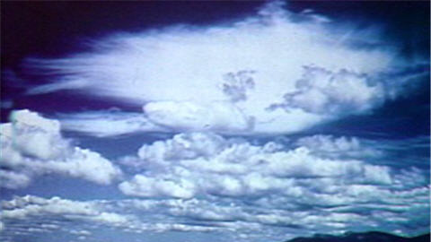
Stratus Clouds
Stratus clouds are among the low-lying clouds. They spread out to storm. They get gloomy skies. We don’t get storms from them but they can change in to a stratonimbus cloud.

Slide 9
Stratonimbus Clouds
Stratonimbus clouds are gray clouds that produce falling rain or snow. They bring rain. The storm last all day. The clouds turn very thick.

Slide 10
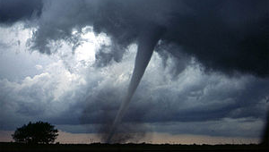
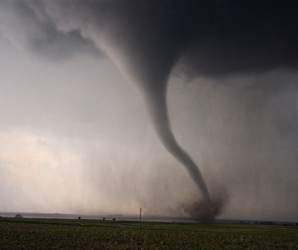
Extreme Weather - Tornadoes
Tornadoes are funnels of powerful wind. They act like giant vacuums. Tornadoes are one of the most violent forces in nature.

Slide 11
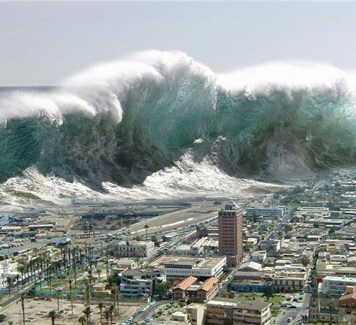
Extreme Weather - Tsunami
Tsunamis start in the ocean when there is an earthquake or volcanoes in the ocean. Tsunamis travel far and fast. One of the most active areas for tsunami has been in Asia. If tsunamis reach shore everything changes.

Slide 12
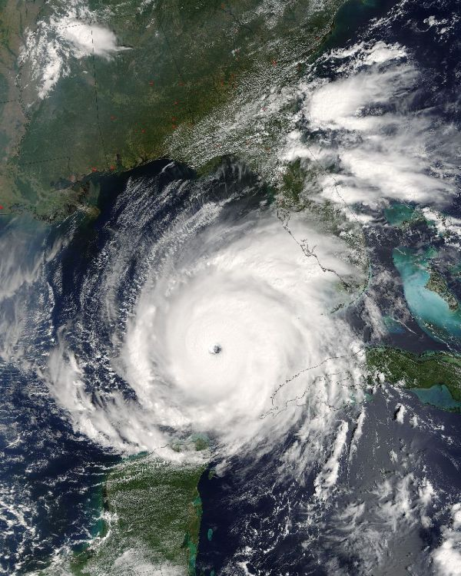
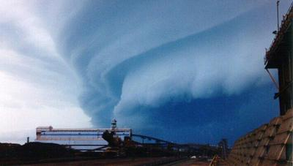
Extreme Weather - Hurricanes
All hurricanes start over the ocean because clouds form in warm, wet air above the ocean. When hurricanes are out of sea, they cause little damage. They begin as tropical storms.

Slide 13
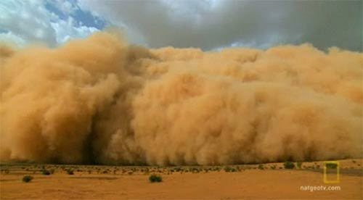
Extreme Weather- Dust Storm
When strong winds combine with dry condition, dust storms appear. Dust is made out of different thing that are all around the world. Bits of rubber from car tires and flakes of dead skin. Sneezing is your body's way of getting rid of dust.

Slide 14
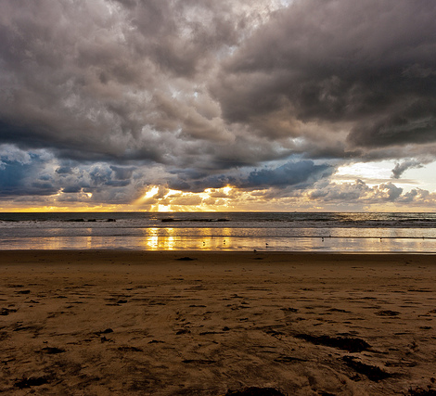
Storms
Storms are very big. They can last all day or 1 hour. This big storm is at the beach.

Slide 15
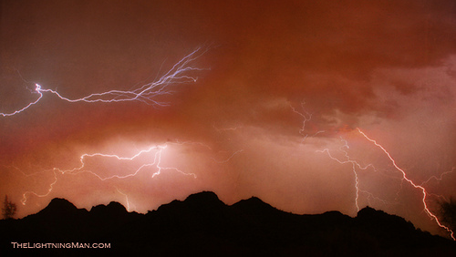
Lightening
Lightening are dangerous. The lightening can make you die. The weather is wild. It can destroy nature and animals habitat.

