Slide 1
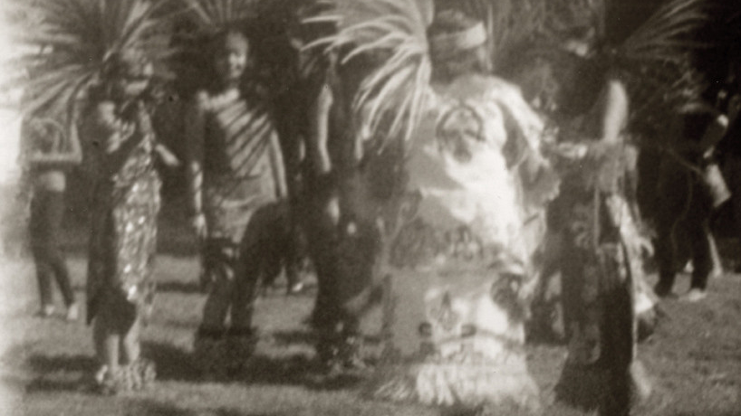
Gabrieleno tribe
Ethan and Max
This Photo by Unknown author is licensed under CC BY-NC.

Slide 2
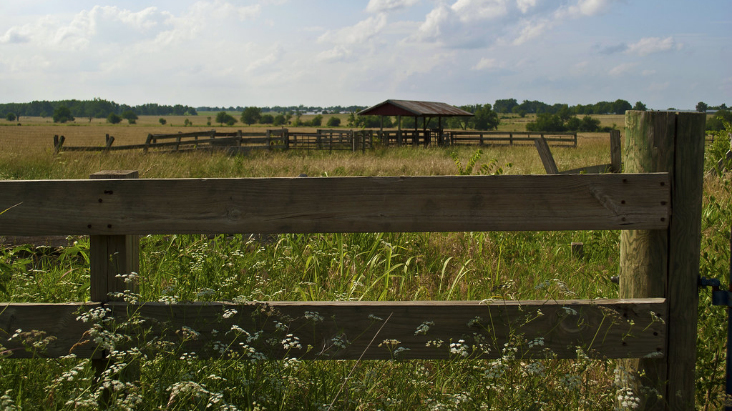
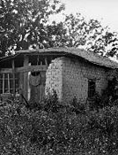
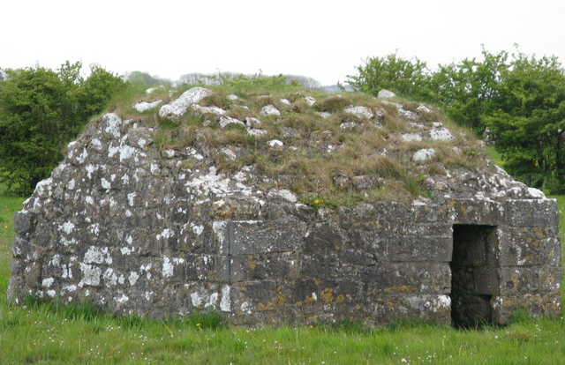
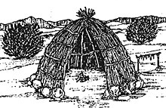
Shelter
The Gabrielino has a unique home . The homes are made with poles covered with bundles of reeds. They have a sweat house that they meet at. They meet in the middle of the house. The sweat home holds over 60 people.
This Photo by Unknown author is licensed under CC BY-NC-ND.
This Photo by Unknown author is licensed under CC BY-SA.
This Photo by Unknown author is licensed under CC BY-SA.
This Photo by Unknown author is licensed under CC BY-SA.

Slide 3
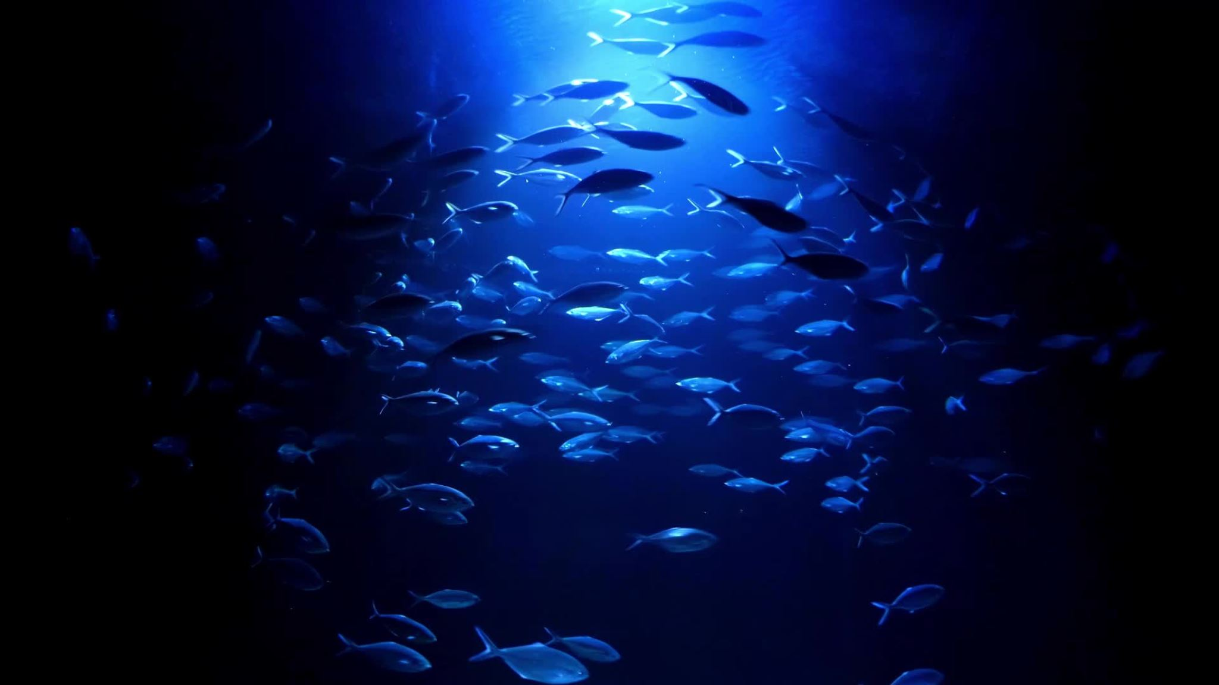
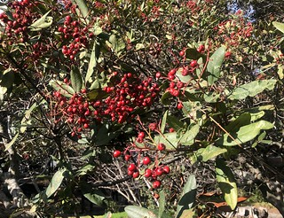
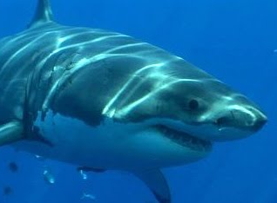
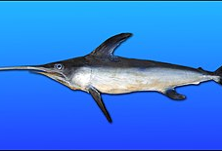
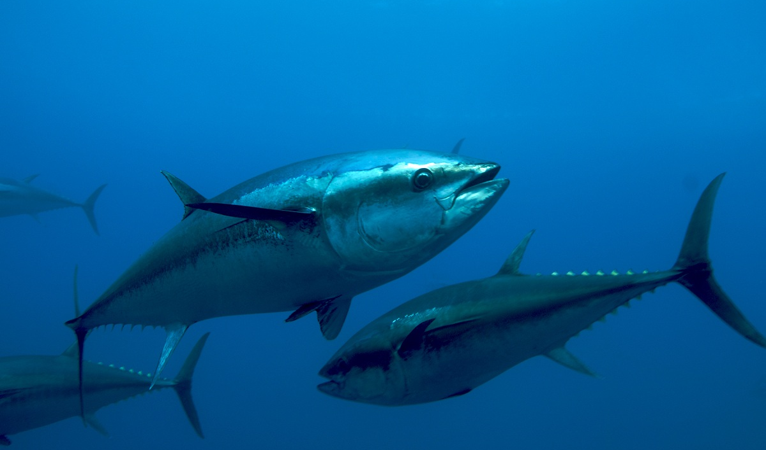
They eat food from the sea like tuna, swordfish, shark and sea otters. They hunt for birds, snakes, and rabbits. They ate pino nuts, sage, berries, and other plants.
Food
pinThis Photo by Unknown author is licensed under CC BY-NC-ND.
This Photo by Unknown author is licensed under CC BY-SA-NC.
This Photo by Unknown author is licensed under CC BY-SA.
This Photo by Unknown author is licensed under CC BY.
This Photo by Unknown author is licensed under CC BY-NC-ND.

Slide 4
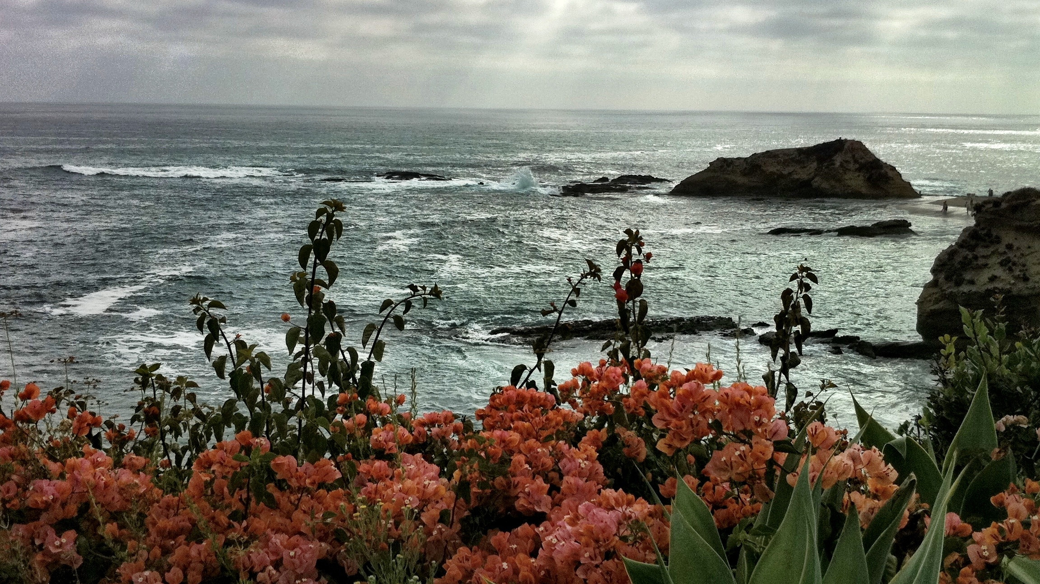
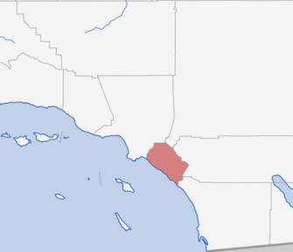
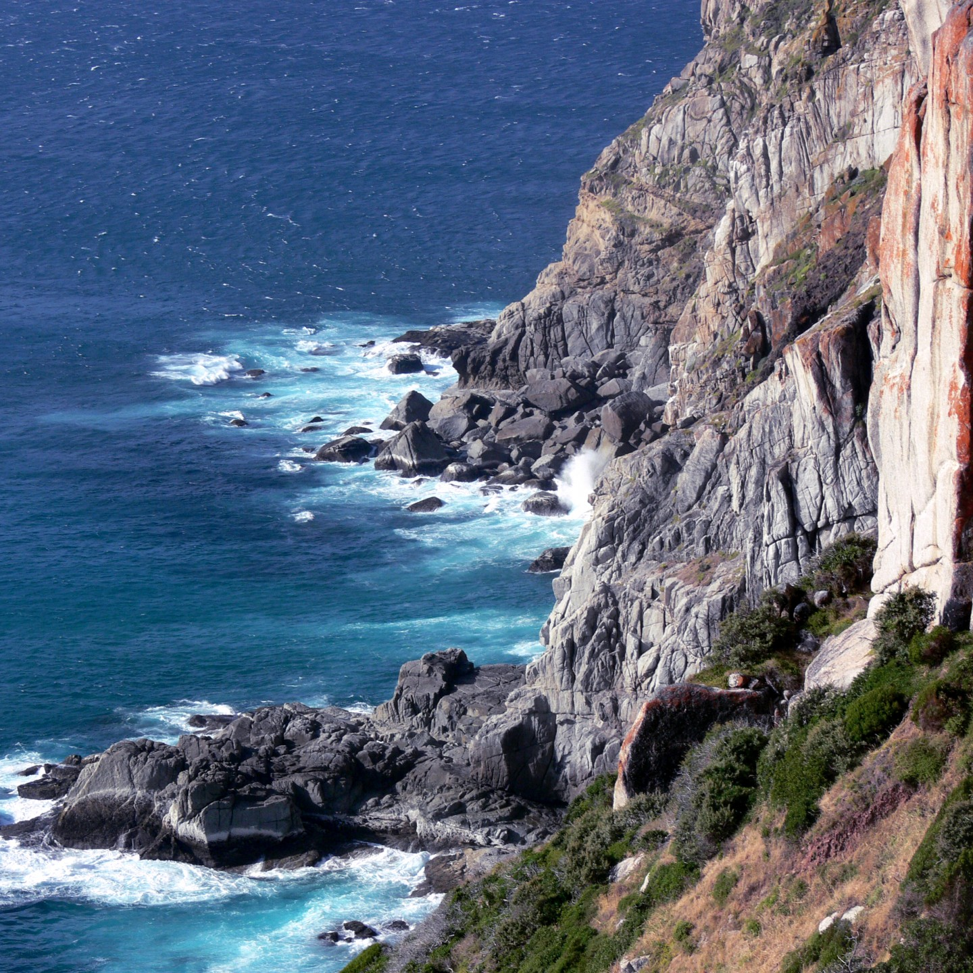
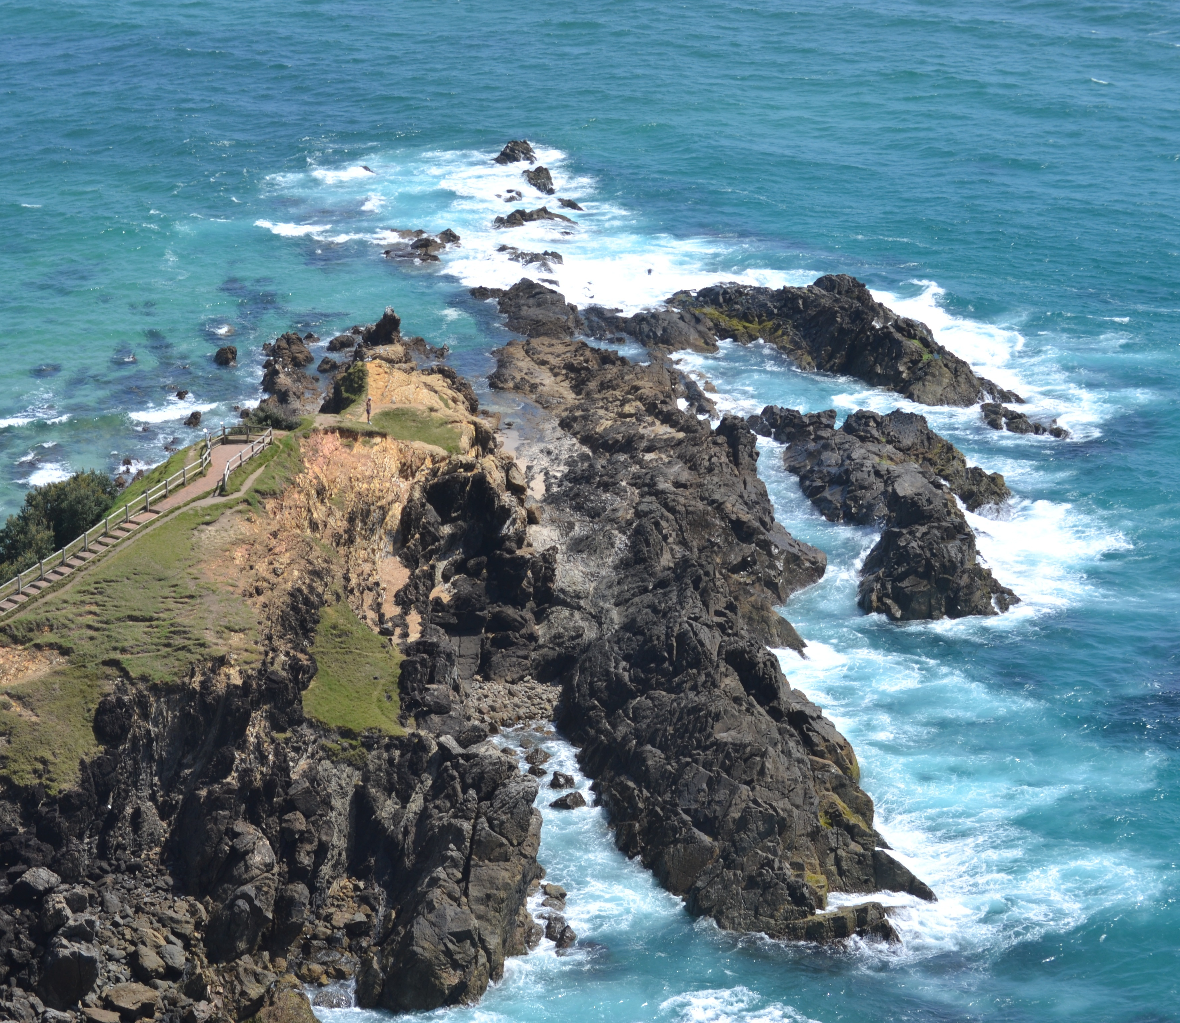
Graphical location
The gabrieleno tribe in the southern coast of California. They live in the river mountain. Sometimes they live in Orange County in Riverside . They live in the coast.
This Photo by Unknown author is licensed under CC BY.
This Photo by Unknown author is licensed under CC BY.

Slide 5
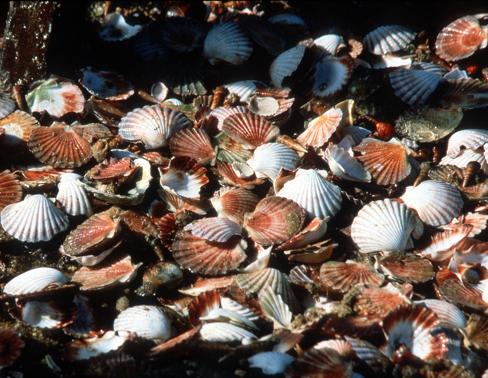
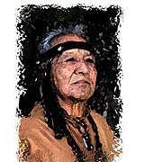
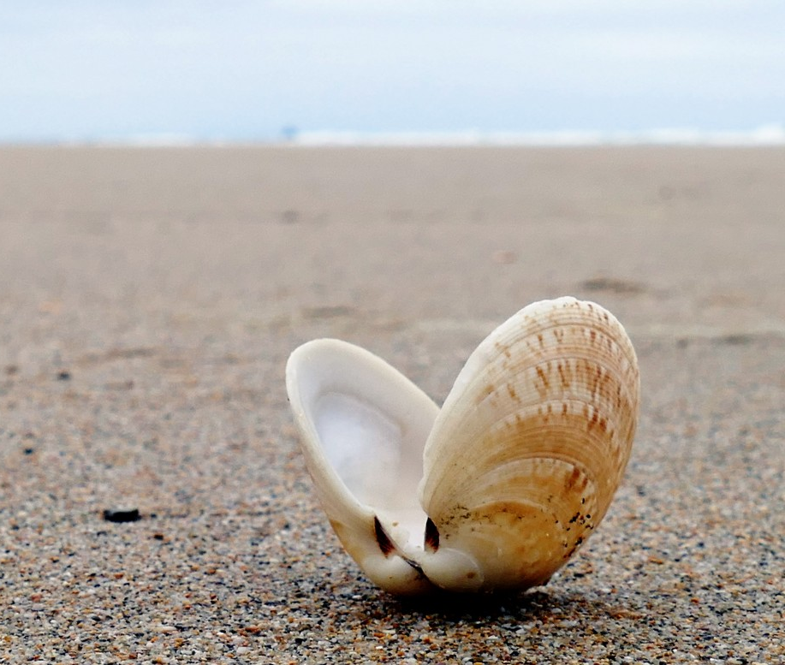
Culture
.The Gabrieleno has a different culture. Woman wore aprons made out of deer skin or bark. They trade dry fish, seeds, and acorns for shells. they carved, bowls, pots, other kitchen supply.
This Photo by Unknown author is licensed under CC BY.
This Photo by Unknown author is licensed under CC BY-SA.

Slide 6
This Photo by Unknown author is licensed under CC BY-SA.

Slide 8
.

Slide 10
_{THE END}
.

