Slide 1
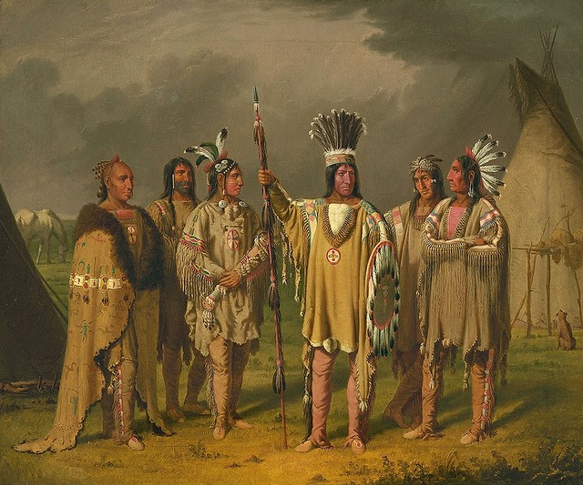
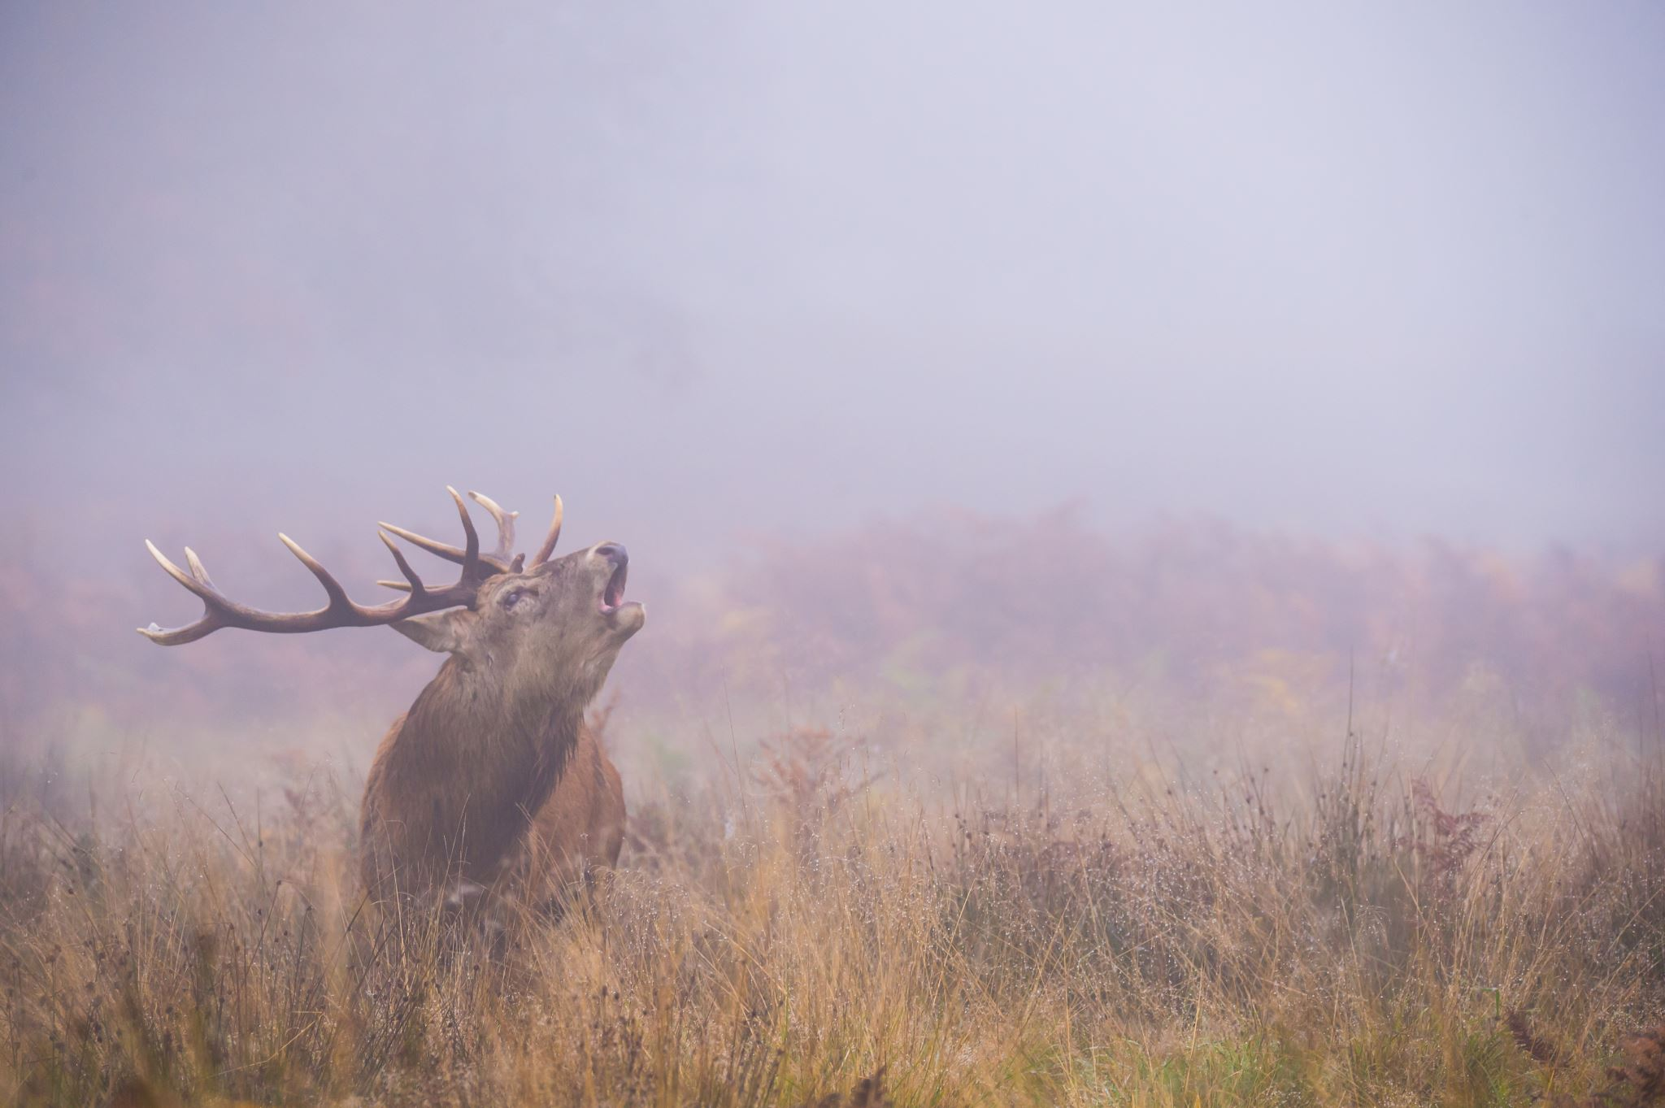
Pomo
By Zeik and Ayden
This Photo by Unknown author is licensed under CC BY-SA.

Slide 2
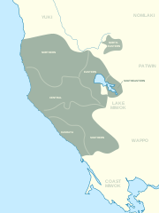
Location
The Pomo lived in the northern part of California.
The Pomo lived in the forests, in mountains, and near rivers and oceans.
This Photo by Unknown author is licensed under CC BY-SA.

Slide 3
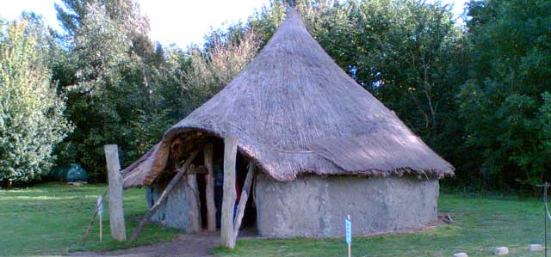
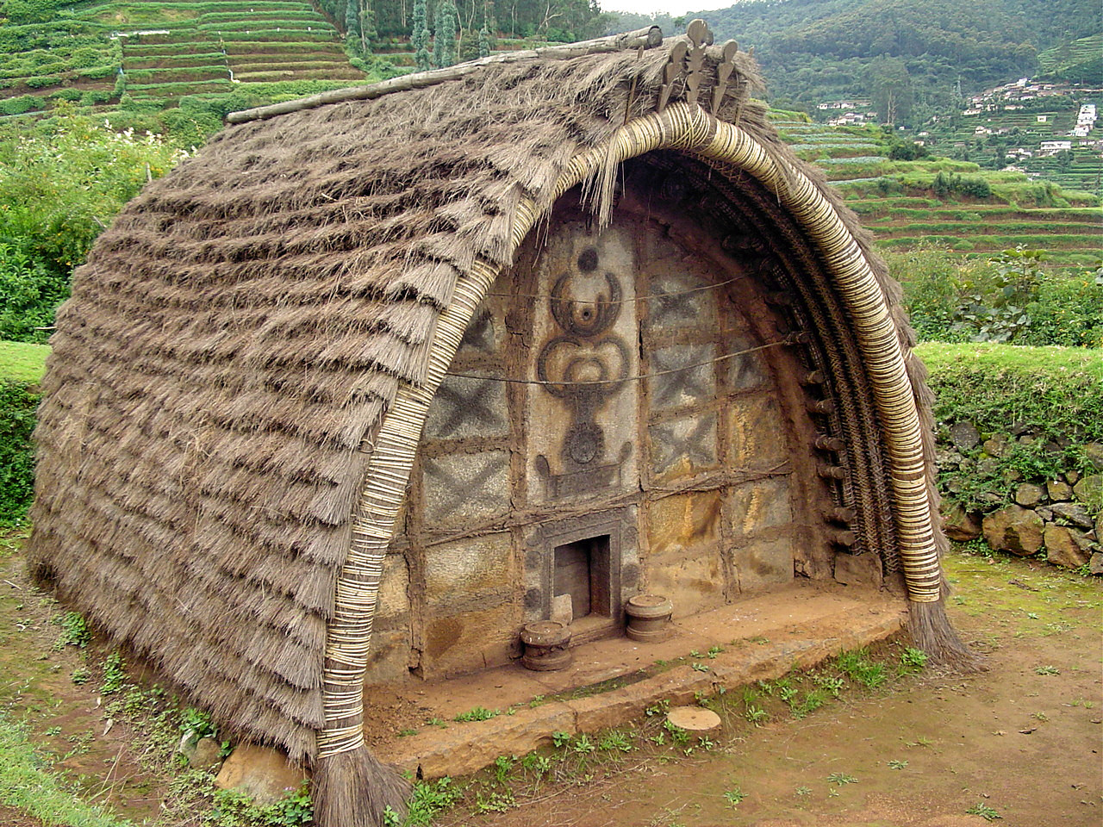
Shelter
The homes of the Pomo protect them from the environment.
They used wood and stick to make the base of houses.
This Photo by Unknown author is licensed under CC BY-SA.
This Photo by Unknown author is licensed under CC BY-SA.

Slide 4
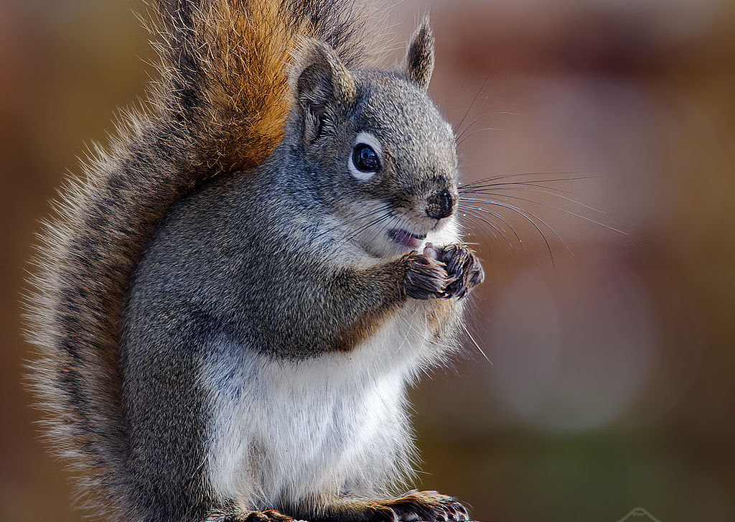
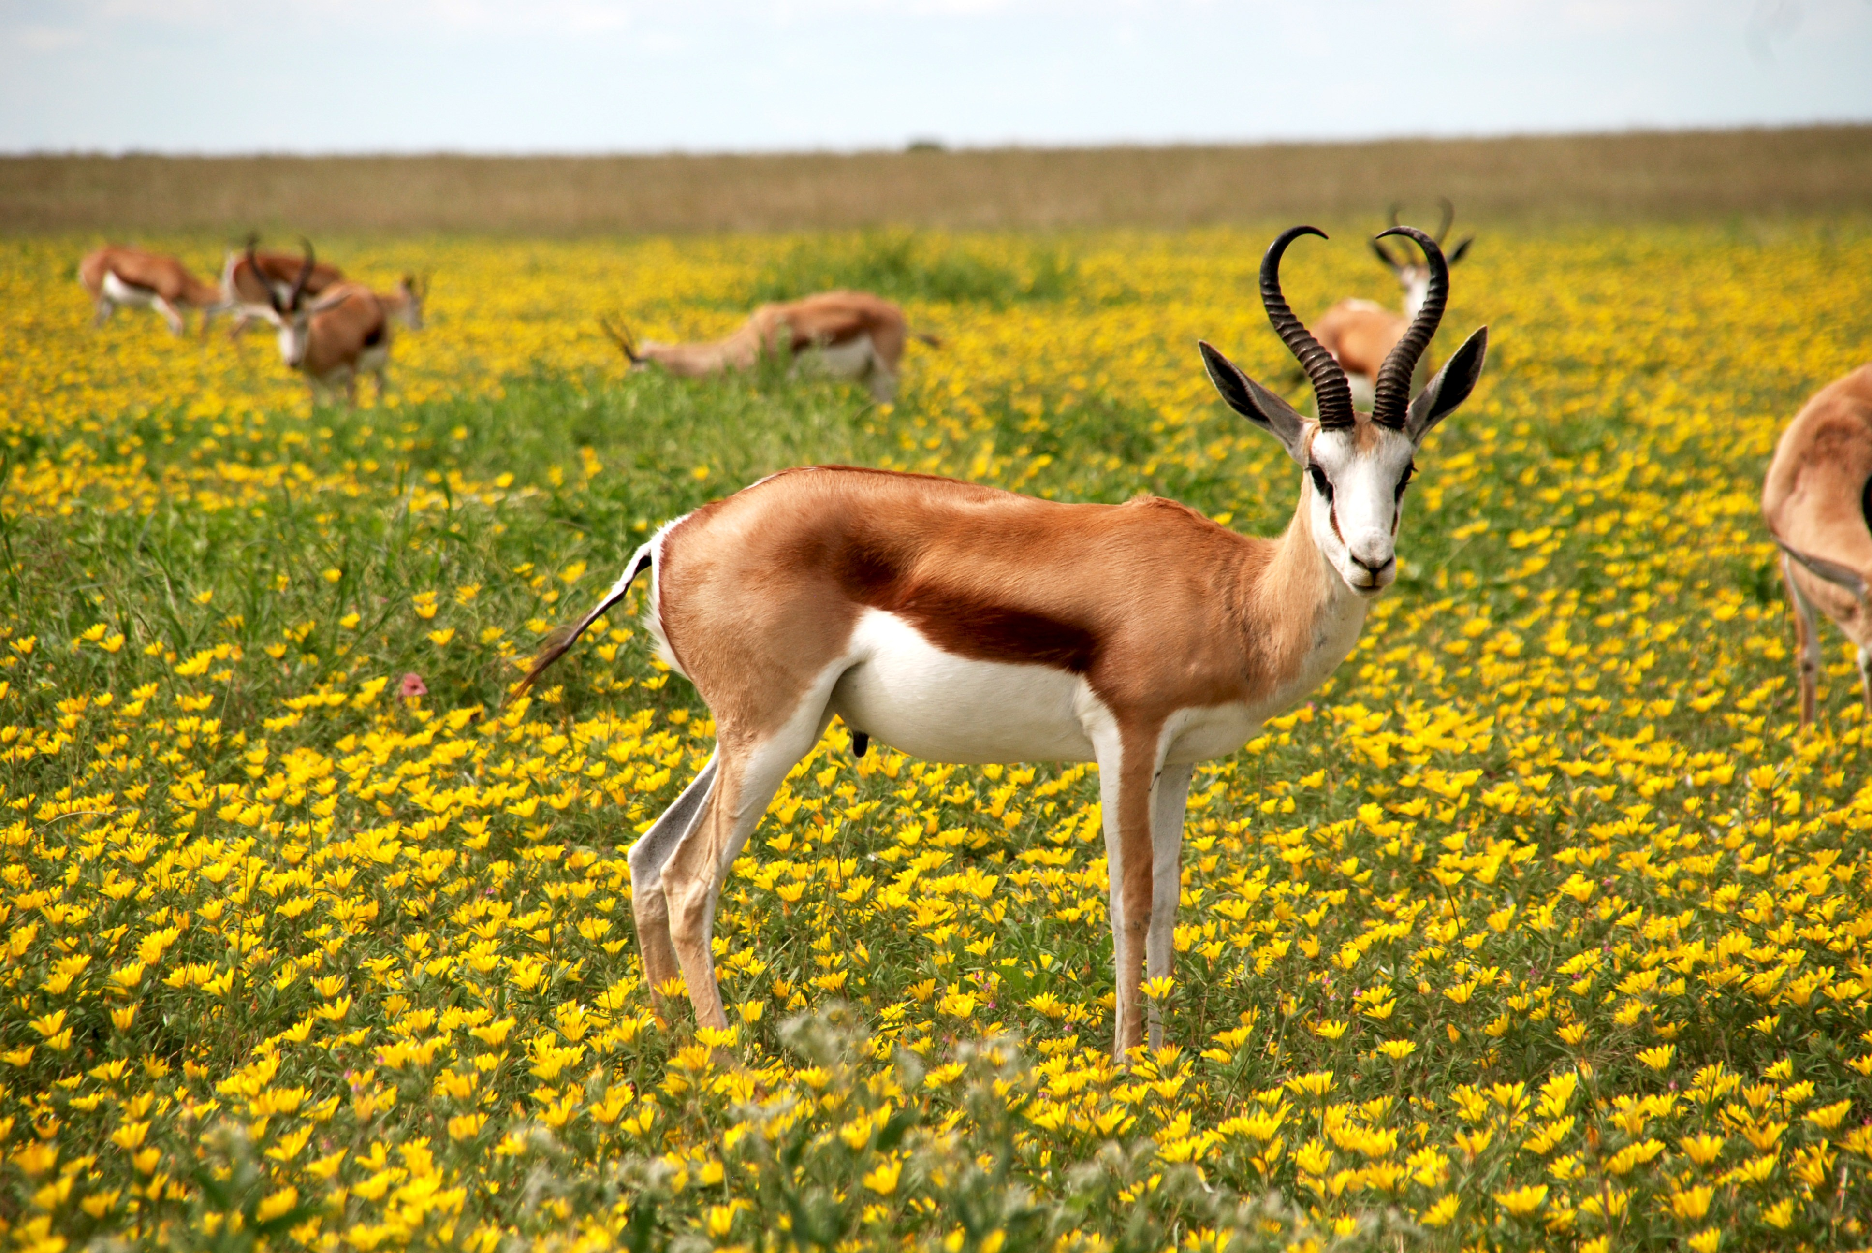
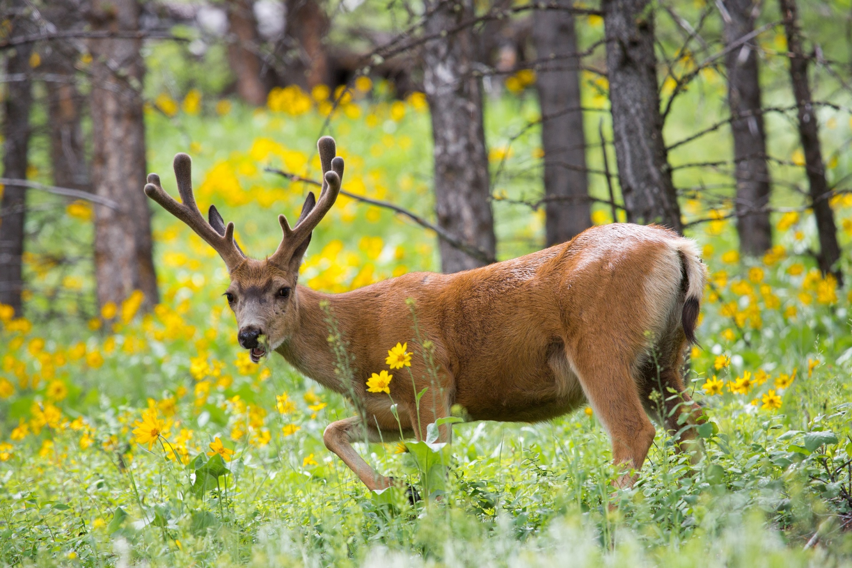
Food
The Pomo tribe hunted deer, elk, antelope, rabbits, and squirrels.
From the sea they got blackfish, bass, and shellfish, seaweed, seals, and sealions.
This Photo by Unknown author is licensed under CC BY-NC-ND.

Slide 5
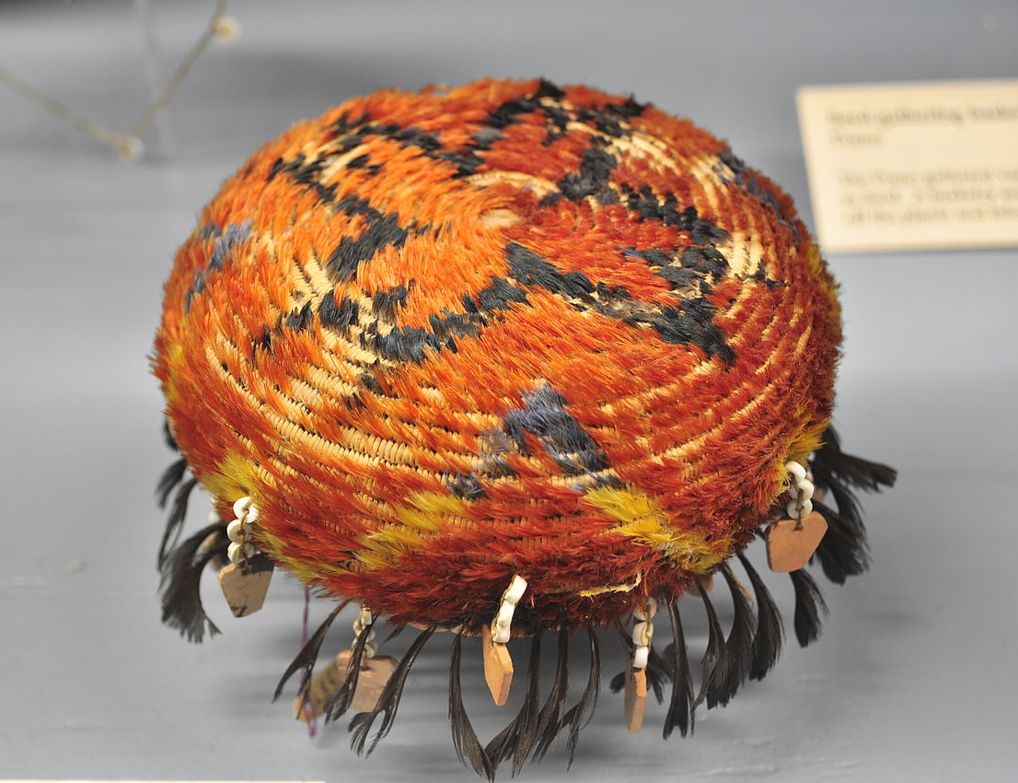
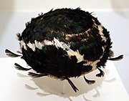
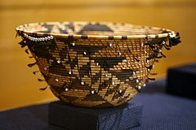
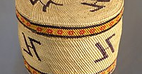
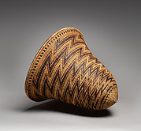
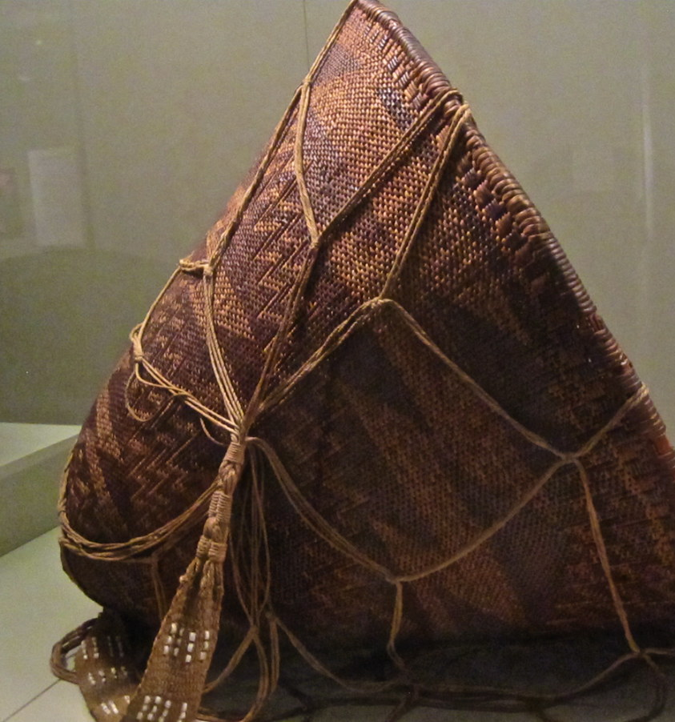
Culture
The women wore skirts made of plants. Men often wore nothing. Pomo people used tule and reeds for clothing.
The Pomo people had feathers and beads in their designs.
This Photo by Unknown author is licensed under CC BY-SA.
This Photo by Unknown author is licensed under CC BY-SA.
This Photo by Unknown author is licensed under CC BY-NC.
This Photo by Unknown author is licensed under CC BY-SA.
This Photo by Unknown author is licensed under CC BY-SA.

Slide 6
This Photo by Unknown author is licensed under CC BY-NC-ND.

