Slide 1
Gabrielino
By: Briseida and Jasmine

Slide 2
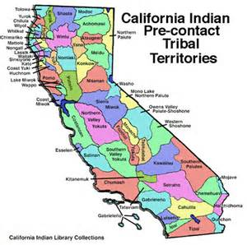
Location
The Gabrielino tribe lived in the California.
They lived in villages, beach, and rivers.
They live in land that is now Los Angeles.

Slide 3
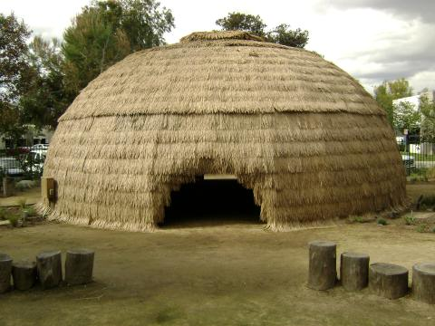
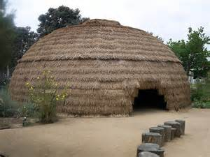
Shelter
The homes of the Gabrielino tribe protected them from the environment.
A Gabrielino shelter is made of plants and mats.
The poles were bent to meat together.
They were about 15 feet to 50 feet across.

Slide 4
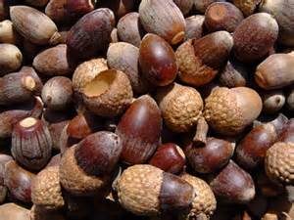
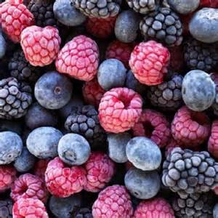
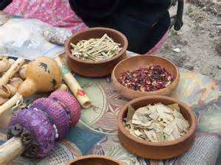
Food
They eat fish, deer, squirrels, and ducks.
They gathered seeds, fruit, and berries
They caught swordfish, seals, and sharks

Slide 5
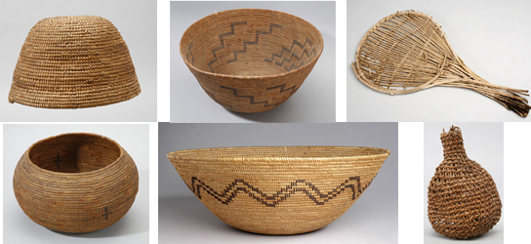
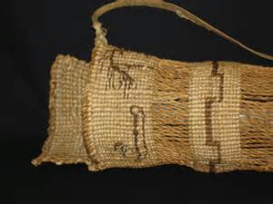
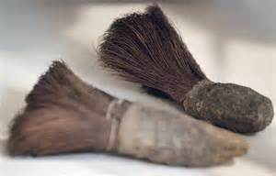
Culture
They made baskets they made bags.
and a beating toll .
They celebrated for the people that died.
They made stuff to clean the floor and pots.

