Slide 1
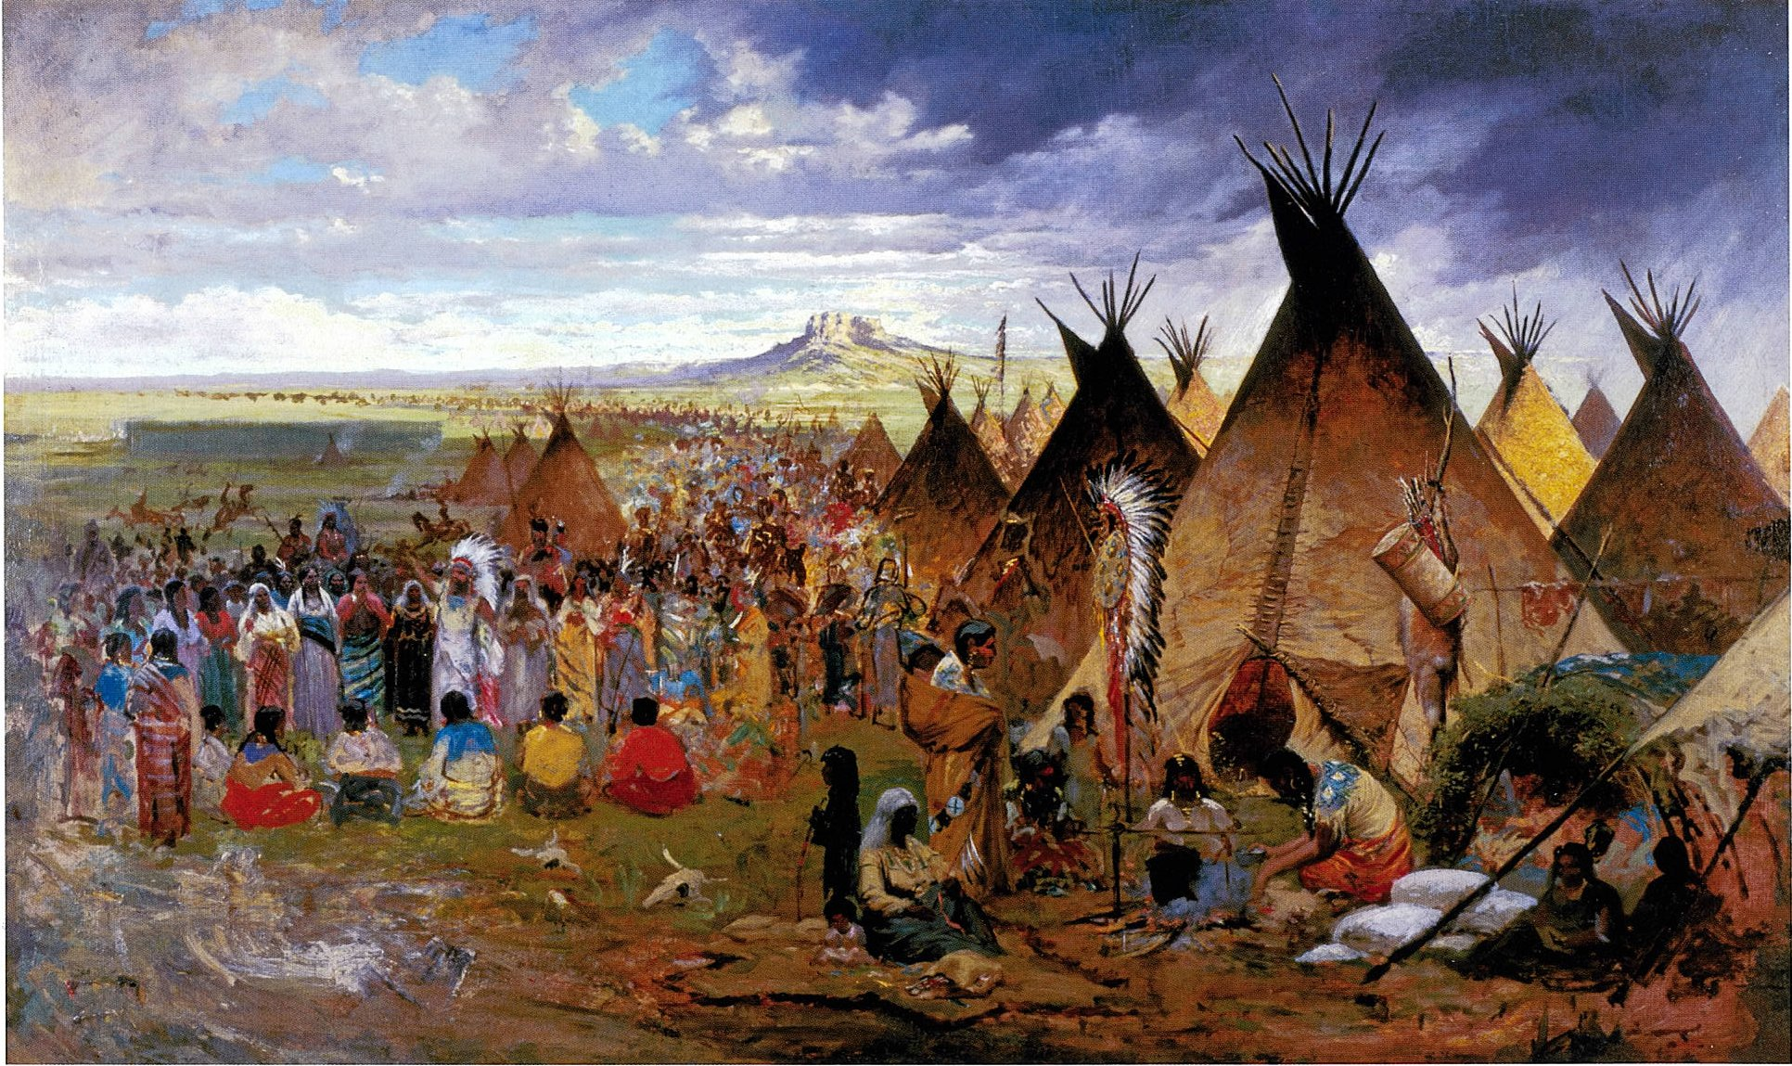
The Sioux
By Ethan and Kazuya
This Photo by Unknown author is licensed under CC BY-SA.

Slide 2
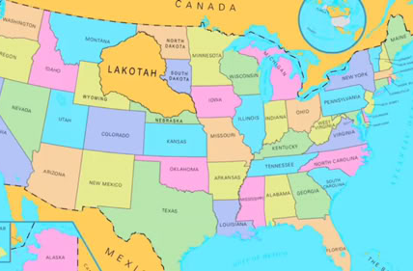
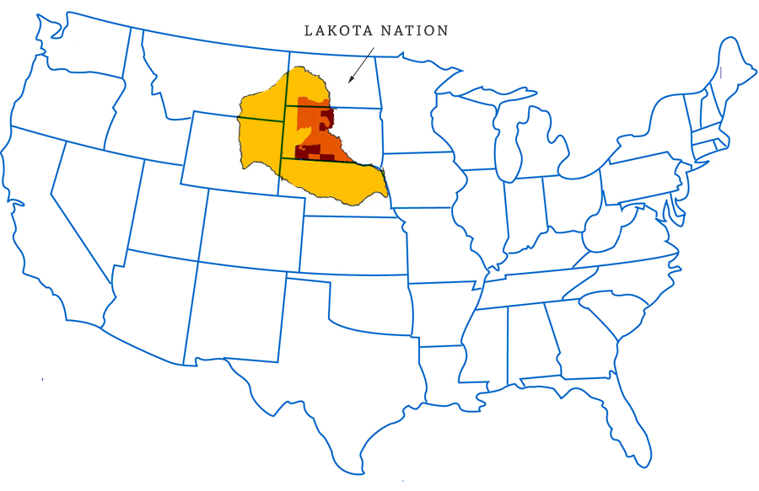
Location
The Sioux lived in the Great Plains.
They lived in South Dakota.
They lived in North Dakota.
This Photo by Unknown author is licensed under CC BY-NC.
This Photo by Unknown author is licensed under CC BY-NC-ND.

Slide 3
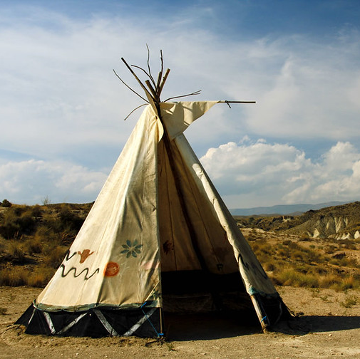
Shelter
The Sioux`s shelter is called a tipi.
The tipi is made from 20 buffalo hides and tree branches.
The tipi is easy to build and take down.
This Photo by Unknown author is licensed under CC BY-SA-NC.

Slide 4
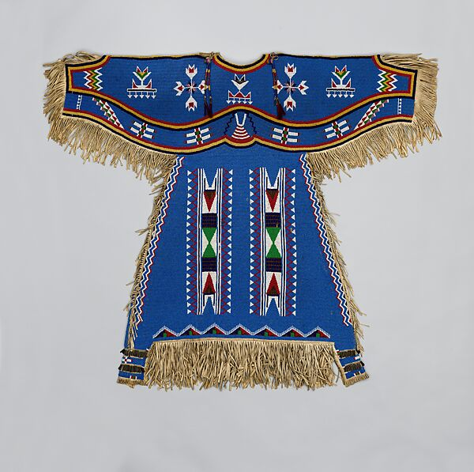
Culture
The woman decorated dresses with rabbit fur.
They did a sun dance to thank for the past years.
They traded things like toy horses made from leather.

Slide 5
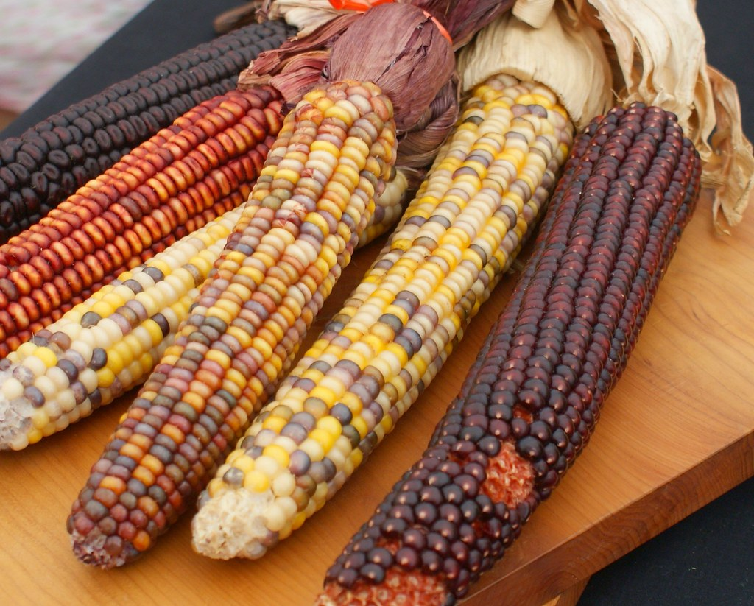
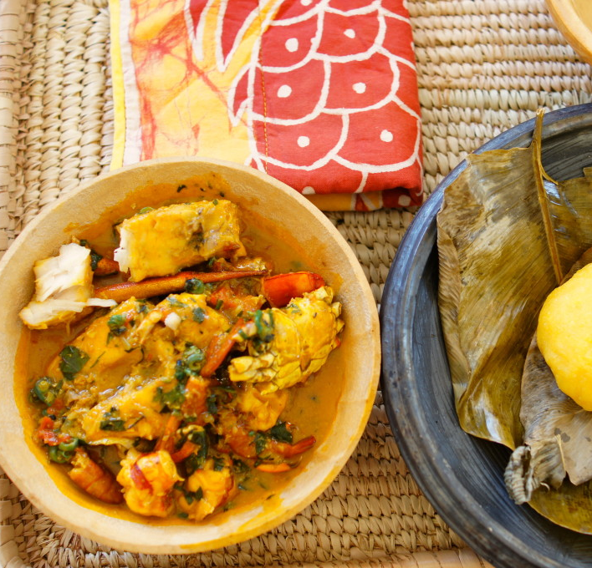
Food
The Sioux grew crops like squash, beans, and corn
The Sioux also hunted bear, deer, elk, bison, and buffalo.
This Photo by Unknown author is licensed under CC BY.
This Photo by Unknown author is licensed under CC BY.

Slide 6
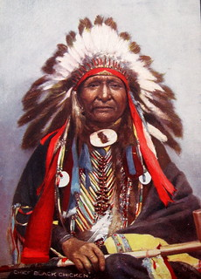
This is a Sioux warrior.
This Photo by Unknown author is licensed under CC BY-NC.

Slide 7
The End
Thank you for listening.

