Slide 1
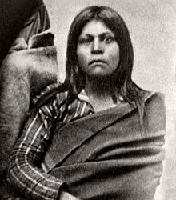
Gabrielino Native Americans By Rebecca Rios
This Photo by Unknown author is licensed under CC BY-SA.

Slide 2
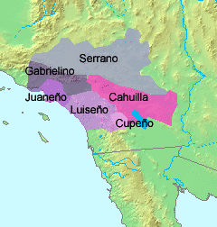
Geographical Location
The Gabrielino tribe lived around the coast of southern California. They lived around the coast and inland in what is known today the Los Angeles basin. The geographical location of the Gabrielino also included the islands of Santa Barbara, San Nicolas, San Clemente, and Santa Catalina. The Gabrielino placed their villages in sheltered bays on the coast.

Slide 3
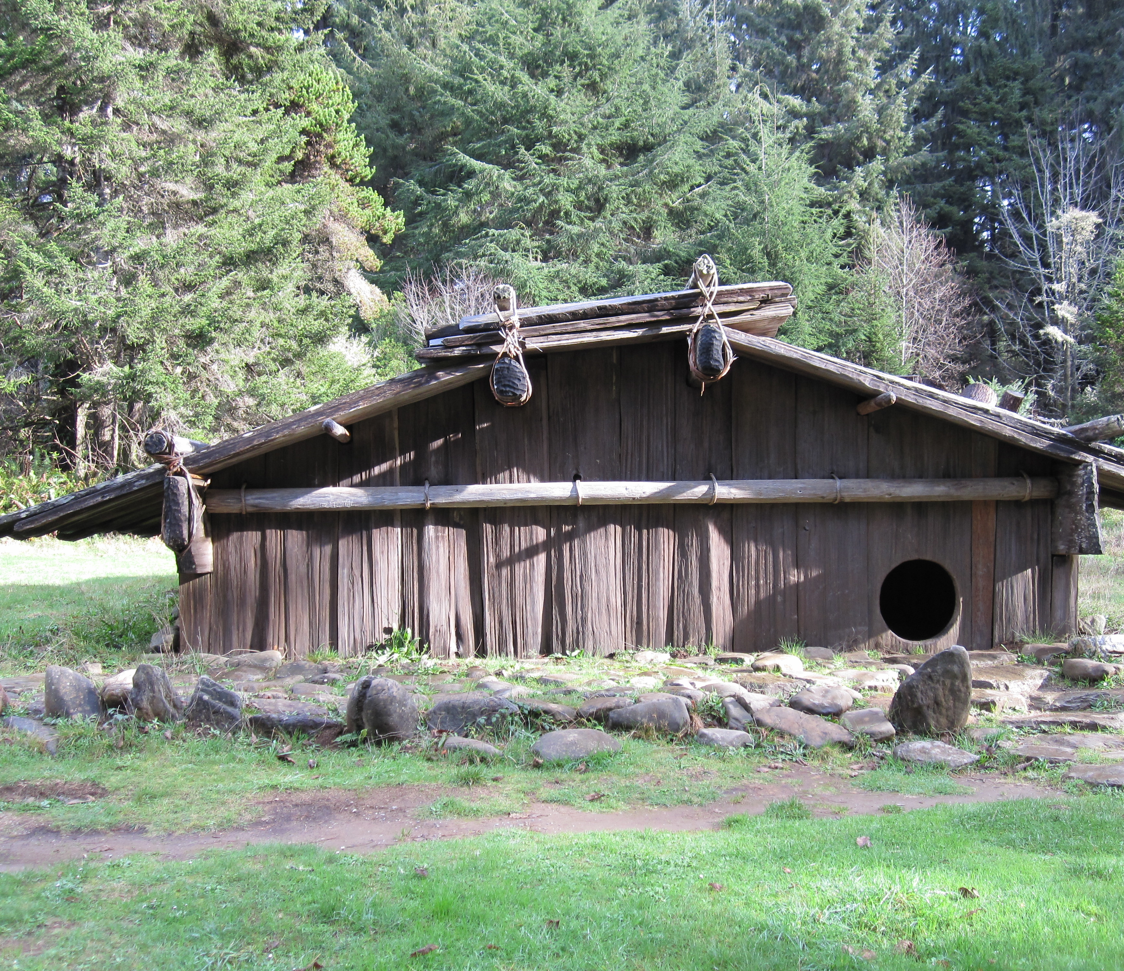
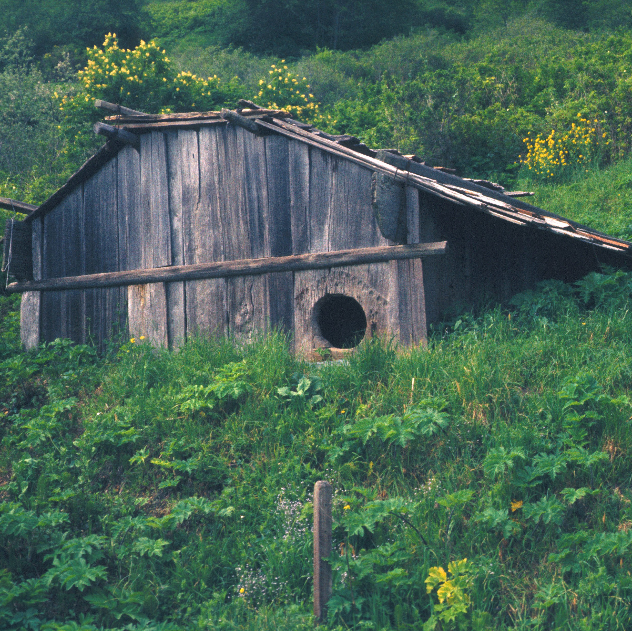
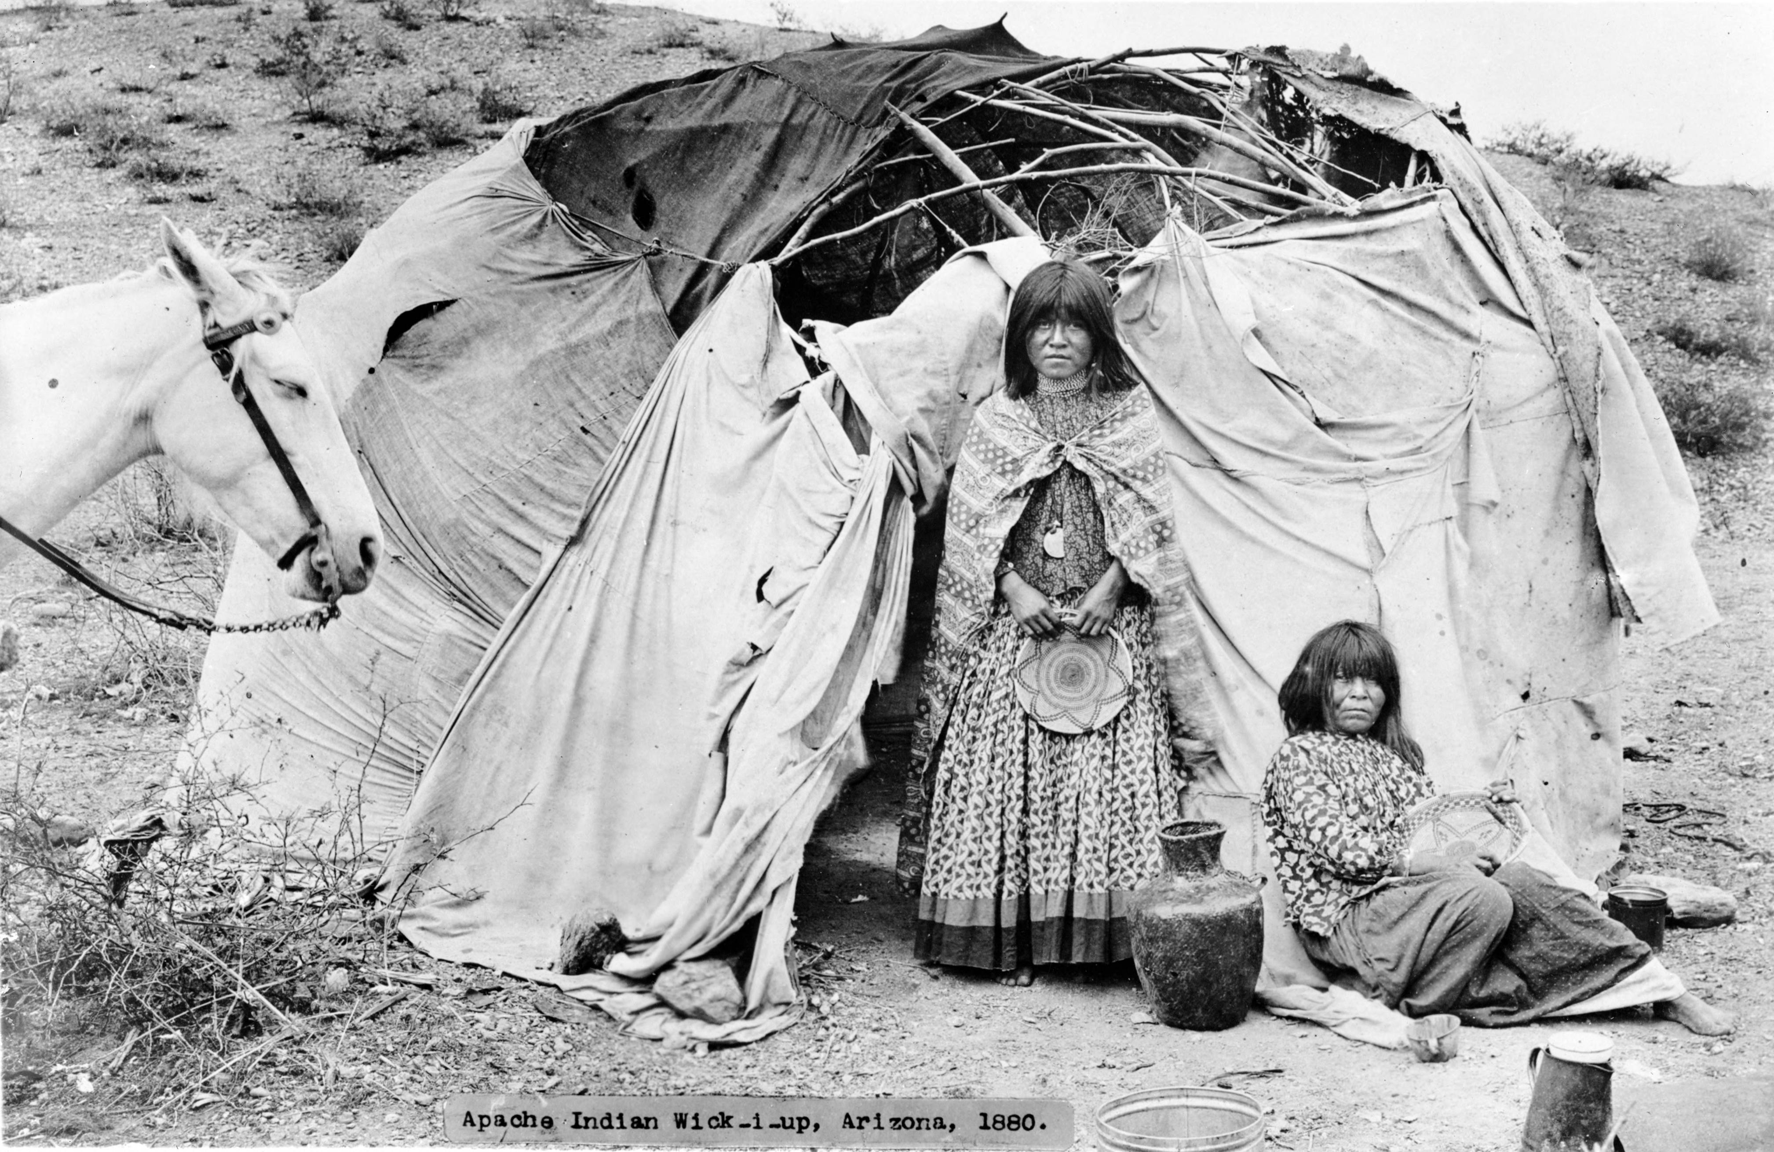
Shelter
Their shelter could fit 50 to 60 people!
They put poles and bent the poles till they met in the middle.
There was only one way to get in.

Slide 4
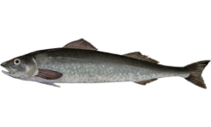
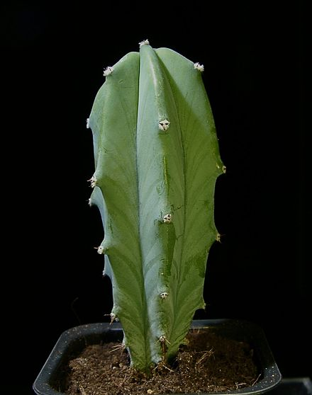
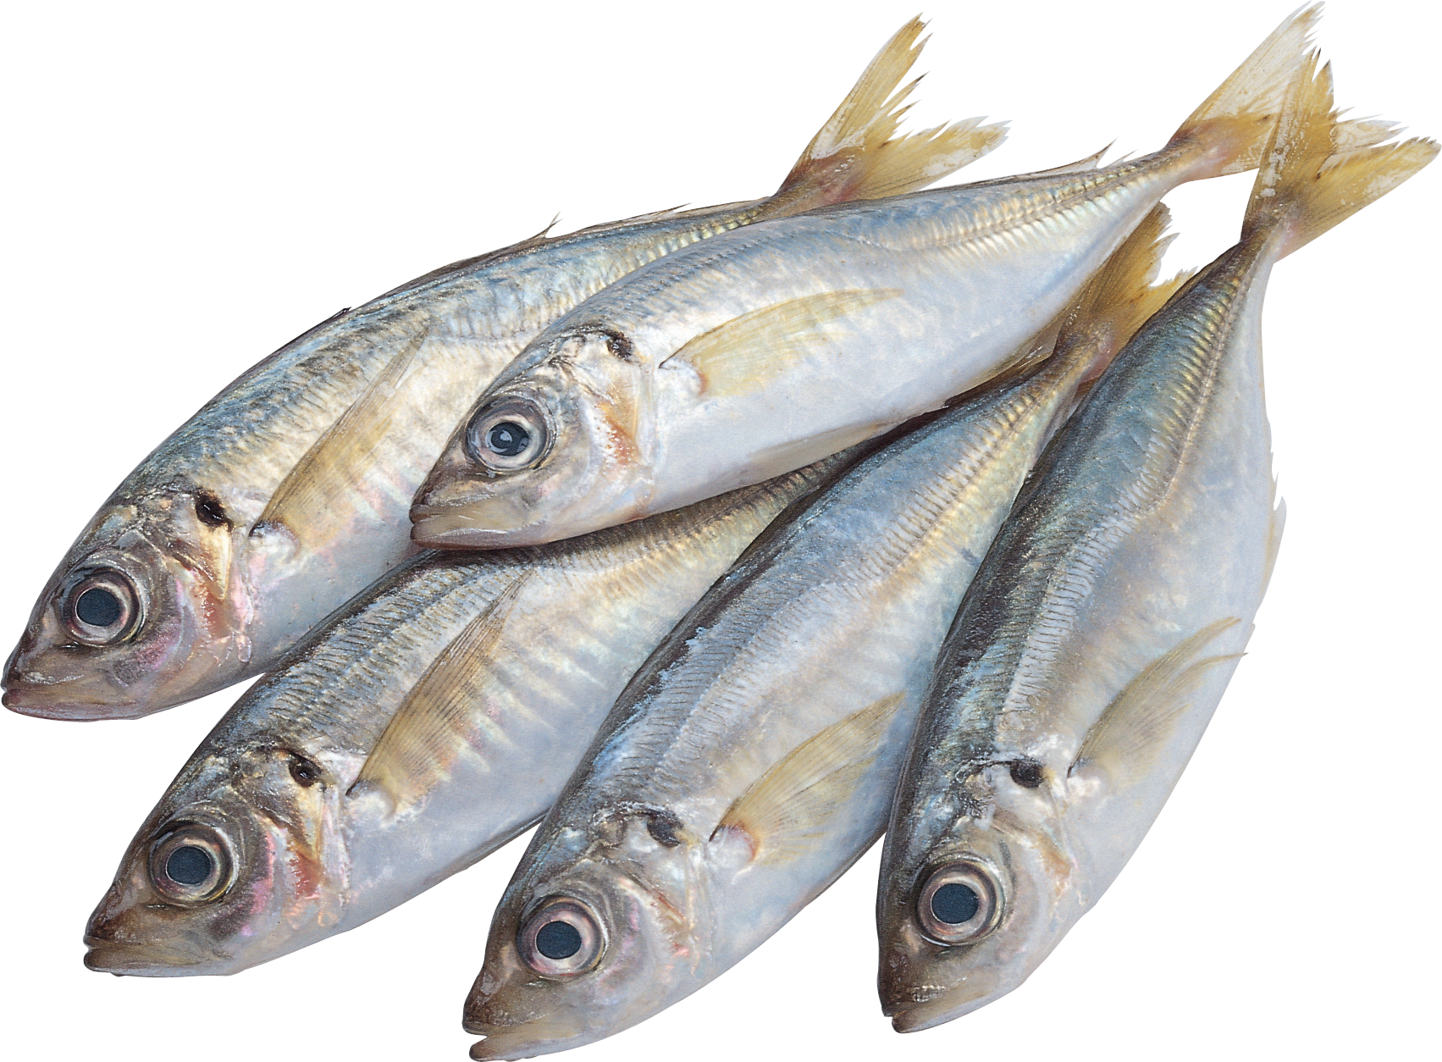
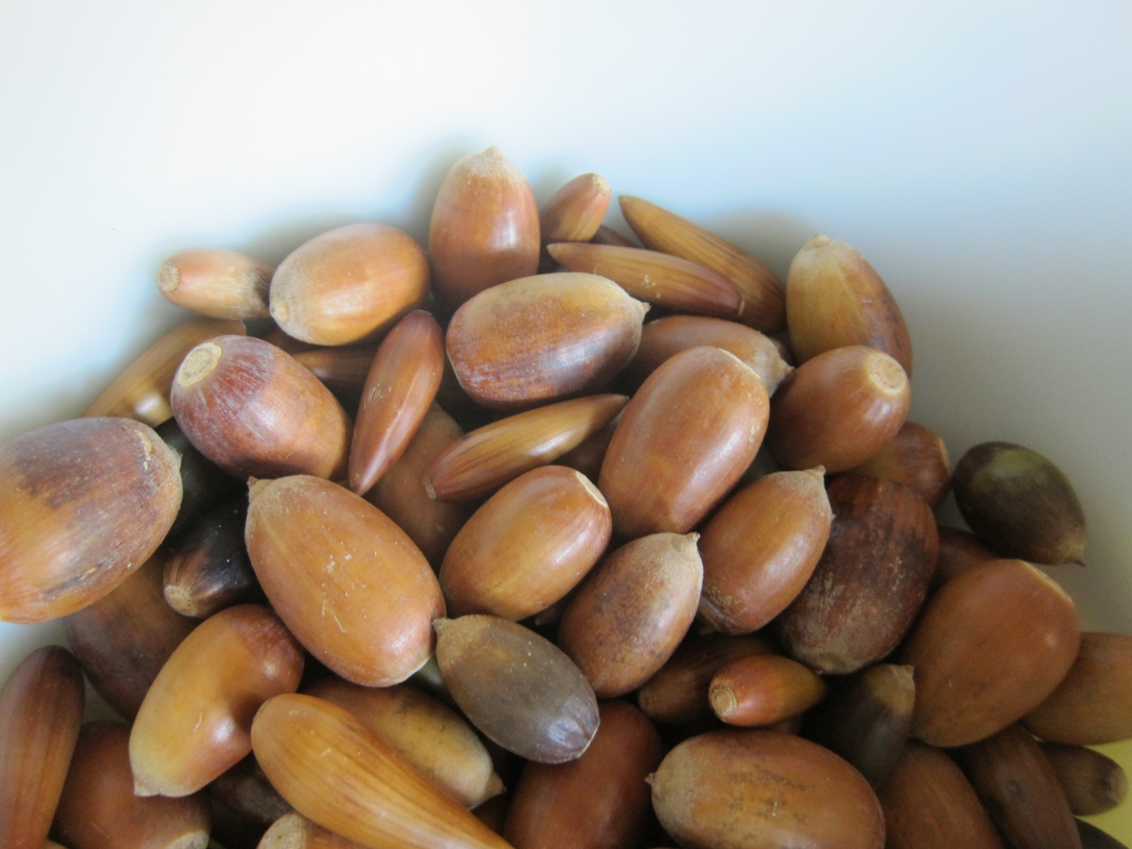
Food
Gabrielino villages near the coast collected lots of kinds of fish, like swordfish, sharks, tuna, and shellfish.
Gabrielino villages from foothills collected pinon nuts, berries, edible cacti, deer, and more.
The main food the Gabrielino collected was from the sea.
This Photo by Unknown author is licensed under CC BY-SA.
This Photo by Unknown author is licensed under CC BY-NC.
This Photo by Unknown author is licensed under CC BY-NC.
This Photo by Unknown author is licensed under CC BY-SA.

Slide 5
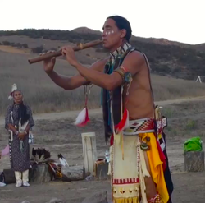
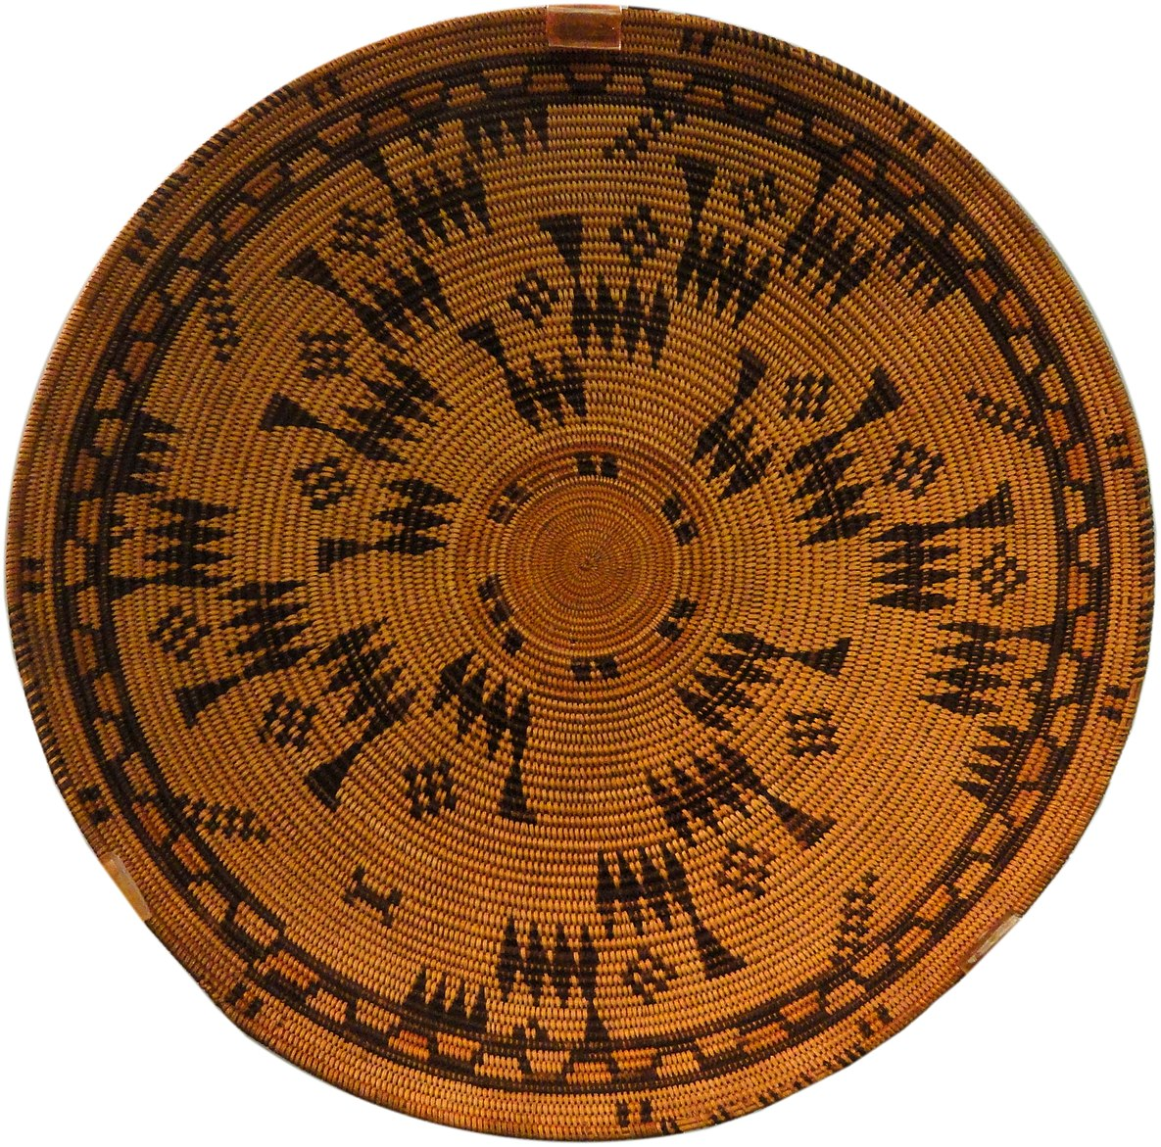
Culture
They made baskets so tight that you could put liquids in them!
The Gabrielino tribe had the biggest ceremony they could make to celebrate the people who died that year.
They feasted for 7 days at the ceremony.

