Slide 1
The Amendments
Ch 3 sec 4
Notes:
http://www.archives.gov/historical-docs/doc-content/images/bill-of-rights-m.jpg

Slide 2
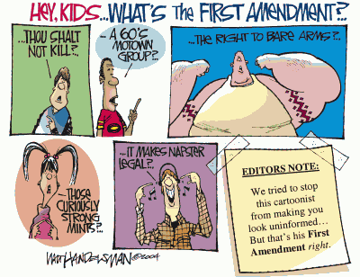
I. The Bill of Rights
These ten amendments originally applied only to the federal government, but through a series of Supreme Court decisions now apply to state governments as well
The First Amendment protects individuals’ right to worship, to speak freely, to assemble, and to petition and criticize the government.
Notes:
http://j-walkblog.com/index.php?/weblog/2005/02/01/

Slide 3
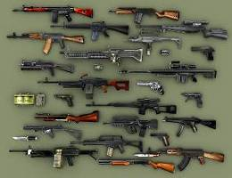
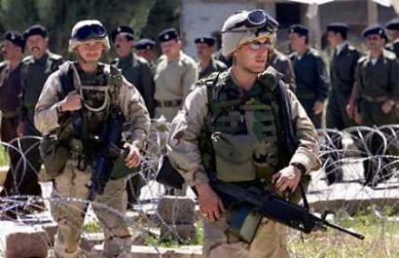
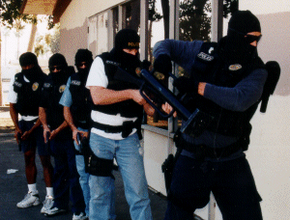
I. The Bill of Rights
The Second Amendment ensures citizens’ right to own firearms.
The Third Amendment prohibits the government from forcing people to provide shelter for soldiers in their homes.
The Fourth Amendment protects individuals from unlawful searches and arrests without court warrants.
Notes:
http://www2.fileplanet.com/images/50000/52029ss_sm2.jpg
http://www.173rdairborne.com/images/iraq-soldiers.jpg
http://www.anaheim.net/depts_servc/police/snu1.gif

Slide 4
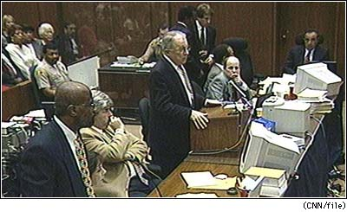
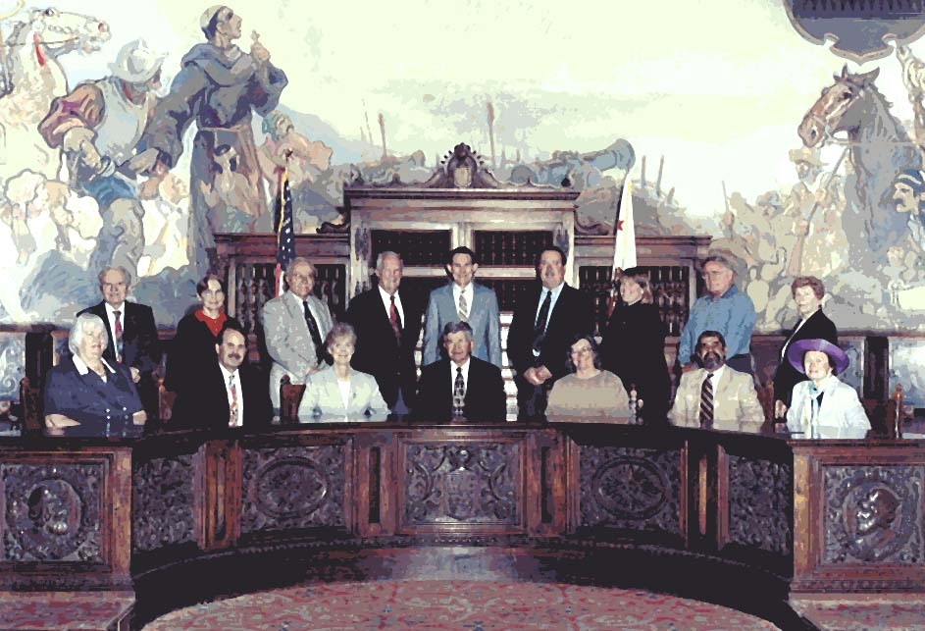
I. The Bill of Rights
The Fifth Amendment protects people charged with a crime: a grand jury must indict them before trial; no one found innocent can be retried for the same crime; people cannot be forced to testify against themselves; and no one can be deprived of life, liberty, or property without due process of law.
Notes:
http://www.sbcgj.org/98-99/gjphoto98-99.jpg

Slide 5
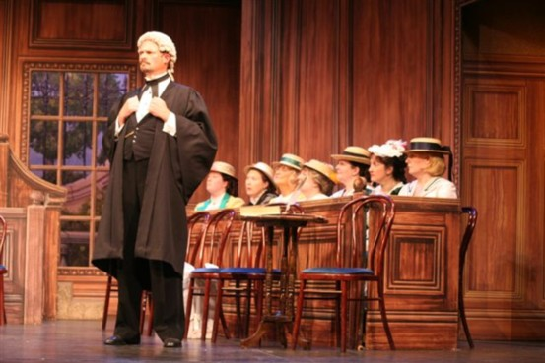
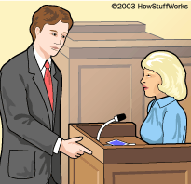
I. The Bill of Rights
The Sixth Amendment guarantees accused persons the right to know the charges against them, a defense attorney, a speedy jury trial, and the right to question all witnesses and compel them to testify.
Notes:
http://hpbimg.williamrevels.com/William%20Revels%20-%20Counsel%20in%20Trial%20by%20Jury.jpg
http://static.howstuffworks.com/gif/lawsuit-questioning.gif

Slide 6
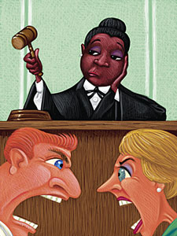
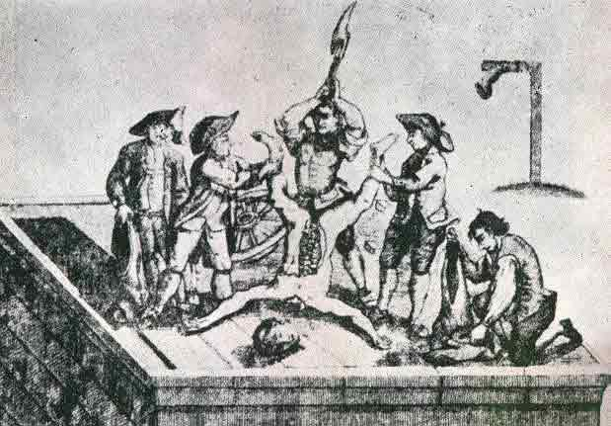
I. The Bill of Rights
The Seventh Amendment provides individuals the right to a trial by jury to settle property disputes, though a judge may try the case if both parties agree.
The Eighth Amendment prohibits excessive bail and fines, and bars cruel and unusual punishment for crimes.
Notes:
http://www.fotosearch.com/comp/ARP/ARP108/judge.jpg
http://www.affordablehousinginstitute.org/blogs/us/drawn_quartered.jpg

Slide 7
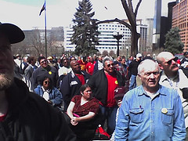
I. The Bill of Rights
The Ninth Amendment states that rights cannot be taken away from people just because the Constitution doesn’t mention those rights.
The Tenth Amendment says that all powers not given to the national government or denied to the states belong to the states or the people.
Notes:
http://static.flickr.com/32/124988402_cc6f47a632_m.jpg

Slide 8
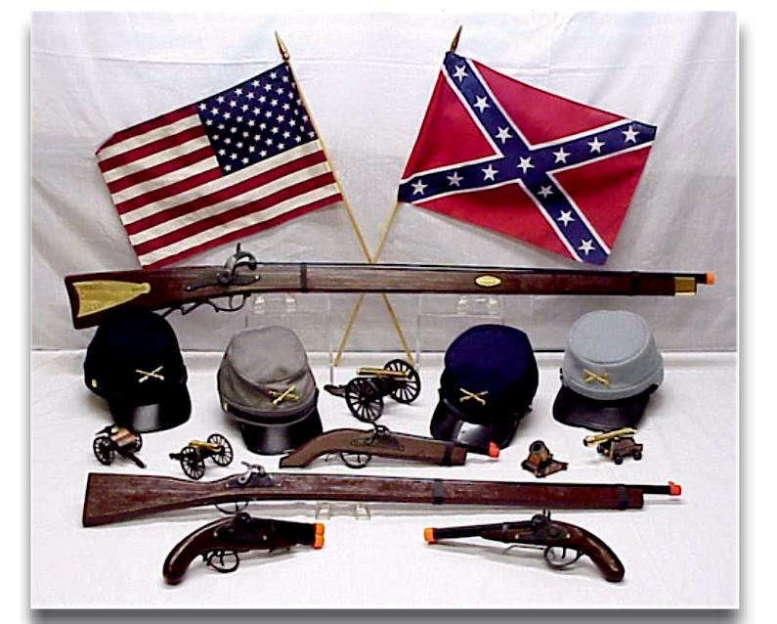
II. Other Amendments
The amendments can be divided into three groups: the first 12 were to finish the original Constitution, 13-15 are the Civil War amendments, and 16-27 are twentieth century additions that reflect social changes in the country.

Slide 9
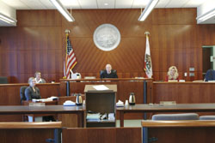
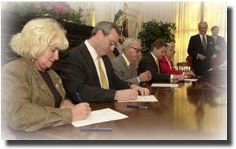
II. Other Amendments
The Eleventh Amendment prohibits a state from being sued in federal court by citizens of another state.
The Twelfth Amendment provides that the Electoral College shall cast separate ballots for president and vice president.
Notes:
http://www.cc-courthelp.org/images/tour_mtz_fam_law_courtroom.jpg
http://usinfo.state.gov/journals/itdhr/1004/ijde/college.jpg

Slide 10
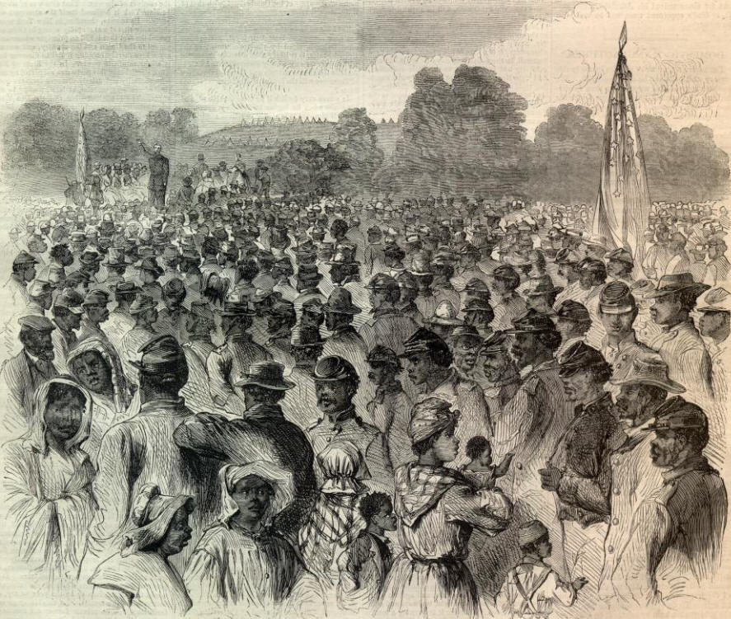
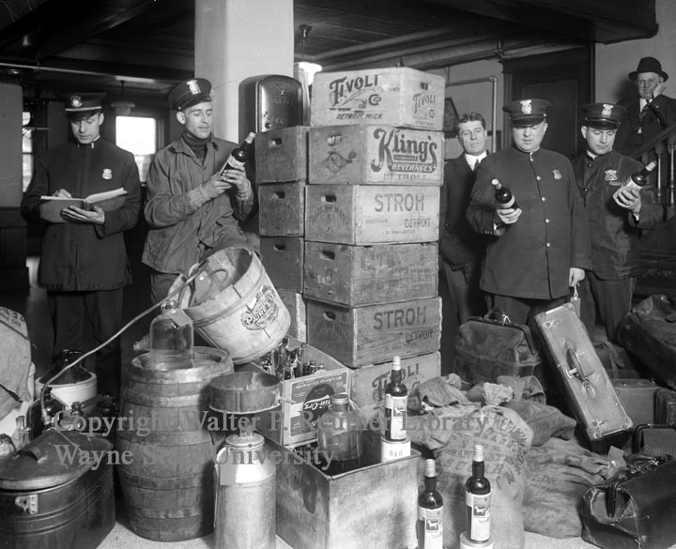
II. Other Amendments
The Thirteenth, Fourteenth, and Fifteenth Amendments outlawed slavery, prohibited depriving anyone of life, liberty, or property without due process of law, and prohibited denying the right to vote based on race.
The later Amendments, Sixteen through Twenty-seven, deal with a wide range of topics reflecting change in modern times.
Notes:
http://www.reuther.wayne.edu/faces/prohibition%20raid.jpg

Slide 11
In your notebooks
Identify three constitutional amendments adopted since the Bill of Rights that have made American government more democratic, and explain how each has done so.

