Slide 1
Don Lugo High School
DANCE TEAM
PARENT INFORMATION 2024

Slide 2
SO YOU WANT TO TRY OUT FOR DANCE TEAM?
WHAT ARE THE BASIC SKILLS WE ARE LOOKING FOR?
WHAT WILL AUDITIONS AND TRY OUTS LOOK LIKE?
What does summer schedules look like?

Slide 3
How many dancers will you take?
It depends on the amount of candidates and total score! WE WOULD LOVE TO HAVE 12-16 DANCERS BUT IT CAN FLUCTUATE!

Slide 4
Requirements and Qualifications
Please go to www.donlugo.com and find dance team under activities
This is very important! Our constitution is updated every year.
Both the Dance team candidate and parent must understand the time comittment and booster donation need. Our parent boosters are very involved.
Notes:
We do not want to spend our time telling you information that you can read online. We have made some major changes to the Constitution and Code of Conduct for this year. This is important for returning families to understand.

Slide 5
Dance Clinic/auditions
WHEN: April 24-26
TIME: 4-5:30
WHERE: DON LUGO Dance Room
WHAT TO WEAR: PLEASE WEAR BLACK ACTIVE WEAR TO SHOW OFF LINES AND ABILITY TO SHOW MOVEMENT.HALF SOLES OR JAZZ SHOES REQUIRED.

Slide 6
each candidate will learn Dance technique skills and show off dance combos that may include but not limited to:
Triple pirouette
A la seconde turns
Leg extentions/tilt
Kick up
Jumps/leaps
Musicality/dynamics

Slide 7
Donation Requests
DANCE is not funded by DLHS ASB, athletics or district programs. It is not a Title IX program. All programs at DLHS ask for donations for items needed for students.
SOME PAYMENTS WILL BE PAID TO VARSITY AND DON LUGO HIGH SCHOOL. DONATIONS AND FUNDRAISING MAY BE ORGANIZED BY THE DALPAB PARENT BOOSTERS.
Not all items are needed every year. BACK PACK AND DANCE DRESS FOR EXAMPLE.
Choreographer/Coach fees
Shoes

Slide 8
EXAMPLE OF BASIC SCHOOL SPIRIT GEAR

Slide 9
EXAMPLE OF PRICING FOR PURCHASED ITEMS BY DANCER AND FAMILY

Slide 10
DONATIONS AND PAYMENT SCHEDULE/DATES (EXAMPLE)
(proposed- will have updated schedule at welcome parent meeting)
ALL UNIFORM AND OR CAMP PAYMENTS WILL BE PAID TO VARSITY/UNITED SPIRIT ASSOCIATION OR DON LUGO HIGH SCHOOL ASB.
April- payments due to Varsity for deposits of camp and uniform (estimate: $350)
May- payment to ASB OR Varsity
June- payment to ASB OR VARSITY
JULY- PAYMENT TO ASB OR VARSITY
September –choreography AND COMPETITION DONATIONS BEGIN
October-choreography AND COMPETITION DONATIONS BEGIN

Slide 11
SUMMER INTENSIVE SCHEDULE EXAMPLE

Slide 12
PHYSICALS after you make the team
Physicals cannot be turned in until May 13. Don Lugo will offer sports physicals on May 13 or May 14 and will cost $35. You may schedule a physical at your own convenience with your doctor or health center.

Slide 13
Go to www.donlugo.com and click on the link under activities and “Don Lugo DANCE” OR USE THE QR CODE AND Fill out the short online application.

Slide 14
Application
Step 1: Make sure that all information has been read and agreed to by the DANCE Family. Check out all of our info at www.donlugo.com
Step 2: DANCE candidates must fill out the ONLINE APPLICATION and submit by: april 23, 2024.
SEE BELOW FOR LINK:
https://forms.gle/eHVdAMpjs67fnVVS7
PLEAESE BRING THE PARENT SIGNATURE FORM AT THE END OF THE CODE OF CONDUCT TO THE FIRST DAY OF CLINIC signed.

Slide 15
WE look forward to meeting you!
All information is subject to change. Donation fees, prices of items and practice schedules are subject to change and will be updated at the parent welcome meeting.

Slide 16
Got more questions?
PARENT INFO ZOOM WILL BE ON APRIL 22 TO GO OVER ANY ADDITIONAL INFO PRIOR TO AUDITIONS!

Slide 17
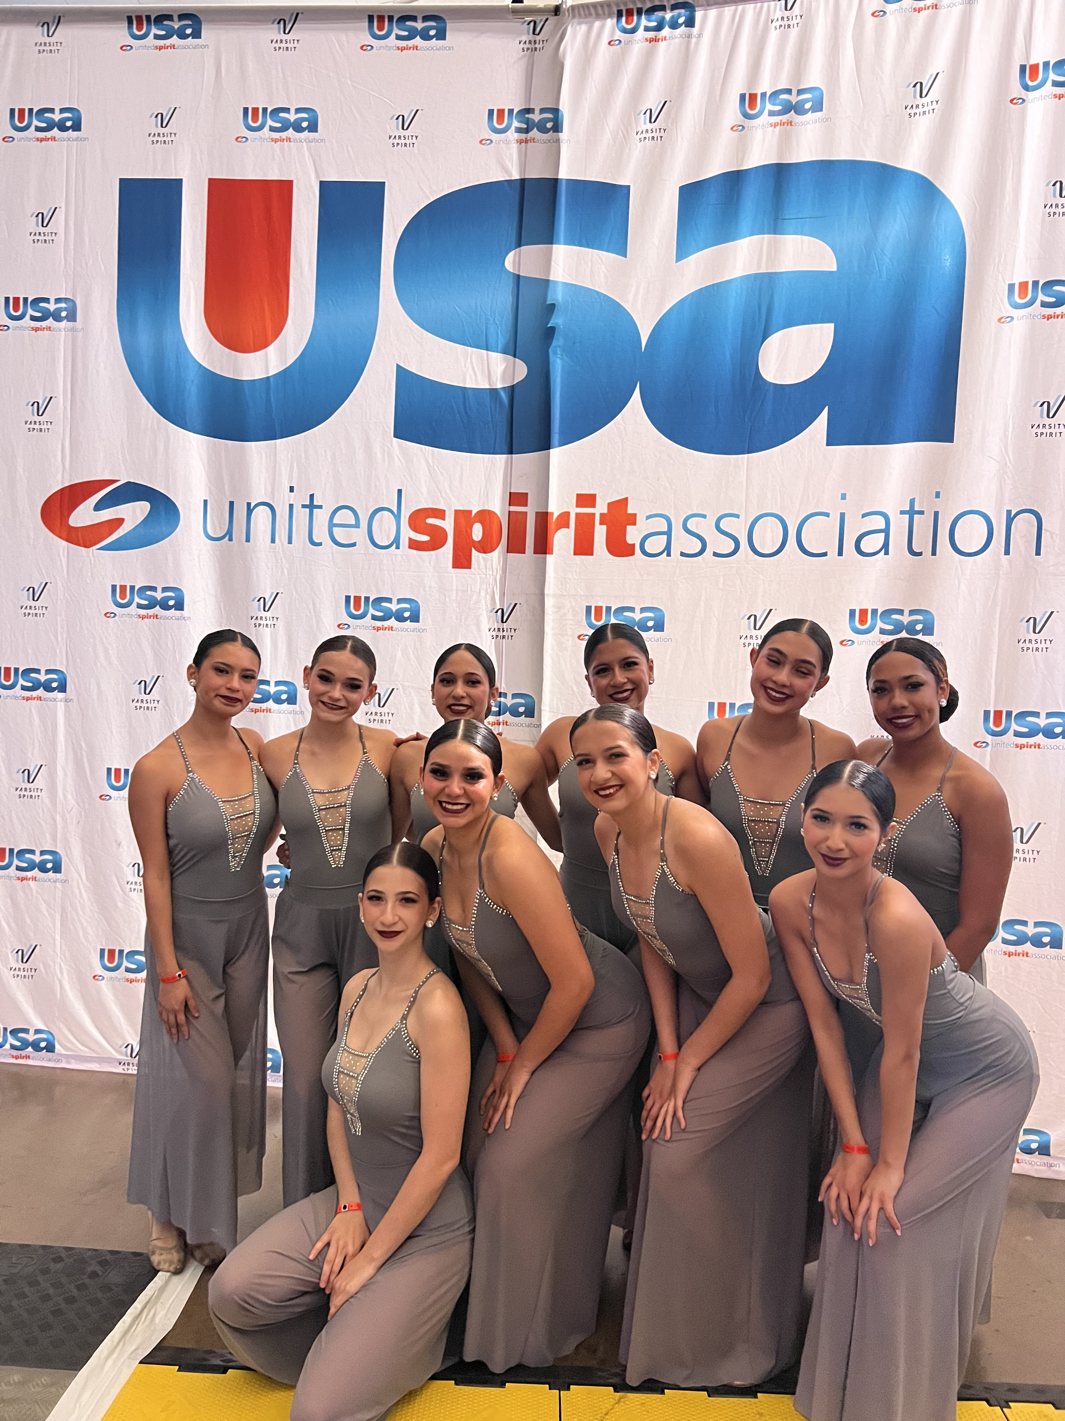
Finally…
We are very proud of our program and hope that you want to be a part of our great team! We are ready to grow!
Remember to check out the material online, including calendars!
THANK YOU AND GOOD LUCK!
ANY QUESTIONS LATER ON…. EMAIL the asb director at:
FARRAH_RIGOWITT@CHINO.K12.CA.US

