Slide 1
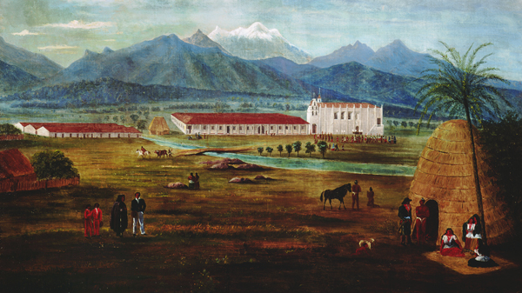
The Gabrielino Tribe
By Noah L
This Photo by Unknown author is licensed under CC BY-NC-ND.

Slide 2
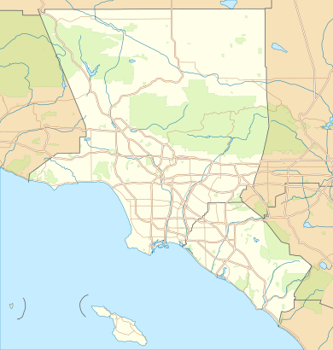
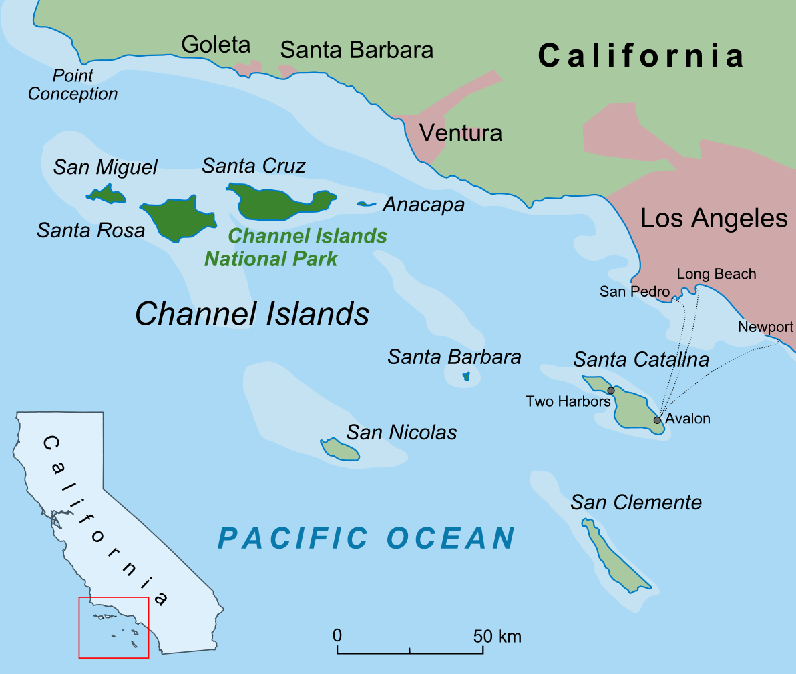
Location
The Gabrielino tribe lived along the southern coast of California.
They inhabited many areas in and around what is now Los Angeles.
This Photo by Unknown author is licensed under CC BY-SA.
This Photo by Unknown author is licensed under CC BY-SA.

Slide 3
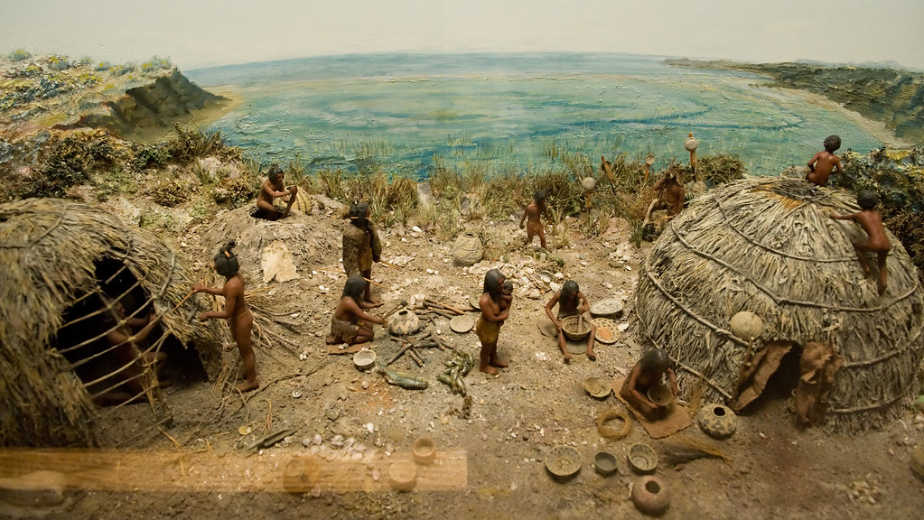
Shelter
Their homes were made of tule.
Some homes could hold up to 60 people.
They also had large sweathouses that the men would use.
This Photo by Unknown author is licensed under CC BY-SA.

Slide 4
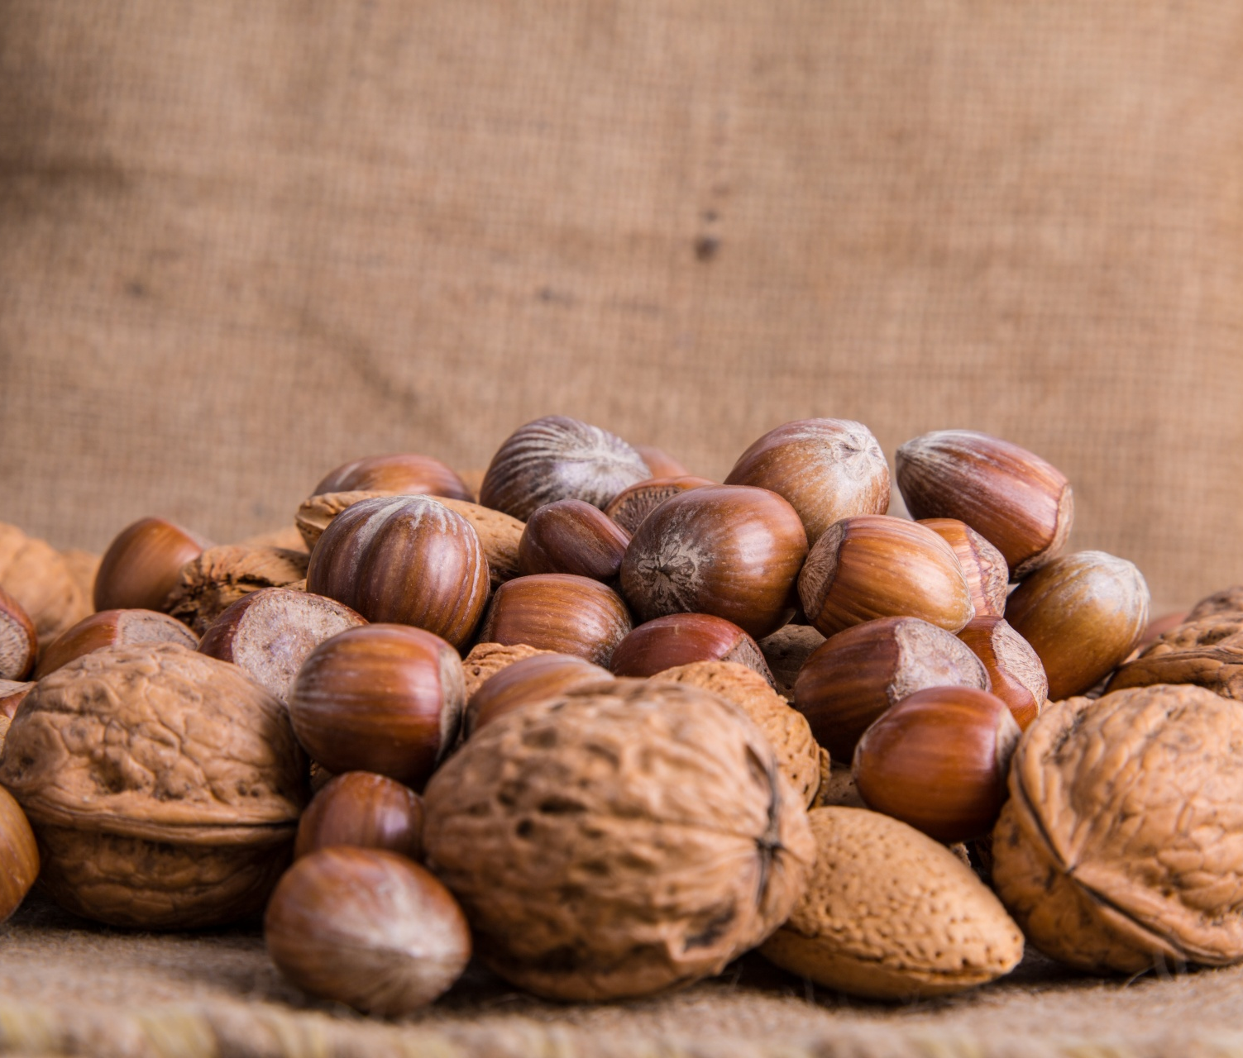
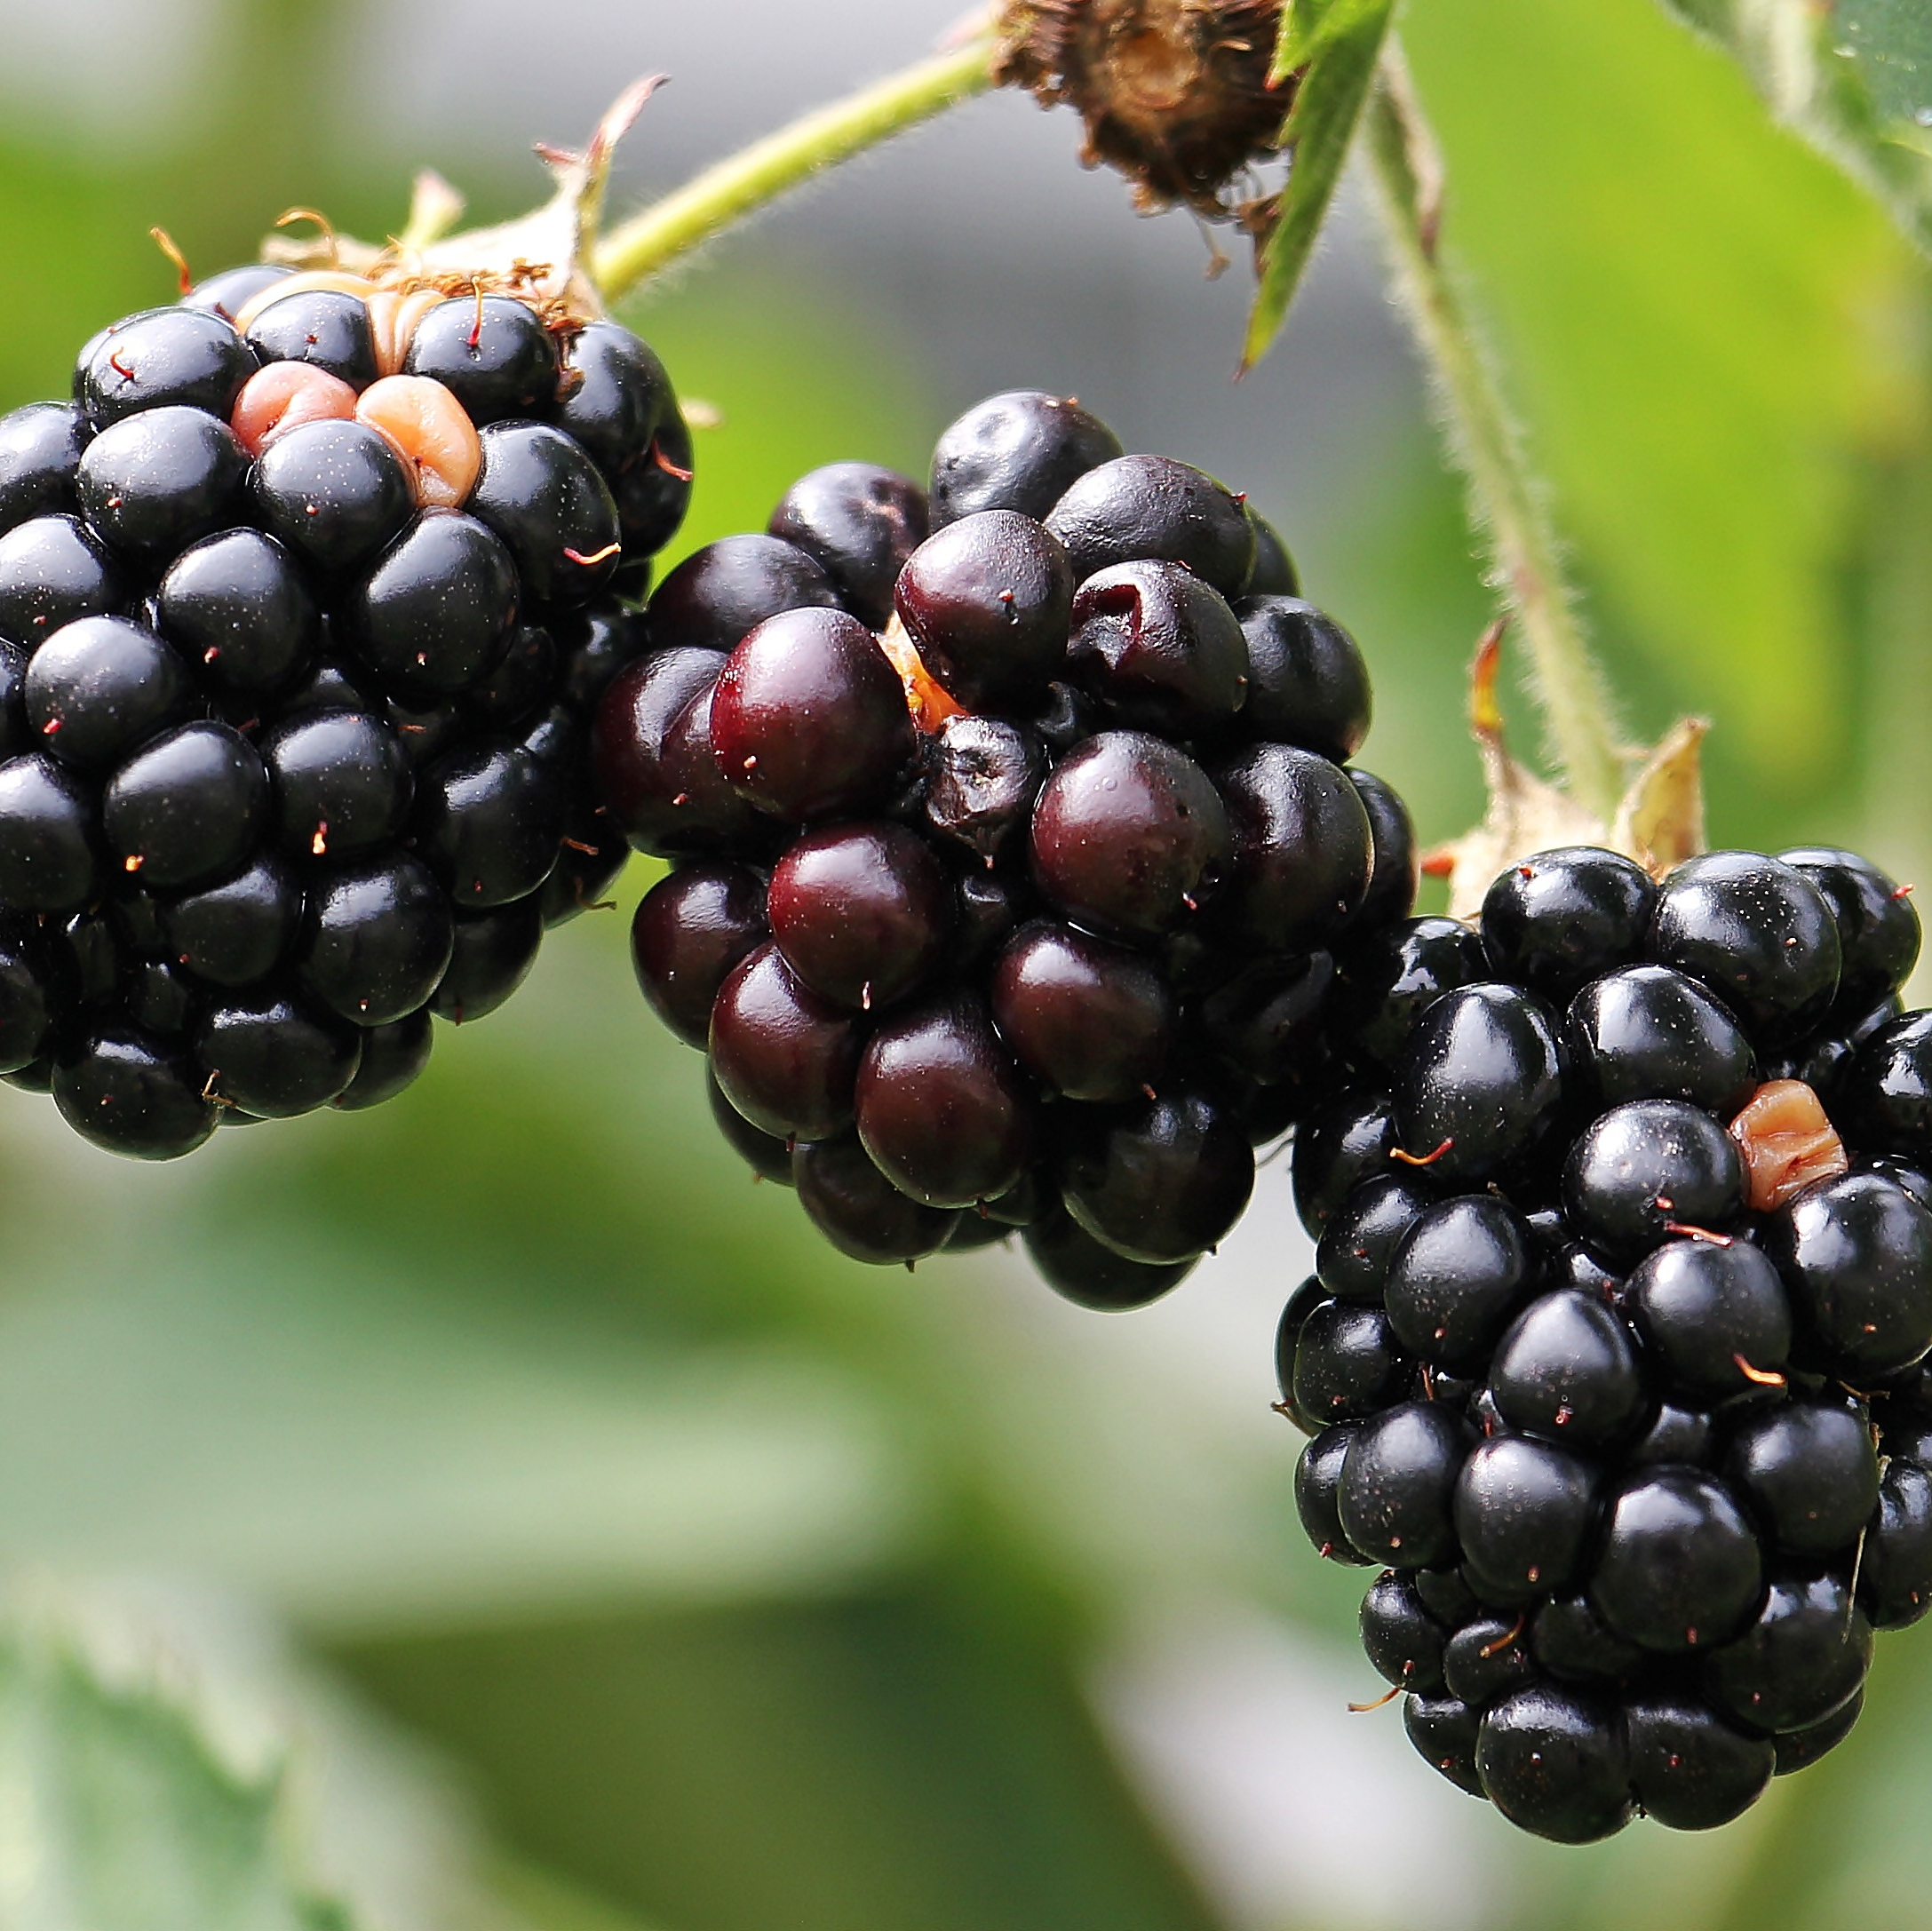
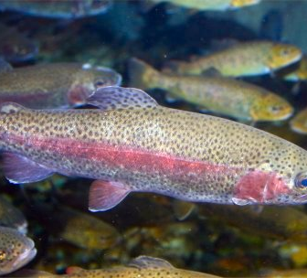
Food
Due to their location their main source of food came from the sea.
They also eat nuts, seeds, and berries.
They also ate many kinds of birds.
This Photo by Unknown author is licensed under CC BY-SA.

Slide 5
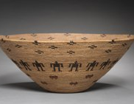
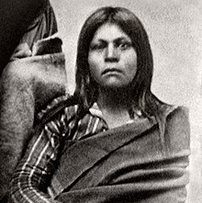
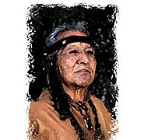
Culture
Ceremonies were held in an oval area where only the most powerful men could go.
Tatooing was popular among girls and women.
Their clothes were made of animal skins and fur.
This Photo by Unknown author is licensed under CC BY-SA.
This Photo by Unknown author is licensed under CC BY-SA.
This Photo by Unknown author is licensed under CC BY-SA.

