Slide 1
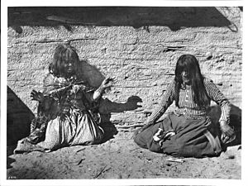
Mojave
^{By Andrew and Andy}
This Photo by Unknown author is licensed under CC BY-SA.

Slide 2
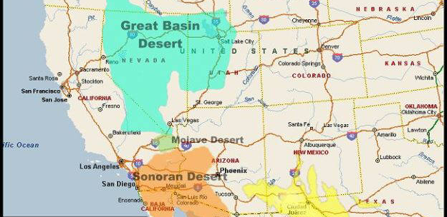
Location
The Mojave lived in the desert where there is very little rain. The exact place is in Southeastern California along the Colorado river. They have hot summers, but mild winters. They move away from the rivers during the rainy season because it might flood.

Slide 3
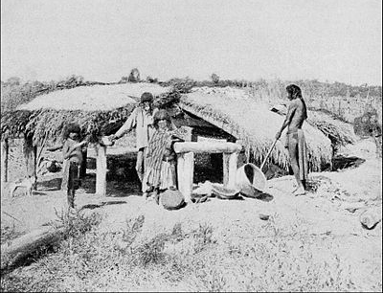
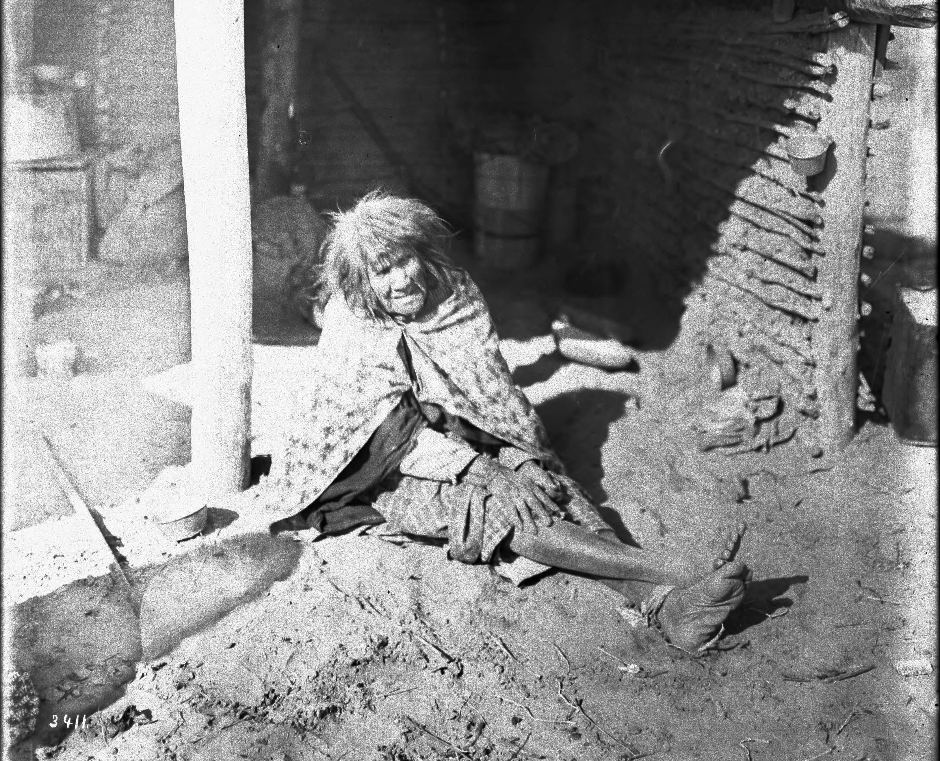
Shelter
The shelter of the Mojave tribe is made from natural resources. The homes are 4 or 6 poles holding a grass roof. It has a flat roof covered with reeds or grasses.
This Photo by Unknown author is licensed under CC BY-SA.
This Photo by Unknown author is licensed under CC BY-SA.

Slide 4
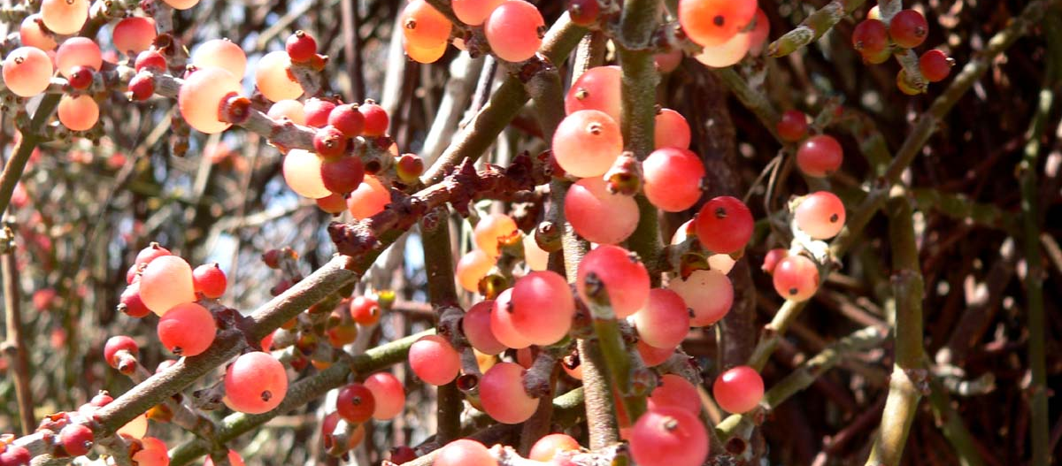
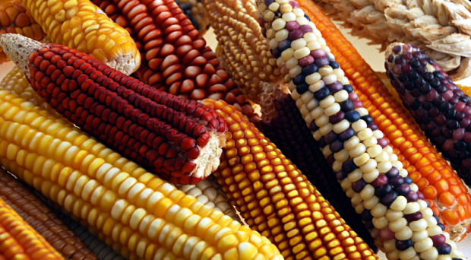
Food
The food of the Mojave was mostly farmed. The men cleared the land, dug planting holes, and weeded. The women planted seeds and worked with the men to harvest. They were expert fishers who used baskets, nets, and rafts to fish. They were farmers who farmed corn, melons, and beans.

Slide 5
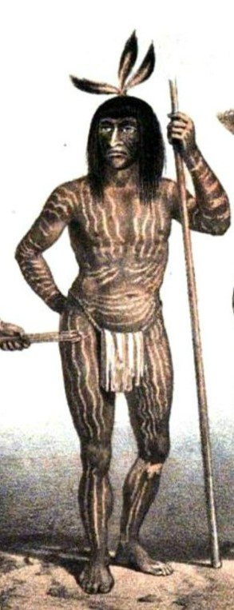
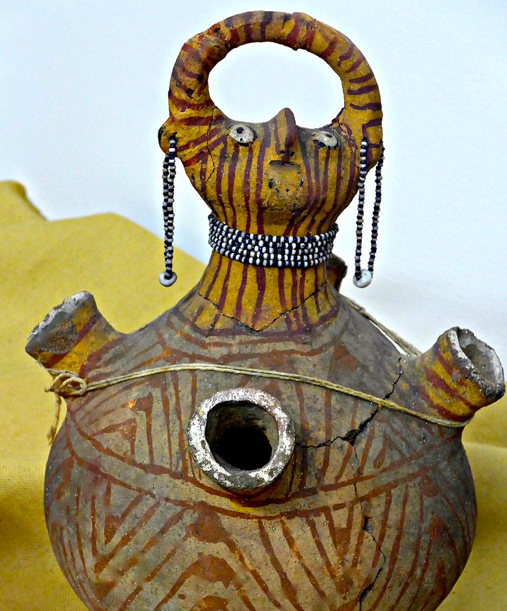
Culture
The Mojave tribe's culture was very interesting. The people got tattoos when they became adults. All the people would gather with their tribal neighbors to celebrate the fall harvest. They made dugout canoes, and made baskets made from clay. They had elected a chief that was responsible for the people. They also had a ceremony to remember people who died during the past year.
This Photo by Unknown author is licensed under CC BY-NC.

Slide 6
The End
In conclusion the Mojave tribe had to use natural resources to survive.

