Slide 1
Ecology Notes Pages 1-7
By Karyssa Casias (Period 3)

Slide 2
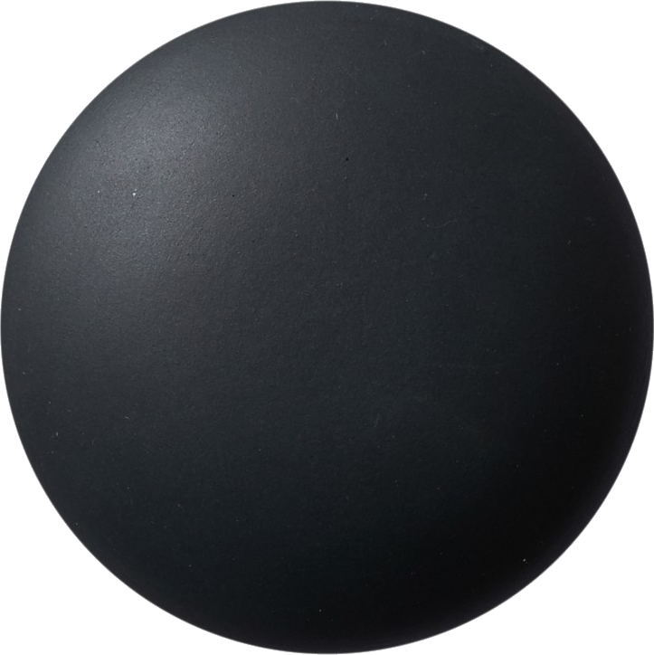
SCIENCE
Page 1
True
Helpful
Inspiring
Necessary
Kind
To: f_last@stu.chino.k12.ca.us
School Email
Cc:
Subject- Class expectations
Short Subject
Dear Student,
Please log on early, be visible, engage and respond, THINK, and ask for help.
Polite Greeting
Message here not in subject
Thank you,
Name
Period
/20 not graded
18/20 your grade
0/20 not turned in
Completed name and period

Slide 3
Page 2
CELL THEORY
- All living things are composed of cells
- Cells are the basic units of structure and function in living things
- All cells are produced from other cells

Slide 4
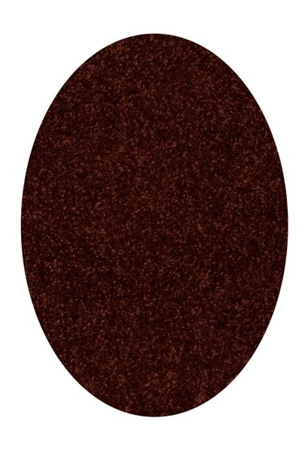
CELLS
Page 3 (Part 1)
Nucleus
PLANT CELL
Cell Wall
Cell Membrane
Chloroplast
photosynthesis
Vacuole
Cytoplasm
Cellular Respiration
Mitochondria

Slide 5
CELLS
Page 3 (part 2)
ANIMAL CELL
Vacuoles
Nucleus
Cellular Respiration
Cell Membrane
Cytoplasm
Mitochondria

Slide 6
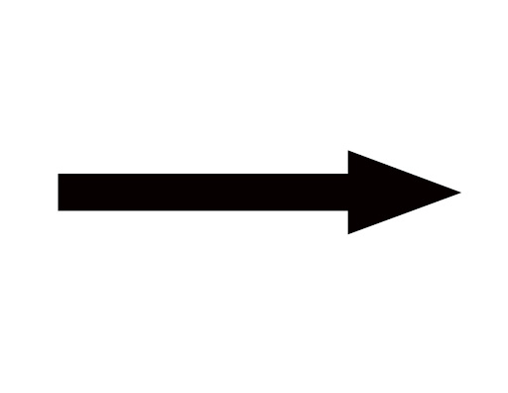
PHOTOSYNTHESIS
Page 4
6CO2 + 6H2O
C6H12O6 + 6O2
Carbon Dioxide + Water + Sunlight yields Glucose + Oxygen
CO
CO
H2O
O2
2
2
+
H2O
O2
CO
H2O
+
O2
2
CO
CO
H2O
O2
2
2
2
CO
O2
H2O
C6H12O6
O2
H2O

Slide 7
CELLULAR RESPIRATION
Page 5
C6H12O6 + 6O2
6CO2 + 6H2O(ATP)
Glucose + Oxygen yields Carbon Dioxide + Water with Energy
CO
O2
2
CO
H2O
O2
2
CO
+
O2
CO
2
+
H2O
C6H12O6​
O2
2
O2
CO
H2O
O2
CO
2
2
H2O
H2O
H2O

Slide 8
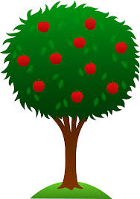
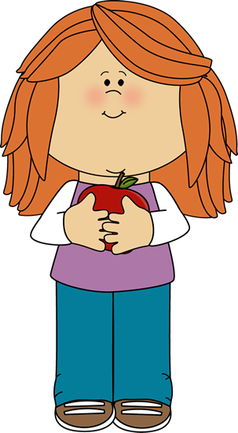
PHOTOSYNTHESIS CELLULAR RESPIRATION CYCLE
Page 6
Oxygen
Sugar Glucose
Water
Energy
Carbon Dioxide
Chemical
Thermal

Slide 9
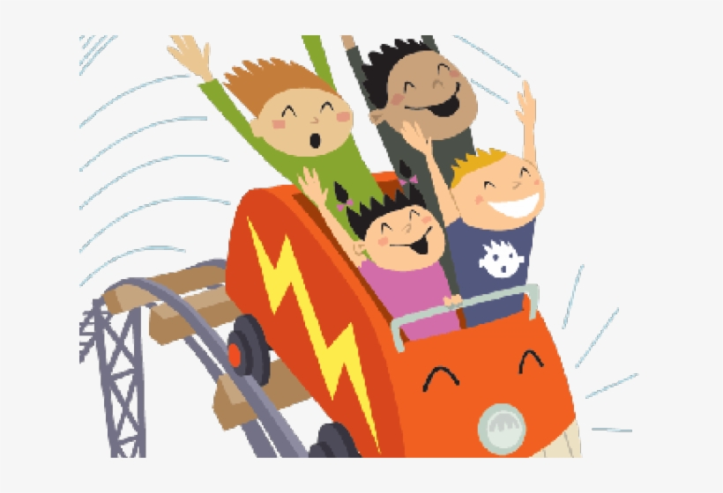
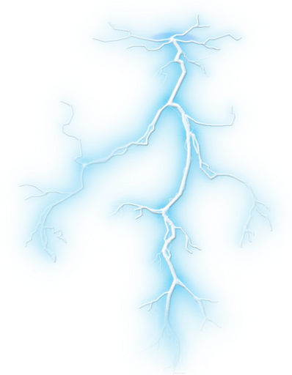
ENERGY...
is the ability to do work, transfer heat or cause change.
Mechanical
Motion and position
Electrical
Flow of electrons
Radiant
Forms of light energy
Chemical
Stored in bonds
Nuclear
Splitting atoms
Thermal
Heat

Slide 10
This must be the last page in the PowerPoint
Instructions
Turn your notes into a complete, detailed PowerPoint presentation. You must do more than just insert photos of your notes, but you may include the pictures you drew as part of your presentation. You may use internet pictures as well and you can be creative with the fonts and colors.

